Slide 1
DRUG-DRUG INTERACTIONS BETWEEN COVID-19 TREATMENT (LOPINAVIR/RITONAVIR) AND ANTIPSYCHOTIC DRUGS
Drug Interactions (PHM5015)
Öykü Tanülkü
17030168
Ankara University, 2021

Slide 2
INTRODUCTION
Management of anxiety, delirium, and agitation cannot be neglected in coronavirus disease (COVID-19). Antipsychotics are usually used for the pharmacological management of delirium, and confusion and behavioral disturbances. The concurrent use of treatments for COVID-19 and antipsychotics should consider eventual drug-drug interactions.
The main interactions between COVID-19 drugs and antipsychotics are the risk of QT-prolongation and TdP, and cytochromes P450 interactions.

Slide 3
Drug-drug interaction between antipsychotics and lopinavir/ritonavir according to their mechanism
This coadministration involves CYP interactions and the risk of QT prolongation and TdP. Lopinavir and ritonavir have “Possible Risk of TdP” according to CredibleMeds®.
Lopinavir is metabolized primarily by hepatic CYP3A4 isoenzymes. Ritonavir inhibit CYP2D6 in vitro but to a lesser extent than CYP3A4, and numerous pharmacokinetics studies suggested that ritonavir is a CYP 3A, 1A2, 2B6, 2C9, 2C19, and glucuronidation inducer. Also, ritonavir is an inducer and inhibitor of p-glycoprotein.
The coadministration of lopinavir/ritonavir helps to stave off lopinavir’s biotransformation and increased plasma levels of active antiviral drug.

Slide 4
Drug-drug interaction between antipsychotics and lopinavir/ritonavir according to their mechanism
Due to the co-treatment between lopinavir and ritonavir, concomitant therapy with other medications which are CYP3A4 substrate can lead to increased concentrations of these drugs.
Consequently, the dose of CY3A4 substrates should be administered with caution when given in combination with lopinavir/ritonavir.
The induction effects of ritonavir on enzymes may result in:
lowered plasma concentrations
and decrease of efficacy of the co-administered medicinal products (respective substrate),
or may increase the concentrations of the active or toxic metabolite (in the case of prodrugs).

Slide 5
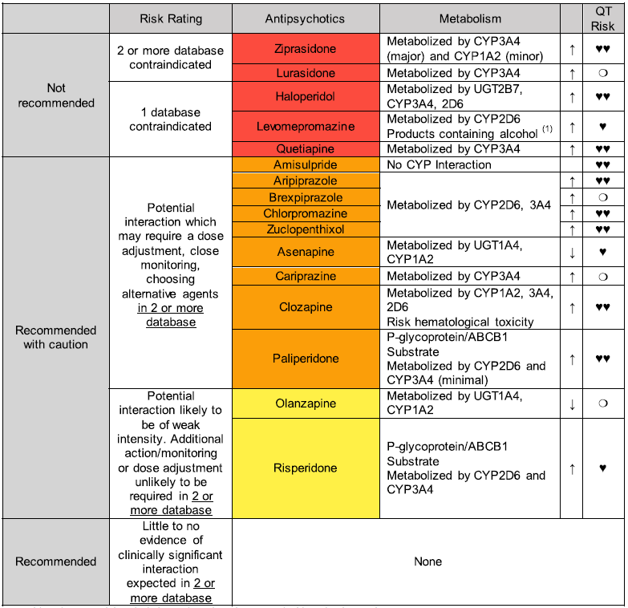
RESULTS
The most demanding COVID-19 treatments for coadministration with antipsychotics are chloroquine, hydroxychloroquine, azithromycin, and lopinavir/ritonavir because of the risk of QT prolongation and TdP and cytochromes interactions. The systematic review provides highly probable drug interaction between lopinavir/ritonavir and ziprasidone, haloperidol or quetiapine.
Reference: Plasencia-García, B. O., Rodríguez-Menéndez, G., Rico-Rangel, M. I., Rubio-García, A., Torelló-Iserte, J., & Crespo-Facorro, B. (2021). Drug-drug interactions between COVID-19 treatments and antipsychotics drugs: integrated evidence from 4 databases and a systematic review. Psychopharmacology, 238(2), 329–340. https://doi.org/10.1007/s00213-020-05716-4
(1) Avoid products containing alcohol (LOP/RIT) in patients treated with methotrimeprazine 🖤🖤 QT-Prolonging agents in 2 or more database, 🖤 QT-Prolonging agents in 1 database. ❍: No database reports additive effects on QT-interval prolongation ↑/↓ Cytochrome P450 interaction (or UGT1A4 or P-glycoprotein/ABCB1 when correspond). Antipsychotic levels may increase/decreased and döşe adjustment may be necessary *Since ritonavir should be considered as CYP450 pan-inducer some of the information listed in this table, which has been attained from the reported data base, may differ if a more thorough and pertinent analysis of the literature on specific ritonavir-AP DDIs would be performed

