Slide 1
Overview of Hematopoietic System Disorders
Meltem Kurt Yüksel MD,Prof
Adult Hematology Department and Stem Cell Transplantation Unit
Ankara University Medicine Faculty
20 December 2021
In person & Virtual 2021-2022

Slide 2
Definition-1
Hematopoietic System
Blood
Bone Marrow
Lymp nodes
Spleen

Slide 3
Definition-2
Disorder
Disease
Illness

Slide 4
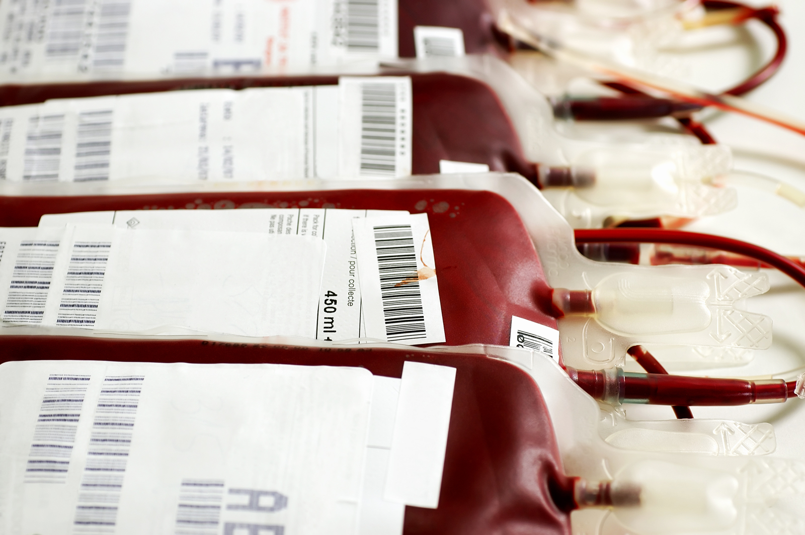
Have you ever donated blood?

Slide 5
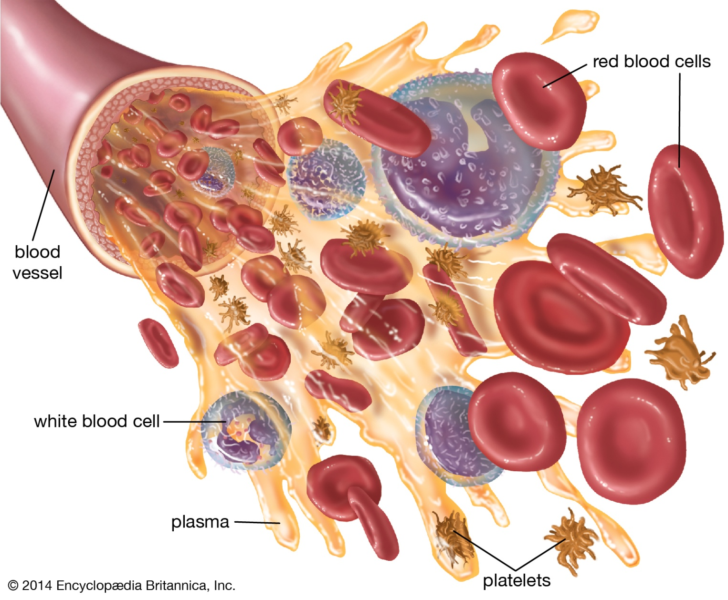
What is blood?

Slide 6
Blood
Both a tissue and fluid
Transports oxygen and nutrients to the cells
Carries away corbondioxide and other waste products
Blood is a tissue because it is a collection of similiar specialized cells that serve particular functions
These cells are suspended in a liquid matrix →PLASMA →This makes the blood liquid

Slide 7
Plasma
The liquid portion of the blood
Complex solution containing more than 90 percent water
The water part of the plasma is freely exchangeable with that of body cells and other extracellular fluids
The water part of the plasma is available to maintain the normal state of hydration of all tissues

Slide 8
Plasma-2
The major solute of plasma is a group of proteins constituting about 7 percent of the plasma by weight
The principle difference between the plasma and the extracellular fluid of the tissues is the high protein content of the plasma
Much of the protein of plasma is produced in the liver
The majör plasma protein is serum albümin
The principal function of which is to retain water in the bloodstream by its osmotic effect
The amount of serum albümin in the blood is a determinat of the total volüme of plasma
Albumin a non spesific carrier protein .Bilirubin for example is bound to albümin
The other protein groups in the plasma are called globulins
The immunoglobulins or antibodies are produced in response to spesific foreign substance or antigen

Slide 9
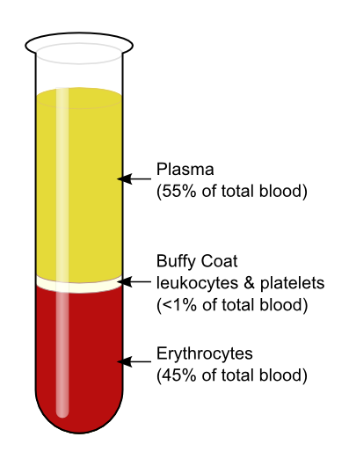

Slide 10
Within the body the blood is permenantly fluid and the turbulent flow assures that cells and plasma are fairly homogeneously mixed

Slide 11
The cells in the blood
The red blood cells (erythrocytes) constitute about 45 percent of the volume of the blood
The remaining cells (White blood cells=leukocytes and platelets=thrombocytes)less than 1 percent
The fluid portion, plasma , is clear, slightly sticky, yellowisf fluid
After a fatty meal plasma transiently appears turbid

Slide 13
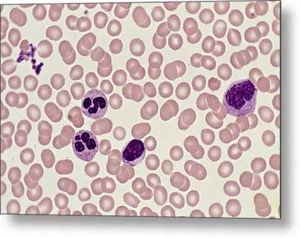
Blood Cells

Slide 14
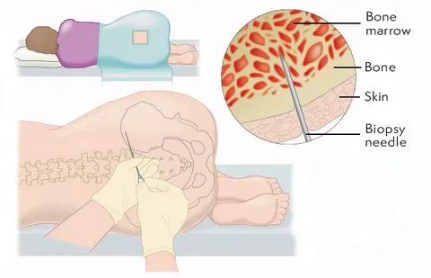
Hematopoietic cells are formed in the bone marrow

Slide 15
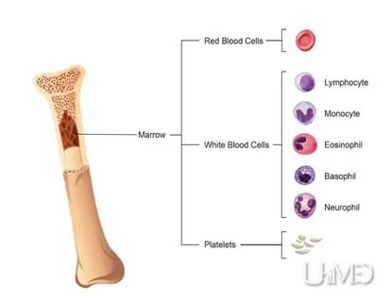

Slide 16
Hematopoeitic Stem Cells

Slide 18
What gives the red colour of the blood?
The charactestic colour is imparted by hemoglobin, a unique iron-containing protein
Hemoglobin brightnes in colour when saturated with oxygen (oxyhemoglobin)
Hemoglobin darkens when oxgen is removed (deoxyhemoglobin)
What colour is the blood in the vein and in the artery?

Slide 19
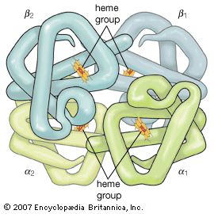

Slide 20
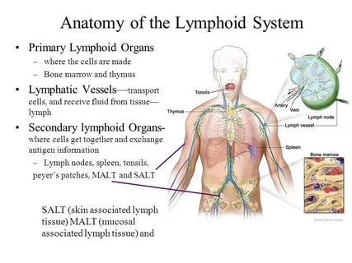

Slide 21
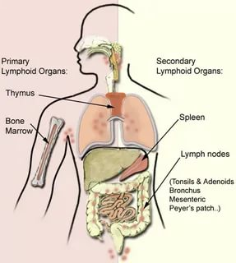

Slide 22
Blood disorders
Quantitative
Number of the cells
Qualitative
Function of the cells

Slide 23
Erythocyte disorders
Anemia
Low Hemoglobin
Erythrocytosis
High erythrocyte count

Slide 24
Granulocyte Disorders
Cytopenia
Neutrophil
Eozinophil
Basophil
Cytositosis
Neutrofili
Eosinophili
Basophilia

Slide 25
Mononuclear Cell Disorders
Lymphocyte
T cell B cell NK cell
Lymphocytopeni
Lymhocytosis
Monocyte
Dendritic Cells
Defficiencies in immun system
Innate or adoptive

Slide 26
Thrombocyte disorders
Cytopenia
Thrombocytopeni
Cytositosis
Thrombocytosis

Slide 27
Bone marrow diseases
Failure
Hypocelluler
Acellular
Hypercellular
Cytopenia
Granulocyte
Thrombocyte
Retikulocyte
Aplastic Anemia
Myelodysplastic Syndromes
Acute leukemia
Chronic Leukemia

Slide 28
Spleen
Splenomegali
Hypersplenism
Hyposplenism

Slide 29
Lymph nodes
Lympadenopathy
Infections
Cancer of the lypmh nodes = Lymphoma
Rare diseases
Castleman
Kikuchi
Rosai Dorfman

Slide 30
Coagulation System Disorders
Thromobosis
Hemorrhagi

Slide 31
Blood disorders according to time of onset
Congenital
Later onset

Slide 32
Blood disorders according to duration
Acute
Chronic

Slide 33
Blood disorders according to etiology
Genetic
İdiopathic

Slide 34
THANKS FOR LISTENING AND GOOD LUCK…

