Slide 1
DNA and Chromatin Structure
Histone code hypothesis and Epigenetic modificatiıons
What is epigenetic memory?*
3. Cellular architecture
Cell communication
Intracellular vesicles*
4. Autophagy*
5. Circadian Clock*
6. Stem Cell Biology
Classification
Embryonic stem cell vs İPSC
EMT
7. Adult Stem Cells
Mesenchymal Stem Cells
Cardiac stem Cells
Epigenetic Reprogramming*
Cancer Stem Cell
Crispr-Cas9 technology*
Nature ( 42,7)
Cell (20)
Journal of Cell Biology (8,8)
Journal of Molecular Cell Biology (5,52)
Journal of cellular and molecular medicine (4,48)
Journal of Biological Chemistry (4,23)
Stem Cell (5,5)
PlosOne (2,74)

Slide 2
Advanced Cellular Biology
Week 1- DNA and Chromatin Structure

Slide 3
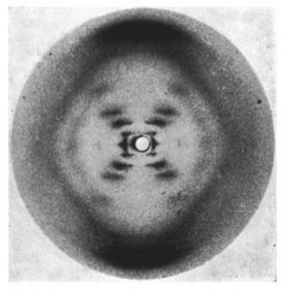
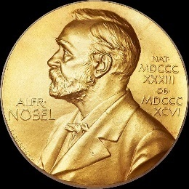
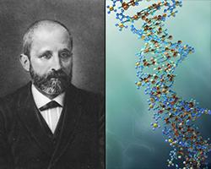
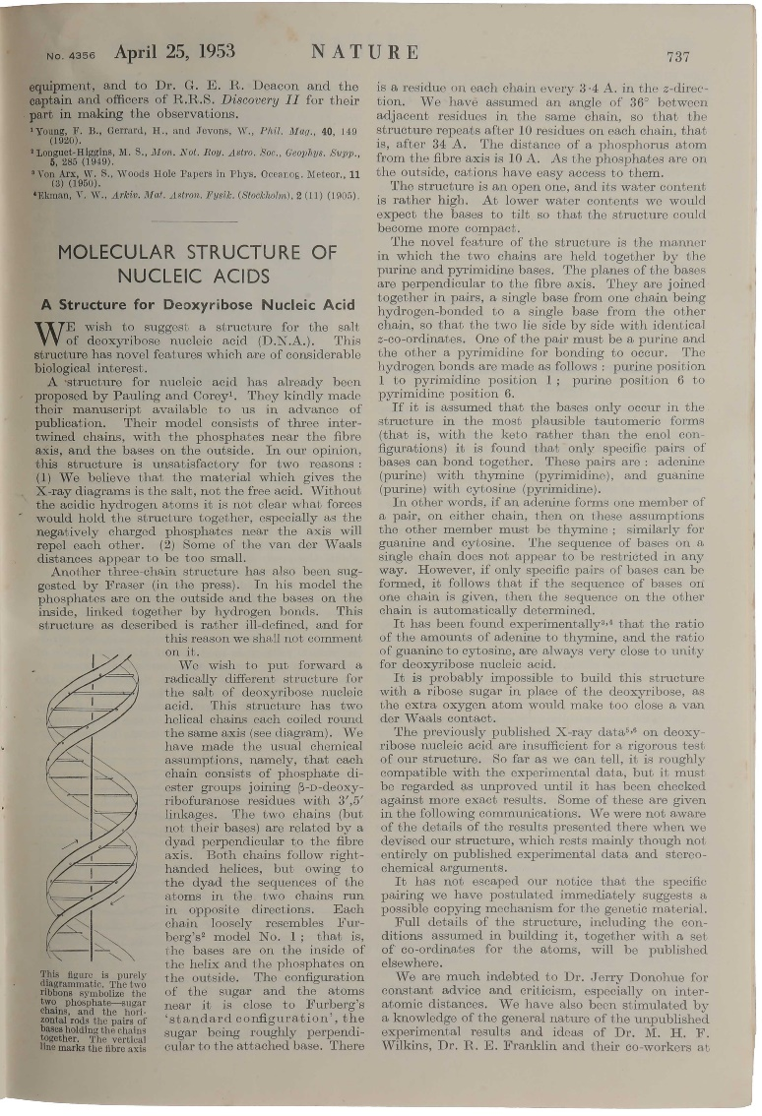
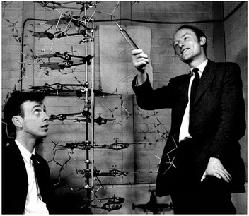
Discovery of Double Helix
The most famous discussion in science
Rosalind Franklin , 1952
1869, by Swiss researcher Friedrich Miescher
Watson and Crick, 1953

Slide 4
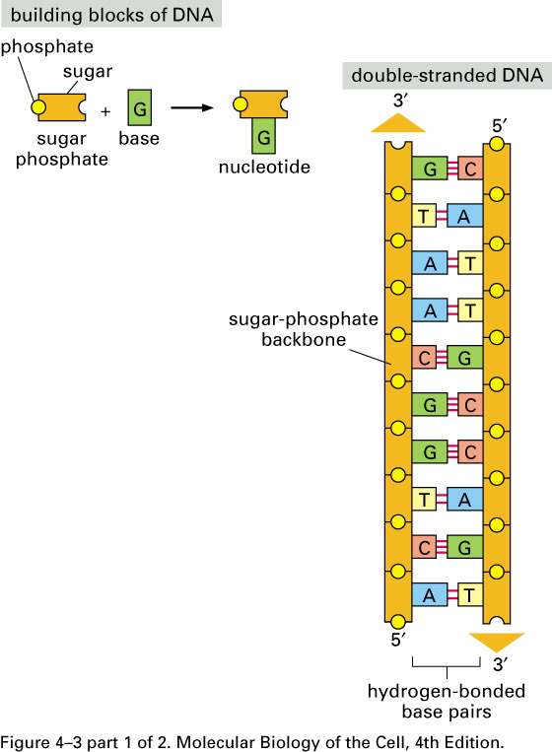
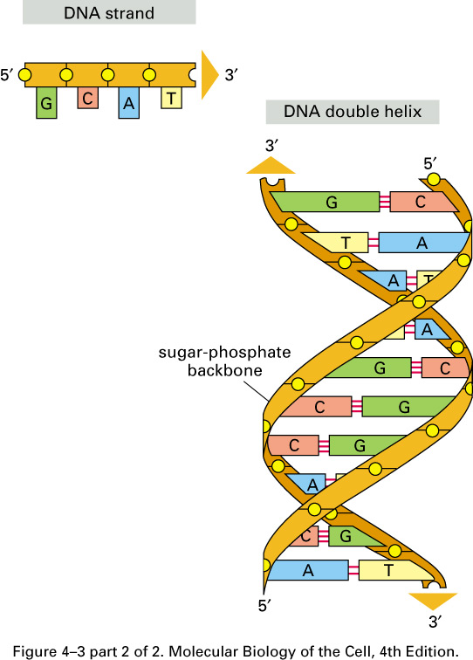

Slide 5
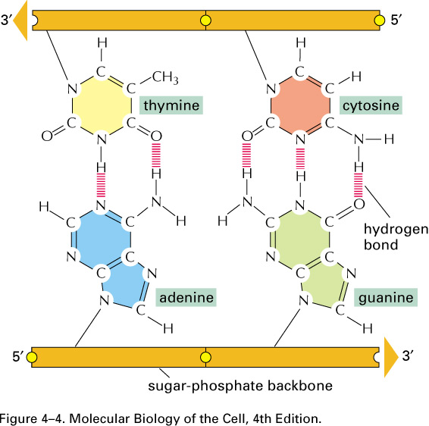
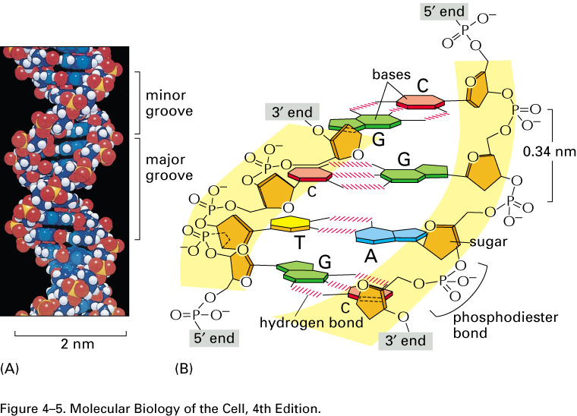
2 ring base=purine
is paired with
1 ring base=pyrimidine
« COMPLEMENTARY»
To maximize the efficiency of base-pairs packing, two sugar-phosphate backbones wind around the each other to form double helix.
1 turn=10 bp

Slide 6
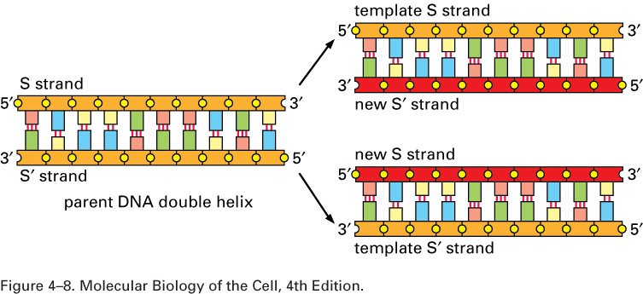
Genetic information is carried out in the linear sequence of nucleotides in DNA.
The dublication of the genetic information occurs by the use of DNA strand as template for the formation of complementary
strand

Slide 7
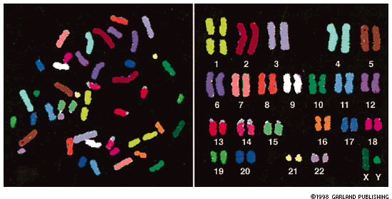
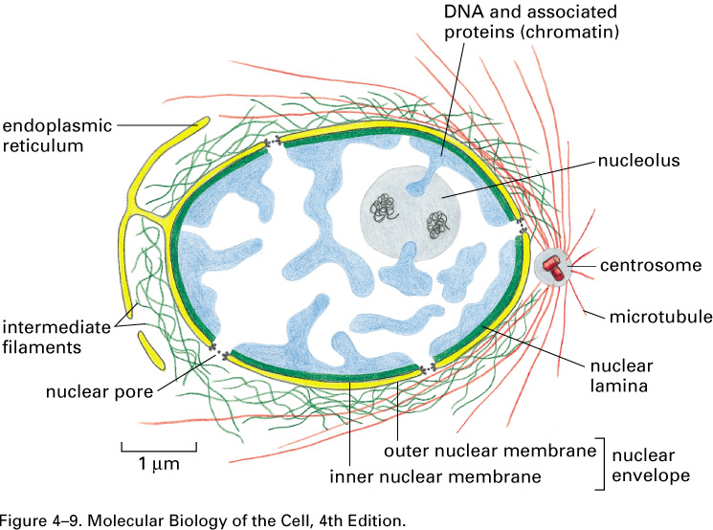
DNA PACKAGING : CHROMOSOMES
Eucaryotic DNA is packaged into a set of chromosomes
Eucaryotic DNA is packaged into Chromosomes. Human cells contain two of each chromosome, one maternal and one paternal – homologous chromosomes Sex chromosomes are non-homologous chromosomes, X from mom, Y from dad.
Bacteria typically have one circular DNA molecule. It is also associated with proteins that condense the DNA but less is know about the structure.

Slide 8
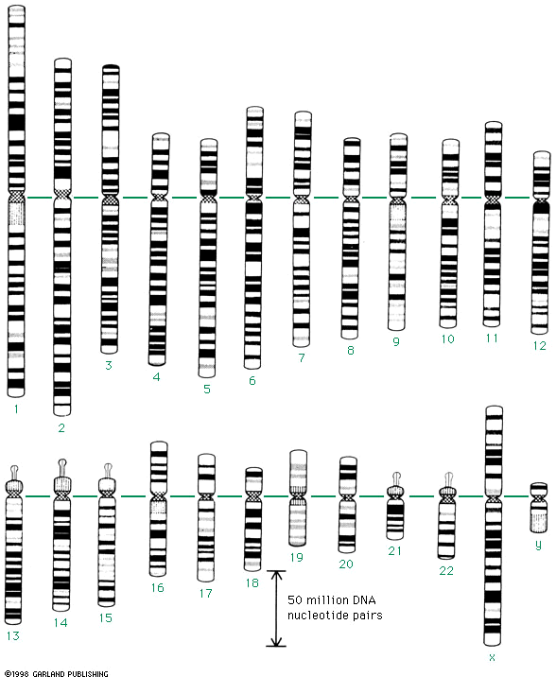
Chromosomes are typically stained by dyes that distinguish between areas rich in A-T nucleotide pairs and areas rich in C-G pairs. This results in a pattern of banding that is unique to each chromosome. Cytogeneticists use these to detect major chromosomal abnormalities = inherited defects.
P ARM
Q ARM
centromere
Karyotype: display of 46 chr. at mitosis (highly compact)
large rRNA

Slide 9
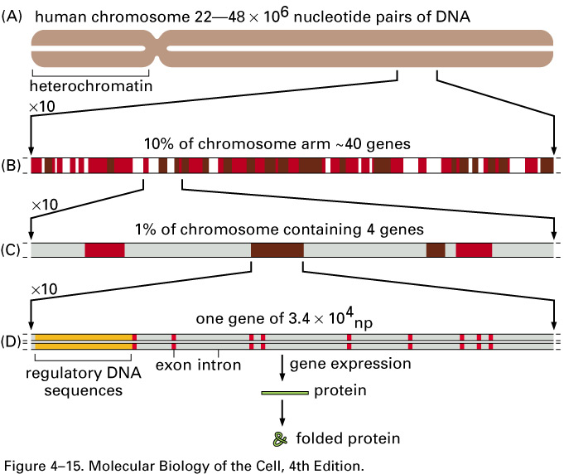
Chromosome contains long strings of genes
The organization of genes on a chromosome.

Slide 10
Cells can vary the structure of their chromosomes for DNA replication and for gene regulation. Chromatin = DNA + proteins.
The state of condensation of chromosomes varies according to the cell growth cycle. The mitotic chromosomes are highly condensed, in contrast to that of the interphase chromosome.

Slide 11
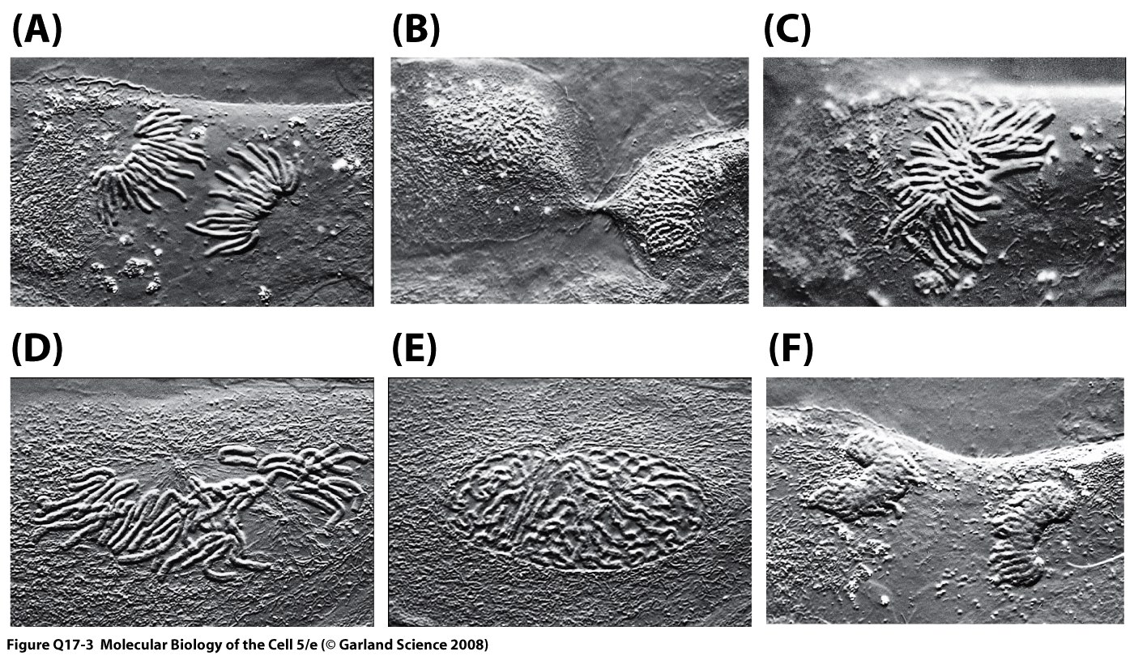
SİNGLE CELL AT DİFFERENT STAGE OF M PHASE

Slide 12
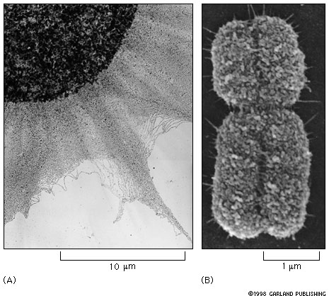
A. chromatin spilling out of a lysed interphase nucleus
B. a mitotic chromosome; condensed and dublicated
A comparison of extended interphase chromatin with the chromatin in a mitotic chromosome.

Slide 13
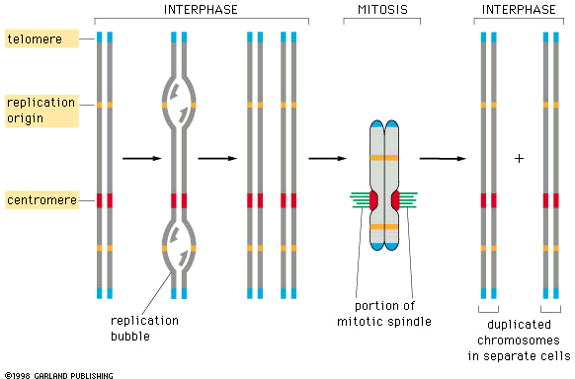
Three types of specialized sequences found in all eucaryotic chromosomes ensure that chromosomes replicate efficiently.
many, to ensure speed
kinetochore = protein complex that binds the spindle and the centromere
The condensed state is important, allowing the duplicated chromosomes to be separated

Slide 14
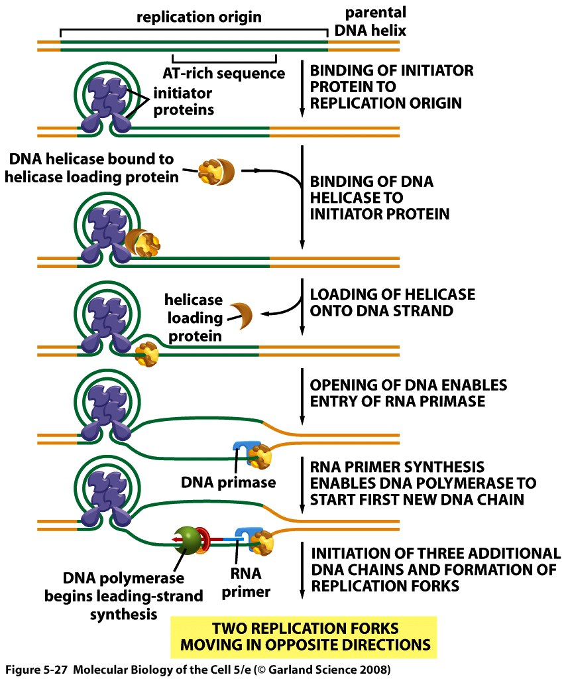

Slide 15
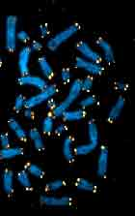
Chromosome Ends are specialized structures called Telomeres
Blue = DNA White = Telomere protein (TERT)

Slide 16
Why are telomeres important?
Telomeres allow cells to distinguish chromosomes
ends from broken DNA
Stop cell cycle!
Repair or die!!
Homologous recombination
(error free, but need nearby homologue)
Non-homologous end joining
(any time, but error-prone)

Slide 17
Telomere Function
distinguishes between the chromosome end and a double strand break
protects the chromosome from end-to-end fusions

Slide 18
Telomere also provide a means for "counting"
cell division: telomeres shorten with each cycle
Telomeres shorten from 10-15 kb
(germ line) to 3-5 kb after 50-60 doublings
(average lengths of TRFs)
Cellular senescence is triggered when
cells acquire one or a few
critically short telomeres.
20
Telomere Length (humans)
Normal
Somatic
Cells
10
(Telomerase
Negative)
Cellular (Replicative) Senescence
Number of Doublings

Slide 19
1960’s -- Leonard Hayflick demonstrates that normal human cells are mortal and suggests that there is an intrinsic counting mechanism that tracks the number of cell divisions a given cell lineage has undergone

Slide 20
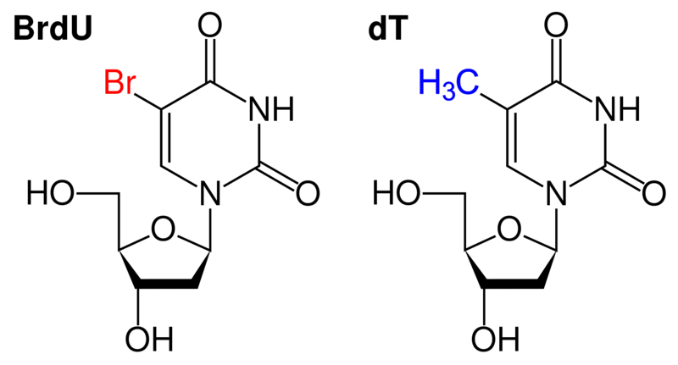
The 5-bromo-2′-deoxyuridine (BrdU) incorporation cell proliferation assay is the most commonly used method for assessing DNA replication.
a synthetic nucleoside analogue of thymidine

Slide 21
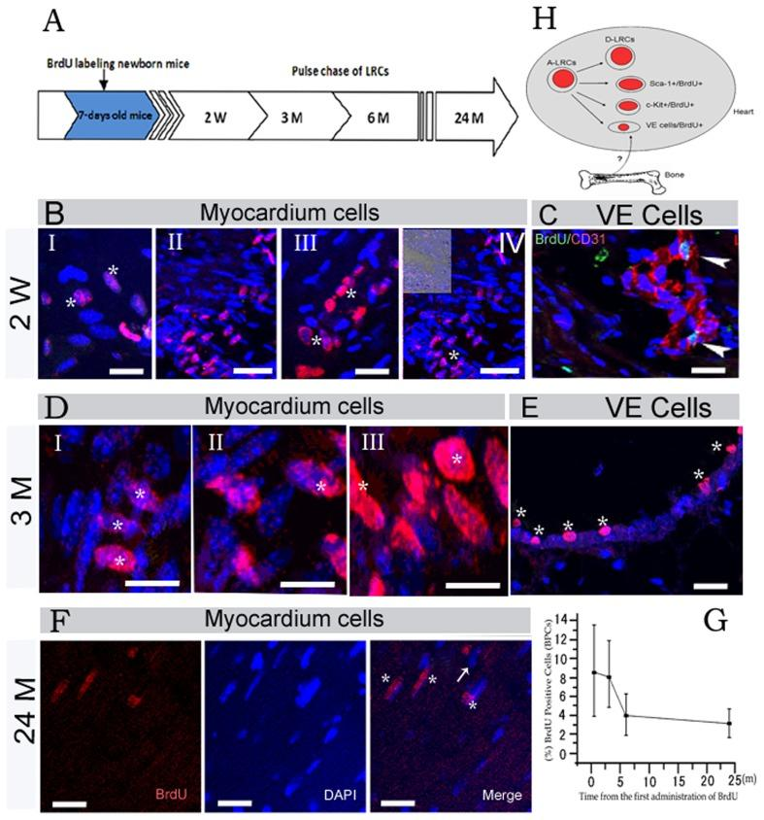
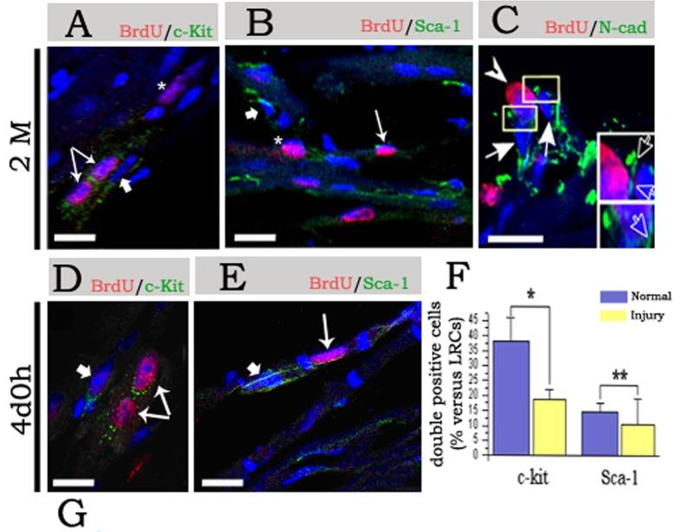
“Identification of functional tissue-resident cardiac stem/progenitor cells in adult mouse.” Cell biology international reports vol. 2012, doi:10.1042/CBR20120001

Slide 22
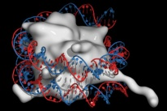
The gift boxes of DNA : Nucleosomes
One chromosome :10⁷ bp LONG
Each human cell contains approximately 2 meters of DNA if stretched out end to end.
Nucleus is just 6 uM
In nuclei of all eukaryotic cells, genomic DNA is highly folded, constrained, and compacted by histone and non-histone proteins in a dynamic polymer called chromatin.
Histones are responsible for the first and most basic level of chromosome packing
NUCLEOSOME: DNA+PROTEIN COMPLEX

Slide 23
Nucleosomes are the basic unit of eucaryotic chromosome structure

Slide 24
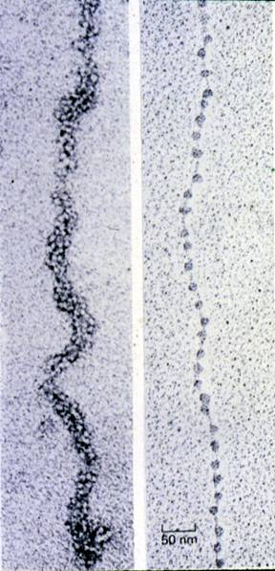
Inactive and Active
Configurations of Chromatin
30 nm fiber:
Inactive
10 nm filament:
Active
Heterochromatin
Euchromatin

Slide 25
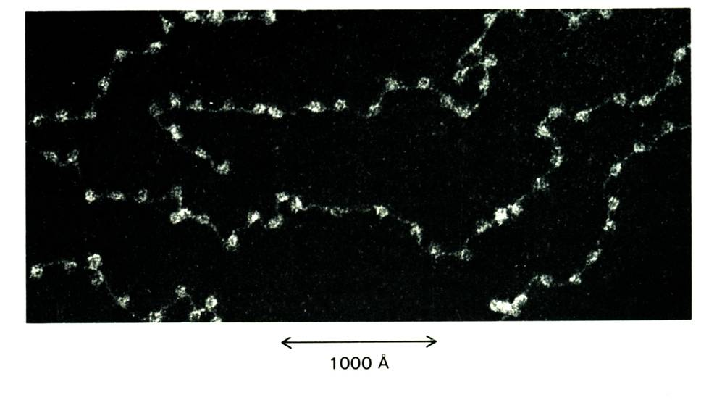
Beads-On-A-String Chromatin Structure
Nucleosome core particle : DNA wound around a protein

Slide 26
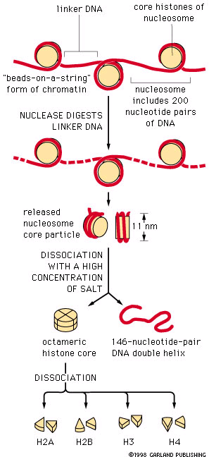
The nucleosome is the first and most fundamental packing level of chromatin.
Histones are small proteins basic proteins comprising
the octameric core of the nucleosome.
Within the core nucleosome, approximately 146 base pairs (bp) of DNA are wrapped in a left-handed superhelical turn around a protein structure
with a high proportion of positively charged N-terminal
tails (lysine and arginine) that protrude from the surface.
These genes are the most highly conserved of all know eucaryotic proteins.

Slide 27
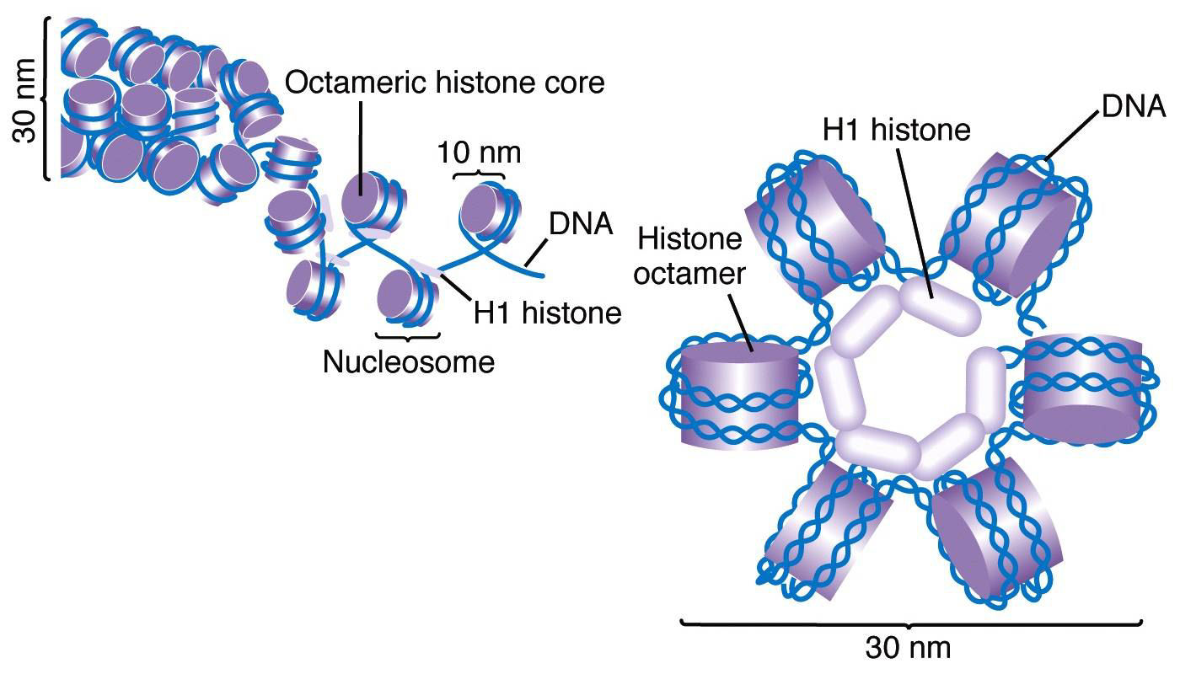
Linker DNA

Slide 28
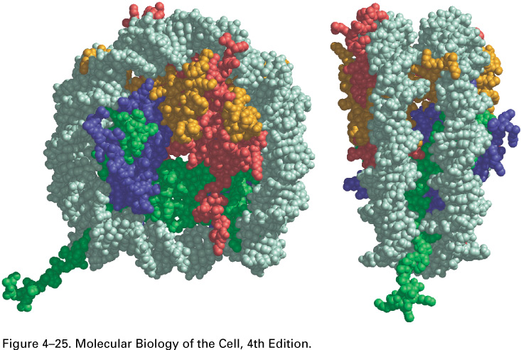
DNA
H3
H2A
H4
H2B
The structure of a nucleosome core particle, as determined by x-ray diffraction analyses of crystals.

Slide 29
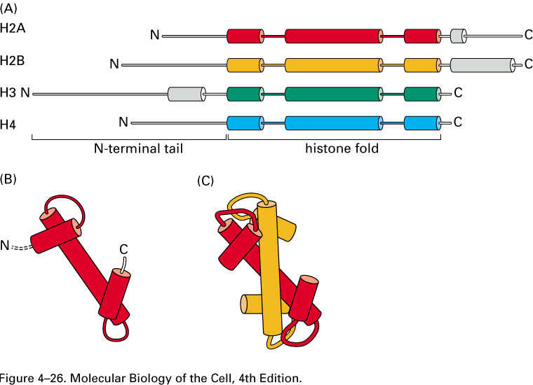
The overall structural organization of the core histones.

Slide 30
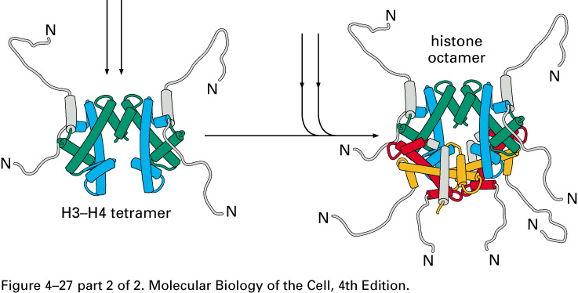
The assembly of a histone octamer.
These histone tails are subjected to several different types of covalent modificaitons that in turn control critical aspects of
chromatin structure
Function

Slide 31
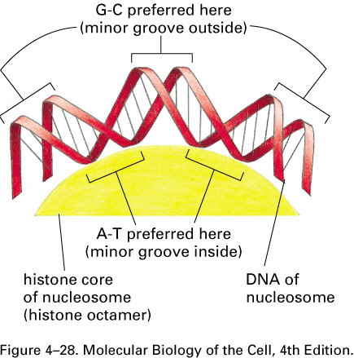
These histone tails are subjected to several different types of covalent modificaitons that in turn control critical aspects of
chromatin structure
Function
The bending of DNA in a nucleosome.The minor groove compressed on the inside of the turn.

Slide 32
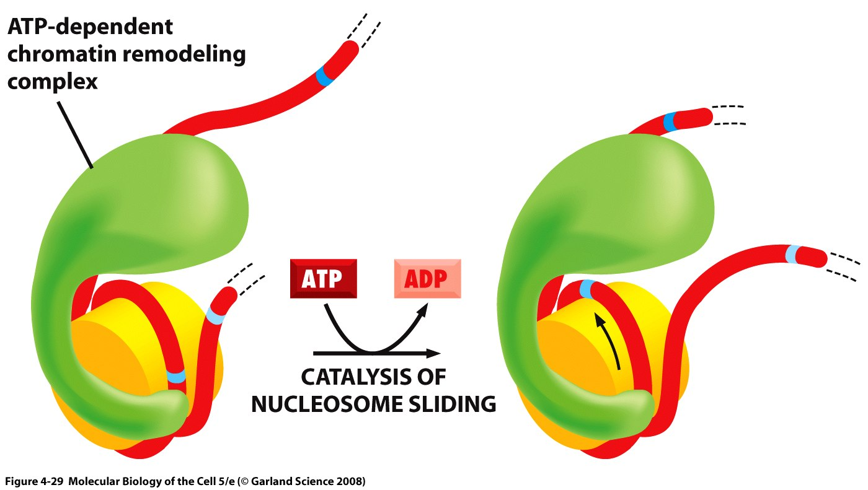
The nucleosome sliding catalyzed by ATP-dependent chromatin remodeling complexes
In order to furher loosening of DNA-histone contacts

Slide 33
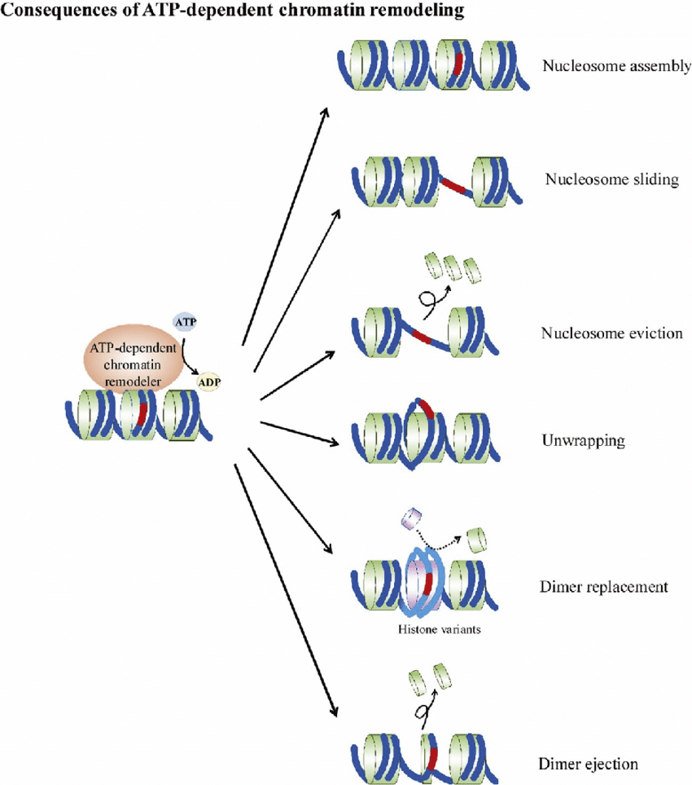
Chromatin remodeling is the dynamic modification of chromatin architecture to allow access of condensed genomic DNA to the regulatory transcription machinery proteins, and thereby control gene expression. ... Aberrations in chromatin remodeling proteins are found to be associated with human diseases, including cancer.

Slide 34
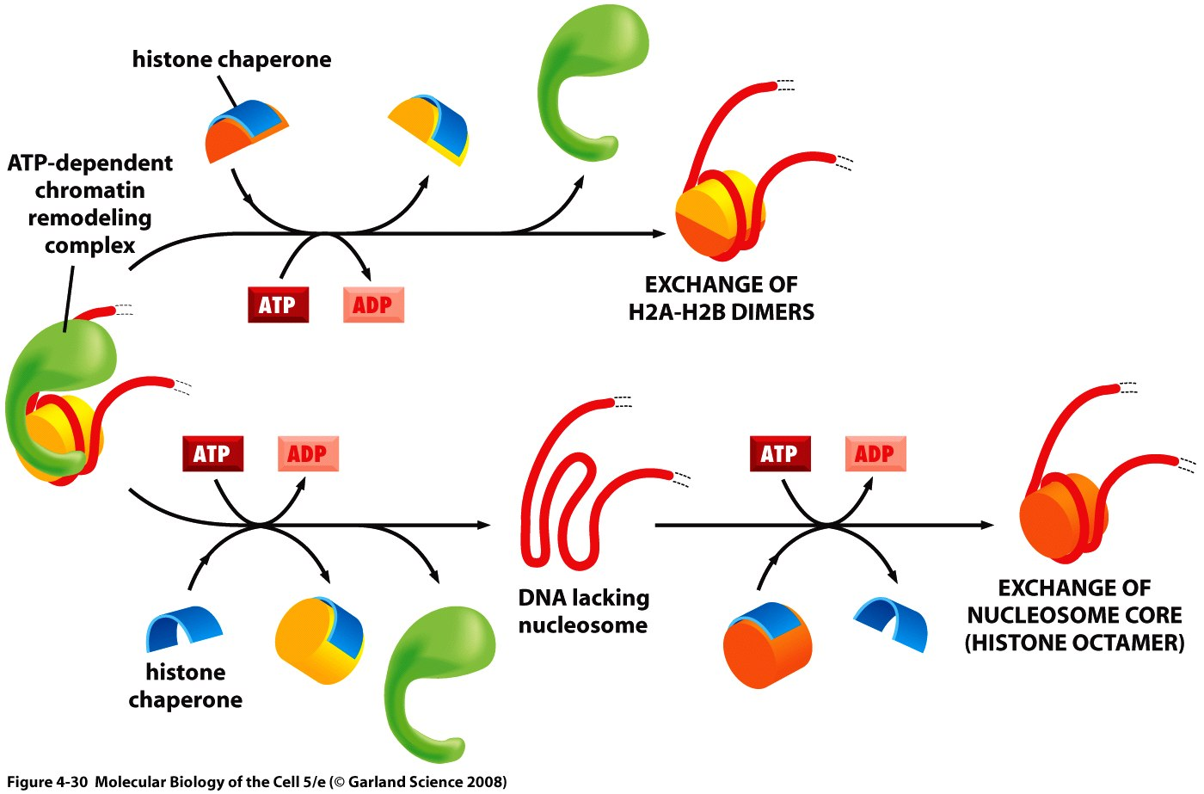
Nucleosome removal and histone exchange catalyzed by ATP-dependent chromatin remodeling complexes
By cooperating with chaperons
Cells contain dozens of different remodeling complexes
Some remodeling complexes can remove H2A-H2B dimers and replace them with histone variants ( H2AZ-H2B)
The activitiy of these complexes are controlled by cell.

Slide 35
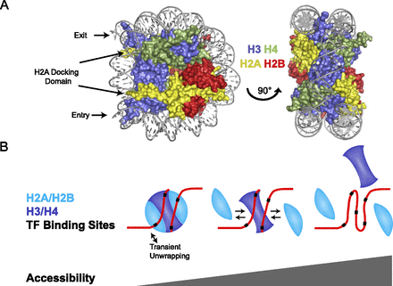
Due to the presence of ATP-dependent chromatin remodelling complexes, nucleosomes are highyl dynamic structure

Slide 36
The histone variants in gene regulation
While canonical histones are expressed exclusively during the S PHASE of replication phase of the cell cycle,
The replacement of a canonical histone by a noncanonical variant is a dynamic process that changes the composition of chromatin.
Apart from histone H4, all histone protein families (H2A, H2B, H3 and H1) are characterized by specialized histone variants and among them the most studied family is the H2A, which comprises several members including macro H2A, H2A.X, H2A.Bbd and H2A.Z
H2A.Z has been linked to diverse biological processes such as memory and epithelial-to-mesenchymal transition (EMT) . At molecular level, it has been implicated in DNA repair and transcriptional regulation
One important question remains: How is the H2A.Z loading and/or acetylation machinery recruited to chromatin? So far, it was shown that different transcription factors (TFs) interact with subunits of the H2A.Z loading complexes .For example, the p400/Tip60 complex interacts with the Notch/RBPJ coactivator complex ,Myc , ERα (estrogen receptor alpha), AR
Giaimo, B.D., Ferrante, F., Herchenröther, A. et al. The histone variant H2A.Z in gene regulation. Epigenetics & Chromatin 12, 37 (2019). https://doi.org/10.1186/s13072-019-0274-9

Slide 37
. H2A.Z is exchanged onto nucleosomes at DSBs by the p400 remodeling ATPase.
• H2A.Z exchange creates open, relaxed chromatin domains at DSBs.
• H2A.Z exchange promotes histone acetylation and chromatin ubiquitination.
• H2A.Z restricts end resection and promotes the correct processing of damaged chromatin.

Slide 38
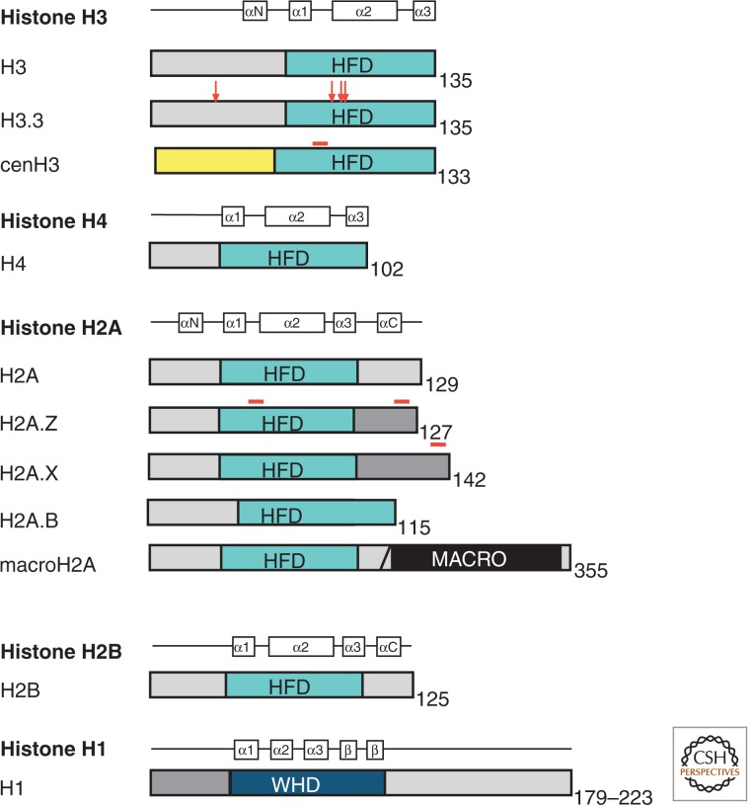
Replacement with H3.3 occurs at active genes, a dynamic process with potential epigenetic consequences. Differences between H3 and H3.3 in their complement of covalent modifications might underlie changes in the properties of chromatin at actively transcribed loci.

Slide 39
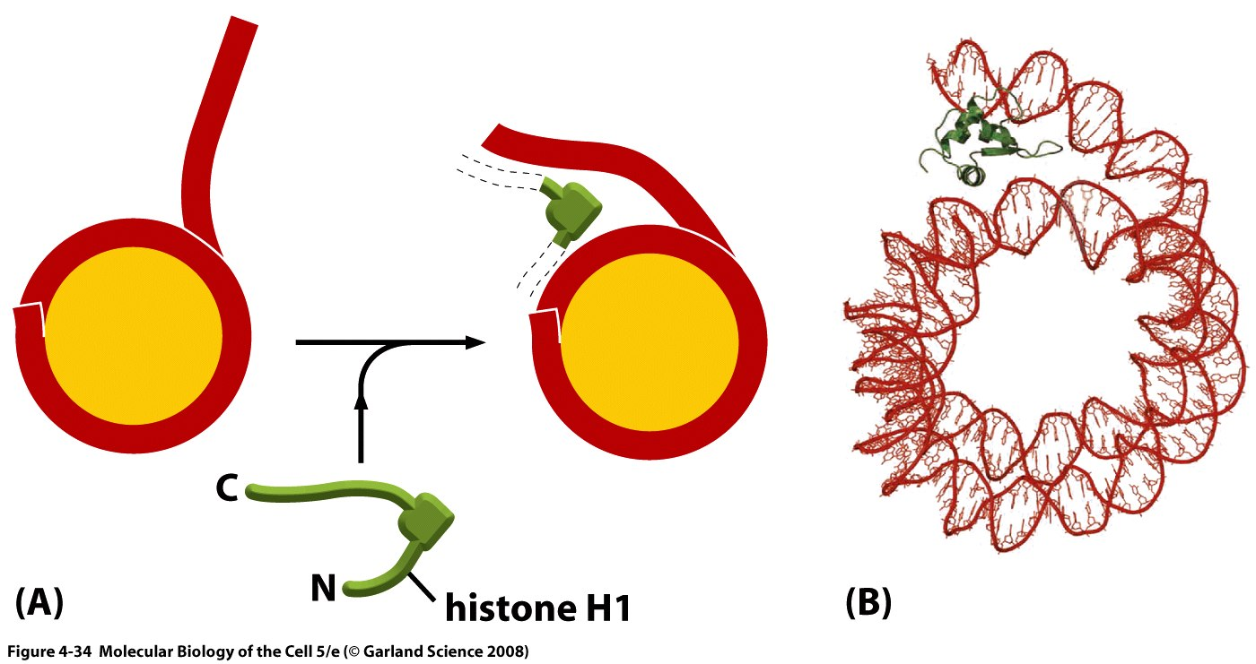
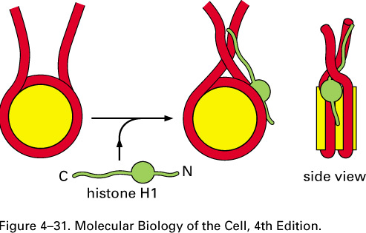
A speculative model for how histone H1 could change the path of DNA as it exits from the nucleosome.

Slide 40
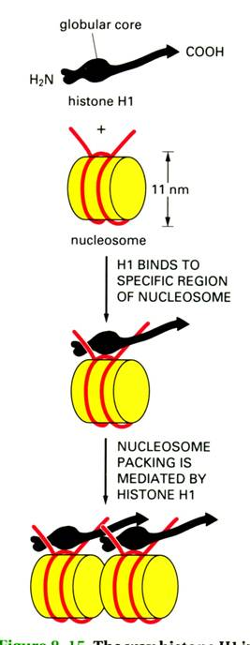
H1 seals the two
superhelical turns
of DNA on the
nucleosome surface
Note
The presence of the linker
histone H1 is a hallmark
of inactive chromatin.
Actively transcribed
chromatin generally lacks H1.

Slide 41
Chromatin Organization
The distinct levels of chromatin organization are dependent on the dynamic higher order structuring of nucleosomes.
Variation of Zigzag model for the 30 nm chromatin fiber.

Slide 42
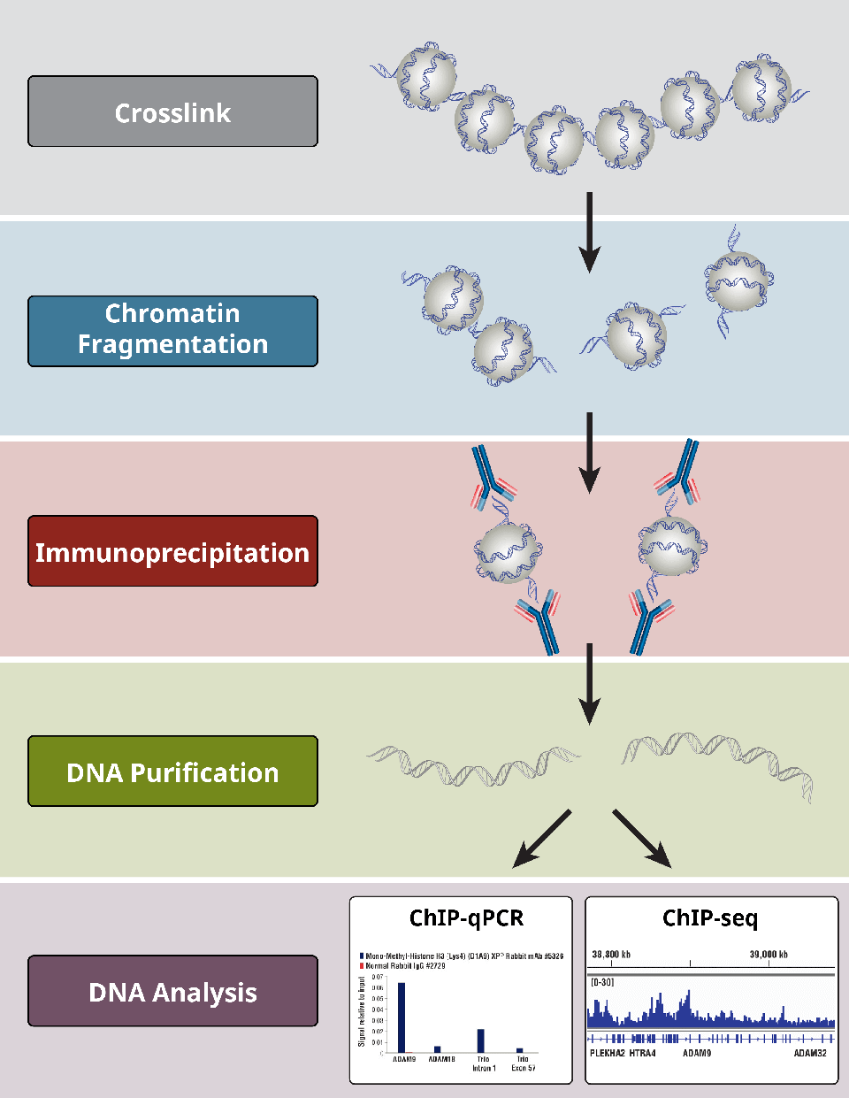
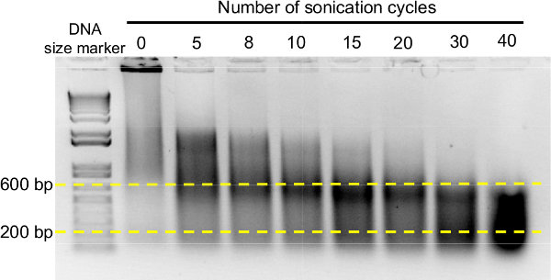
ChIP =Chromatin ImmunoPrecipitation

Slide 43
next lecture
Histone code hypothesis
Epigenetic modifications
Epigenetic memory

