Slide 1
CHAPTER 1
Research Assist. PhD. Arzu GÖKDAİ

Slide 2
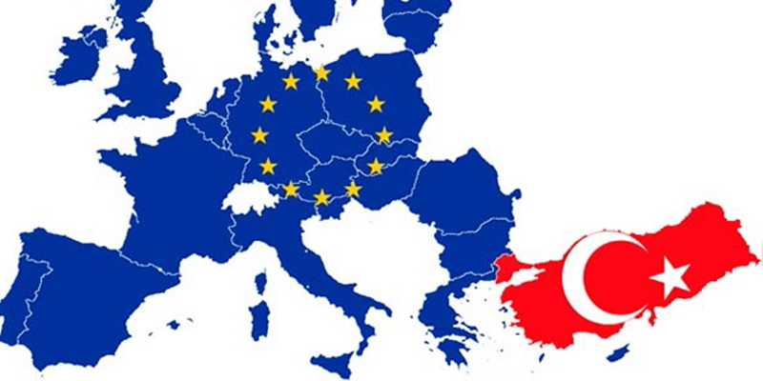
History of European Union
The United States of Europe was a part of a humanistic and peaceful dream. Europe often witnessed bloody wars for centuries. France and Germany had three wars between years 1870 and 1945. Plenty of people lost their lives during these wars. As a result of those catastrophes, European leaders and thinkers came to an agreement that the only way to sustain peace is to unite countries in economic as well as political terms. The establishment of an organization, which could overcome the national conflicts in Europe, stemmed from resistance movements that fought against totalitarian regimes during the World War II.

Slide 3
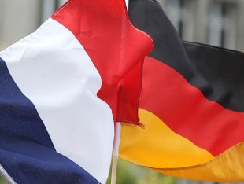
THE NEED OF ESTABLISHING AND MAKING THE WELFARE AND PEACE IN EUROPE AFTER THE WORLD WAR II
1. IN TERMS OF POLITICS ➔ THE NEED TO REACH THE PROBLEMS BETWEEN GERMANY AND FRANCE IN THE PERMANENT FORM
2. IN TERMS OF SAFETY ➔NEED TO CREATE AN INTEGRATION THAT MAY AGAINST SOVIET THREAT (TRUMAN DOCTRINE-BRUSSELS TREATY)
3. IN TERMS OF ECONOMICS ➔MARSHALL AID (ESTABLISHING AND SPREADING WELFARE BY REMOVING POST-BATTLE WASH)

Slide 4
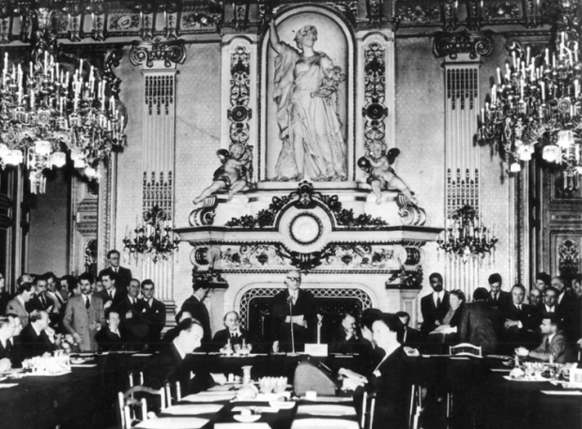
Schuman Plan
Following World War II, the effort of European statesmen to form a lasting peace in Europe gained momentum. On May 9th, 1950 Robert Schuman, French Foreign Minister, encouraged European states to transfer the decisions on coal and steel production to an independent and supranational institution based on the draft of Jean Monnet who was former Secretary General of the League of Nations.

Slide 5
According to Schuman Plan, the centuries-old contest between France and Germany had to come to an end in order to establish peace in Europe. The ways to achieve that were to assure the collective production of coal and steel under the institution and to keep this organization accessible for all European states.

Slide 6
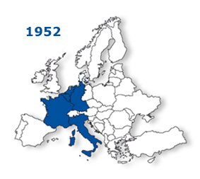
European Coal and Steel Community (ECSC)
BELGIUM
LUXEMBURG
NETHERLANDS
Country of Benelux
As a result of the Schuman Declaration, 6 members consist of Belgium, Federal Germany, Luxembourg, France, Italy and Netherlands founded the European Coal and Steel Community (ECSC) in 1951. The first president of the High Authority of the Community was Jean Monnet, who provided the inspiration for this idea of the Schuman Declaration. Thus, coal and steel, which were the raw materials of the war, became tools for peace and, for the first time in the history, states transferred some part of their sovereignty to a supranational institution by their own will.

Slide 7
According to Monnet's plan, the ECSC had 4 bodies:
Supreme Authority (Although its members are elected by national councils, it has a transnational character. The ECEC's executive body. First President J. Monnet)
Council of Ministers: The decision-making body.
Court of Justice: A place of dispute resolution.
Common Assembly: of a very weak nature. Groups are not based on member states, but on political trends; It was founded in the form of socialists, liberals, Christian democrats.

Slide 8
Treaty of Rome and European Economic Community (EEC)
Belgium,
Federal Germany, Luxemburg, France, Italy and Netherlands
In 1957, six member states decided to establish an economic community based on the free movement of workers, goods and services. Consequently, in 1957, after the Treaty of Rome was signed, European Economic Community (EEC) founded in order to establish economic unity in other sectors besides coal and steel.

Slide 9
The main goal of the EEC was to set a common market where there is a free movement of goods, workers, services and capital, so finally to reach political integration.

Slide 10
TREATY OF ROMA
The Treaty of Rome is generally aimed at:
- In 12 years, removing all barriers to trade in the domestic market and establishing a common market.
Establishing a “common customs tariff” for third part countries and establishing a common trade policy.
Removal of obstacles to free movement of goods, capital, services and persons between Member States.
Establishment of the Common Agricultural Policy.
Establishment of the European Social Fund and the European Investment Bank.
Creating a common policy in the field of transportation
Establishing a system that ensures that the competition does not deteriorate in the common market

Slide 11
European Atomic Energy Community (EURATOM)
Similar to European Economic Community, the European Atomic Energy Community (EURATOM) was established by the Treaty of Rome entered into force in 1st of January, 1958.
The aim of the community was to coordinate the research programs of member states to ensure that the use of nuclear energy is safe and limited with peaceful purposes.

Slide 12
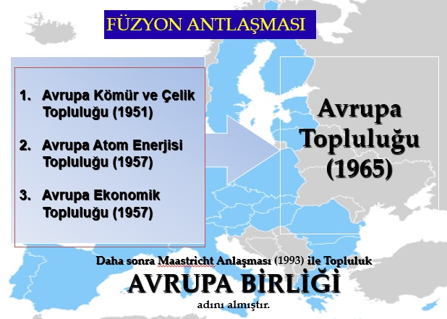
Merger Treaty and European Communities
In 1967, the Merger Treaty combined three communities (European Coal and Steel Community, European Economic Community, and European Atomic Energy Community) and set out single Council and single Commission for all. Since then, these communities were named as European Communities.

Slide 13
The Community Court of Justice would oversee the functioning of this community to the Treaty of Rome.
The Commission will follow of community interests as the executive body of the EEC. The members of the commission will consist of 9 people selected by the member countries, they will serve for 4 years and they will not receive directives from the countries in which they are selected. Decisions will be taken by majority vote.
The Council is formed by the participation of one minister representing the member states. It is the main decision-making body of the EEC. Decisions are taken unanimously.
The European Parliament was very weak. Members came with direct elections. It could not affect the appointment of commission members. Its effect on the decisions of the Commission and the Council was at the recommended level.
The Court of Justice would maintain the rule of law in the implementation of treaties. It consisted of seven judges, elected by the member states.

