Slide 1
Third-order reactions
There is four types of third-order reactions:
Integrated forms of the kinetic equation
Reaction half-life for third order reaction of this type

Slide 2
nth-order reactions with one reactant
Kinetic equation
Integrated forms of the kinetic equation
Reaction half-life nth order reactions
For time as a function of the reactant concentration

Slide 3
The influence of Temperature on rate
Variation of reaction rate with temperature is usually exponential, as you know if you have ever been tempted to heat a reaction mixture “just a little bit more.” Observed exponential rate curves tempt us to write equations of the same form as the van’t Hoff equation to describe the rate constant k
In a chemical system, kinetic processes can be written

Slide 4
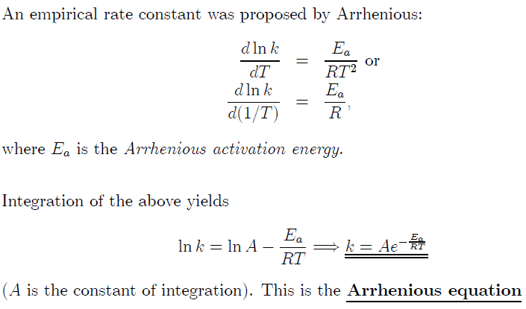

Slide 5
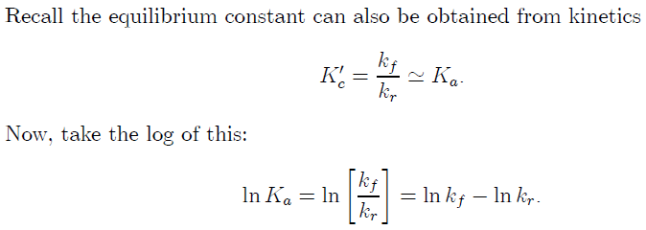

Slide 6
where [B] is an activated complex, possibly a very fleeting intermediate like a free radical. An enthalpy diagram for the reaction involving an intermediate is given as Figure. The enthalpy change for the reaction is given as the down arrow from level A to level C. This is the measured thermochemical value. The activation energy of the reaction is the up arrow from A to [B]. Viewed only from the enthalpy point of view, this is a nonspontaneous process. If the activation enthalpy to get to [B] is supplied, the reaction takes place and the enthalpy change from [B] to C more than repays the enthalpy debt incurred in production of [B]. The enthalpy hill from A to [B] is the activation barrier .

Slide 7
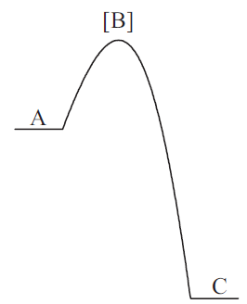
The enthalpy to get over the activation barrier comes from ambient heat supplied to the system at temperatures greater than 0 K. Evidently, the higher the temperature, the more enthalpy is supplied to the system and the more molecules of a statistical distribution have enough enthalpy to get over the barrier. That supplies the qualitative answer to the question: Why do reactions go exponentially faster at higher temperatures than at lower temperatures? The number of activated molecules rises exponentially with temperature.
Temperature effects on rate constants
The quantitative relationship between the reaction rate constant and temperature is
An activation barrier

