Slide 1
BLM258
Chapter 15: Normalization for Relational Databases

Slide 2
Outline
Informal Design Guidelines for Relation Schemas
Functional Dependencies
Normal Forms Based on Primary Keys
Boyce-Codd Normal Form

Slide 3
Informal Design Guidelines for Relation Schemas
Quality Measures
Attribute semantics should be clear
Reducing redundant information
Reducing NULL values
Preventing spurious tuples

Slide 4
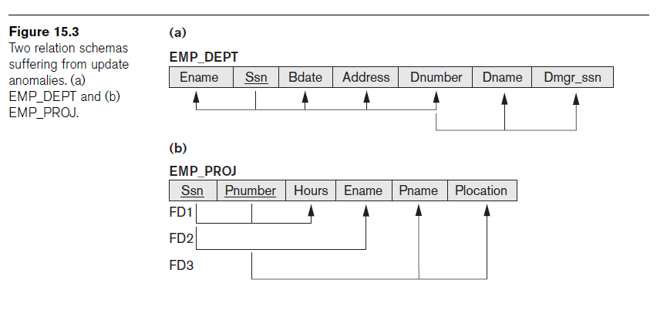
Informal Design Guidelines for Relation Schemas
Quality Measures
Guideline 1
Create a schema with clear meaning
Do not collect attributes from different entity types and relationship types in a single relation

Slide 5
Informal Design Guidelines for Relation Schemas
Redundant Information in Tuples and Update Anomalies
Update anomalies: The result of storing natural joins
Update anomaly types:
Insertion
Deletion
Modification

Slide 6
Informal Design Guidelines for Relation Schemas
Redundant Information in Tuples and Update Anomalies
Guideline 2
Design base relation schemas to eliminate update anomalies

Slide 7
Informal Design Guidelines for Relation Schemas
NULL Values in Tuples
The meaning of NULL values may not be clear
Storage space is wasted
Guideline 3
Do not put attributes in a base relation whose values may be NULL

Slide 8
Informal Design Guidelines for Relation Schemas
Generation of Spurious Tuples
Natural join operation may produce many more tuples than the valid set of tuples.
Guideline 4
Create relation schemas so that no spurious tuples are produced
Eliminate relations that contain the matching attributes are not FK and PK pairs

Slide 9
Functional Dependencies
Functional dependencies are formal tool to evaluate the quality of relational schemas

Slide 10
Normal Forms Based on Primary Keys
Normalization process
Test the relation schema on series of normal forms
Determine which is the highest normal form the relation schema staisfies
First Normal Form (1NF)
Second Normal Form (2NF)
Third Normal Form (3NF)
Boyce-Codd Normal Form (BCNF)

Slide 11
Normal Forms Based on Primary Keys
First Normal Form (1NF)
Attribute values should be atomic (indivisible) values
There are three ways to achieve 1NF
Removing attribute and use it in a different relation
Expand the key
Use several atomic attributes
Nested relations (the relation within a tuple) should not be exist
Remove nested relation attributes into a separate relation

Slide 12
Normal Forms Based on Primary Keys
Second Normal Form (1NF)
A relation schema is in 2NF if each of the nonprime attributes is fully functionally dependent on the primary key.
Second normalize into a number of 2NF relations
In this new relations, nonprime attributes are placed with part of primary key on which they are dpendent.

Slide 13
Normal Forms Based on Primary Keys
Third Normal Form (1NF)
A relation schema is in 3NF if it is in 2NF and no nonprime attribute is transitively dependent an primary key.
If left-hand side of FD is part of the key or left-hand side of FD is a nonkey attribue, we have a porblem with 3NF.

Slide 14
Normal Forms Based on Primary Keys

Slide 15
Boyce-Codd Normal Form (BCNF)
Boyce-Codd Normal Form (BCNF)
If a relation is in BCNF, it is also in 3NF.
If a relation is in 3NF, it is not necessarily in BCNF
A relation schema is in BCNF if a nontrivial functional dependency X->A holds, X is superkey of this relation.

