Slide 1
Mutations
Asist Prof. Nüket Bilgen

Slide 2
What is the common feature…???
mutation

Slide 3
We have the same eye and hair color as many of our family members. The same thing can happen with diseases—they can be passed down from one family member to another. The way this happens is through genes, the genetic information that you get directly from your parents.
In most cases, diseases or other problems do not have one single cause. They come from a combination of your genes, your choices, and your environment.

Slide 4
Mutation is a permanent change in the DNA sequence that makes up a gene.
Mutations range in size from one DNA base to a whole chromosome change.
Gene mutations occur in two ways:
they can be inherited from a parent ( hereditary mutations or germline mutations) or
acquired during a person’s lifetime and occur in the DNA of individual cells (acquired or sporadic mutations).

Slide 5
Mutations can be grouped according to
their sizes,
phenotypic effects,
the cause of occurrence
the type of cell in which they occur.

Slide 6
Mutations by size
Microscopic (macro mutations, chromosomal abnormalities) –it varies from 2000 kb to larger
Submicroscopic (micro mutations, gene mutations)
- a single base or
- mutations that are too small not to be evaluated at the microscope level
Notes:
We can analyse them into two clusters. One of them is microscopic mutations, it has synonims as macro mutations, chromosomal abnormalities. it varies from two thousand kb.
The other one is Submicroscopics. Generally the term of gene mutation is used for this cluster..

Slide 7
Chromosome abnormalities
There are usually two sets of haploid chromosomes in diploid organisms, but in some cases they can change for reasons such as changes in chromosome number, fragment deletion, addition or repetition, interchromosomal fragmentation.
Changes are visible in a light microsope
Chromosomal abnormalities are identified in approximately 0.6% of liveborn infants
More than 50% miscarriages in the first trimester of pregnancy may be due to chromosomal changes
Notes:
Lets talk about the Chromosome abnormalities.
Zero poiint 6 percent

Slide 8
Types of chromosomal abnormalities:
Numerical abnormalities: - poliploidy: triploidy, tetraploidy - aneuploidy: trisomy, monosomy
Structural: translocation, deletion, inversion, duplication, ring, marker
The Cytogenetics field particularly works on chromosomal aberrations by using Karyotyping.

Slide 9
I.Numerical chromosomal abnormalities:
Poliploidy - occurs when there are more than two paired (homologous) sets of chromosomes (triploidy, tetraploidy, etc.).
Triploidy – 3n (if it is human 69,XXX 69,XXY 69,XYY)
Triploidy - is a rare lethal chromosome abnormality caused by the presence of an extra set of chromosomes
The most usual cause is two sperm fertilizing a single oocyte (dispermy)
Sometimes the cause is a diploid gamete
The condition is not compatible with life
Tetraploidy – 4n (if it is human 92,XXXX 92,XXYY)
is caused by the presence of two extra sets of chromosomes
is extremely rare, lethal condition
it is usually due to failure to complete the first zygotic division

Slide 10
I.Numerical chromosomal abnormalities:
Aneuploidy - one chromosome is extra (trisomy) or one is lost (monosomy). They can occur within autosomal and sex chromosomes
Trisomy - is an abnormality in which there are three copies of a particular chromosome (e.g. 47,XX,+21)
Monosomy – occurs when there is only one of a pair of chromosomes (e.g. 45,X)
Aneuploidy cells arise through two main mechanisms:
Nondisjunction – failure of chromosome pairs to separate properly during cell division or failure of sister chromatids to disjoin (trisomy or monosomy)
Anaphase lag – delayed movement of chromosome during anaphase (monosomy)

Slide 11
Nullisomy 2n-2
Monosomy 2n-1
Trisomy 2n+1
Tetrasomy 2n+2
Nondisjunction
Notes:
Nullisomy 2n-2= two n minus 2
Trisomy 2n plus one

Slide 12
Aneuplidies of sex chromosomes
Klinefelter syndrome, 47,XXY
Children: learning disabilities, delayed speech and language development
In adolescent may be discovered during an endocrine evaluation for delayed or incomplete pubertal development, gynecomastia, and small testes.
Adults are often evaluated for infertility or breast malignancy

Slide 13
45,X – Turner syndrome
Short stature - broad chest - low hairline - low-set ears - webbed neck Girls with Turner syndrome typically experience gonadal dysfunction (non-working ovaries), which results in amenorrhea (absence of menstrual cycle) and sterility –
Mental development is normal

Slide 14
II.Structural chromosomal abnormalities
Structural chromosomal abnormalities result from breakage and incorrect rejoining of chromosomal segments.
Structural rearrangements are defined as balanced if the complete chromosomal set is still present, and unbalanced if information is additional or missing.
Balanced: if there is no gain or loss of chromosomal material
• Translocations
• Inversions
Unbalanced: – if there is gain or loss of chromosomal material
• Duplication
• Deletion
• Insertion
• Ring chromosome

Slide 15
Balanced Structural rearrangements
Reciprocal Translocation : A type of chromosome rearrangement involving the exchange of chromosome segments between two chromosomes that do not belong to the same pair of chromosomes.
Carriers of balanced reciprocal translocation are healthy persons but can produce gametes with unbalanced chromosomal material
For example: Robertsonian translocation
A type of chromosome rearrangement involving the exchange between the proximal short arms of the acrocentric chromosomes: 13, 14, 15, 21 and 22.
The most common Robertsonian translocation is between chromosomes 13 and 14
Carriers are asymptomatic but often produce unbalanced gametes that can result in miscarriage (monosomic or trisomic zygote).

Slide 16
Balanced Structural rearrangements
A Robertsonian translocation results when the long arms of two acrocentric chromosomes fuse at the centromere and the two short arms are lost.
Notes:
S

Slide 17
Balanced Structural rearrangements
Inversion: Inversion occurs when the segment between two breakpoints is inverted before rejoining the breaks

Slide 18
Unbalanced Structural rearrangements
(if there is gain or loss of chromosomal material)
Deletion - loss of a segment of the chromosome

Slide 19
Unbalanced Structural rearrangements
Duplication occurs when a segment of the chromosome is repeated, once or several times.

Slide 20
Unbalanced Structural rearrangements
Ring chromosome: Two ends of the segment between breakpoints are joined to form a circular structure.

Slide 21
What kind of abnormalities?
Cri-du-chat sendromu
Down sendromu

Slide 22
Mutations can be grouped according to
their size,
the cause of occurrence
the type of cell in which they occur,
phenotypic effects.

Slide 23
the cause of occurrence
A mutation occurs when a DNA gene is damaged or changed in such a way as to alter the genetic message carried by that gene.
- spontaneous: Caused by replication mistakes
- induced: Induced by exposure to a variety of mutagens
Physical
Radiation
Heat
Chemical
Base analogs
Alkylating/intercalating agents
Metal ions
biological
Viruses
bacteria
transposons

Slide 24
Mutations can be grouped according to
their size,
the cause of occurrence
the type of cell in which they occur,
phenotypic effects.

Slide 25
the type of cell in which they occur
Somatic cells - the mutation is not passed along to the next generation. Cancer tumors are a unique class of somatic mutations.
Germinal cells - germ cells give rise to gametes; some gametes will carry the mutation and it will be passed on to the next generation.
Typically, germinal mutations are not expressed in the individual containing the mutation.

Slide 26
Mutations by size
Remember…
Microscopic (macro mutations, chromosomal abnormalities) –it varies from 2000 kb to larger
Submicroscopic (micro mutations, gene mutations)
- a single base or
- mutations that are too small not to be evaluated at the microscope level

Slide 27
Gene mutations
(Submicroscopic, micro mutations)

Slide 28
Base pair substitution mutations in a nucleotide is observed as conversion to another nucleotide.
transition - exchange purin-purin or pirymidyn-pirymidin
transversion - exchange purin-pyrimidin
Example:
Substitution in FGFR3 (Fibroblast Growth Factor Receptor 3) gene, Achondroplasia,
Autosomal dominant disorder
long, narrow trunk - short extremities, particularly in
the proximal (rhizomelic) segments
a large head with frontal bossing
hypoplasia of the midface
trident configuration of the hands

Slide 30
missense mutations – replace one amino acid with another in gene product. These are nonsynonymous substitutions occur in coding region and changes the triplet codon for different amino acid
nonsense mutations – replace an amino acid codon with a stop codon. Point mutation, which converts the normal codon to UAA, UGA, UAG, creating a premature STOP codon is called.
synonymous (silent) mutations do not change the sequence of the gene product. Causes a codon change but does not result in an altered amino acid because of the degeneracy of the genetic code.
frameshift mutation - Insertion or deletion of a small number of nucleotides (different than multiplication of three) into a coding region, which alter the reading frame of translation from that point.

Slide 32
a cat felled off the balcony
missense
a dog felled off the balcony
nonsense
a cat felled XXX
synonymous (silent) mutations
a cat felled off the balcony
frameshift mutation
a cat felledeoffthebalcony
İnsertion
Deletin
a cat felled ofthebalcony

Slide 34
Dynamic mutations
Dynamic mutation is caused by the expansion of trinucleotide repeats within the genome
Trinucleotide repeat units lies within or adjacent to a disease-associated gene, there is a tendency for the tract to become progressively larger by expansion at meiosis, it becomes «unstable» by reaching a certain threshold size.
Anticipation – the tendency for the severity of a condition in successive generations
Huntington’s disease- example of dynamic mutation
HD is a rare neurodegenerative disorder of the central nervous system characterized by unwanted choreatic movements, behavioral and psychiatric disturbances and dementia.
CAG repeats expansion in IT15 gene - which adds a string of glutamines (Gln) to the encoded protein called huntingtin

Slide 36
Fragile X syndrome is an example for repeat extension

Slide 37
Mutations can be grouped according to
their size,
the cause of occurrence
the type of cell in which they occur,
phenotypic effects.

Slide 38
According to phenotypic effects
Loss of function mutations: Such mutations cause protein to be partially (hypomorph) or totally (amorph) loss of function.
Gain of Function mutations: Due to such mutations, the gene product acquires a new, hypermorphic function.

Slide 39
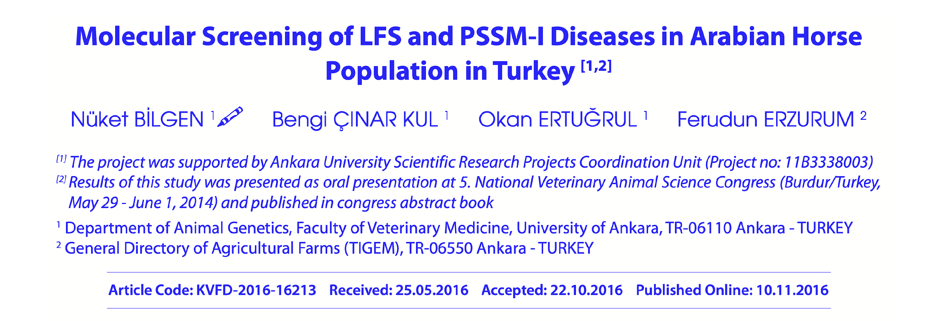
Lavender foal syndrome
Lethal Types of mutations seen in genes with vital functions.
In a mutation that is associated with a functional protein, if the mutant protein unable to tolerate the lack of expression, this situation is resulted in the death of the organism and the mutation is termed "LETHAL" mutation.

Slide 40
Gain of Function mutations: PSSM-I disease in Throughbred horses is a gain of function
mutation. The enzyme responsible for glycogen storage work faster than normal.
this results with abnormal glycogen in the muscle.

Slide 41
What is your diagnosis?

Slide 42
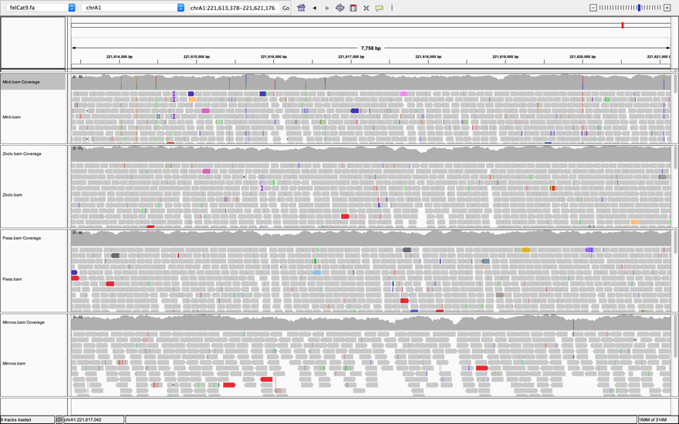
Model Animal Cat; Investigation of Genetic Substructure of Radial Aplasia / Hypoplasia Malformation with Whole Genomic Sequence

Slide 43
Genetic variation
All individuals are 99.9 percent the same genetically.
The differences in the sequence of DNA among individuals, or genetic variation, explain some of the differences among people such as physical traits and higher or lower risk for certain diseases.

Slide 44
Mutations and polymorphisms are forms of genetic variation. While mutations are generally associated with disease and are relatively rare, polymorphisms are more frequent, and their clinical significance is not as straightforward. Single nucleotide polymorphisms (SNPs, pronounced “snips”) are DNA sequence variations that occur when a single nucleotide is altered.
SNPs occur every 100 to 300 bases along the 3 billion-base human genome. A single individual may carry millions of SNPs.

