Slide 1
Yapay Zeka 802600715151
Doç. Dr. Mehmet Serdar GÜZEL

Slide 2
Recurrent Neural Networks by Çağla Ballı

Slide 3
What is RNN?
A recurrent neural network (RNN) is a class of artificial neural network where connections between nodes form a directed graph along a temporal sequence. This allows it to exhibit temporal dynamic behavior.

Slide 4
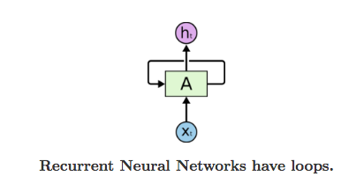
RNN Nodes
They are networks with loops in them, allowing information to persist.

Slide 5
RNN Nodes
A loop allows information to be passed from one step of the network to the next. A recurrent neural network can be thought of as multiple copies of the same network, each passing a message to a successor.

Slide 6
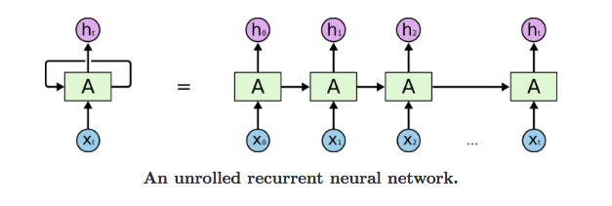
RNN Nodes
Consider what happens if we unroll the loop:
This chain-like nature reveals that recurrent neural networks are intimately related to sequences and lists.

Slide 7
RNN vs Feedforward Neural Networks
Unlike feedforward neural networks, RNNs can use their internal state (memory) to process sequences of inputs.This makes them applicable to tasks such as unsegmented, connected handwriting recognition or speech recognition.

Slide 8
RNN vs Feedforward Neural Networks
Denetimli öğrenmede, ilk girdi veya başlangıçta verilen girdi hakkında karar verilir.
Örn : Nesne tanımlama

Slide 9
Particular type of RNN : LSTM
Long short-term memory (LSTM) is a deep learning system that avoids the vanishing gradient problem. LSTM is normally augmented by recurrent gates called "forget" gates. LSTM prevents backpropagated errors from vanishing or exploding.

Slide 10
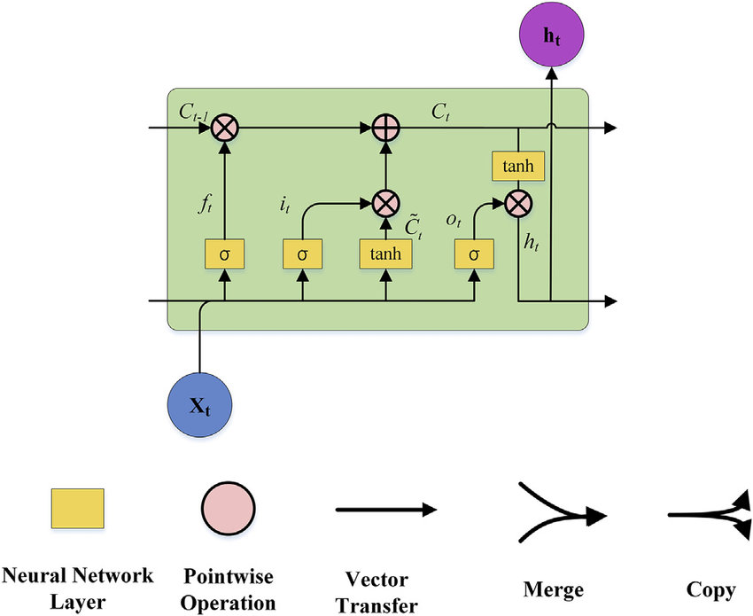
LSTM Unit

Slide 11
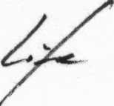
Handwritten Text Recognation
Offline Handwritten Text Recognition (HTR) systems transcribe text contained in scanned images into digital text

Slide 12
Handwritten Text Recognation
Dataset : The IAM Handwriting Database
contains forms of handwritten English text which can be used to train and test handwritten text recognizers.

Slide 13
Model Overview
The implementation only depends on numpy, cv2 and tensorflow imports. It consists of 5 CNN layers, 2 RNN (LSTM) layers and the CTC loss and decoding layer.

Slide 14
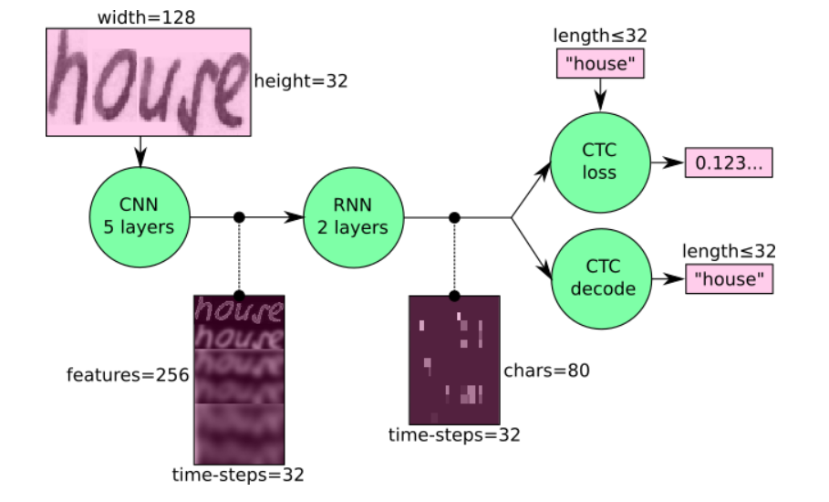
Model Overview

Slide 15
Model Overview
The input image is a gray-value image and has a size of 128x32
5 CNN layers map the input image to a feature sequence of size 32x256
2 LSTM layers with 256 units propagate information through the sequence and map the sequence to a matrix of size 32x80. Each matrix-element represents a score for one of the 80 characters at one of the 32 time-steps
The CTC layer either calculates the loss value given the matrix and the ground-truth text (when training), or it decodes the matrix to the final text with best path decoding or beam search decoding (when inferring)
Batch size is set to 50

Slide 16
Operations : CNN
CNN: the input image is fed into the CNN layers. These layers are trained to extract relevant features from the image. Each layer consists of three operation. First, the convolution operation, which applies a filter kernel of size 5×5 in the first two layers and 3×3 in the last three layers to the input. Then, the non-linear RELU function is applied. Finally, a pooling layer summarizes image regions and outputs a downsized version of the input. While the image height is downsized by 2 in each layer, feature maps (channels) are added, so that the output feature map (or sequence) has a size of 32×256.

Slide 17
Operations : RNN
RNN: the feature sequence contains 256 features per time-step, the RNN propagates relevant information through this sequence. The popular Long Short-Term Memory (LSTM) implementation of RNNs is used, as it is able to propagate information through longer distances and provides more robust training-characteristics than vanilla RNN. The RNN output sequence is mapped to a matrix of size 32×80. The IAM dataset consists of 79 different characters, further one additional character is needed for the CTC operation (CTC blank label), therefore there are 80 entries for each of the 32 time-steps.

Slide 18
Operations : CTC
CTC: while training the NN, the CTC is given the RNN output matrix and the ground truth text and it computes the loss value. While inferring, the CTC is only given the matrix and it decodes it into the final text. Both the ground truth text and the recognized text can be at most 32 characters long.

Slide 19
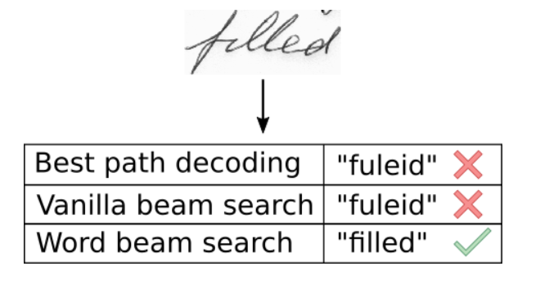
Word Beam Search Decoding
Using this decoder, words are constrained to those contained in a dictionary, but arbitrary non-word character strings (numbers, punctuation marks) can still be recognized.

Slide 20
Improve Accuracy
74% of the words from the IAM dataset are correctly recognized by the NN when using vanilla beam search decoding.here are some ideas how to improve it :
*Data augmentation: increase dataset-size by applying further (random) transformations to the input images. At the moment, only random distortions are performed.
*Remove cursive writing style in the input images
*Increase input size (if input of NN is large enough, complete text-lines can be used.

Slide 21
Improve Accuracy
*Add more CNN layers
*Replace LSTM by 2D-LSTM.
*Replace optimizer: Adam improves the accuracy, however, the number of training epochs increases.
*Decoder: use token passing or word beam search decoding to constrain the output to dictionary words.
*Text correction: if the recognized word is not contained in a dictionary, search for the most similar one.

Slide 22
References
https://github.com/githubharald/SimpleHTR
https://towardsdatascience.com/build-a-handwritten-text-recognition-system-using-tensorflow-2326a3487cd5
http://www.wikizero.biz/index.php?q=aHR0cHM6Ly9lbi53aWtpcGVkaWEub3JnL3dpa2kvTG9uZ19zaG9ydC10ZXJtX21lbW9yeQ
https://medium.com/@hamzaerguder/recurrent-neural-network-nedir-bdd3d0839120
https://medium.com/explore-artificial-intelligence/an-introduction-to-recurrent-neural-networks-72c97bf0912
http://www.wikizero.biz/index.php?q=aHR0cHM6Ly9lbi53aWtpcGVkaWEub3JnL3dpa2kvUmVjdXJyZW50X25ldXJhbF9uZXR3b3Jr

