Slide 1
Cis PLATİN
PART 1. İNTRODUCTİON

Slide 2
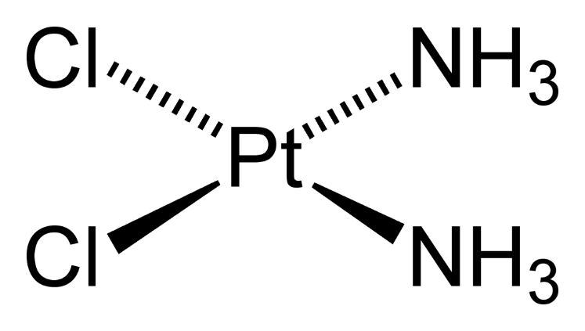
Cisplatin, cis-diamminedichloroplatinum(II), a square planar complex (Figure 1), was the first metal based agent to enter into worldwide clinical use for the treatment of cancer. Currently, cisplatin is used either by itself or in combination with other drugs for treating lung, ovarian, bladder, testicular, head and neck, esophageal, colon, gastric, breast, melanoma and prostate cancer. Although sales of cisplatin are presently on the decline, with second- and third-generation analogs being more widely prescribed, cisplatin remains the ‘gold standard’ to which aspiring platinum and non platinum metal-based anticancer drugs are compared.
$${Pt}^{2+}$$
Figure 1. Cisplatin

Slide 3
1 Discovery of cisplatin
The idea of investigating the antitumor properties of cisplatin was based on an accidental discovery made by Barnett Rosenberg, a professor of biophysics at Michigan State University, and his coworkers in the early 1960s. Professor Rosenberg was studying the effects of electric fields on the growth of cells and he and his group constructed a special cell culture apparatus containing platinum mesh electrodes that allowed cells to grow and be harvested on a continuous basis. The goal of the study was to apply alternating currents of different frequencies to the electrodes and determine whether and to what extent electric current affected the ability of the cells to divide. While the investigators were really interested in mammalian cells, they tested the new apparatus using E. coli bacteria and found to their surprise that certain frequencies of current greatly reduced the number of cells growing in the culture apparatus. A check on the appearance of the bacteria that had been subjected to electric current revealed that bacterial cells were present but instead of having their normal ‘sausage’ shape, they were long spaghetti-like filaments, which indicated that the cells were growing but not dividing.

Slide 4
Sensing that they were observing something new and very unusual, the investigators carried out a number of control experiments which showed that, while the electric current itself had no direct effect on cell division, the current was causing a chemical reaction to take place in the cell culture medium, which required oxygen, ammoniumion (NH⁴⁺) and chloride ion (Cl⁻). After learning this, and after realizing that the current was causing a small amount of platinum metal on the surface of the electrodes to dissolve, they hypothesized that the
Current was in some way producing platinum complexes in the culture medium and that these chemical species, not the electric current, were affecting the growth of E. coli. Suspecting that elemental platinum in the electrode was being oxidized to Ptþ4, they tested a sample of [NH₄]₂[PtCl₆], which, in addition to having Pt⁴⁺, also contained chloride and ammonium ion, but the compound had no effect on the growth of the bacteria. However, if solutions of [NH₄]₂[PtCl₆] were exposed to ambient light for a long period of time on the laboratory bench top, or if they were deliberately irradiated using a light source, the resulting solutions were very effective in blocking division of E. coli.

Slide 5
These observationsl ed the investigators to irradiate solutions of [NH₄]₂[PtCl₄], which contained Pt²⁺, and after analyzing the solutions they concluded that neutral chemical species produced in the photoreactions were responsible for the lack of division of E. coli cells. By synthesizing authentic samples of many platinum complexes, they learned that sixcoordinate octahedral cis-[PtCl₄(NH₃)₂], which contains Pt⁴⁺,
and four-coordinate square planar cis-[PtCl₂(NH₃)₂], which contains Pt²⁺, were very effective in causing the bacterial cells to elongate. Thinking that a platinum complex capable of inhibiting cell division could also be useful for treating cancer,Rosenberg and his group studied the effects of the platinum compounds on tumor-bearing mice.
They found that cis-[PtCl₂(NH₃)₂], later to become known as cisplatin, was remarkably effective at arresting sarcoma180 and leukemia L1210 in mice, while the trans isomer, trans[PtCl₂(NH₃)₂], exhibited little antitumor activity.

Slide 6
2. Physical and chemical properties of cisplatin
Cis-diamminedichloroplatinum(II), cis-[PtCl₂(NH₃)₂], cisplatin, is a bright-yellow solid that was first synthesized by Peyrone in 1844.
The modern synthesis of cisplatin usually employs the method of Dhara, which uses the trans effect of iodide ion to efficiently direct two ammonia molecules into cis sites on the square planar platinum ion (scheme 1)

Slide 7
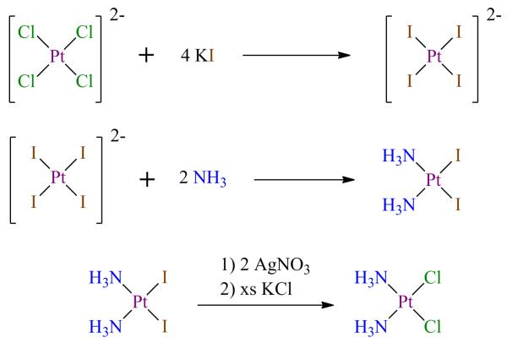
scheme1. Synthesis of cisplatincisplatinin Dhara method All reactions in aquoeus media

Slide 8
Since ${Pt}^{2+}$ has the electronic configuration 5d⁸, and cisplatin is diamagnetic (S=0),
the electronic configuration involving the d-orbitals in the square planar complex, in order of increasing energy, is d² _{xz} ; d² _{yz} (degenerate),
d² _{z}²; d² _{xy} ; d⁰ _{x}²_{-y}² .
The highest-energy orbital, d_{x}²_{-y}², is unoccupied because the energy difference between it and d_{xy}, which is $Δ$, is large, forcing the two electrons to pair in the more stable d_{xy} orbital. (figure 2)

Slide 9
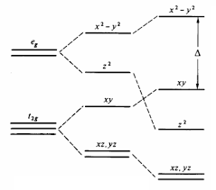
Figure 2. Octahedral square planar

Slide 10
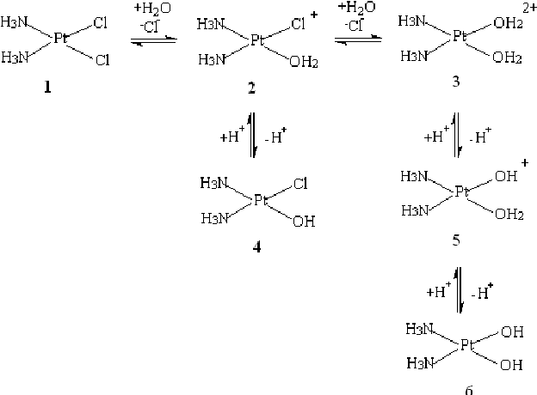
Scheme 2. Cisplatinin in aquoeus media . Equliubrium reactions in biological medium

Slide 11
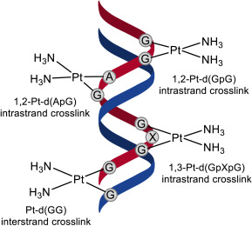
Figure 3DNA ve cisplatn..DNA nın onarılmasını sağlar

Slide 12
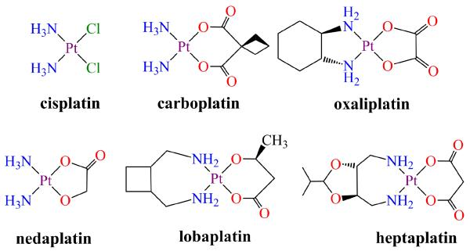
Figure 4. some cisplatin drugs

