Slide 1
Writing: Charts and Graphs

Slide 2
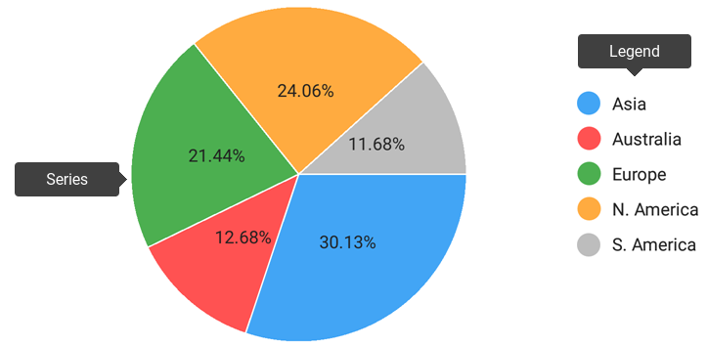
Terminology for Charts and Graphs
Pie Chart:
A circular chart cut by radii into segments illustrating relative magnitudes or frequencies.

Slide 3
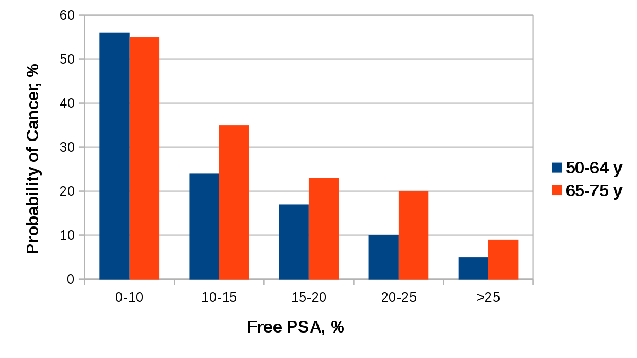
Terminology for Charts and Graphs
Bar Graph:
A graphic means of quantitative comparison by rectangles with lengths proportional to the measure of the data or things being compared.

Slide 4
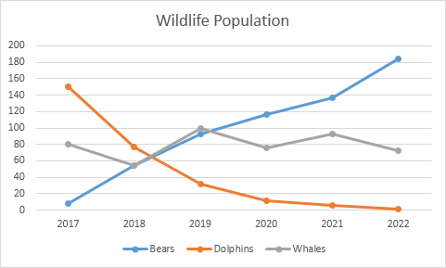
Terminology for Charts and Graphs
Line Graph:
A graph in which points representing values of a variable for suitable values of an independent variable are connected by a broken line.

Slide 5
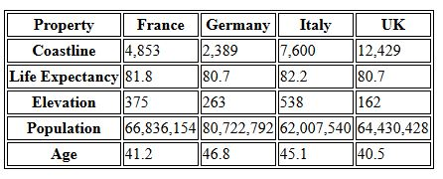
Terminology for Charts and Graphs
Table Chart:
It is a means of arranging data in rows and columns.

Slide 6
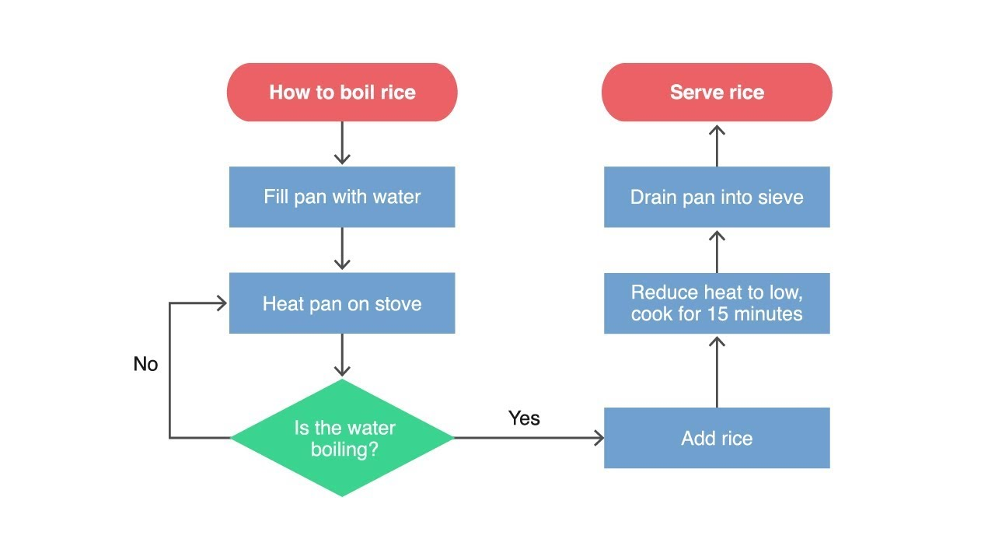
Terminology for Charts and Graphs
Flow Chart:
A diagram that shows step-by-step progression through a procedure or system especially using connecting lines and a set of conventional symbols.

Slide 7
Vocabulary for Analysis
Verbs
Go up
Boom
Decline
Plunge
Improve
Leap
Go down
Slump
Pick up
Rocket
Drop
Dive
Climb
Shoot
Fall
Increase
Soar
Decrease
Reduce
Surge
Rise
Source: Ramedani, A. (2012). «IELTS Writing Compact»

Slide 8
Vocabulary for Analysis
Verbs
Oscillate
Stay constant
Hold steady
Be erratic
Stay static
Vacillate
Level off
Be unpredictable
Maintain the same level
Fluctuate
Stabilize
Source: Ramedani, A. (2012). «IELTS Writing Compact»

Slide 9
Vocabulary for Analysis
Nouns
Rise
Decline
Oscillation
Stability
Growth
Reduction
Vacillation
Leveling out
Increase
Decrease
Fluctuation
Plateau
Improvement
Fall
Surge
Drop
Jump
Source: Ramedani, A. (2012). «IELTS Writing Compact»

Slide 10
Vocabulary for Analysis
Examples:
London saw a significant increase in the cost of homes. → Noun
The cost of homes in London increased significantly. → Verb
There was a rise in house prices between 1990 and 1995. → Noun
House prices rose between 1990 and 1995. → Verb

Slide 11
Vocabulary for Analysis
Adjectives
High Degree of Change
Medium Degree of Change
Dramatic
Moderate
Steep
Steady
Sharp
Progressive
Significant
Constant
Marked
Remarkable
Source: Ramedani, A. (2012). «IELTS Writing Compact»

Slide 12
Vocabulary for Analysis
Adjectives
Low Degree of Change
Slow
Marginal
Slight
Minimal
Insignificant
Negligible
Gradual
Source: Ramedani, A. (2012). «IELTS Writing Compact»

Slide 13
Vocabulary for Analysis
Adverbs
High Degree of Change
Medium Degree of Change
Dramatically
Suddenly
Moderately
Steeply
Radically
Steadily
Sharply
Progressively
Significantly
Constantly
Markedly
Remarkably
Source: Ramedani, A. (2012). «IELTS Writing Compact»

Slide 14
Vocabulary for Analysis
Adjectives
Low Degree of Change
Slowly
Marginally
Slightly
Minimally
Insignificantly
Negligibly
Gradually
Source: Ramedani, A. (2012). «IELTS Writing Compact»

Slide 15
Vocabulary for Analysis
Examples:
The number of people owning mobile phones rose dramatically between 1990 and 1995.
Migration from rural regions to urban centers has leveled out over the last ten years.
The amount of time spent on leisure activities fell slightly in 2008.
Source: Ramedani, A. (2012). «IELTS Writing Compact»

Slide 16
Vocabulary for Analysis
Examples:
Newspaper circulation during 1990s fluctuated considerably.
The rate of application for the nursing profession plateaued between 2001 and 2007.
There was a 7% fall in the average house price in Tokyo.

