Slide 1
Production of fishery products in the world 135 million tons
95 million tons (70 %) obtained by fishing (catching, hunting)
40 million tons (30 %) obtained by aquaculture
Aquaculture is the fastest growing animal based food-producing sector, particularly in developing countries.
This sector alone contributes nearly a third of the world’s supply of fish products.
China and other Asian countries are by far the largest producers.
fishery products in Turkey 600.000 tons
85 % fishing
15 % aquaculture
38.067 tons (50% of aquaculture) Rainbow trout
ANIMAL PROTEIN NEEDS = AQUACULTURE

Slide 2
World fisheries production and utilization
 | 1998 | 1999 | 2000 | 2001 | 2002 | 2003¹
 | (million tonnes)
PRODUCTION
INLAND
Capture | 8.1 | 8.5 | 8.7 | 8.7 | 8.7 | 9.0
Aquaculture | 18.5 | 20.2 | 21.3 | 22.5 | 23.9 | 25.2
Total inland | 26.6 | 28.7 | 30.0 | 31.2 | 32.6 | 34.2
MARINE
Capture | 79.6 | 85.2 | 86.8 | 84.2 | 84.5 | 81.3
Aquaculture | 12.0 | 13.3 | 14.2 | 15.2 | 15.9 | 16.7
Total marine | 91.6 | 98.5 | 101.0 | 99.4 | 100.4 | 98.0
Total capture | 87.7 | 93.8 | 95.5 | 92.9 | 93.2 | 90.3
Total aquaculture | 30.6 | 33.4 | 35.5 | 37.8 | 39.8 | 41.9
Total world fisheries | 118.2 | 127.2 | 131.0 | 130.7 | 133.0 | 132.2
UTILIZATION
Human consumption | 93.6 | 95.4 | 96.8 | 99.5 | 100.7 | 103.0
Non-food uses | 24.6 | 31.8 | 34.2 | 31.1 | 32.2 | 29.2
Population (billions) | 5.9 | 6.0 | 6.1 | 6.1 | 6.2 | 6.3
Per capita food fish supply (kg) | 15.8 | 15.9 | 15.9 | 16.2 | 16.2 | 16.3

Slide 3
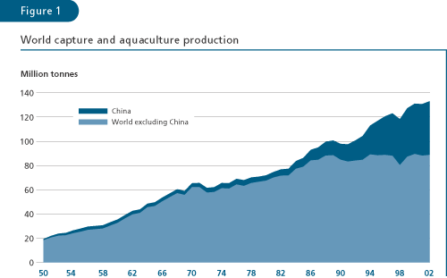

Slide 4
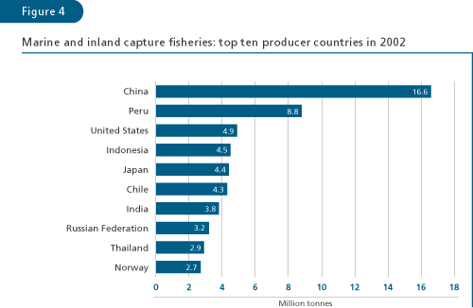

Slide 5
Slovakia Fisheries
Total fish production in aquaculture is showing an increasing trend: in 2004 it reached 1 181 tonnes. The economic role of fisheries in the Slovak national economy is insignificant: in 2004 fisheries accounted for 0.002 percent of GDP. Fish consumption is also low, amounting to 4.2 kg per capita in 2004. In Slovakia fish farming consists of both salmonid (cold-water species) production, mainly trout, and cyprinid (warm-water species) production, mainly carp. Production is based mainly on rainbow trout (69.5 percent) and carp (29.2 percent).
Only private owners and companies currently operate in the Slovak freshwater aquaculture. In 2004, according to the Ministry of Agriculture, there were 33 fish farms in operation, practicing cyprinid (warm-water species) production in ponds, including predatory fish species, such as Northern pike, zander and wels catfish. Of these, 15 were family-owned farms, 14 cooperatives and 4 companies.
There were 32 fish farms using intensive farming systems for salmonids (cold-water species) production including grayling, and sterlet. Of these 15 were family-owned, 14 cooperatives and 3 were companies.

Slide 6
Slovakia Fisheries
Rainbow trout (Oncorhynchus mykiss) is the dominant species, accounting for about 70 percent of total production. It is marketed at 250 g or more of its live weight after 16-24 months.
The production of common carp (Cyprinus carpio) accounts for approximately 20 percent of total production. Common carp is marketed at 2 kg or more of its live weight, after 3-4 growth seasons.
Common carp is supplemented in polyculture stocks by other fish species: Prussian carp (Carassius gibelio), grass carp (Ctenopharyngodon idella), bighead carp (Aristichthys nobilis), silver carp (Hypophthalmichthys molitrix), tench (Tinca tinca), and some predatory fish such as Northern pike (Esox lucius), zander (Sander lucioperca), and wels catfish (Silurus glanis).

Slide 7
Table 1. Production of cultured fish species (in tonnes) during 2000-2004

