Slide 1
Bone Tissue

Slide 2
Bone
A bone is a rigid organ that constitutes part of the vertebrate skeleton.
Bone tissue (osseous tissue) is , a type of dense connective tissue.
Bones support and protect the various organs of the body, produce red and white blood cells, store minerals and enable mobility.
Bones come in a variety of shapes and sizes and have a complex internal and external structure.
They are lightweight but strong and hard, and serve multiple functions.
It has a honeycomb-like matrix inside, which helps to give the bone rigidity.
Bone tissue is made up of different types of bone cells.

Slide 3
Osteoblasts and osteocytes are involved in the formation and mineralization of bone; osteoclasts are involved in the resorption of bone tissue.
Modified (flattened) osteoblasts become the lining cells that form a protective layer on the bone surface.
The mineralised matrix of bone tissue has an organic component, mainly collagen and an inorganic component, bone minerals made up of various salts.

Slide 4
Bones tissues include
bone marrow,
endosteum,
periosteum,
nerves,
blood vessels
and cartilage.
In the human body at birth, there are over 270 bones, but many of these fuse together during development, leaving a total of 206 separate bones in the adult,
not counting numerous small sesamoid bones.
The largest bone in the body is the femur, and the smallest is the stapes in the middle ear.

Slide 5
Bone is not uniformly solid, but includes a tough matrix.
This matrix makes up about 30% of the bone and the other 70% is salts that give strength to it.
The matrix is made up of between 90-95% collagen fibers, and the remainder is ground substance.
The primary bone tissue, is relatively hard and lightweight.

Slide 6
Bone matrix is mostly made up of;
A composite material incorporating the inorganic mineral calcium phosphate in a chemical arrangement termed calcium hydroxylapatite (bone mineral that gives rigidity)
Collagen, improving fracture resistance.
The collagen of bone is known as ossein.
Bone is formed by the hardening of this matrix around entrapped cells.
When these cells become entrapped from osteoblasts they become osteocytes.

Slide 7
Bone Tissue Anatomy and Structure
There are primarily five types of bones that can be generally identified based on their forms (general shape).
Bones in the human body:
long,
short,
flat,
irregular, and
sesamoid.

Slide 8
Long Bones -
Long bones develop through the endochondral ossification process and include those located in the appendicular skeleton such as the tibia and femur.
They have a shaft part that connects the two ends referred to as epiphysis (mostly spongy bone with a thin layer of compact bone).
The metaphysis, which is the point between the shaft and epiphysis, is often the point of growth during development.
Short Bones -
Short bones are largely composed of a thin layer of compact bone that covers vast spongy bone and marrow.
This causes them to appear cuboid in shape.
They serve to provide support and stability and include such bones as the carpal and tarsal bones.

Slide 9
Flat Bones -
Unlike short bones, two layers of compact bone cover the spongy bone and marrow in flat bones.
Examples of flat bones include ribs, scapulae and skull bones.
Sesamoid Bones -
These bones are largely found at the end of long bones and include such bones as the patella bone located in the knee.
They primarily serve to protect tendons from excess wear.
Irregular Bones -
With irregular bones, a thin layer of the compact bone cover the spongy bone.
This category is largely categorized by the content of the bone rather than the shape. It includes such bones as the hip and vertebrae.

Slide 10
Bone tissue is a mineralized tissue of two types,
cortical bone
cancellous bone.

Slide 11
Cortical bone (Compact bone)
The hard outer layer of bones is composed of cortical bone also called compact bone being much denser than cancellous bone.
It forms the hard exterior (cortex) of bones.
The cortical bone gives bone its smooth, white, and solid appearance, and accounts for 80% of the total bone mass of an adult human skeleton.
It facilitates bone's main functions:
to support the whole body,
protect organs,
provide levers for movement,
and store and release chemical elements, mainly calcium.

Slide 12
Compact bone tissue consists of units called osteons or Haversian systems.
Osteons are cylindrical structures that contain a mineral matrix and living osteocytes connected by canaliculi, which transport blood.
They are aligned parallel to the long axis of the bone.
Each osteon consists of lamellae, which are layers of compact matrix that surround a central canal called the Haversian canal.
The canal contains the bone’s blood vessels and nerve fibers
Osteons in compact bone tissue are aligned in the same direction along lines of stress and help the bone resist bending or fracturing.
Therefore, compact bone tissue is prominent in areas of bone at which stresses are applied in only a few directions

Slide 13
Volkmann's canals at right angles connect the osteons together.
The columns are metabolically active, and as bone is reabsorbed and created the nature and location of the cells within the osteon will change.
Cortical bone is covered by a periosteum on its outer surface, and an endosteum on its inner surface.
The endosteum is the boundary between the cortical bone and the cancellous bone.
The primary anatomical and functional unit of cortical bone is the osteon.

Slide 14
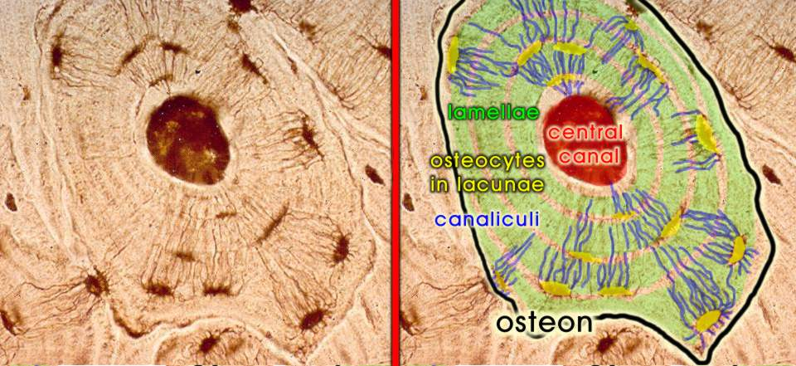
Kemik dokusu

Slide 15
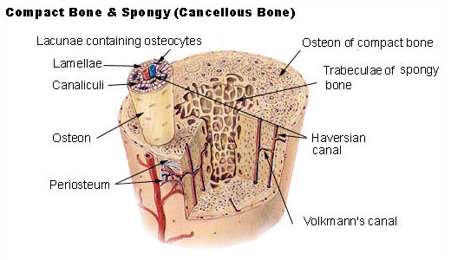

Slide 16
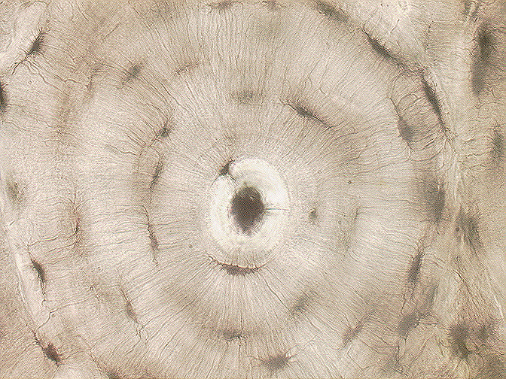
H
Havers kanalı ve etrafında konsantrik lameller.
Lakünler arası alan mineralize kemiktir.

Slide 17
Cancellous bone (Spongy Bone) Tissue
Whereas compact bone tissue forms the outer layer of all bones, spongy bone or cancellous bone forms the inner layer of all bones
Spongy bone tissue does not contain osteons that constitute compact bone tissue.
Instead, it consists of trabeculae, which are lamellae that are arranged as rods or plates.
Cancellous bone has a higher surface-area-to-volume ratio than cortical bone because it is less dense.
This makes it softer and weaker, but more flexible.
It reduces the density of bone and allows the ends of long bones to compress as the result of stresses applied to the bone.

Slide 18
The greater surface area also makes it suitable for metabolic activities such as the exchange of calcium ions.
It contains the bone marrow
Plays an important role of protecting the marrow where blood cells are produced.
Cancellous bone is typically found at the ends of long bones, near to joints and within the interior of vertebrae.
Cancellous bone is highly vascular and frequently contains red bone marrow where haematopoiesis, the production of blood cells, occurs.
The primary anatomical and functional unit of cancellous bone is the trabecula.
The trabeculae are aligned towards the mechanical load distribution that a bone experiences within long bones such as the femur.

Slide 19
Red bone marrow is found between the trabuculae.
Blood vessels within this tissue deliver nutrients to osteocytes and remove waste.
The red bone marrow of the femur and the interior of other large bones, such as the ileum, forms blood cells.
Trabecular marrow is composed of a network of rod- and plate-like elements that make the overall organ lighter and allow room for blood vessels and marrow.
Trabecular bone accounts for the remaining 20% of total bone mass but has nearly ten times the surface area of compact bone.

Slide 20
Bone marrow
Bone marrow, also known as myeloid tissue in red bone marrow, can be found in almost any bone that holds cancellous tissue.
In newborns, all such bones are filled exclusively with red marrow or hematopoietic marrow
But as the child ages the hematopoietic fraction decreases in quantity and the fatty/ yellow fraction called marrow adipose tissue (MAT) increases
In adults, red marrow is mostly found in the bone marrow of the femur, the ribs, the vertebrae and pelvic bones.

Slide 21
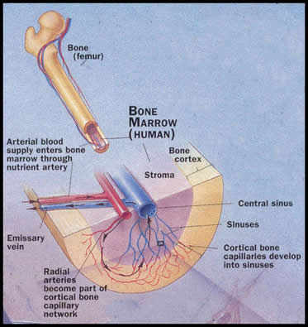

Slide 22
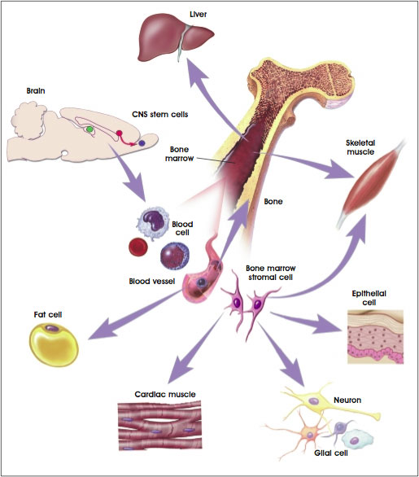

Slide 23
Bone tissue
Bone cells
Bone is a metabolically active tissue composed of several types of cells.
These cells include osteoblasts, which are involved in the creation and mineralization of bone tissue, osteocytes, and osteoclasts, which are involved in the reabsorption of bone tissue.
Osteoblasts and osteocytes are derived from osteoprogenitor cells, but osteoclasts are derived from the same cells that differentiate to form macrophages and monocytes.
Within the marrow of the bone there are also hematopoietic stem cells.
These cells give rise to other cells, including white blood cells, red blood cells, and platelets.

Slide 24
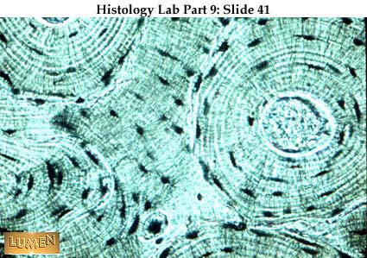

Slide 25
Osteoblast
Light micrograph of cancellous decalcified bone displaying osteoblasts actively synthesizing osteoid, containing two osteocytes.
Osteoblasts are mononucleate bone-forming cells.
They are located on the surface of osteon seams and make a protein mixture known as osteoid, which mineralizes to become bone.
The osteoid seam is a narrow region of newly formed organic matrix, not yet mineralized, located on the surface of a bone.
Osteoid is primarily composed of Type I collagen.
Osteoblasts also manufacture hormones, such as prostaglandins, to act on the bone itself.
The osteoblast creates and repairs new bone by actually building around itself.

Slide 26
First, the osteoblast puts up collagen fibers.
These collagen fibers are used as a framework for the osteoblasts' work.
The osteoblast then deposits calcium phosphate which is hardened by hydroxide and bicarbonate ions.
The brand new bone created by the osteoblast is called osteoid.
Once the osteoblast is finished working it is actually trapped inside the bone once it hardens.
When the osteoblast becomes trapped, it becomes known as an osteocyte.
Other osteoblasts remain on the top of the new bone and are used to protect the underlying bone, these become lining cells.

Slide 27
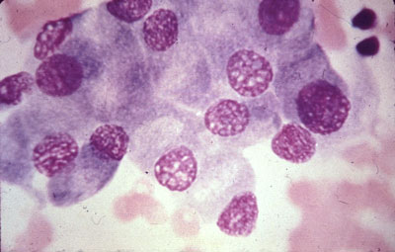
Osteoblastlar
http://www.thecrookstoncollection.com/Collection/medslides/Medslides6.htm

Slide 28
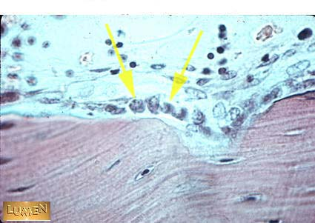
Osteoblast
Osteoblast
Kemik dokusu ve osteoblastlar

Slide 29
Osteocyte
Osteocytes are mostly inactive osteoblasts.
They originate from osteoblasts that have migrated into and become trapped and surrounded by bone matrix that they produced.
The spaces they occupy are known as lacunae.
Osteocytes have many processes that reach out to meet osteoblasts and other osteocytes probably for the purposes of communication
Osteocytes remain in contact with other cells in the bone through gap junctions—coupled cell processes—which pass through small channels in the bone matrix called the canaliculi.

Slide 30
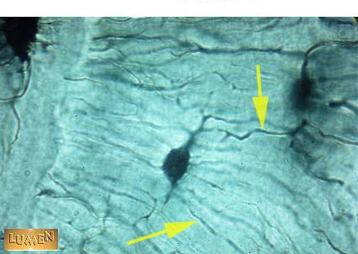
O
Osteocyte, Small channels

Slide 31
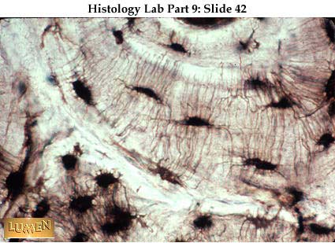
Kemik dokuda konsantrik lameller, osteositler ve kanalcıklar

Slide 32
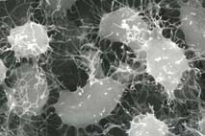
Osteositlerin taramalı elektron mikroskobunda (SEM) görünüşü.
Kemik matriksi EDTA ve KOH ile uzaklaştırılmıştır. x2000

Slide 33
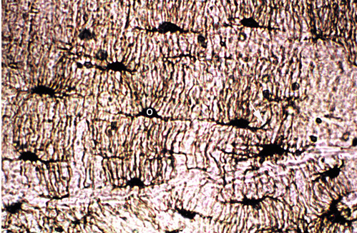
Osteositler

Slide 34
Kemik dokusu

Slide 35
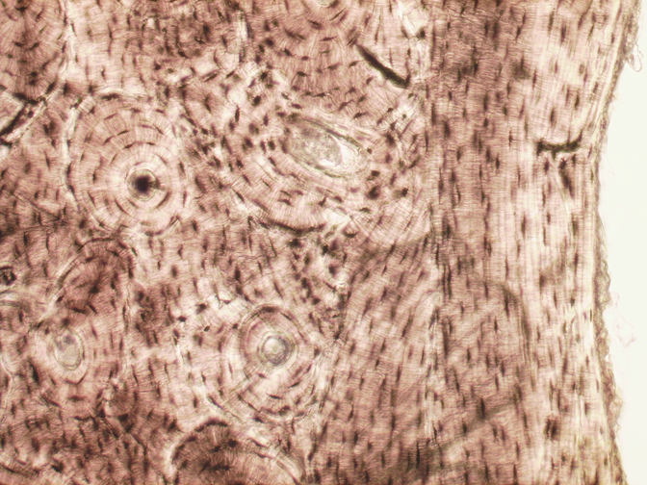
Endosteum
İç halkasal
lameller
Kemik dokusu

Slide 36
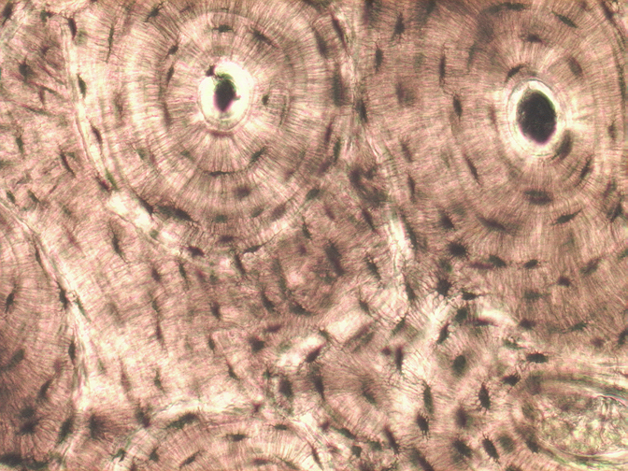
Havers
kanalı
Havers sistemi veya Osteon

Slide 37
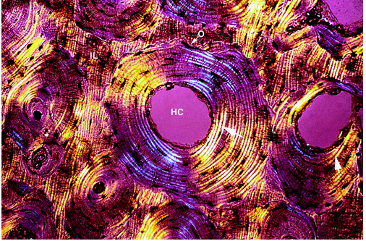
Sert kemik yapısında Osteositler (O), Havers kanalı (HC),
Havers sistemi ve ara lameller (IL)

Slide 38
Osteoclast
Osteoclasts are very large multinucleate cells that are responsible for the breakdown of bones by the process of bone resorption.
New bone is then formed by the osteoblasts.
Bone is constantly remodelled by the resorption of osteoclasts and created by osteoblasts.
Osteoclasts are large cells with multiple nuclei located on bone surfaces in what are called Howship's lacunae
These lacunae are the result of surrounding bone tissue that has been reabsorbed.

Slide 39
Because the osteoclasts are derived from a monocyte stem-cell lineage, they are equipped with phagocytic-like mechanisms similar to circulating macrophages.
Osteoclasts mature and/or migrate to discrete bone surfaces.
Upon arrival, active enzymes, such as tartrate resistant acid phosphatase, are secreted against the mineral substrate.
The reabsorption of bone by osteoclasts also plays a role in calcium homeostasis

Slide 40
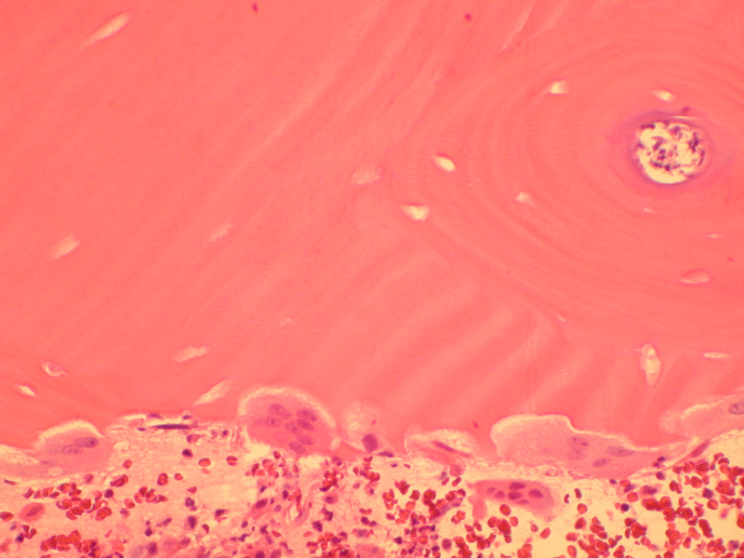
Osteoclast
http://www.sarcoma.org/pathology_review/pathology%2520introduction/source/osteoclast.html

Slide 41
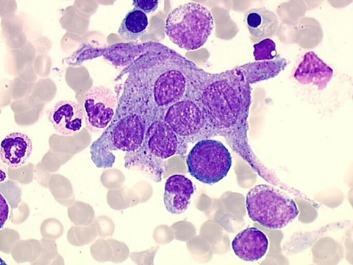
Osteoclast

Slide 42
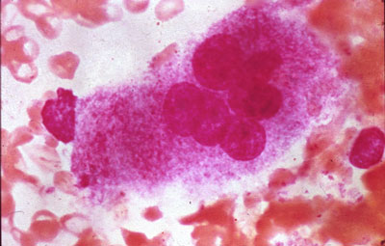
Osteoclast
http://www.thecrookstoncollection.com/Collection/medslides/Medslides6.htm

Slide 43
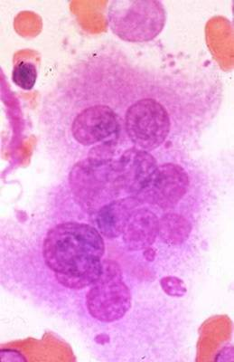
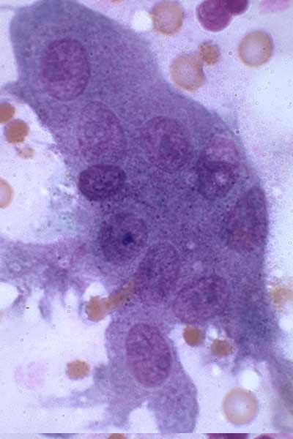
Osteoclast
http://www.thecrookstoncollection.com/Collection/medslides/Medslides6.htm
Osteoclasr with 10 nuclei, x100.
http://mmserver.cjp.com/images/image/2559055.jpg

Slide 44
Deposition
The extracellular matrix of bone is laid down by osteoblasts, which secrete both collagen and ground substance.
These synthesies collagen within the cell, and then secrete collagen fibrils.
The collagen fibres rapidly polymerise to form collagen strands.
At this stage they are not yet mineralised, and are called "osteoid".
Around the strands calcium and phosphate precipitate on the surface of these strands, within a days to weeks becoming crystals of hydroxyapatite.

Slide 45
In order to mineralise the bone, the osteoblasts secrete vesicles containing alkaline phosphatase.
This cleaves the phosphate groups and acts as the foci for calcium and phosphate deposition.
The vesicles then rupture and act as a centre for crystals to grow on.
More particularly, bone mineral is formed from globular and plate structures.

Slide 46
Development
The formation of bone is called ossification.
During the fetal stage of development this occurs by two processes:
intramembranous ossification and
endochondral ossification.
Intramembranous ossification involves the formation of bone from connective tissue whereas
endochondral ossification involves the formation of bone from cartilage.

Slide 47
Kıkırdak içi kemikleşme ve
Epifizyal plak.
Hücre çoğalması PC),
hücre ölümü (D),
kalsifikasyon (PC),
Osteoblast (O)

Slide 48
Kıkırdak içi kemikleşme ve
kireçleşmiş kıkırdak (CC)

Slide 49
Endokondral kemikleşme zonu

Slide 50
Function
Functions of Bone
Mechanical Protection
Gives structure
Facilitates movement
Facilitates hearing
Synthetic
Contains bone marrow
Metabolic
Stores calcium
Helps regulate the acid-base balance

Slide 51
BLOOD TISSUE

Slide 52
In terms of histology, blood is considered a specialized form of connective tissue, originated from bones and the presence of potential molecular fibers in the form of fibrinogen

Slide 53
Blood is a body fluid that delivers nutrients and oxygen to the cells and transports metabolic waste products away from the cells.
In vertebrates, it is composed of blood cells suspended in blood plasma.
The blood cells are mainly
red blood cells (also called RBCs or erythrocytes),
white blood cells (also called WBCs or leukocytes) and
platelets (also called thrombocytes).

Slide 54
The most abundant cells are red blood cells.
These contain hemoglobin, an iron-containing protein, which facilitates oxygen transport by reversibly binding to this respiratory gas and greatly increasing its solubility in blood.
In contrast, carbon dioxide is mostly transported extracellularly as bicarbonate ion transported in plasma.
Vertebrate blood is
bright red when its hemoglobin is oxygenated and
dark red when it is deoxygenated.

Slide 55
Some animals, such as crustaceans and mollusks, use hemocyanin to carry oxygen, instead of hemoglobin.
Insects and some mollusks use a fluid called hemolymph instead of blood, the difference is, hemolymph is not a closed circulatory system.
In most insects, this "blood" does not contain oxygen-carrying molecules such as hemoglobin because their bodies are small enough for their tracheal system for supplying oxygen.

Slide 56
Jawed vertebrates have an adaptive immune system, based largely on white blood cells.
White blood cells function on defense againts infections and parasites.
Platelets are important in coagulation
Arthropods, using hemolymph, have hemocytes as part of their immune system

Slide 57
Blood is circulated around the body through blood vessels by the pumping action of the heart.
In animals with lungs,
Arterial vessels carries oxygen from inhaled air to the tissues
Venous vessels, carries carbon dioxide, a waste product of metabolism produced by cells, from the tissues to the lungs to be exhaled.

Slide 58
Functions of Blood
Supply of oxygen to tissues (bound to hemoglobin, which is carried in red cells)
Supply of nutrients such as glucose, amino acids, and fatty acids (dissolved in the blood or bound to plasma proteins
Removal of waste such as carbon dioxide, urea, and lactic acid
Immunological functions, including circulation of white blood cells, and detection of foreign material antigens by antibodies

Slide 59
Coagulation, the response to damaged blood vessel, the conversion of blood from liquid to semisolid gel to stop bleeding
Messenger functions, including the transport of hormones and the signaling of tissue damage
Regulation of body temperature
Hydraulic functions

Slide 60
Blood accounts for 7% of the human body weight, with an average density around 1060 kg/m³, very close to pure water's density of 1000 kg/m³.
The average adult has a blood volume of roughly 5 litres , which is composed of plasma and cells.
By volume,
the red blood cells constitute about 45% of whole blood,
the plasma about 54.3%, and
white cells about 0.7%.
If all human hemoglobin were free in the plasma rather than being contained in RBCs, the circulatory fluid would be too viscous for the cardiovascular system to function effectively.

Slide 61
One microliter of blood contains:
4.7 to 6.1 million (male), 4.2 to 5.4 million (female) erythrocytes:
Red blood cells contain the blood's hemoglobin and distribute oxygen.
Mature red blood cells lack a nucleus and organelles in mammals.
The red blood cells are marked by glycoproteins that define the different blood types.
The proportion of blood occupied by red blood cells is referred to as the hematocrit, and is normally about 45%.
The combined surface area of all red blood cells of the human body would be roughly 2,000 times as great as the body's exterior surface

Slide 62
4,000–11,000 leukocytes:
White blood cells are part of the body's immune system; they destroy and remove old or aberrant cells and cellular debris, as well as attack infectious agents (pathogens) and foreign substances.
The cancer of leukocytes is called leukemia.
200,000–500,000 thrombocytes:
Also called platelets, they take part in blood clotting (coagulation).
Fibrin from the coagulation cascade creates a mesh over the platelet plug.

Slide 63
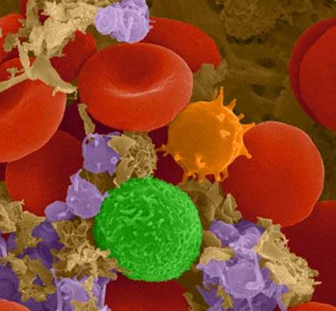
Blood cells in
mamals
SEM, 1.200x
Lymphcyte
Eritrocytes
Monocytes
platalets

Slide 64
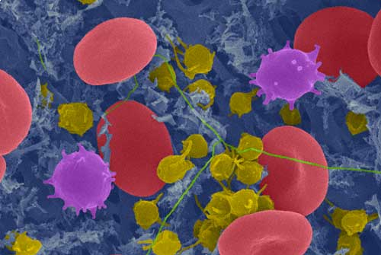
Eritrosit
Lenfosit
Fibrin telleri
Kan
pulcukları
Human blood SEM, 1.200x

Slide 65
Plasma
About 55% of blood is plasma which is blood's liquid medium, and in straw-yellow color.
The blood plasma volume is 2.7–3.0 liters in an average human.
It is essentially an aqueous solution containing;
92% water,
8% blood plasma proteins, and
trace amounts of other materials.

Slide 66
Plasma circulates
dissolved nutrients, such as glucose, amino acids, and fatty acids
dissolved in the blood or bound to plasma proteins, and
removes waste products, such as carbon dioxide, urea, and lactic acid.

Slide 68
Body weight
Blood, 7%
Other tisssues, 92
Plasma, 55%
cells, % 45
Plasma proteins, 7%
Albumin, % 55 (4.5g)
Globuins, % 38 (2.2g)
Alpha %14, Beta %13, Gama %11
Fibrinojen, % 7 (0.3g)
Leucytes
5.000-10.000
Notrophils, % 57-67
Eozinophil, % 1-3
Basophils, % 0-1
Lymphocytes, % 25-33
Monocytes, % 3-7
water, % 91
İnorganic salts, Lipits,
Carbohidrates, Enzymes,
Hormons, Vitamins
Eritrocytes
Male, 5 milion
Female, 4.5 milion
Trombocytes
140.000-340.000
Blood in humans

Slide 69
Other important components include:
Serum albumin
Albumin is the main protein in plasma, and it functions to regulate the colloidal osmotic pressure of blood.
Blood-clotting factors (to facilitate coagulation)
Immunoglobulins (antibodies)
lipoprotein particles
Various other proteins
Various electrolytes (mainly sodium and chloride)
The term serum refers to plasma from which the clotting proteins have been removed.
Most of the proteins are albumin and immunoglobulins.

Slide 70
Major Plasma Proteins
Protein Function
Albumin Maintain colloid osmotic pressure; transport insoluble metabolites
Globulins
α and β Transport metal ions, protein-bound lipids, lipid-soluble vitamins
γ Antibodies for host defense
Complement proteins Destruction of microorganisms
Clotting factors Formation of blood clots
Plasma lipoproteins Transport of triglycerides and cholesterol to/from liver

Slide 71
Formation of Blood Cells
Negative feedback systems regulate the total number of RBCs and platelets in circulation
Abundance of WBC types based of response to invading pathogens or foreign antigens
Hemopoiesis or hemotopoiesis
Red bone marrow primary site
Pluripotent stem cells have the ability to develop into many different types of cells

Slide 73
Stem cells in bone marrow
Reproduce themselves
Proliferate and differentiate
Cells enter blood stream through sinusoids
Formed elements do not divide once they leave red bone marrow
Exception is lymphocytes

Slide 74
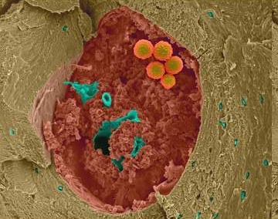
Adult bone marrow stem cell http://www.astrographics.com/GalleryPrints/Display/GP2008.jpg Dennis Kunkel.

Slide 75
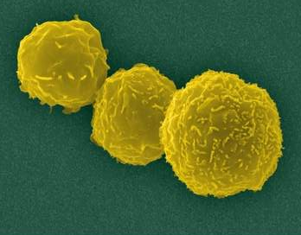
Human adult hemopoietik stem cell
http://www.astrographics.com/GalleryPrints/Display/GP2008.jpg Dennis Kunkel

Slide 76
Erythrocyte
Biconcave disk which has no nucleus
There is about 7.8 µm diameter in fresh state and 7.2 - 7.4 µm in stained smears
Large surface area for gas exchange
4-6 million per mm³
Flexible; squeeze when pass through capillaries
Survive about 120 days in circulation
Old RBC removed by macrophages in spleen and bone marrow
Reticulocytes are about 1% of total population

Slide 77
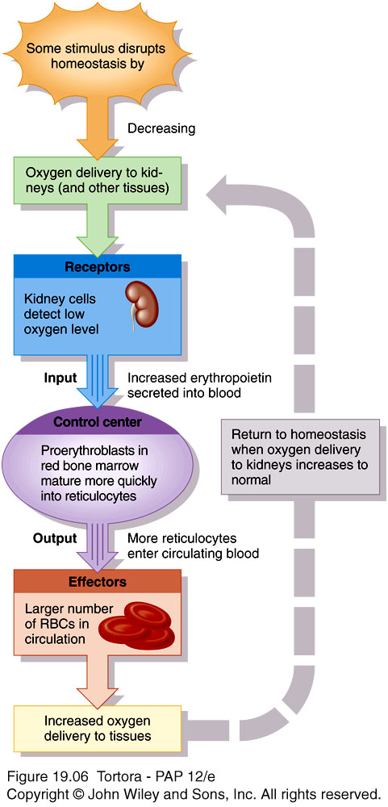
Erythropoiesis
Starts in red bone marrow with proerythroblast
Cell near the end of development ejects nucleus and becomes a reticulocyte
Develop into mature RBC within 1-2 days
Negative feedback balances production with destruction
Controlled condition is amount of oxygen delivery to tissues
Hypoxia stimulates release of erythropoietin

Slide 78
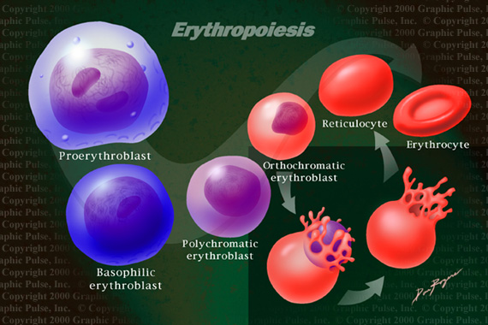
Retikülosit
Eritrosit
Proeritroblast
.
Ortokromatik
Eritroblast
Polikromatofil
Eritroblast
Bazofilik
Eritroblast
. . . . .
Eritropoiez. www231.pair.com/grpulse/ gp/medill/wblood.html

Slide 79
Blood diseases involving the red blood cells include:
Anemias are diseases characterized by low oxygen transport capacity of the blood, because of low red cell count or some abnormality of the red blood cells or the hemoglobin.
Iron deficiency anemia is the most common anemia; it occurs when the dietary intake or absorption of iron is insufficient, and hemoglobin, which contains iron, cannot be formed
Sickle-cell disease is a genetic disease that results in abnormal hemoglobin molecules.
When these release their oxygen load in the tissues, they become insoluble, leading to mis-shaped red blood cells.
These sickle shaped red cells are less deformable and viscoelastic meaning that they have become rigid and can cause blood vessel blockage, pain, strokes, and other tissue damage.

Slide 80
Thalassemia is a genetic disease that results in the production of an abnormal ratio of hemoglobin subunits.
Hereditary spherocytosis syndromes are a group of inherited disorders characterized by defects in the red blood cell's cell membrane, causing the cells to be small, sphere-shaped, and fragile instead of donut-shaped and flexible.
These abnormal red blood cells are destroyed by the spleen.
Several other hereditary disorders of the red blood cell membrane are known.
Pernicious anemia is an autoimmune disease wherein the body lacks intrinsic factor, required to absorb vitamin B₁₂ from food.
Vitamin B₁₂ is needed for the production of hemoglobin.
Aplastic anemia is caused by the inability of the bone marrow to produce blood cells.

Slide 81
Hemolysis is the general term for excessive breakdown of red blood cells.
It can have several causes and can result in hemolytic anemia.
The malaria parasite spends part of its life-cycle in red blood cells, feeds on their hemoglobin and then breaks them apart, causing fever.
Both sickle-cell disease and thalassemia are more common in malaria areas, because these mutations convey some protection against the parasite

Slide 82
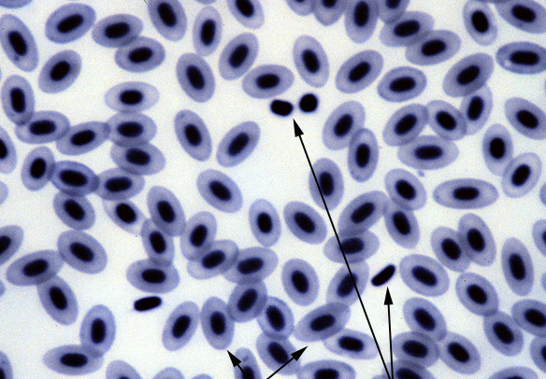
Alabalık kanı. Çekirdekli alyuvarlar ve Trombositler.

Slide 83
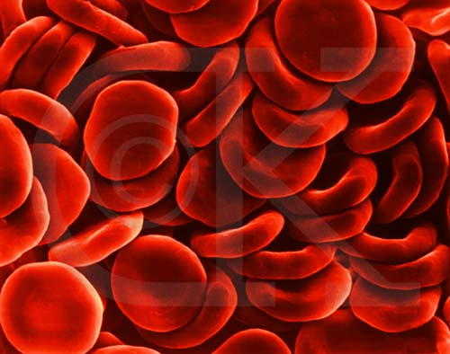
Alyuvarlar (Eritrositler )

Slide 84
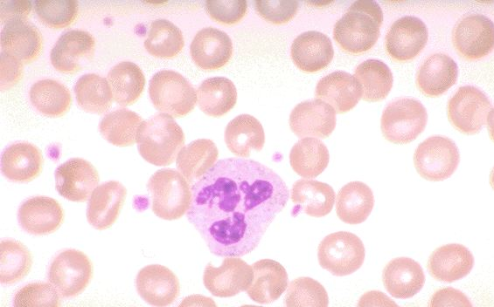
Yayma memeli kan preparatı, eritrositler, nötrofil lökosit ve kan pulcukları

Slide 85
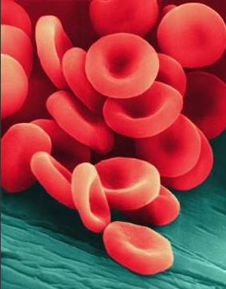
İnsan kılcal damarı (mavi) içinde eritrositler (Kırmızı) http://www.astrographics.com/GalleryPrints/Display/GP2008.jpg
Dennis Kunkel’den

Slide 86
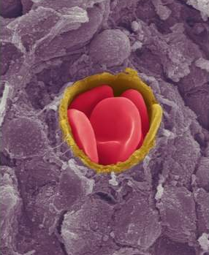
Kılcal damar içinde insan eritrositleri (Kırmızı) ve kan damarı (Sarı). http://www.astrographics.com/GalleryPrints/Display/GP2008.jpg Dennis Kunkel’den

Slide 87
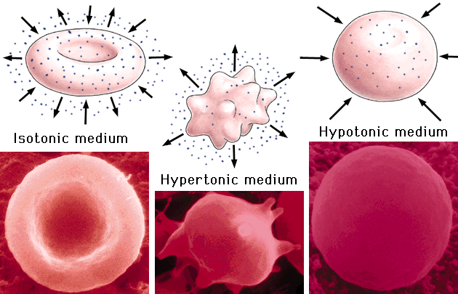
İzotonik ortam
Hipotonik ortam
Hipertonik ortam

Slide 88
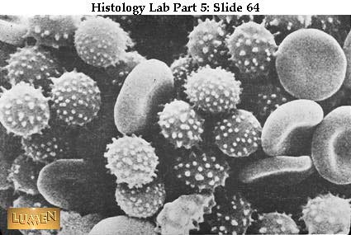
Eritrositler
Hipertonik solüsyonda bikonkav şekilli ve dikensi çıkıntılı eritrositler (SEM)

Slide 89
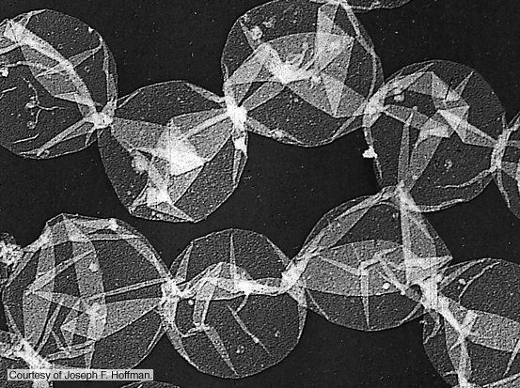
Hemolizle içi boşaltılmış eritrosit zarları

Slide 90
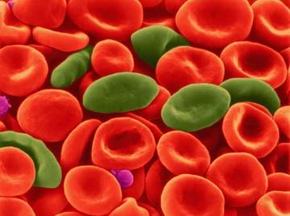
Orak hücre anemisinde eritrositler. Dennis Kunkel’den

Slide 91
White blood cells (WBCs),
Also called leukocytes, are the cells of the immune system that are involved in protecting the body against both infectious disease and foreign invaders.
All white blood cells are produced and derived from multipotent cells in the bone marrow known as hematopoietic stem cells.
Leukocytes are found throughout the body, including the blood and lymphatic system

Slide 92
All white blood cells have nuclei, which distinguishes them from the other blood cells, the anucleated RBCs and platelets.
Two pairs of broadest categories classify them either by structure
granulocytes
agranulocytes)
or by cell division lineage
myeloid cells or
lymphoid cells

Slide 93
These broadest categories can be further divided into the five main types:
neutrophils,
eosinophils (acidophilus),
basophils,
lymphocytes and
monocytes
These types are distinguished by their physical and functional characteristics.
Monocytes and neutrophils are phagocytic.
Further subtypes can be classified; for example, among lymphocytes, there are B cells, T cells, and NK cells.

Slide 94
Granulocytes are distinguished from agranulocytes by their nucleus shape
lobed versus round,
that is, polymorphonuclear versus mononuclear)
and by their cytoplasm granules (present or absent),
or more precisely, visible on light microscopy or not thus visible.
The other dichotomy is by lineage:
Myeloid cells (neutrophils, monocytes, eosinophils and basophils) are distinguished from
lymphoid cells (lymphocytes) by hematopoietic lineage (cellular differentiation lineage).

Slide 95
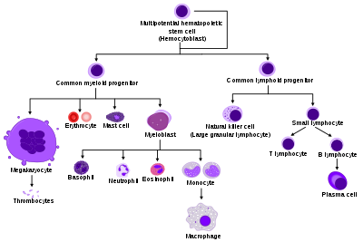

Slide 96
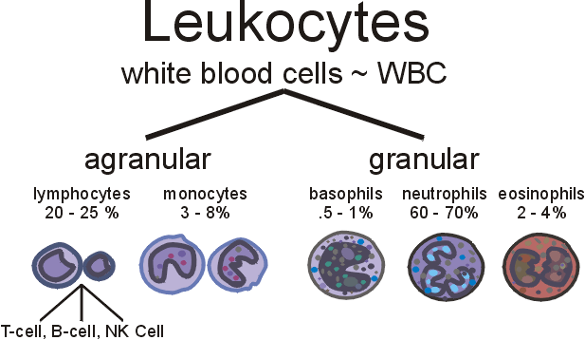

Slide 97
The number of leukocytes in the blood is often an indicator of disease, and thus the WBC count is an important subset of the complete blood count.
The normal white cell count is usually between 4 × 10⁹/L and 1.1 × 10¹⁰/L.
In the US, this is usually expressed as 4,000 to 11,000 white blood cells per microliter of blood.
They make up approximately 1% of the total blood volume in a healthy adult
However, this 1% of the blood makes a large difference to health, because immunity depends on it.

Slide 98
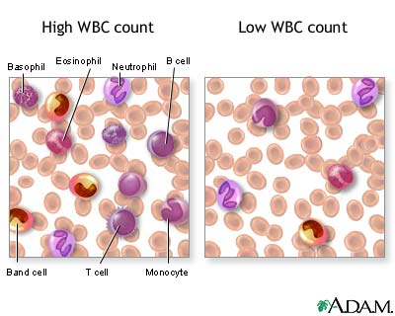

Slide 99
An increase in the number of leukocytes over the upper limits is called leukocytosis.
It is normal when it is part of healthy immune responses, which happen frequently.
It is occasionally abnormal, when it is neoplastic or autoimmune in origin.
A decrease below the lower limit is called leukopenia.
This indicates a weakened immune system.

Slide 100
Neutrophils
Neutrophils are the most abundant white blood cell, constituting 60-70% of the circulating leukocytes.
They defend against bacterial or fungal infection.
They are usually first responders to microbial infection; their activity and death in large numbers form pus.
They are commonly referred to as polymorphonuclear (PMN) leukocytes, although, in the technical sense, PMN refers to all granulocytes.

Slide 101
They have a multi-lobed nucleus, which consists of three to five lobes connected by slender strands.
This gives the neutrophils the appearance of having multiple nuclei, hence the name polymorphonuclear leukocyte.
The cytoplasm may look transparent because of fine granules that are pale lilac when stained.

Slide 102
Neutrophils are active in phagocytosing bacteria and are present in large amount in the pus of wounds.
These cells are not able to renew their lysosomes (used in digesting microbes) and die after having phagocytosed a few pathogens.
Neutrophils are the most common cell type seen in the early stages of acute inflammation.
The life span of a circulating human neutrophil is about 5.4 days.

Slide 103
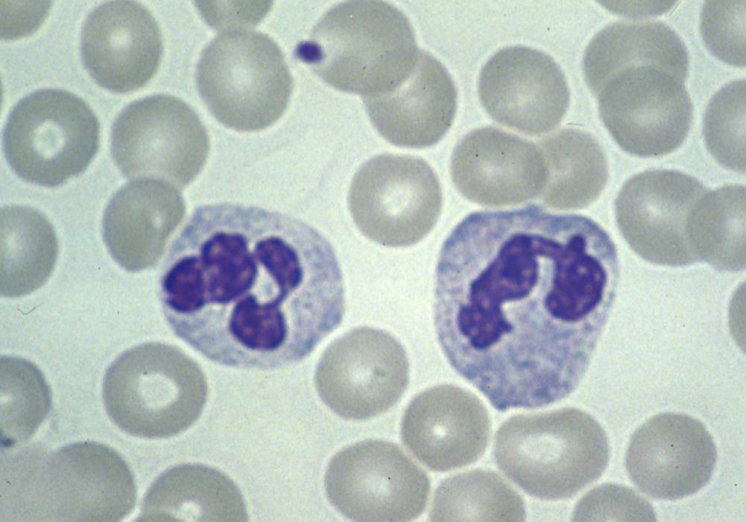
E
E
Nötrofil lökositler ve eritrositler

Slide 104
Nötrofil lökositler ve Eritrositler

Slide 105
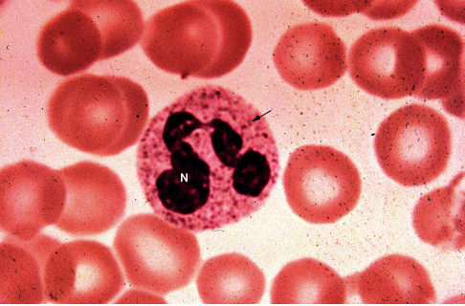
Memelilerde nötrofil lökosit, çok loplu çekirdeği ve sitoplazmasında granüller (Ok).

Slide 106
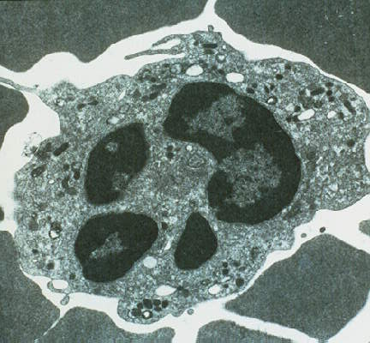
Nötrofil lökosit (TEM)

Slide 107
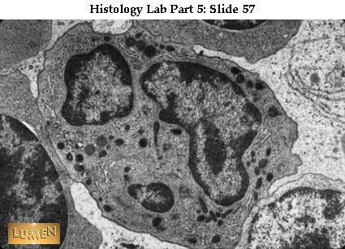
Nötrofil lökosit, çok loplu çekirdeği ve sitoplazmasında lizozomlar, TEM.

Slide 108
Eosinophil
Eosinophils compose about 2-4% of the WBC total.
This count fluctuates throughout the day, seasonally, and during menstruation.
It rises in response to allergies, parasitic infections, collagen diseases, and disease of the spleen and central nervous system.
They are rare in the blood, but numerous in the mucous membranes of the respiratory, digestive, and lower urinary tracts.
They primarily deal with parasitic infections.
Eosinophils are also the predominant inflammatory cells in allergic reactions.

Slide 109
The most important causes of eosinophilia include allergies such as asthma, hay fever, and hives; and also parasitic infections.
They secrete chemicals that destroy these large parasites, such as hook worms and tapeworms, that are too big for any one WBC to phagocytize.
In general, their nucleus is bi-lobed.
The lobes are connected by a thin strand.
The cytoplasm is full of granules that assume a characteristic pink-orange color with eosin staining

Slide 110
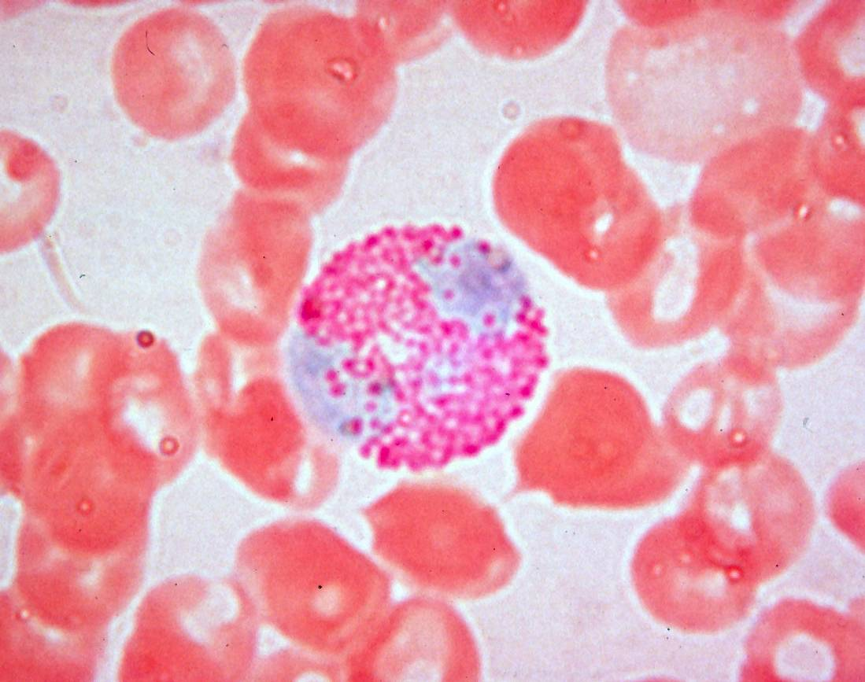
Eritrosit
Eozinofil lökosit ve eritrositler

Slide 111
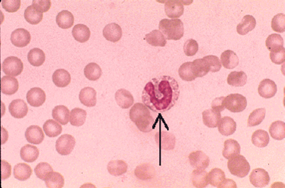
Köpek kanı yayma preparat.
Eritrositler arasında bir eozinofil lökosit (Ok). x 1000.

Slide 112
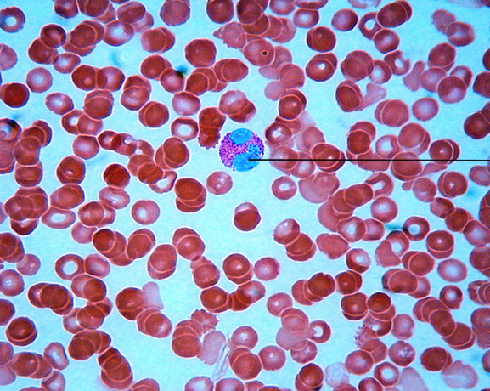
E
Eozinofil
lökosit
E
İnsan kanında eozinofil lökosit ve eritrositler, x1.000
http://blc1.kilgore.cc.tx.us/ kcap2/practical_2.htm

Slide 113
Eozinofil lökosit ve eritrositler
E
E

Slide 114
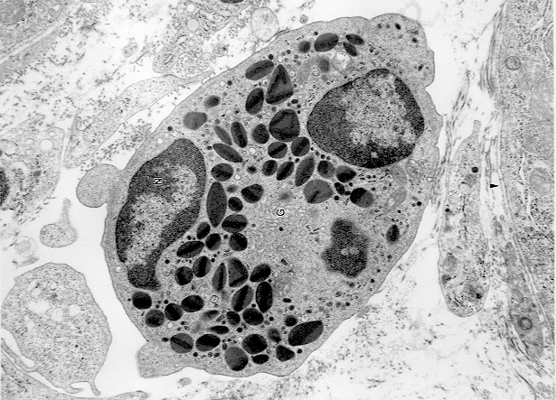
Ç
Eozinofil lökosit ve granülleri içinde kristaloit yapılar

Slide 115
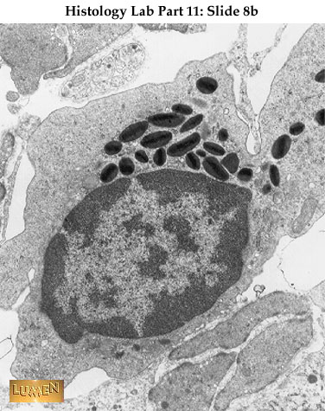
Eozinofil lökosit ve granülleri içinde kristaloit yapılar (TEM)
Eozinofil
Lökosit

Slide 116
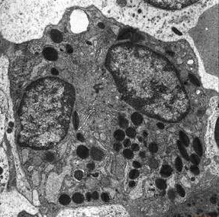
Eozinofil lökosit ve granülleri içinde kristaloit yapılar (TEM)

Slide 117
Basophil
Basophils are chiefly responsible for allergic and antigen response by releasing the chemical histamine causing the dilation of blood vessels.
Because they are the rarest of the white blood cells (less than 0.5% of the total count) and share physicochemical properties with other blood cells, they are difficult to study.
They can be recognized by several coarse, dark violet granules, giving them a blue hue.
The nucleus is bi- or tri-lobed, but it is hard to see because of the number of coarse granules that hide it.

Slide 118
They excrete two chemicals that aid in the body's defenses: histamine and heparin.
Histamine is responsible for widening blood vessels and increasing the flow of blood to injured tissue.
It also makes blood vessels more permeable so neutrophils and clotting proteins can get into connective tissue more easily.
Heparin is an anticoagulant that inhibits blood clotting and promotes the movement of white blood cells into an area.
Basophils can also release chemical signals that attract eosinophils and neutrophils to an infection site.

Slide 119
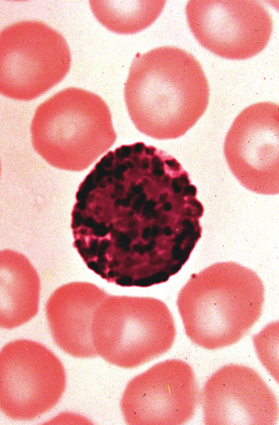
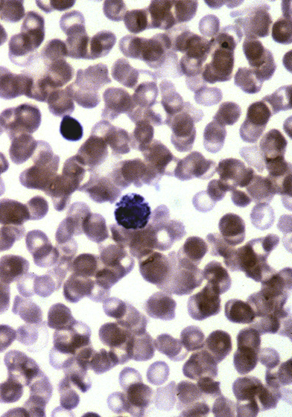
Bazofil lökosit ve granülleri

Slide 120
Bazofil lökosit
(TEM)

Slide 121
Lymphocytes
Lymphocytes are the cells that specifically recognize and respond to foreign antigens and are therefore the mediators of humoral and cellular immunity.
There are distinct subpopulations of lymphocytes that differ in how they recognize antigens and in their functions

Slide 122
Lymphocytes are much more common in the lymphatic system than in blood.
Lymphocytes are distinguished by having a deeply staining nucleus that may be eccentric in location, and a relatively small amount of cytoplasm.
Lymphocytes include:
B Lymphocytes(B cells)
T Lymphocytes (T cells)

Slide 123
B lymphocytes
make antibodies that can bind to pathogens block pathogen invasion, activate the complement system, and enhance pathogen destruction.
Are the only cells capable of producing antibodies.
They recognize extracellular soluble and cell surface antigens,
They differentiate into antibody-secreting plasma cells,
Functioning as the mediators of humoral immunity.

Slide 124
T lymphocytes
The cells of cell-mediated immunity,
Recognize the antigens of intracellular microbes
either help phagocytes to destroy these microbes or they kill the infected cells.
T cells do not produce antibody molecules.
Their antigen receptors are membrane molecules distinct from but structurally related to antibodies
T lymphocytes have a restricted specificity for antigens; they recognize peptides derived from foreign proteins that are bound to host proteins called major histocompatibility complex (MHC) molecules, which are expressed on the surfaces of other cells.
T cells recognize and respond to cell surface–associated but not soluble antigens

Slide 125
T lymphocytes consist of functionally distinct populations,
helper T cells
displaying co-receptor CD4 are known as CD4+ T cells
In response to antigenic stimulation, helper T cells secrete cytokines, which are responsible for many of the cellular responses of innate and adaptive immunity and thus function as the “messenger molecules” of the immune system.
The cytokines secreted by helper T lymphocytes stimulate the proliferation and differentiation of the T cells themselves and activate other cells, including B cells, macrophages, and other leukocytes.

Slide 126
cytotoxic T lymphocytes (CTLs)
displaying co-receptor CD8 are known as CD8+ T cells.
CTLs kill cells that produce foreign antigens, such as cells infected by viruses and other intracellular microbes.
Some T lymphocytes, which are called regulatory T cells, function mainly to inhibit immune responses.

Slide 128
E
E
Lenfositler ve Eritrositler

Slide 129
L
E
Amazon papağanında çekirdekli eritrositler ve lenfositler

Slide 130
İnsan T Lenfositi
http://www.astrographics.com/GalleryPrints/Display/GP2008.jpg Dennis Kunhel’den.

Slide 131
Lenfosit
(TEM)

Slide 132
Lenfositler (TEM)

Slide 133
Monocyte
Monocytes, the largest type of WBCs, share the phagocytosis function of neutrophils, but are much longer lived as they have an extra role:
they present pieces of pathogens to T cells so that the pathogens may be recognized again and killed.
This causes an antibody response to be mounted.
Monocytes eventually leave the bloodstream and become tissue macrophages, which remove dead cell debris as well as attack microorganisms.

Slide 134
Neither dead cell debris nor attacking microorganisms can be dealt with effectively by the neutrophils.
Unlike neutrophils, monocytes are able to replace their lysosomal contents and are thought to have a much longer active life.
They have the kidney shaped nucleus and are typically agranulated.
They also possess abundant cytoplasm

Slide 135
In adults, cells of the macrophage lineage arise from committed precursor cells in the bone marrow, driven by a protein called monocyte (or macrophage) colony-stimulating factor (M-CSF).

Slide 136
Some leucocytes migrate into the tissues of the body to take up a permanent residence at that location rather than remaining in the blood.
Often these cells have specific names depending upon which tissue they settle in, such as fixed macrophages in the liver, which become known as Kupffer cells
These cells still serve a role in the immune system.

Slide 137
Histocytes
Dendritic cells (Although these will often migrate to local lymph nodes upon ingesting antigens)
Mast cells
Microglia

Slide 138
Monositler

Slide 139
Nötrofil Lökosit
Lenfosit
Monosit

Slide 140
Eritrositler, Nötrofil lökosit, Bazofil lökosit, Eozinofil lökosit, Monosit, Trombosit.

Slide 141
Monosit

Slide 142
Monosit

Slide 143
Monosit

Slide 144
Platelets (thrombocytes)
Mammalian platelets are pitted, small and colorless cytoplasmic particles
It protects the organism against excessive blood loss by providing blood to clot in the blood vessels in the damaged areas.
They may be round, oval, biconvex discs or flat shapes.
The sizes of platelets are 2-3 μm.
There is about 150 000-350 000 in 1 mm3 blood in humans.

Slide 145
Platelets have no cell nucleus: they are fragments of cytoplasm that are derived from the megakaryocytes of the bone marrow, which then enter the circulation.
Activated platelets have cell membrane projections covering their surface.
Platelets are found only in mammals, whereas in other vertebrates (e.g. birds, amphibians) thrombocytes circulate as intact mononuclear cells

Slide 146
Lökosit
Eritrosit
Kan pulcukları

Slide 147
Alligator kanı,
yayma preparat. x1.000
Çekirdekli eritrositler
Monosit
Trombositler

Slide 148
Megakaryosit (Kemik iliği)

Slide 149
Megakaryosit

