Slide 1
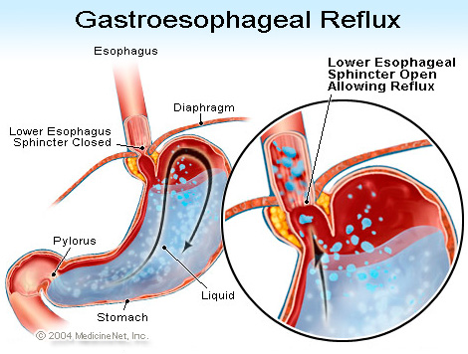
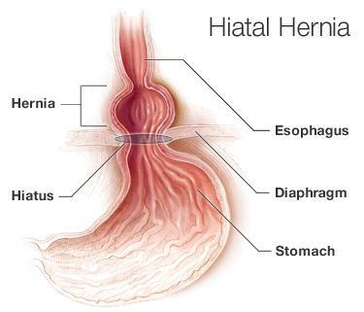

Slide 2
heartburn
Where?
When? Postprandial / Nocturnal
≥ 2 days / week and ≥ 3 months ⇨⇨ GERD
Difficulty swallowing, pain and/or bleeding ⇨⇨ medical ref!!
complications?
Aspiration, asthma, chronic laryngitis, hoarseness, caugh, feeling lump in throat, dental issues, sleep apnea
GERD-related chest pain is similar to ischemic heart disease

Slide 3
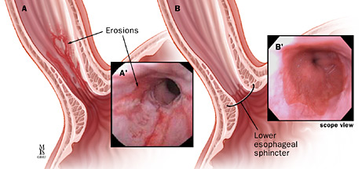
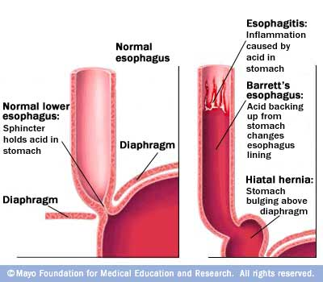
GERD Complications
Erosive esophagitis
Barrett’s esophagus (precancerous)

Slide 4
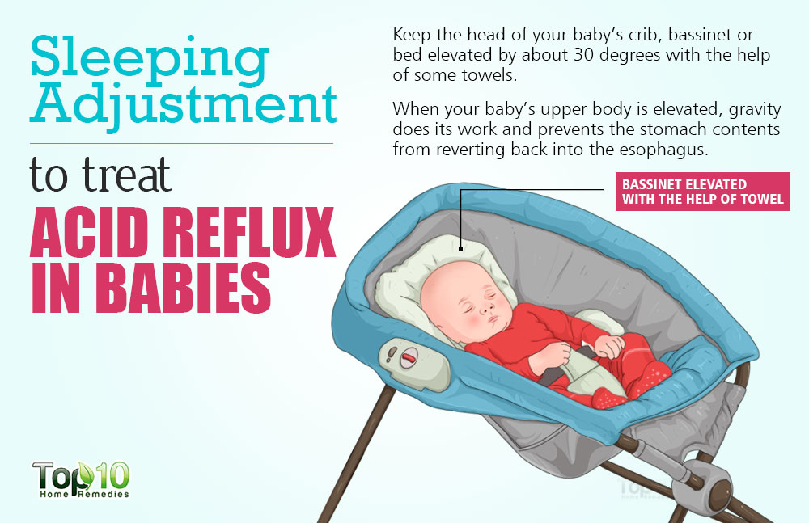
Feed baby in an upright position
Hold upright for 20 minutes to 30 minutes after each feed
Try giving your baby smaller, but more frequent, feeds
If bottle-feeding, burp him every two minutes or three minutes during feeds, and make sure that the hole in the teat isn't too large. A teat that's too big can cause milk to come out too fast
https://www.babycentre.co.uk/a567208/reflux#ixzz4uVtcTrtl

Slide 5
Dispepsia (bad digestion)
Discomfort around epigastrum, constant or repetitive
Subjective, not pain-like more bloated, fullness, sometimes nausea
Associated with alcohol, smoking, stress
GERD, gastric cancer, H. pylori infection, GI dysmotility
Drugs: NSAID, bisphosphonates, supplements containing Fe or K, some Abs

Slide 6
Fatty food, fried food, spices
Food with high acid (tomato, citrus, caffeine)
Alcohol
Tight clothing
SMOKING!!
High BMI
Elevate head
Stop eating/drinking before 3 hrs bedtime
OTC DRUGS, AOB

Slide 7
ANTACIDS / Drugs for heartburn
Bases that neutralize gastric acid
Gastric pH>5 ⇨⇨ inhibit pepsine activation
Stimulate PG synthesis
No absoption except sodium bicarbonate
Used for peptic ulcer, no longer
H2 receptor blockers and PPI
Symptomatic relief for heartburn, but
no study that report efficacy
OTC DRUGS, AOB

Slide 8
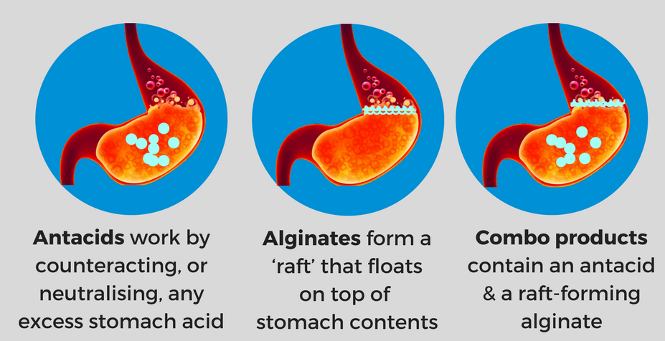
Aim should be treatment, not only symptomatic relief
prn (pro re nata) in OTC setting
Tb or liquid
½ - 1 hr after meals or before bedtime
Antacids that contain alginic acid (Gaviscon®) are claimed to reduce heartburn
: bind to bicarbonate in saliva for sodium-alginate which –in theory- creates a physical barrier
OTC DRUGS, AOB

Slide 9
Adverse effects
Al-salts constipation, Mg-salts diarrhea ⇨⇨ drug combination
MAY interact with absorption of other drugs by altering gastric pH
OTC DRUGS, AOB

Slide 10
Aluminum
Usually combined with other antacids
Alcacyl®, Bismomagnesie®, Gaviscon®,
Kompensan®
May bind some other drugs
(FQ, tetracyclines, warfarin, digoxin)
Also binds pepsin
Magnesium
Magnesie Calcinee®, Magcar®, Rennie®
Magnesium hydroxide is laxative
OTC DRUGS, AOB

Slide 11
Calcium
Gaviscon®, Rennie®
Long lasting and effective
Induces acid secretion
Constipation (reduced by added Mg)
CO₂ release ⇨⇨ bloating ☺
Sodium bicarbonate
Gaviscon®
Fast relief, short lasting
CO₂ release
Na absorption : hypertension, HF
May induce alcalosis
OTC DRUGS, AOB

Slide 12
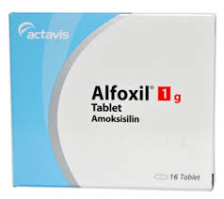
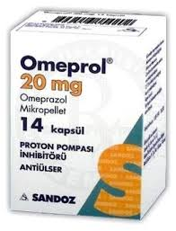

Slide 13
PEPTIC ULCER

Slide 14
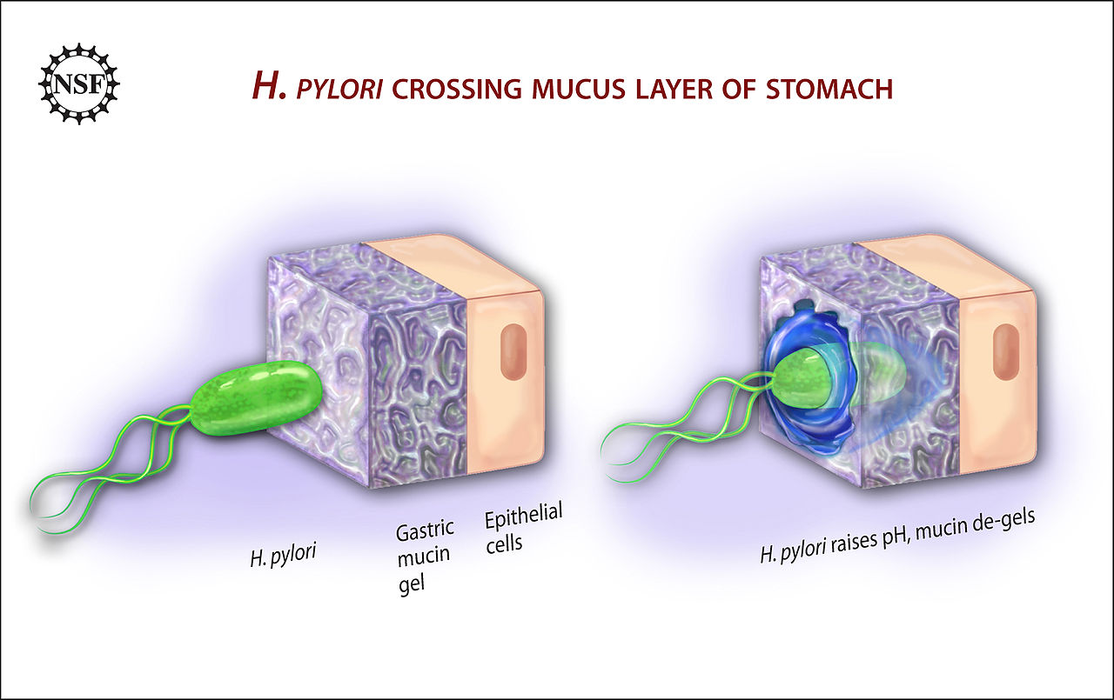
AGA
Introducing…..

Slide 15
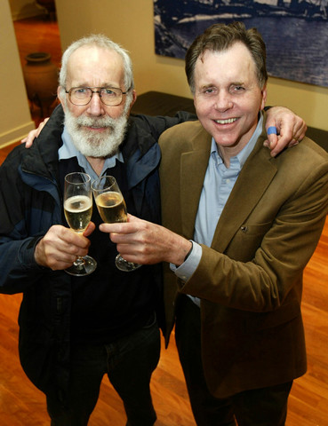
The Nobel Prize in
Physiology / Medicine 2005
Barry J. Marshall and J. Robin Warren
for their discovery of
"the bacterium Helicobacter pylori
and its role in gastritis and peptic ulcer disease"

Slide 16
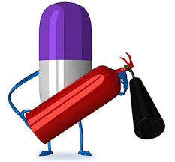
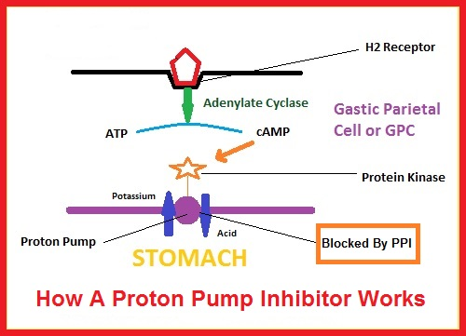
Pharmacologic
American Gastroenterological Association;
One PPI, antibiotics

Slide 17
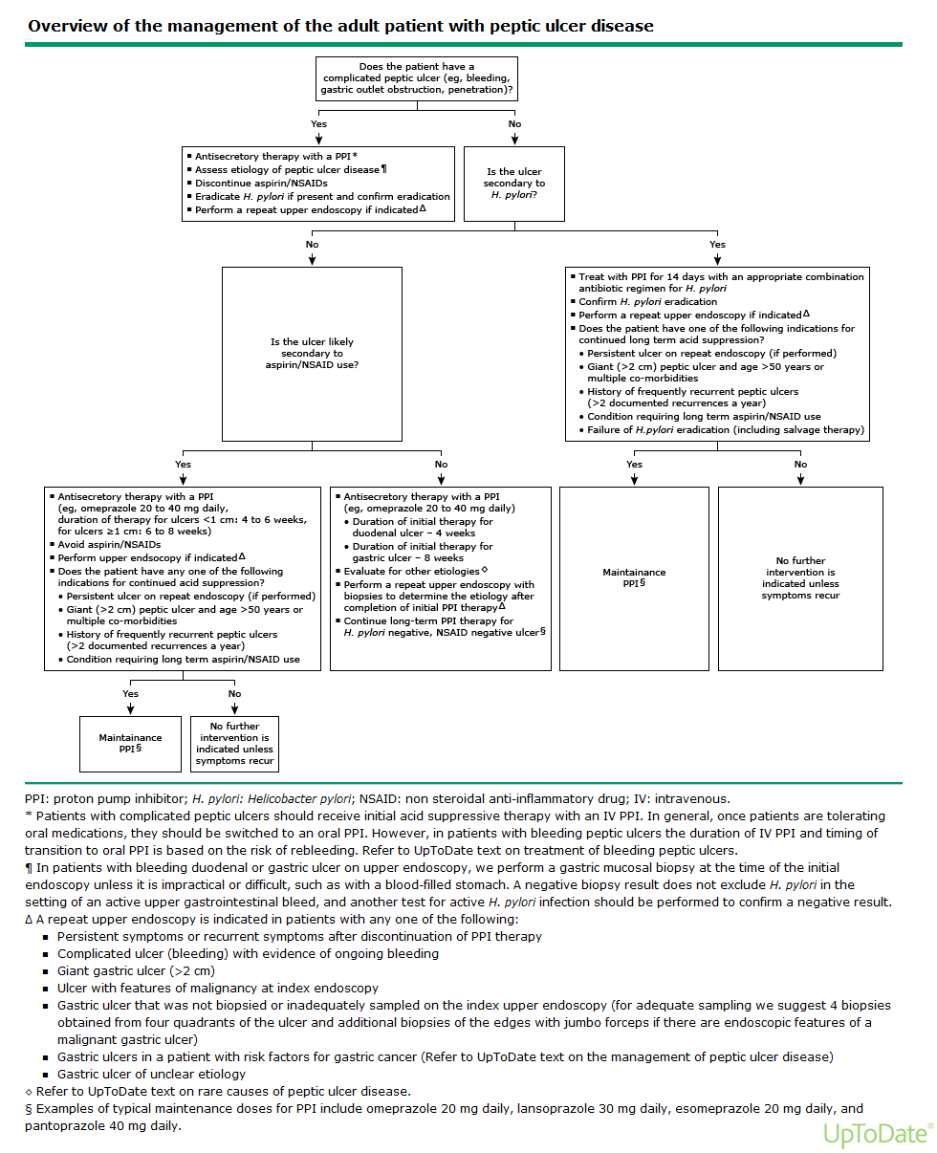
https://www.uptodate.com/contents/peptic-ulcer-disease-treatment-and-secondary-prevention

Slide 18
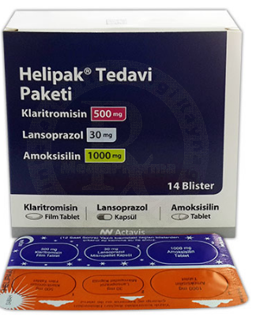
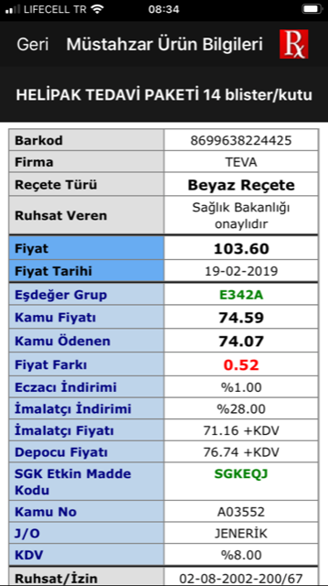
Initiation
Triple , 14 days
Penicillin allergy
metronidazole, 500mg bid

Slide 19
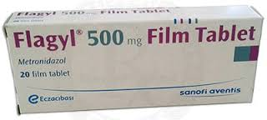

Slide 20
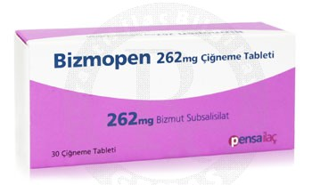
Quadruple Therapy
14 days
PPI
Bismuth subsalicylate
Metronidazole
Tetracycline
Non-Bizmuth Quadruple Therapy
1. PPI
2. amoxycillin
3. metronidazole
4. clariythromycin

Slide 21
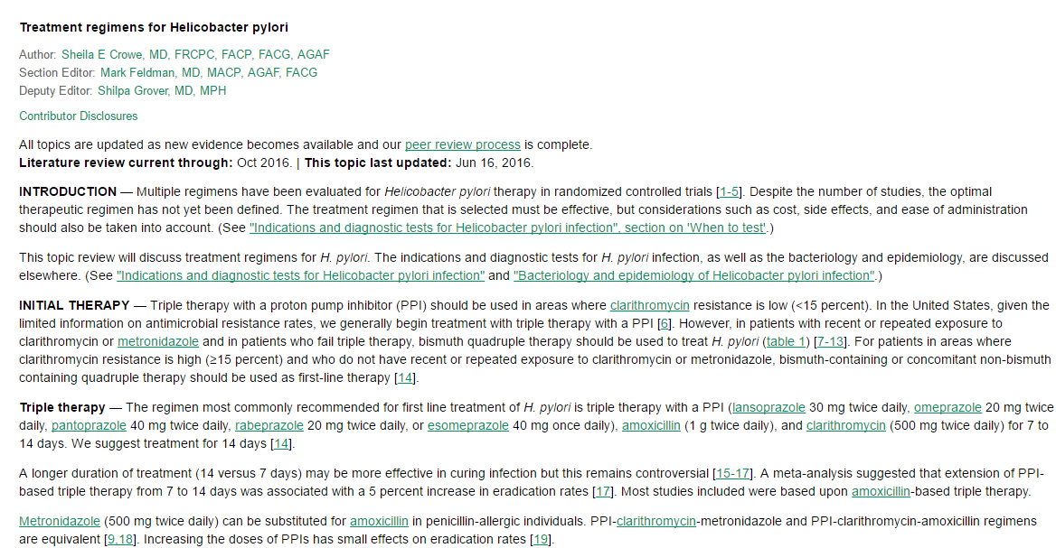
Multiple regimens have been evaluated…
Optimal yet not defined….

Slide 22
Clarithromycin remains as the most effective ab
azithromycin or erythromycin may not be substituted for clarithromycin

Slide 23
To enhance efficiency;
Omeprazol, 1 hour before meal
Antibiotics with meals, if nausea and dyspepsia

Slide 24
Reflux during pregnancy

Slide 25
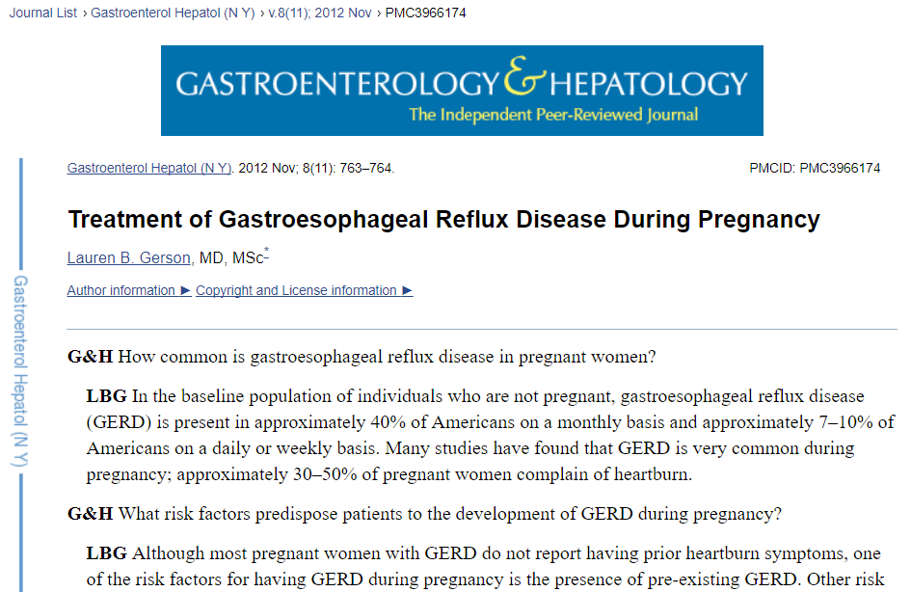
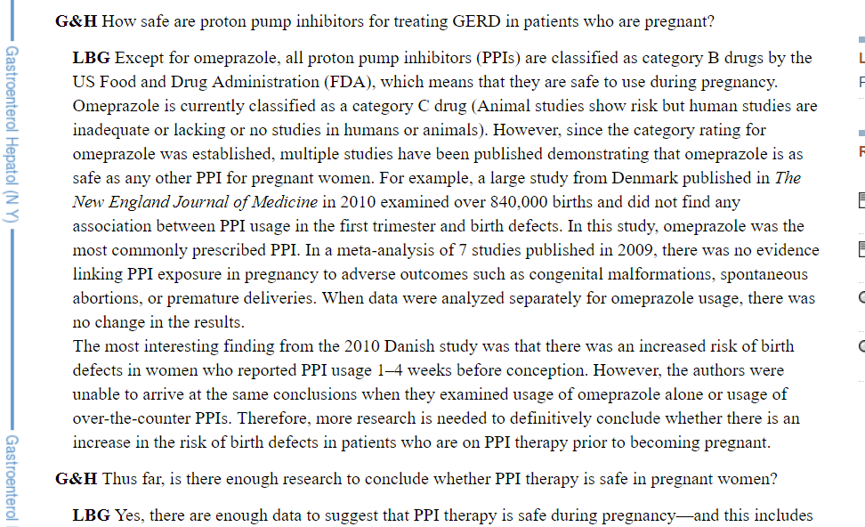

Slide 26
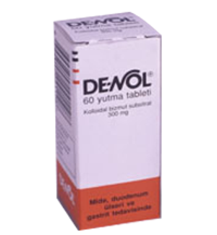
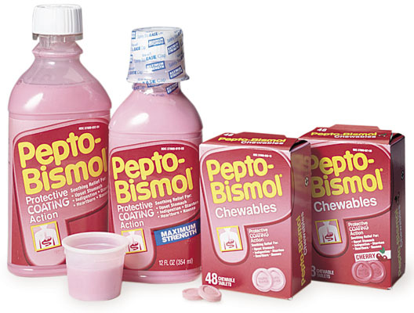
Bismuth Subsalicylate
Bismuth Subgallate
Bismuth compounds damage H.pylori
Cell Wall ⇨ lysis
Black discoloration in mouth and feces
Warn patients
Many drugs in other countries
Only colloidal bismuth subcitrate in
Turkey (De-Nol® tb)
Bismuth subsalicylate (Bizmopen®) tb.
in diarrhea
Bismuth subgallate, «wound powder»
OTC DRUGS, AOB

Slide 27
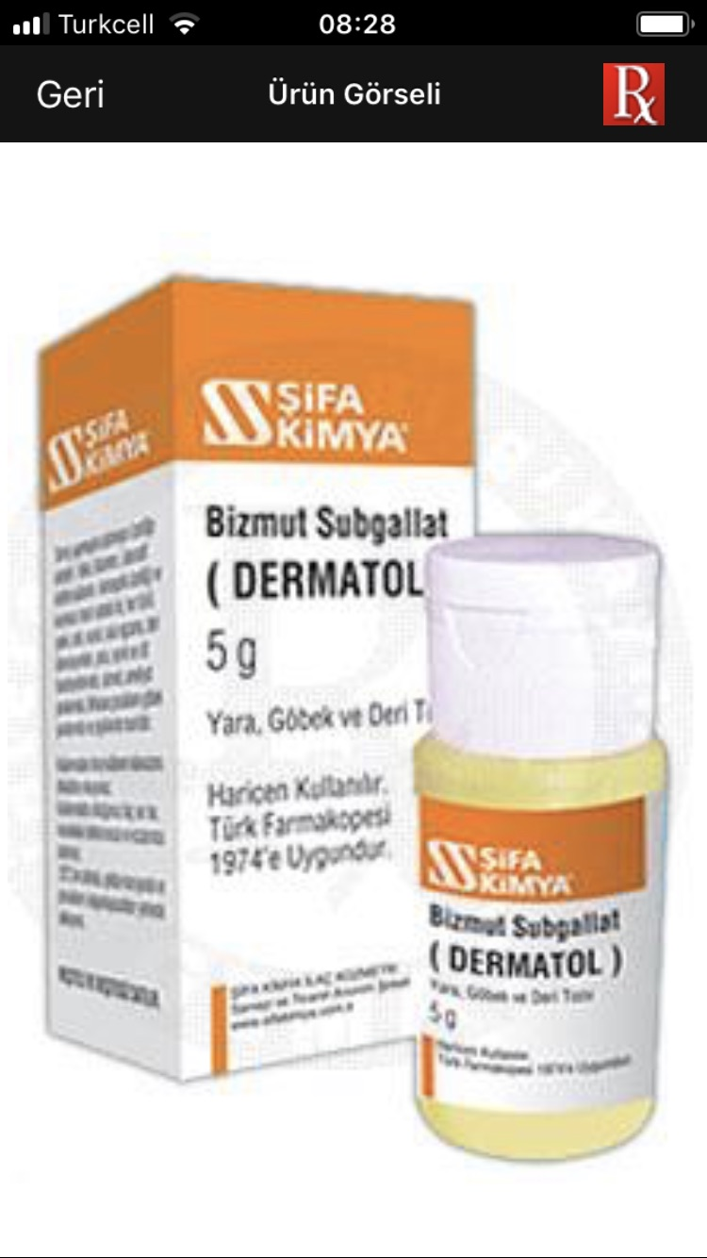
Bismuth subgallate

Slide 28
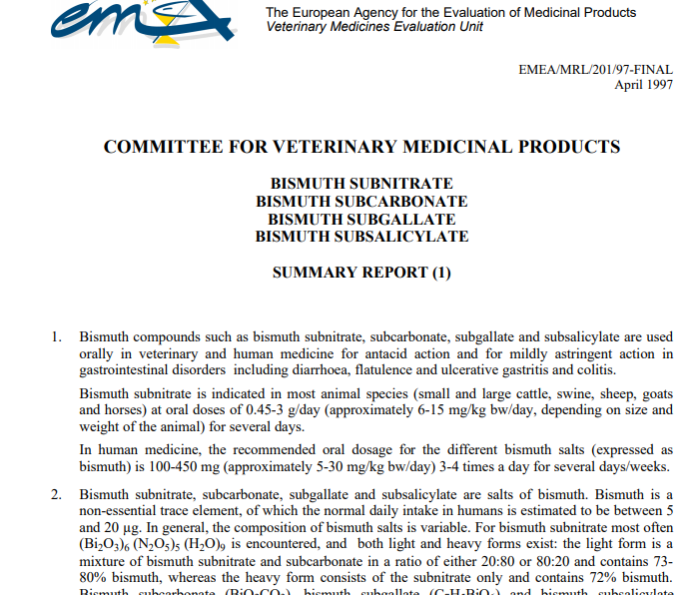

Slide 29
H₂ RB
Ranitidine
Famotidine
Nizatidine
Cimetidine
Most frequently prescribed drugs 1970-1990
Antibiotics and PPIs lowered their use
OTC DRUGS, AOB

Slide 30
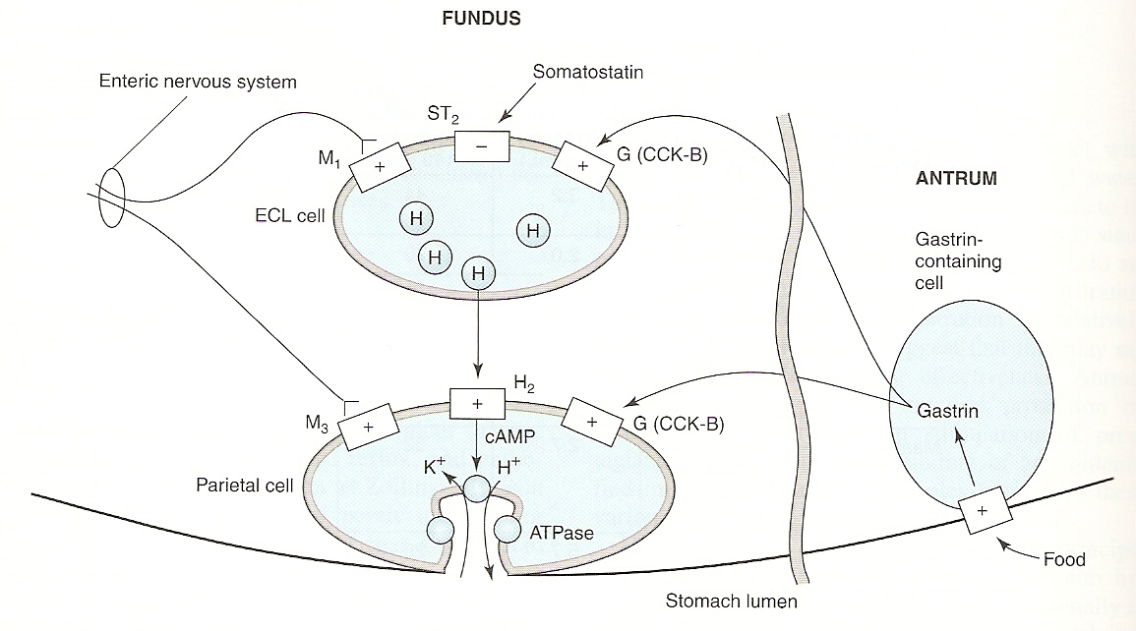
2
1
2
Reduce 24-hrs acid secretion by 60-70%
Supress mainly nocturnal acid
(90%, histamine)
Less effective for postprandial acid
(60-80%, gastrin+Ach+histamine)

Slide 31
Adverse
Very safe drugs
Diarrhea/constipation/headache/fatigue/
Myalgia in 3% of patients
Cimetidine, DHT receptor antagonist…and
an inhibitor of CYP450
All pass through placenta
Category B for pregnancy
OTC DRUGS, AOB

Slide 32
Omeprazole, Esomeprazole, Lansoprazole,
Pantoprazole
VERY effective in suppressing acid
Inhibit last point in acid release:
H⁺-K⁺ ATPase
One dose lowers acid secretion by 97%
Irreversible effect lasts until new enzymes
are synthesized (partial 3-5 days, several
weeks)
OTC DRUGS, AOB

Slide 33
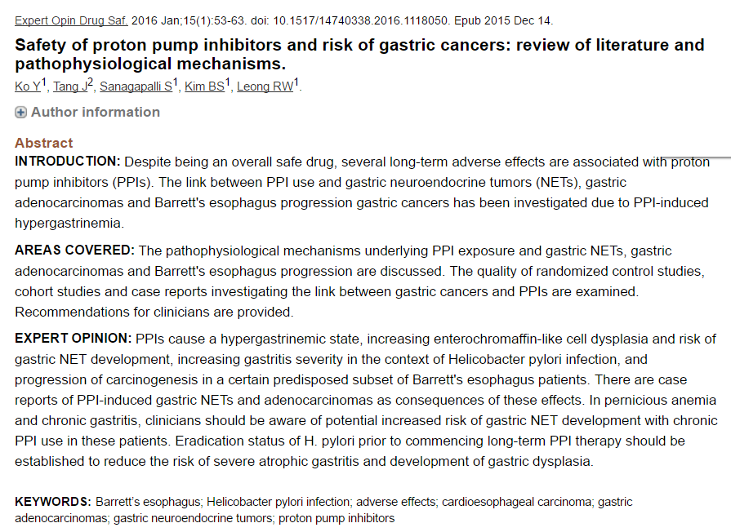

Slide 34
Treatment should be limited to
4-8 weeks
Minor adverse effects of H₂ blockers
may be seen with PPIs
Chronic suppression of acid secretion may
induce gastric epithelial hyperplasia
OTC use:
14 days
20 mg omeprazole before breakfast
for patients with > 2 reflux

OTC DRUGS, AOB

Slide 35
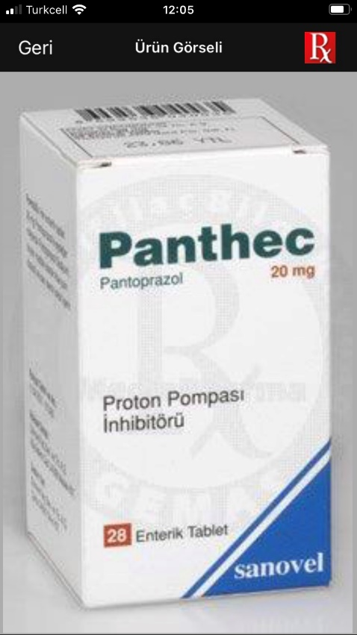
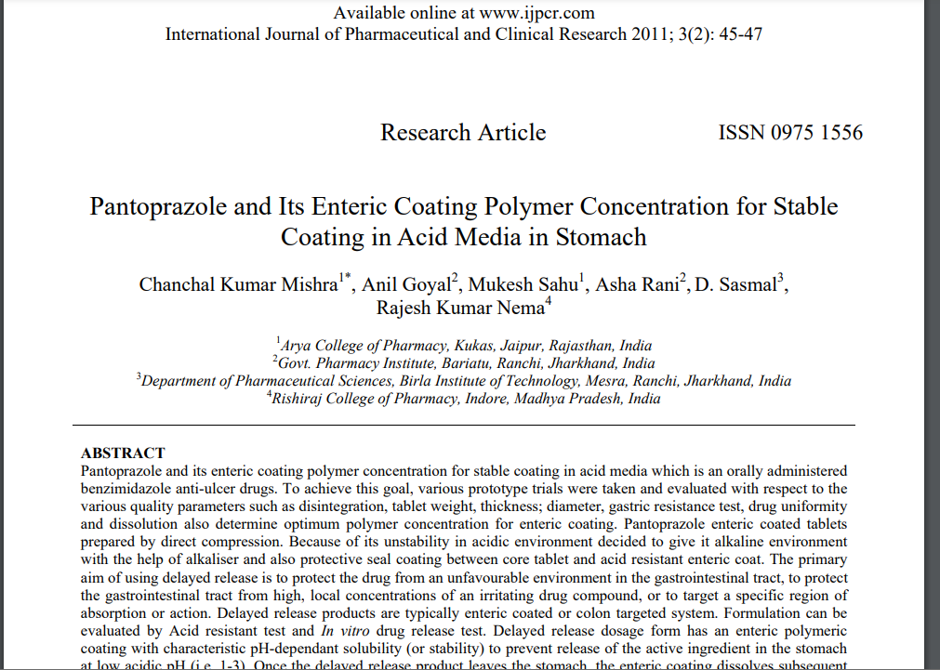
«Enteric coated»

Slide 36
Reflux treatment
Drug | Effective in | How long?
Antacids | <5’ | 20-30’
H₂RAs | 30-45’ | 4-10 sa
H₂RA + antacid | <5’ | 8-10 sa
PPI | 2-3 hrs | 12-24 hrs
Combining PPIs and H2RAs adds to cost without enhancing healing.
Although antacids and sulralfate can heal duodenal ulcers, they are not routinely recommended to treat peptic ulcers as PPIs heal ulcers more rapidly and to a greater extent.

