Slide 1
Mesleki Yabancı Dil 2

Slide 2
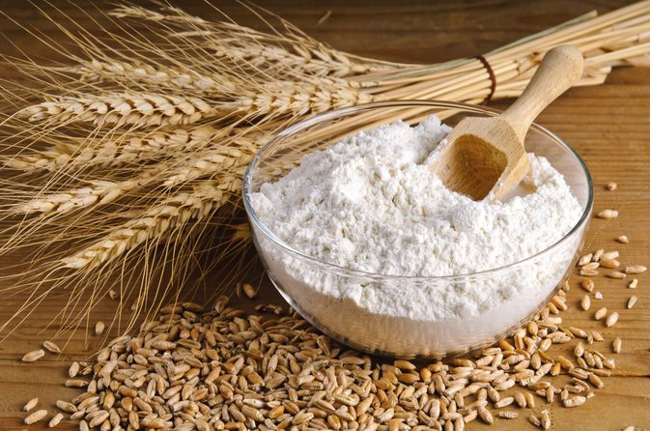
MEAT
FLOUR
Mix the flour, sugar and …
Notes:
The flesh of an animal (especially a mammal) as food.
A powder obtained by grinding grain, typically wheat, and used to make bread, cakes, and pastry

Slide 3
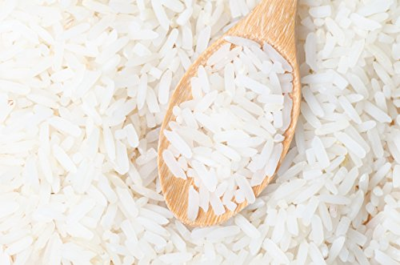
Pomegranate
(Pamıgrenıd
Pamgrenıd)
Rice
Notes:
is an orange-sized fruit with a tough reddish outer skin and sweet red gelatinous flesh containing many seeds.

Slide 4
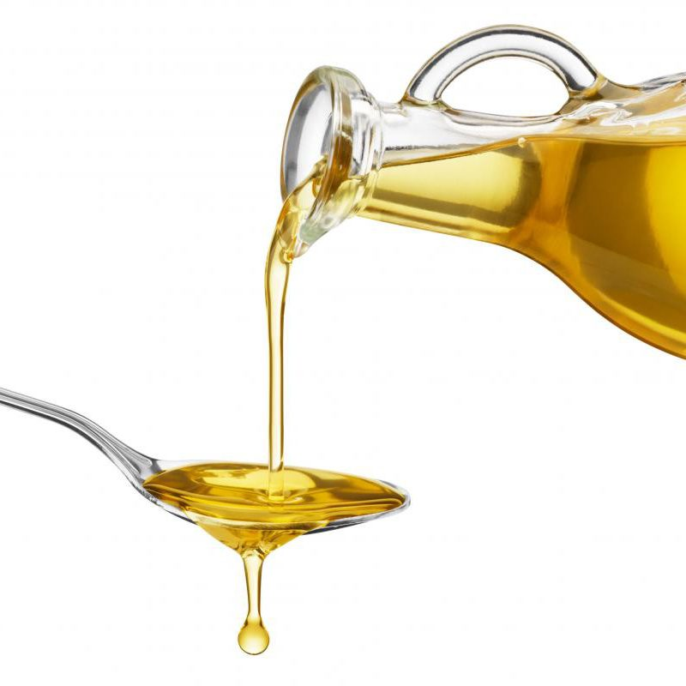
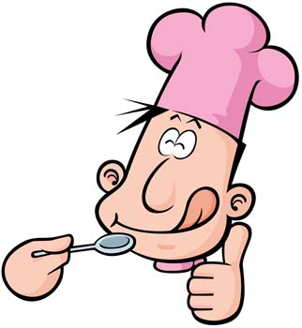
Delicious
(Dılişıs)
Lezzetli (adjective)
Leziz/Nefis (adjective)
Oil

Slide 5
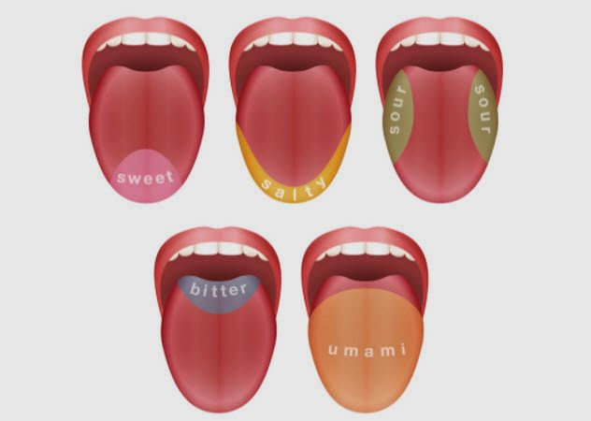
TASTE
Tat (noun)
Tatmak (verb)
Lezzet (noun)
Tat vermek (noun)
Tat almak (verb)
Notes:
Bidır
seevır

Slide 6
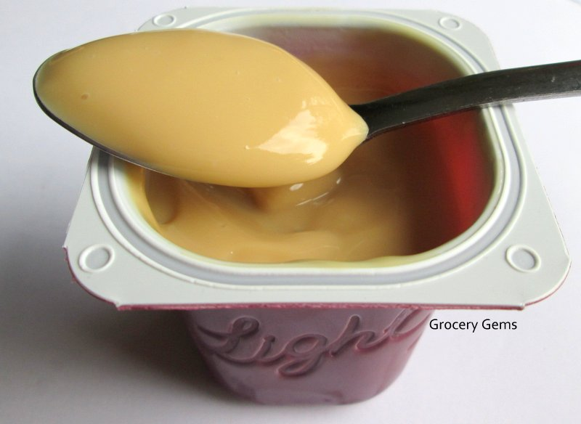
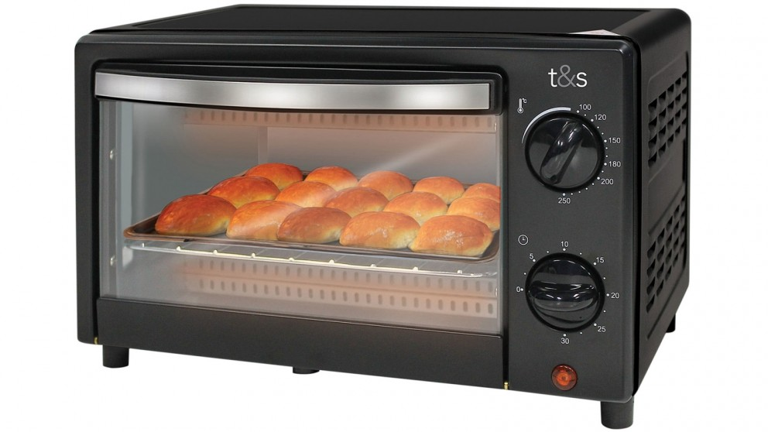
Smooth
Oven
Cooker

Slide 7
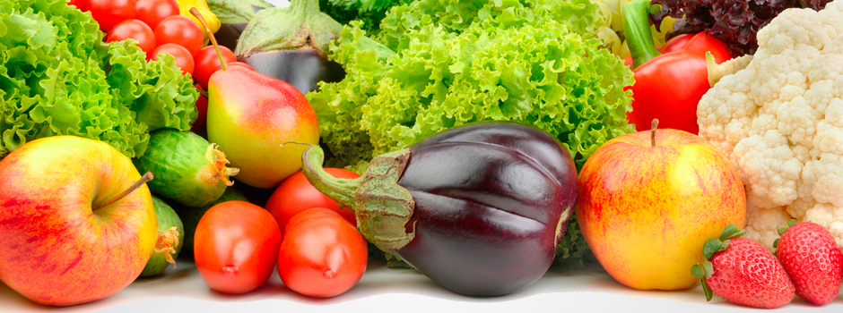
Raw (Rra)
Cooked

Slide 8
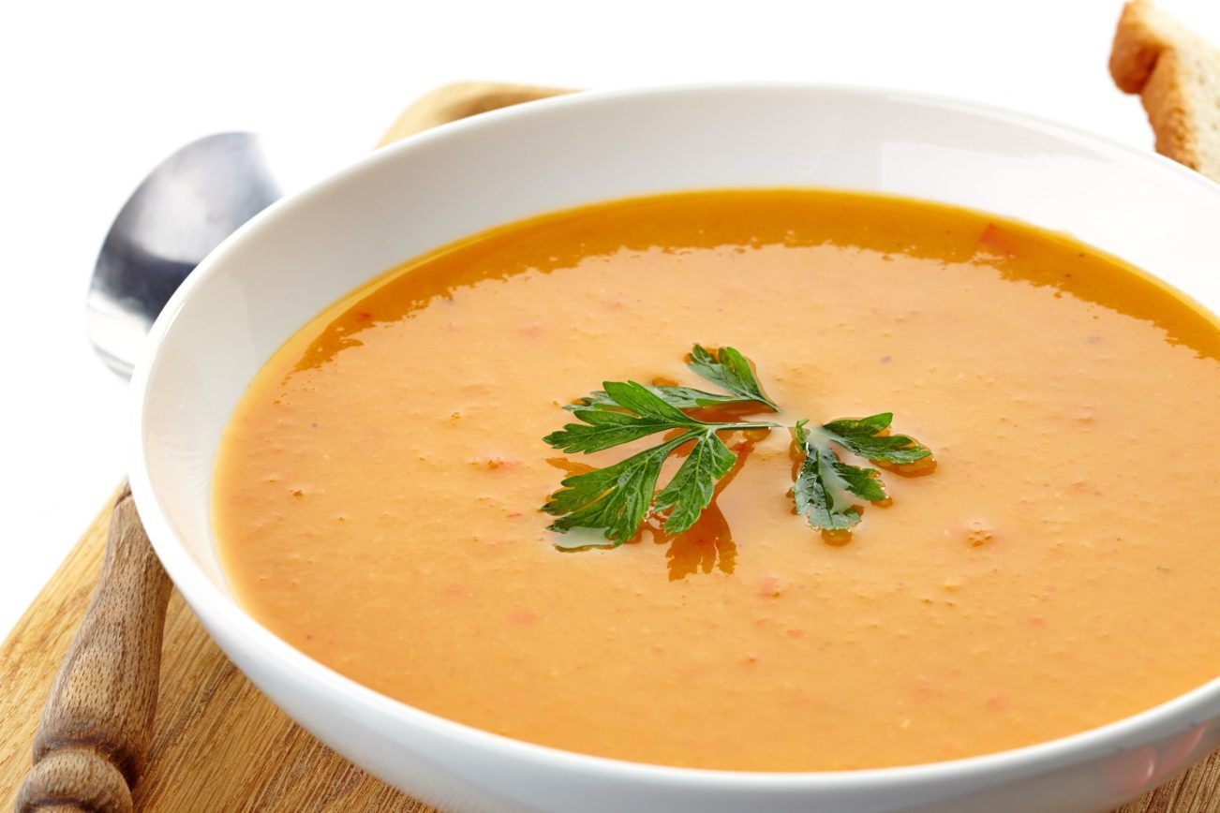
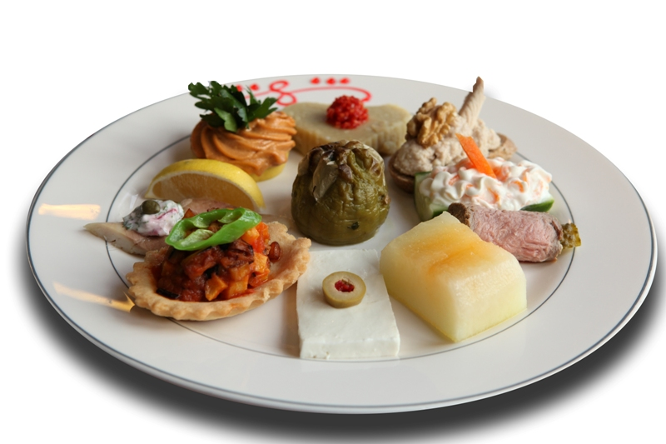
Soup
First Course
Starter
Main Course

