Slide 1
PRE-CIVIL WAR AFRICAN AMERICAN SLAVERY
AKE 117 aMERICAN HISTORY
Dr. Gamze KATI GUMUS

Slide 2
Slave narratives
“When a negro was put on the block he had to help sell himself by telling what he could do. If he refused to sell himself and acted sullen, he was sure to be stripped and get thirty lashes.” L.M. Mills
Hartman, Saidiya V. Scenes of Subjection: Terror, Slavery and Self-Making in the Nineteenth Century America. Oxford UP, 1997. [p. 38]

Slide 3
Slave narratives
“The slaves are brought from all parts. Are all sort, sizes and ages, and arrive in various states of fatigue and condition; but soon they improve their looks, as they are regularly fed, and have plenty to eat. As soon as we were roused in the morning, there was a general washing, and combing, and shaving, and pulling of grey hairs, and dyeing the hair of those who were too grey to be plucked without making them bald. When this was over […] we used to breakfast […] we might plump up and become sleek.Bob would then proceed to instruct us how to show ourselves off.
[…]
When spoken to, they must reply quickly, with a smile on their lips, though agony is in their heart, and the tear in the trembling eye. They must answer every question, and do as they are bid, to show themselves off; dance, jump, walk, leap, squat, tumble, and twist about, that the buyer may see they have no stiff joints, or other physical defect.” John Brown
Hartman, Saidiya V. Scenes of Subjection: Terror, Slavery and Self-Making in the Nineteenth Century America. Oxford UP, 1997. [p. 39]

Slide 4
Slave narratives
“Sukie was her name. She was a big stappin nigger gal dat never had nothin’ to say much. She used to cook for Miss Sarah Ann, but ole Marsa was always tryin’ to make Sukie his gal. One day Sukie was in the kitchen making soap. Marsa […] tell Sukie to take off her dress. She tell him no. […] Den dat black girl got mad. She took an push ole Marsa an’ made him break loose an’ den she gave him a shove an’ push his hind parts down in de hot pot o’ soap. Soap was near boilin’, an it burnt him near to death. […]
Well, few days later he took Sukie off an’ sol’ her to de nigger trader. An’ dey ‘zamined her an’ pinched her an’ dey opened her mouf, an’ stuck dey fingers in to se how her teeth was. Den Sukie got awful mad, and she pult up her dress an’ tole de nigger traders to look an’ see if dey could find any teef down dere.” Fannie Berry
Hartman, Saidiya V. Scenes of Subjection: Terror, Slavery and Self-Making in the Nineteenth Century America. Oxford UP, 1997. [p. 40]

Slide 5
Slave narratives
I use’ to drive my Massa’s family in town to church, in the “two-horse surey,” on a Sunday. I had to sit upstairs with the other slaves. We act like we enjoy’ the services, but we didn’t. … But the slave’ had they Christian religion too, an’ it wasn’t cole and “Proper,” like in the white folk’ church. The fact is, the black folk in my day didn’t even have a church. They meet in a cabin in cole weather an’ outdoors, under a tree or a “brush arbor” in the summer time. Sometimes the Massa’s preacher would “talk” at the meetins ‘bout bein’ obedient to our massas an’ good servants, an’ ‘bout goin’ to heaven when we die. … But, oh, my, when my people got together to “Wishop” God, the Spirit would “move in the meetin!” Simon Brown
Stuckey, Sterling. Slave Culture: Nationalist Theory and the Foundations of Black America. Oxford UP, 1988. [p.33]

Slide 6
The other end of the spectrum…
“On Monday when I gave her the clothes and told her to go and wash with Maum Liddie, she said she was not strong enough to do my washing…. I asked her what had I brought her for. I told her before I left home that she was to do my washing and wait on me. Said she could bring water and help fix the rooms but she could not do my washing because she did not have the strength. She pretends she can’t even help to throw the mattress off to beat up the feather bed. She is positively not worth the corn she eats. Would have been better off if I had come without a servant for she is only a bother to me. I often feel like giving her a switching.” Alice Palmer, mistress
Thavolia Glymph. Out of the House of Bondage: The Trnasformation of the Plantation Household. Cambridge UP, 2012. [p. 162]

Slide 7
Notes:
An African man being inspected for sale into slavery while a white man talks with African slave traders. 1854 engraving
https://www.loc.gov/pictures/item/98510180/

Slide 8
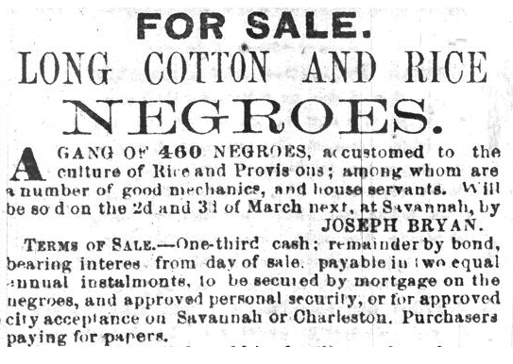
An advertisement published in The Savannah Republican on Feb. 8, 1859, by the slave dealer Joseph Bryan for a two-day auction that became the largest in history. Four hundred thirty-six men, women and children were sold for $303,850, equivalent to about $9.4 million today.
Notes:
https://www.nytimes.com/interactive/2020/02/12/magazine/1619-project-slave-auction-sites.html

Slide 9
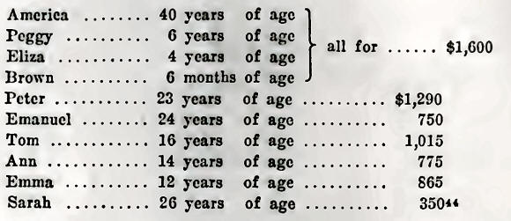
The county commissioner of Harrison auctioned the slaves of the deceased George Kirk Patrick with the following prices received:
Notes:
https://www.electricscotland.com/history/america/slavery_kentucky2.htm

Slide 10
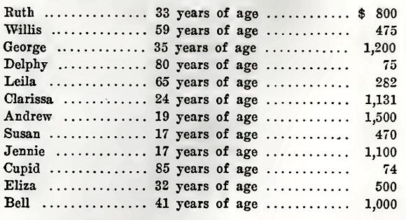
The county commissioner at Henderson received the following prices for slaves in the settlement of several estates on January 28, 1858:
“This sale is most significant for the cases of “Delphy,” 80 years old, and “Cupid,” 85 years of age. It is difficult to account for such a sale in any discussion of the slave trade, but it does show the humanitarian side of Kentucky slavery. Negroes at such an age had no economic value even if they were given away, because the expense of their maintenance was more than the value of any possible labor they could perform.”
Notes:
https://www.electricscotland.com/history/america/slavery_kentucky2.htm

Slide 11
“Henry Bibb describes this scene. He writes about a Mr. Young, a Methodist, who was the owner of a large number of slaves, many of whom belonged to the same church with their master. They worshipped together. Bibb describes Young as a kind master who ultimately became deeply involved in debt forcing him to sell his property, including his slaves, many of whom were his brothers and sisters in the church. . . . The slaves were offered on the auction block one after another, until they were all sold before their old master's face. . . . After the men were all sold they then sold the women and children. They ordered the first woman to lay down her child and mount the auction block; she refused to give up her little one and clung to it as long as she could, while the cruel lash was applied to her back for disobedience. “
Notes:
http://slaveryimages.org/s/slaveryimages/item/1940

Slide 12
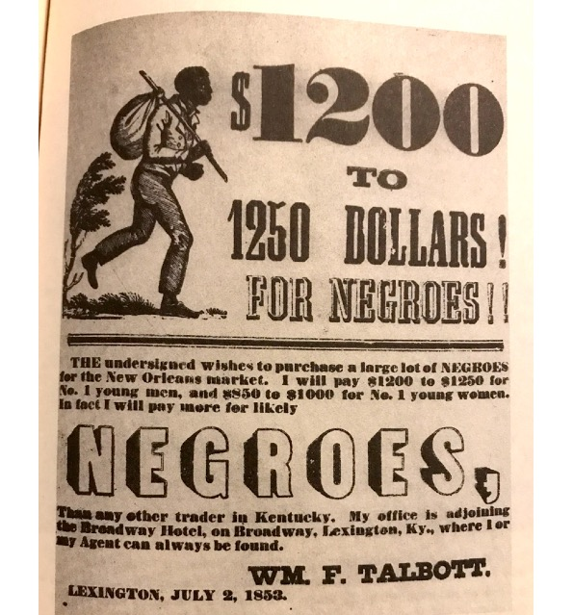
“Slave traders all over the upper South gathered slaves in the summer months and shipped them south in the fall.”
Johnson, Walter. Soul by Soul: Life Inside the Antebellum Slave Market. Harvard UP, 1999.

Slide 13
“For some, death was preferable to the slave trade. Their suicides made credible the threats of other slaves who resisted their owners’ efforts to sell them by threatening suicide or self-mutilation.”
Johnson, Walter. Soul by Soul: Life Inside the Antebellum Slave Market. Harvard UP, 1999.

Slide 14
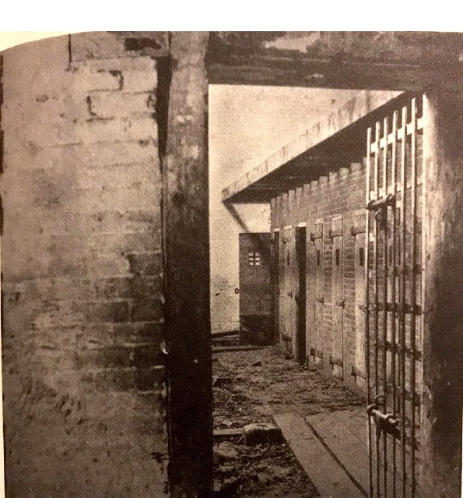
“While they were for sale in the market, slaves slept in jails within the slave traders’ yards.
Johnson, Walter. Soul by Soul: Life Inside the Antebellum Slave Market. Harvard UP, 1999.

Slide 15
“Before an 1852 law banned the practice, slaves in New Orleans were often sold on the street. Their uniform dress was calculated to obscure differences among them.”
Johnson, Walter. Soul by Soul: Life Inside the Antebellum Slave Market. Harvard UP, 1999.

Slide 16
