Slide 1
An Overview of Gene Expression

Slide 2
DNA of an organism encodes all of the RNA and proteins needed to make its cells

Slide 3
- different cell types of an organism differ in both structure and function
- due to the differences in gene expression in these cell types

Slide 4
the difference in gene expression in different cell types is due to;
the difference in their genome?
the difference in their genome usage?

Slide 6
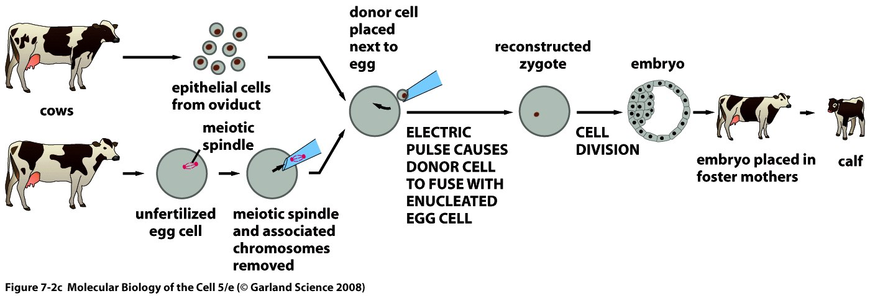

Slide 8
recombinant DNA techniques can be used for detailed comparison of genomes of different cell types

Slide 9
all cells of an organism contain the same genome
differences in gene expression is not due to the changes or rearrangements in nucleotide sequence
different RNA-protein sets are expressed in different cell types

Slide 10
reassociation kinetics

Slide 11
most of the cellular functions are common, and therefore, many proteins are common to all cells (housekeeping)
some of the proteins are expressed only in a certain cell type (tissue specific)
about 10.000-15.000 genes are expressed in a cell, and expressed set of genes differs in different cell types

Slide 13
a cell may change its gene expression in response to external signals
different cell types may respond different in their gene expression

Slide 15
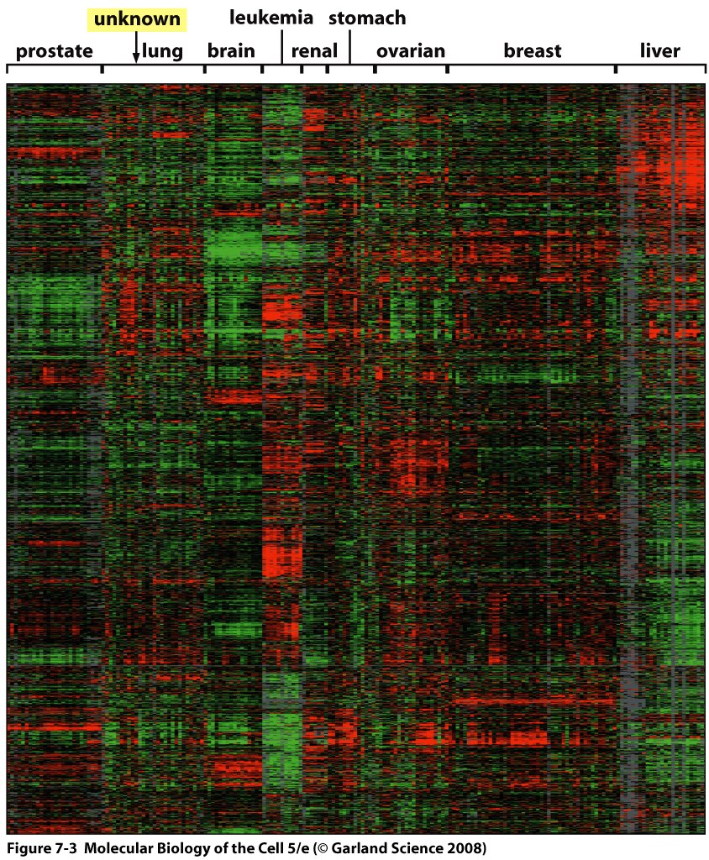

Slide 16
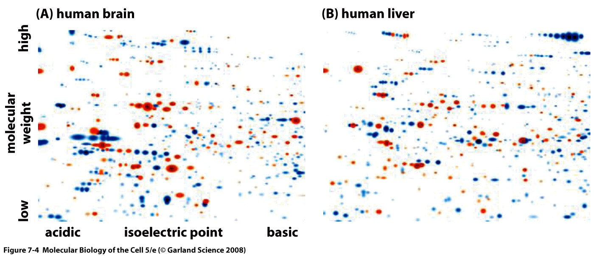

Slide 17
gene expression can be regulated at different steps

Slide 18
References
Molecular Biology of the Cell, 6th Ed. 2015
Molecular Biology of the Gene, 7th Ed. 2014
Genes XII, 2018

