Slide 1
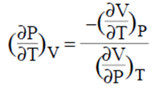
BASIC DERIVATIVES
isobaric thermal expansion coefficient
İsothermal compressibility coefficient

Slide 2
Exact differentials and state functions
Consequently, for a process in which a system goes from state 1 to state 2 a change in a state function aa can be evaluated simply as
And for a state function aa in a thermodynamic cycle
Condition for an exact differential
In mathematical thermodynamics, the condition for an exact differential is that given some function u of two or more variables, such as:

Slide 3
hen P and Q satisfy the following condition or criterion:
du = P dx + Q dy
the expression on the right side of the equation Pdx + Qdy is an exact differential only when P and Q satisfy the following condition or criterion:
meaning that the partial derivative of the function P with respect to y at constant x equals the partial derivative of the function P with respect to x at constant y.
hence, by comparison of these two expressions, we find that:
and

Slide 4
Differentiating the first of these with respect to y, and the second with respect to x, we have:

