Slide 1
GOLD COMPOUNDS: Treating of Arthritis, Cancer and Other Diseases

Slide 15
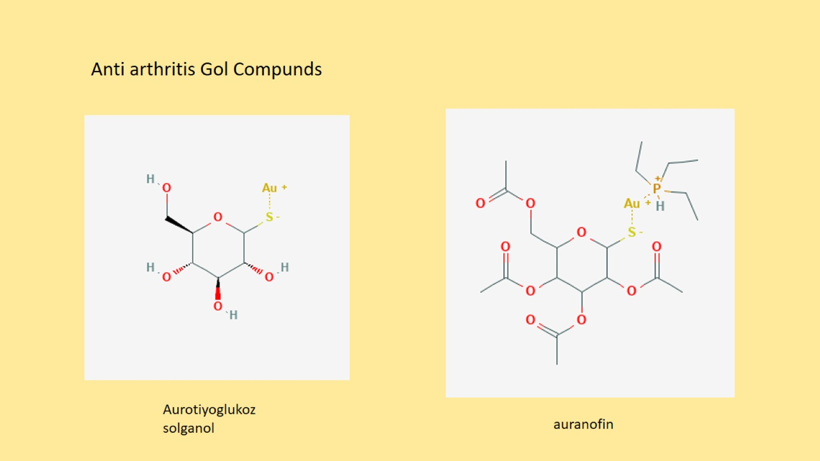

Slide 16
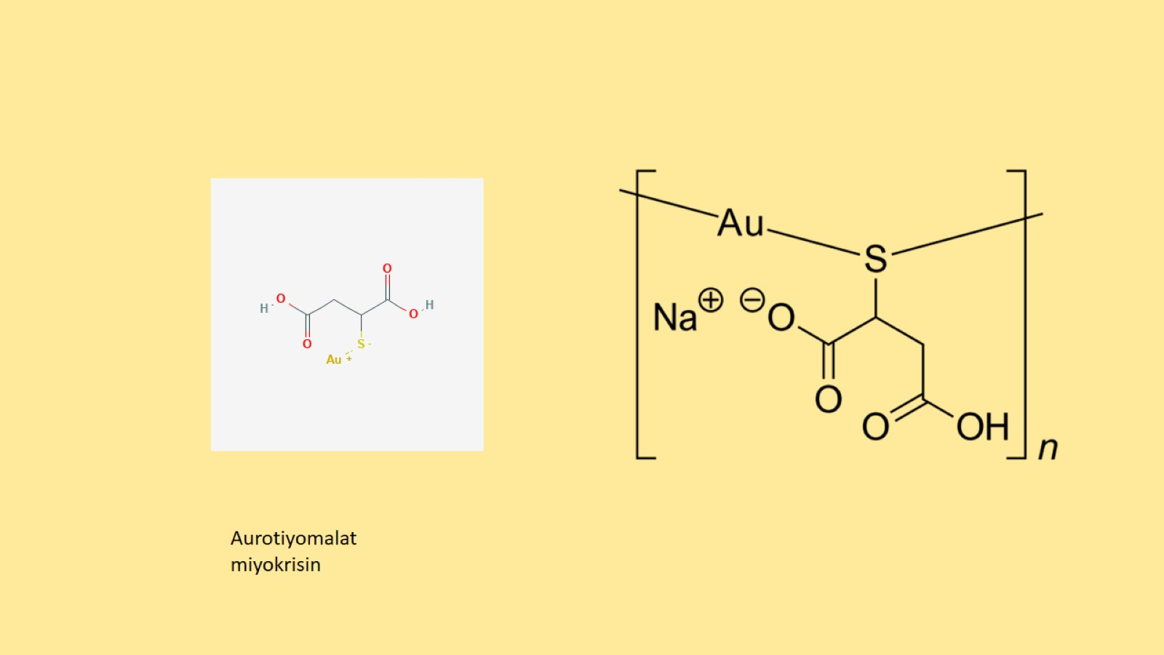

Slide 17
