Slide 1
Plant Identification

Slide 2
Plant Identification

Slide 3
Methods of identification

Slide 4
Methods of identification

Slide 5
Methods of identification

Slide 6
Methods of identification

Slide 7
Methods of identification

Slide 8
Methods of identification

Slide 9
Methods of identification

Slide 10
Methods of identification

Slide 11
Modern Identification Keys

Slide 12
Identification

Slide 13
Plant Morphology

Slide 21
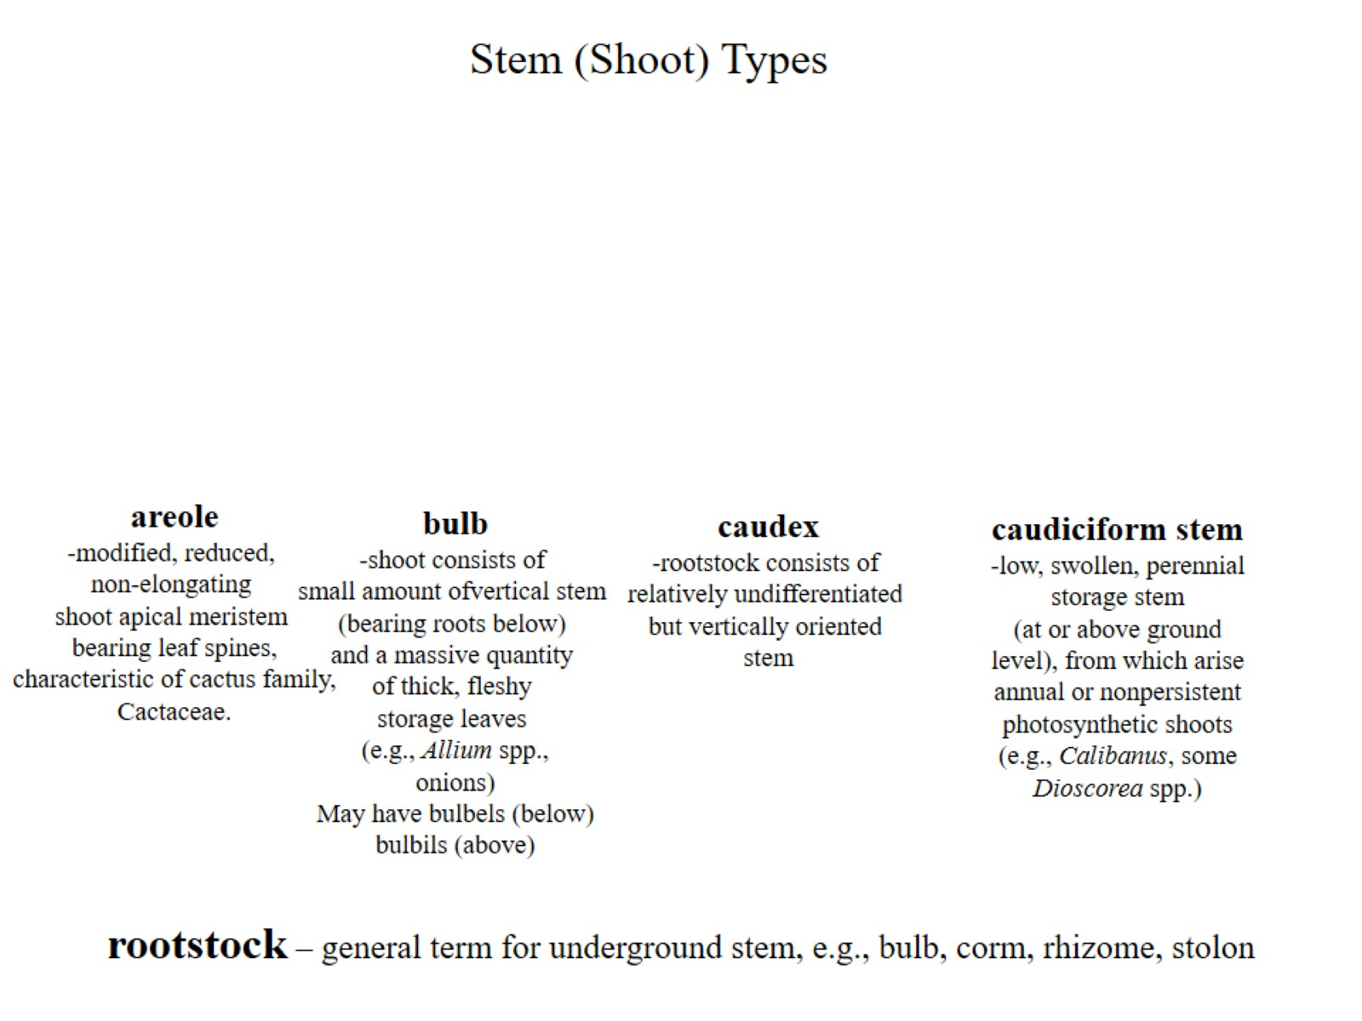

Slide 24
Flower

