Slide 1
General Conclusion

Slide 2
What we have learned during this course:
The basis of Islamic Religious Education and educational institutions in early period. Those institutions are (Celebi, 1998):
Kuttab
Education in the palace
Book stores
Homes of scholars
Majlis
Desert
Masjid

Slide 3
What are the basis of Religious Education and Instruction in Turkey?
Those were as follows (Tosun, 2001):
Individual Basis
Social Basis
Cultural Basis
Universal Basis
Philosophical Basis
Legal Basis

Slide 4
The conceptual analyzes of Religious Pedagogy

Slide 5
( See Tosun, 2001)

Slide 6
The Place of Religious Education Between Other Sciences

Slide 7
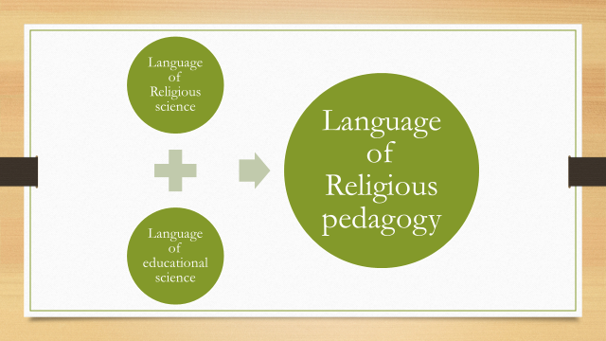
Educational is a whole process and religion is the one part of it. So it is not true to deal with just with religious sciences. On the other hand, it is not the true way to look and analyze Religious pedagogy just from the educational science side (Tosun, 2001).

Slide 8
Curriculum Development in Religious Pedagogy
The elements of curriculum development:
Educational Philosophy
Goals
Educational process (models, methods, and approaches)
Content
Evaluation

Slide 9
The History of Religious education in the Republic of Turkey
When we take the education during the Republic era, we see three different practices. These are as follows: religion courses during the formation years of the Republic and in the one-party era, those in the multi-party period, and finally the ones after 1980, the post-coup d’état period (Yuruk, 2012).

Slide 10
Example of Religious Education overall the world
What effects countries in adapting religious education model?
Educational policy
Ideology
Educational Philosophy
Educational approach
Religious Educational Model
School type (See Hull, 2003)

Slide 11
An Analyzing of compulsory and elective religious education curriculum
Curriculum has six learning domain:
Faith
Worship
Prophet Mohammad
Koran and its comment
Ethics
Religion and culture

Slide 12
There are three elective course for religious education:
Basic knowledge of Islam
Koran
The life of Prophet Mohammad

Slide 13
Public Religious Education: Koran Courses
There are three tips of Koran Courses in general:
1. Koran Courses for adult
2. Koran Courses for early childhood
3. Summer Koran Courses

Slide 14
Religious Education in Prison
Even though it had started to discuss religious education in prisons in 1959,
According to the agreement between Department of Religious Affairs and Ministry of Justice, the official employment started in 1974 (Ozdemir, 1998).
In 1983, it had been conducted an educational program including Religion and Moral courses. After having special employees for this course, the curriculum of the course had been developed (Ozdemir, 2012).

Slide 15
Religious Education in Social Service and Child Protection Agency
In our history we had some place for children who have no family and home.
In 1917 «Istanbul Himayeyi Etfal Cemiyeti (the institution of children protection) » was opened. In 1983 this institution was shut down and opened a new institution named «Social Service and Child Protection Agency» In 2012, that institution was turn over to the «Ministry of Family and Social Politics»
(http://cocukhizmetleri.aile.gov.tr/hakkimizda/tarihce)

Slide 16
Religious Education at Home
There are two main theories on moral development:
Piaget Moral Development Theory
Kohlberg Moral Theory

Slide 17
Thank you for being part of this course..
Assoc. Prof. Yildiz Kizilabdullah

