Slide 1
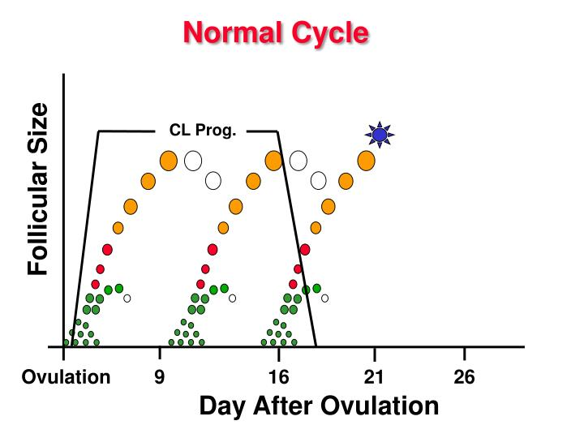
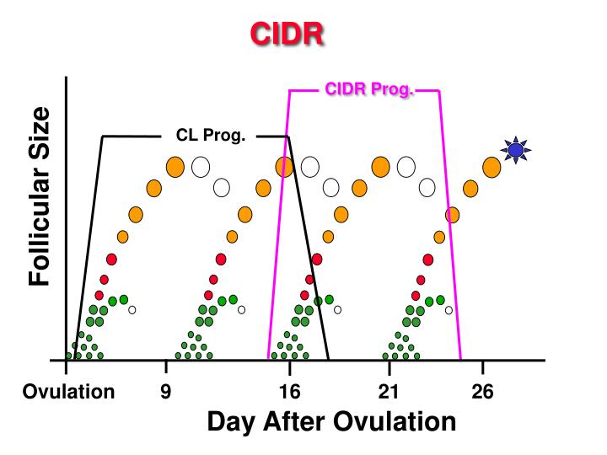
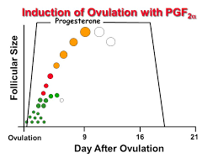
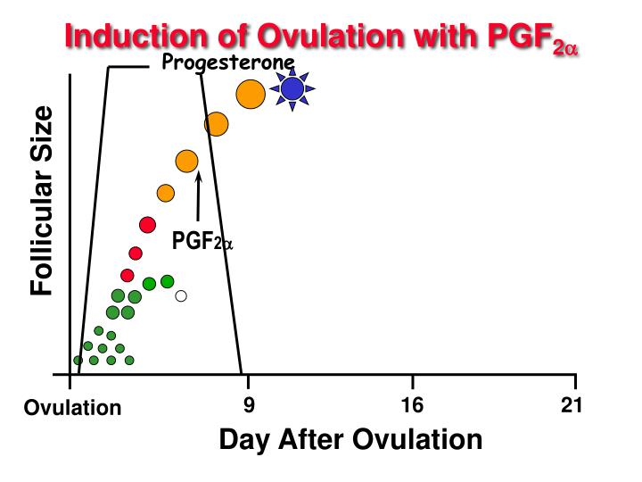
How hormonal syncronisation works ?
Synchronisation products control the esters cycle by influencing structures that are present on the ovary
Prolonging luteal phase with Progesterone
Shortening the life span of CL with PGF2a

Slide 2
Progesterone based Synch
Use progestagen/progesterone impregnated vaginal devices
Three types of devices are available: cronolone (20mg) impregnated sponges (Chronogest CR, MSD AH), MAP (60mg) impregnated sponges and CIDR(0.3g progesterone)
Treatment schedule
Sponge removal & PMSG
43-45h in goats
55h in sheep
Day 0
Day 5-14
AI

Slide 3
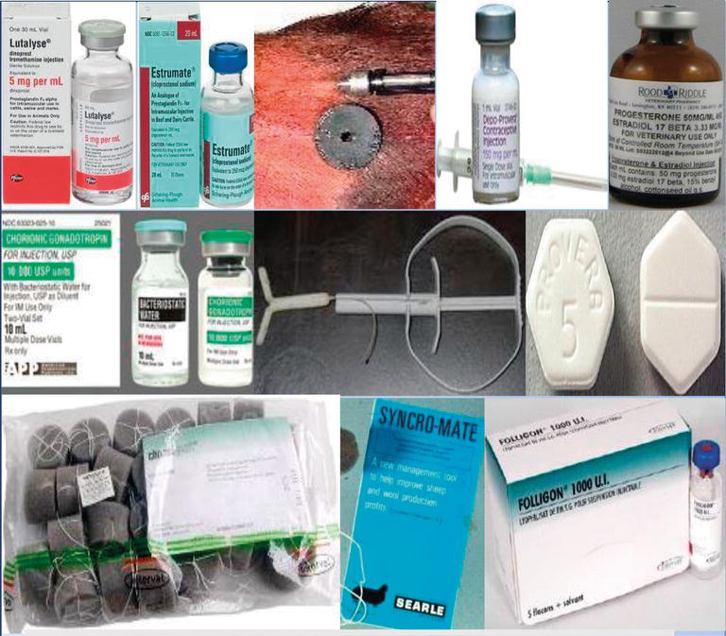

Slide 4
Prostoglandin based Synch
Luteolytic agent
Clean, Green and Ethical
Metabolised in lungs, not in tissues
Day 3 of Estrus cycle
PGF2
PGF2
48-72h
48-72h
Day 0
Heat detect and AI
Day 11-13
Heat detect and AI
Day 7–9

Slide 5
GnRH based Synchronisation
GnRH
PGF2
GnRH
Detect heat and AI
Day 0
Day 6
Day 9

Slide 6
Melatonin Based Synch
Melatonin 18 mg
GnRH
Detect heat and AI
Day 0
Day 50-70

