Slide 1
Reaction mechanisms
Elementary reactions, molecularity, reaction mechanism
Chemical reactions as we write them usually do not show the real course of processes on the molecular level but merely the stoichiometric ratios between the reactants. The reactions proceeding on a molecular level are called elementary reactions. The number of molecules participating in an elementary reaction is called the molecularity of the reaction. Based on molecularity we classify elementary reactions as:
a) unimolecular—the reaction occurs due to the decomposition of a molecule,
b) bimolecular—the reaction occurs when two molecules collide,
c) trimolecular—the reaction occurs when three molecules collide.

Slide 2
Radioactive decay represents a typical unimolecular reaction. Most elementary reactions are bimolecular. Trimolecular reactions are very rare. Higher than trimolecular reactions have not been observed. If a reaction is not elementary, it proceeds as a sequence of elementary reactions. This sequence is called the mechanism of reaction
Temperature dependence of the rate of a chemical reaction
The rate of reaction depends on temperature via the rate constant. In a simple reaction, both the rate constant and the rate of reaction increase with temperature. The rate of parallel and consecutive reactions also increases with temperature. In reactions proceeding by more complex mechanisms, the rate may decrease with temperature.

Slide 3
Mechanism of some third-order reactions
If the third-order reaction (second-order with respect to A and first-order with respect to B)
İt were trimolecular, there would have to be two molecules of substance A and one molecule of substance B coming into contact. However, a collision of three molecules is a rare event. Consequently, a mechanism has been suggested explaining some reactions of the type as a sequence of bimolecular reactions
The rate of formation of the product is provided that the pre-equilibrium principleapplies for the intermediate A2

Slide 4
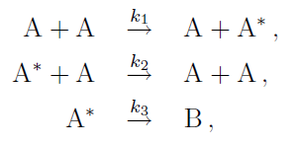
All elementary reactions fall in the group of simple reactions, but far from all simple reactions are elementary. The order of an elementary reaction is identical with its molecularity, the orders with respect to individual components are equal to their stoichiometric coefficients and acquire the value of 1, 2 or 3.
Lindemann mechanism of first-order reactions
Some reactions of the type A and B proceed neither as unimolecular nor as bimolecular. Lindemann suggested the following mechanism for these reactions:
where A is the activated molecule, a molecule endowed with a substantially higher energy than its fellow-molecules.

Slide 5
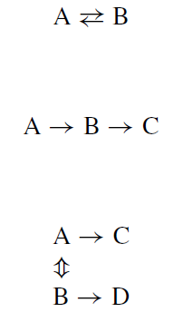
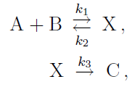
The mechanism by which molecules actually combine is rarely as simple as the rate law suggests. Complex reactions may involve equilibriums,
Let us consider the reaction
equilibrium reactions
and its mechanism as a sequence of reactions
consecutive reactions,
parallel reactions,
or combinations of any or all of them.

Slide 6
Because of these complications, the terms order and molecularity must be clearly differentiated. The order is the sum of exponents in the rate equation, while the molecularity is the number of molecules taking part in a simple reaction step. The order and molecularity will be the same in only the simplest reactions.
Chain reactions
Chain reactions are complex consecutive reactions characterized by a cyclic consumption and formation of reactive intermediates, most often radicals. We distinguish three stages of a chain reaction:
a) Initiation or formation of reactive intermediates. Usually it occurs when the reactants are heated (thermal initiation) or irradiated (photoinitiation).

Slide 7
b) Propagation. This is a cyclically proceeding reaction or a sequence of reactions (cycle).
– Unbranched-chain reactions, in which the same number of reactive intermediates is formed as consumed in the course of the cycle.
Branched-chain reactions, in which more reactive intermediates are formed than consumed in the course of the cycle.
c) Termination or end of reaction during which the reactive intermediates cease to exist in consequence of either their mutual reaction or their adsorption on the walls of the containing vessel.

