Slide 1
FIRST AID FOR MEDICAL CONDITIONS-II
Berna GUVEN, PhD

Slide 2
Medical Conditions
Diabetes
Hypoglycemia
Headache
Vomiting
Diarrhea

Slide 3
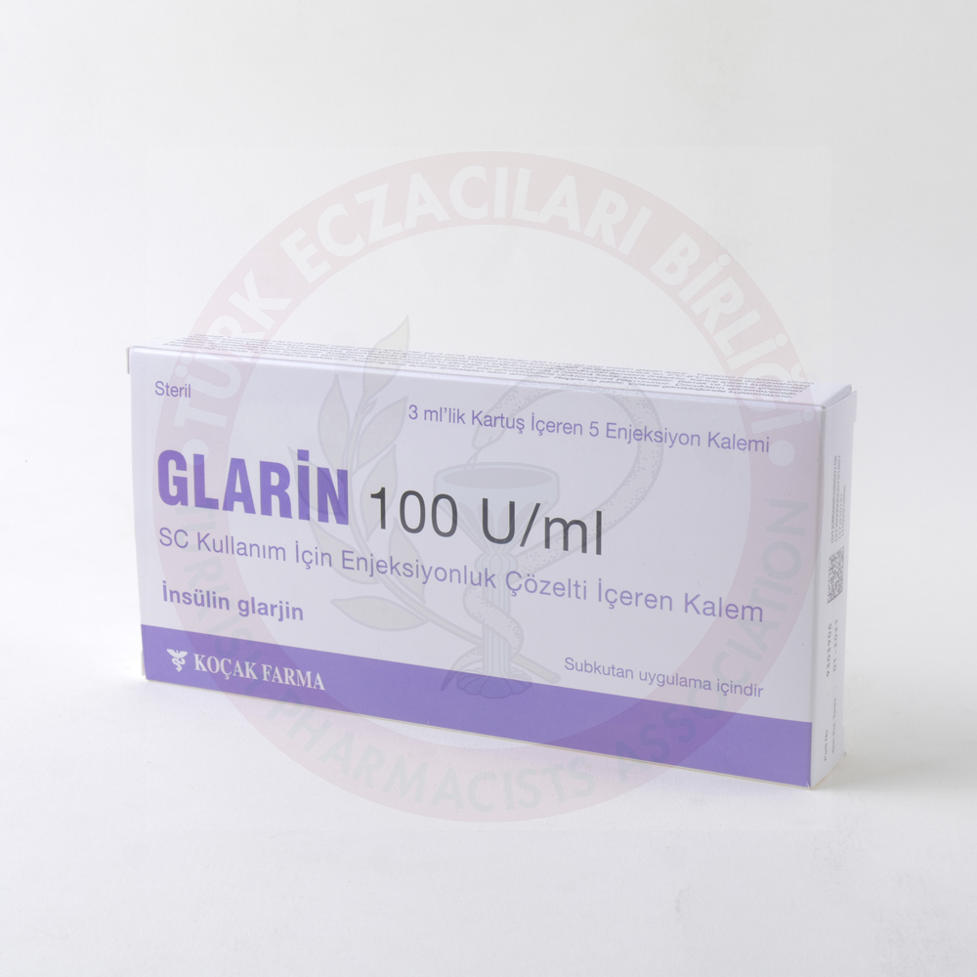
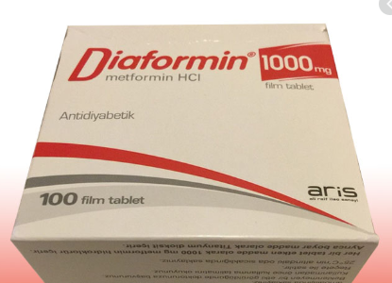
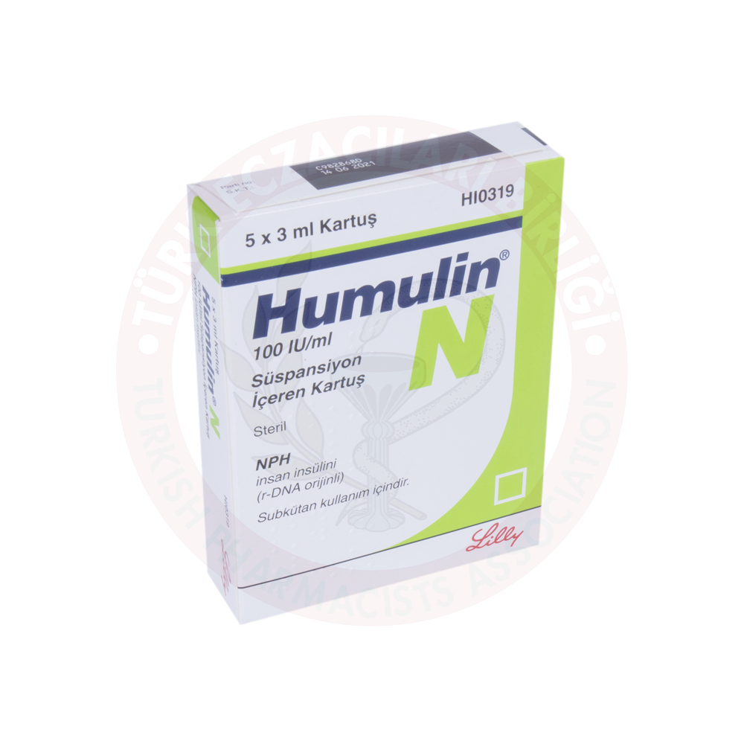
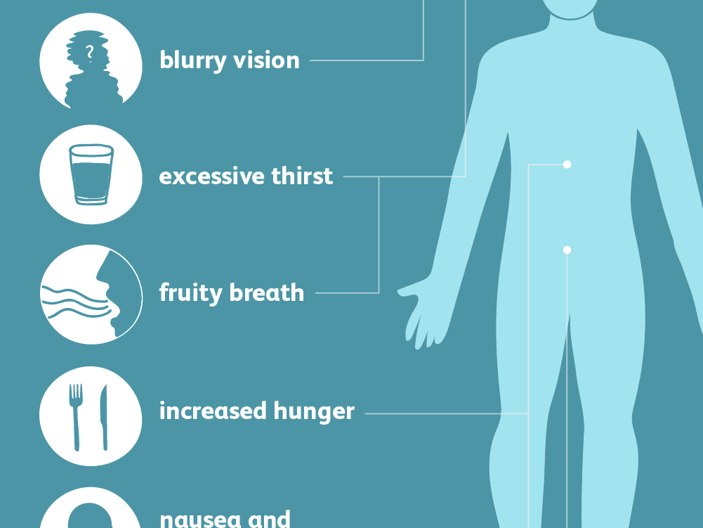
DIABETES
Chronic condition in which the body fails to produce or use insulin.
Type 1, Type 2
HYPERGLYCEMIA
■ Warm, dry skin
■ Rapid pulse and breathing
■ Fruity sweet breath and
excessive thirst
■ Drowsiness, leading to
unconsciousness if untreated
If it is not treated, hyperglycemia will result in unconsciousness (diabetic coma) and therefore requires urgent treatment in the hospital.

Slide 4
HYPERGLYCEMIA-What to do
1. Call for emergency
2. Record vital signs—level of
response, breathing, and pulse

Slide 5
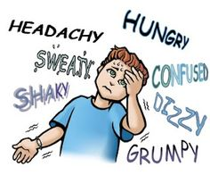
HYPOGLYCEMIA
This condition occurs when the blood sugar level falls below normal.
RECOGNITION:
■ A history of diabetes—the casualty himself may recognize the onset of a hypoglycemic attack
■ Weakness, faintness, or hunger
■ Confusion and irrational behavior
■ Sweating with cold, clammy skin
■ Rapid pulse
■ Palpitations and muscle tremors
■ Medical warning bracelet or necklace, and glucose gel or tablets
■ Medication such as an insulin pen or tablets, and a glucose testing kit

Slide 6
HYPOGLYCEMIA-What to do
1. Help the casualty sit down. give him the equivalent of 10 g of glucose—for example, two teaspoons of sugar (or two lumps of sugar), or sugary candy such as hard candies.
2. If the casualty responds quickly, give him more food or drink and
let him rest until he feels better. Help him find his glucose testing
kit so that he can check his glucose level. Monitor him until he is
completely recovered.
3. If the casualty’s condition does not improve, look for other possible causes. Call 112 for emergency help and monitor and record vital signs—level of response, breathing, and pulse while waiting for help to arrive.

Slide 7
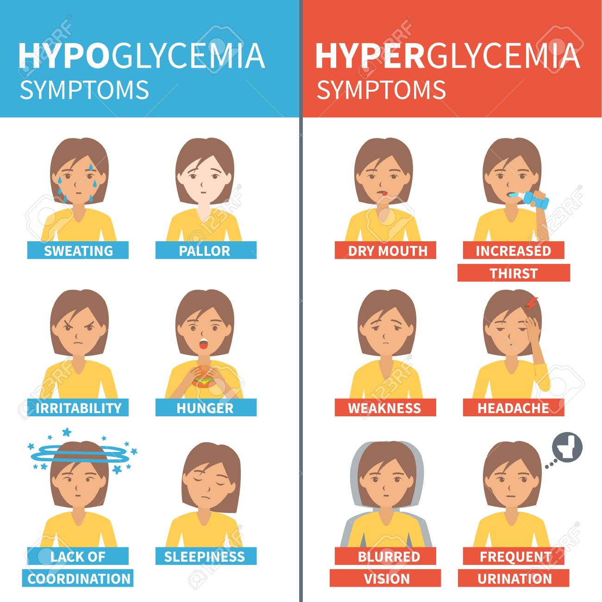

Slide 8
HEADACHE
CAUTION:
■ Do not give aspirin to anyone
under 16 years of age.
Seek urgent medical advice if
the pain:
■ Develops very suddenly.
■ Is severe and incapacitating.
■ Is accompanied by fever
or vomiting.
■ Is recurrent or persistent.
■ Is accompanied by loss of
strength or sensation, or by
impaired consciousness.
■ Is accompanied by a stiff neck
and sensitivity to light.
■ Follows a head injury.
What to do
1. Help the casualty sit or lie down in a quiet place.
Give him a cold compress to hold against his head.
2. An adult may take the recommended dose of acetaminophen tablets or his own pain relievers. A child may have the recommended dose of acetaminophen syrup (not aspirin).

Slide 9
MIGRAINE
What to do
1. Help the casualty take any medication that he may have for migraine attacks.
2. Advise the casualty to lie down or sleep for a few hours in a quiet, dark room. Provide him with some towels and a container in case he vomits.
3. If this is the first attack, advise the casualty to seek medical advice.
■ Before the attack there may be disturbance of vision in the form of
flickering lights or an aura
■ Intense throbbing headache, which is sometimes on just one side of the head
■ Abdominal pain, nausea, and vomiting
■ Inability to tolerate bright light or loud noise

Slide 10
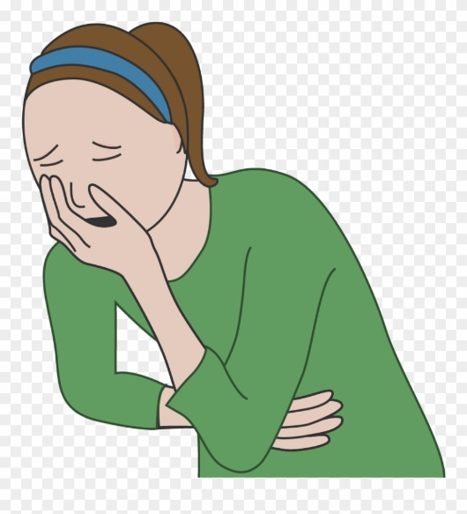
VOMITING AND DIARRHEA
Irritation of the digestive system.
dehydration
What to do
1. Reassure the casualty if she is vomiting and give her a warm damp cloth to wipe her face.
2. Help her sit down and when the vomiting stops give her water or unsweetened fruit juice to sip slowly and often.
3. When the casualty is hungry again, advise her to eat easily digested foods such as pasta, bread, or potatoes for the first 24 hours.
4. If the vomiting and/or diarrhea are severe, or the casualty develops chest pain, difficulty breathing or severe abdominal pain, take or arrange to send her to the hospital. If the casualty becomes lightheaded or dizzy, treat for fainting.

Slide 12
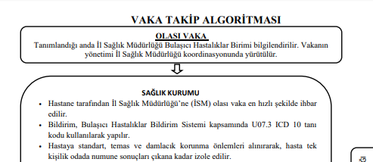
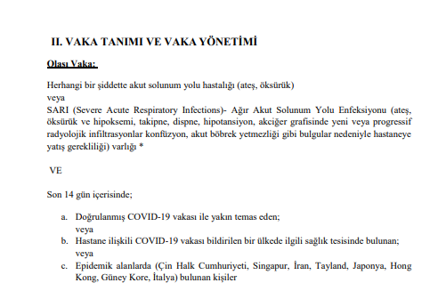

Slide 13
a new detection technique should be developed as soon as possible.
Oxygen therapy

Slide 14
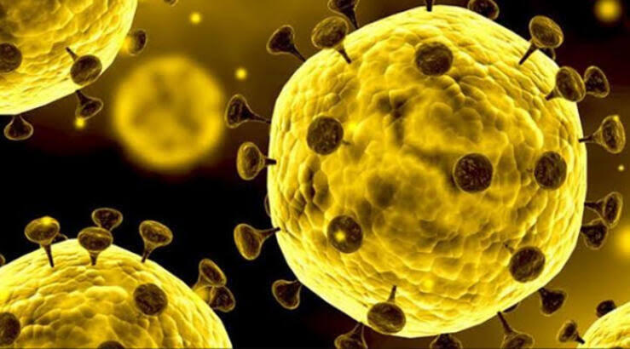
Notes:
Two phase III trials were initiated in early
February to evaluate intravenous remdesivir (200 mg on day 1 and 100 mg once daily for 9 days) in
patients with 2019-nCoV (NCT04252664 and NCT04257656)

Slide 16
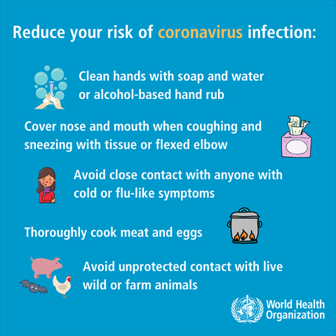
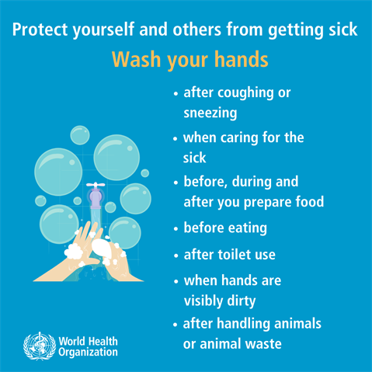
Advice of WHO
Notes:
Wash your hands frequently
Maintain social distancing
Avoid touching eyes, nose and mouth
Practice respiratory hygiene

Slide 17
Myth busters
Cold weather and snow CANNOT kill the new coronavirus.
Taking a hot bath does not prevent the new coronavirus disease
The new coronavirus cannot be transmitted through goods manufactured in China or any country reporting COVID-19 cases.
The new coronavirus CANNOT be transmitted through mosquito bites.

Slide 18
Common questions
Are antibiotics effective in preventing and treating the new coronavirus?
No, antibiotics do not work against viruses, only bacteria.
Are there any specific medicines to prevent or treat the new coronavirus?
To date, there is no specific medicine recommended to prevent or treat the new coronavirus (2019-nCoV).

Slide 19
Common questions
Can pets at home spread the new coronavirus (2019-nCoV)?
At present, there is no evidence that companion animals/pets such as dogs or cats can be infected with the new coronavirus. However, it is always a good idea to wash your hands with soap and water after contact with pets. This protects you against various common bacteria such as E.coli and Salmonella that can pass between pets and humans.
Do vaccines against pneumonia protect you against the new coronavirus?
No. Vaccines against pneumonia, such as pneumococcal vaccine and Haemophilus influenza type B (Hib) vaccine, do not provide protection against the new coronavirus.

Slide 20
Common questions
Can regularly rinsing your nose with saline help prevent infection with the new coronavirus?
No. There is no evidence that regularly rinsing the nose with saline has protected people from infection with the new coronavirus.
Does the new coronavirus affect older people, or are younger people also susceptible?
People of all ages can be infected by the new coronavirus (2019-nCoV). Older people, and people with pre-existing medical conditions (such as asthma, diabetes, heart disease) appear to be more vulnerable to becoming severely ill with the virus.

Slide 21
Common questions
Can the virus that causes COVID-19 be transmitted through the air?
Studies to date suggest that the virus that causes COVID-19 is mainly transmitted through contact with respiratory droplets rather than through the air.
Can CoVID-19 be caught from a person who has no symptoms?
The main way the disease spreads is through respiratory droplets expelled by someone who is coughing. The risk of catching COVID-19 from someone with no symptoms at all is very low. However, many people with COVID-19 experience only mild symptoms. This is particularly true at the early stages of the disease.

Slide 22
Common questions
How long does the virus survive on surfaces?
It is not certain how long the virus that causes COVID-19 survives on surfaces, but it seems to behave like other coronaviruses. Studies suggest that coronaviruses (including preliminary information on the COVID-19 virus) may persist on surfaces for a few hours or up to several days. This may vary under different conditions (e.g. type of surface, temperature or humidity of the environment).
Is there anything I should not do?
The following measures ARE NOT effective against COVID-2019 and can be harmful:
Smoking
Wearing multiple masks
Taking antibiotics
In any case, if you have fever, cough and difficulty breathing seek medical care early

Slide 23
REFERENCES
The American College Of Emergency Physıcıans (Acep)-First Aid Manuel 5th Edition The Everything First Aid Book
https://gisanddata.maps.arcgis.com/apps/opsdashboard/index.html#/bda7594740fd40299423467b48e9ecf6

