Slide 1
Makroiktisat
Acemoğlu vd. (İkinci basım)
Bölüm 3
Optimizasyon
Notes:
If this PowerPoint presentation contains mathematical equations, you may need to check that your computer has the following installed:
1) MathType Plugin
2) Math Player (free versions available)
3) NVDA Reader (free versions available)

Slide 2
Amaç
3.1 Eniyileme
3.2 Eniyilemenin Uygulanması
3.3 Marjinal Analiz

Slide 3
Temel hususlar
Erişilebilir tercihler olması
Toplam değerleri kıyaslama
Marjinal değerleri kıyaslama

Slide 4
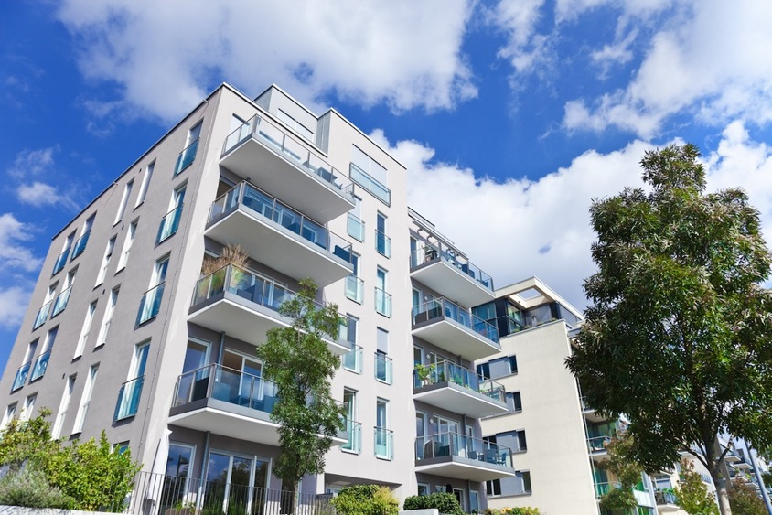
Veri temelli analiz
Ev kiralamada karar alma

Slide 5
En iyi tercihin seçimi
Her zaman en iyi seçim yapıyor musunuz?
Nedenleri?
Notes:
Ask students how many of them make the best choice in every situation. Ask them, why not?

Slide 6
Eniyileme
Sınırlı bilgiye sahip olma
Bilginin kıyaslanmasında karşılaşılan zorlukalr
Deneyim eksikliği
Notes:
People have limited information available to them and information is costly to obtain. Sometimes there is so much information surrounding a choice that it’s difficult to know where to begin in sorting through it. And if you don’t have experience in dealing with a given situation, you may not be able to put whatever information you do have to good use.

Slide 7
Eniyileme teknikleri
1. Toplam değer
Toplam yarar– total maliyet (net yarar)
Ya da
2. Marjinal analiz
tercihlerdeki değişimin net yararda yarattığı değişime göre
Notes:
Ask students to think about a choice they have made recently. How did they arrive at that choice? What kinds of factors did they think about? Try to categorize them into the “total” or “marginal” bucket.

Slide 8
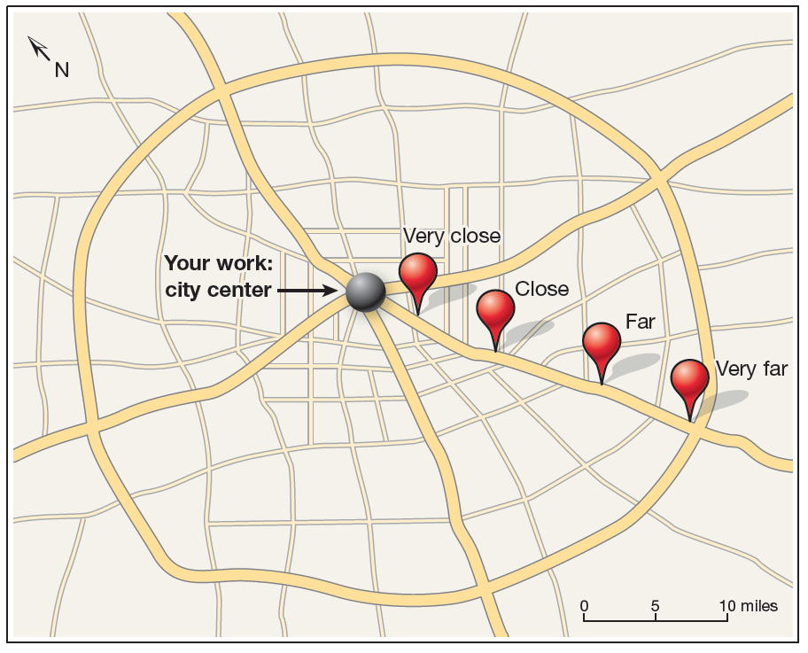
Ev kiralama (örnek)
Değiş-tokuş: Maliyete karşılık Merkeze Uzaklık
Notes:
Tell students to imagine that they have just graduated from college and have accepted a job in the center of a large city. Now they need to decide where to live. There are four general apartment options, varying by how far away they are from your job and the cost.

Slide 9
Ev kiralama (örnek)
Optimization using total value
Tüm maliyetleri ve yararları aynı birime taşımak (ör: dolar/aylık)
Her seçeneğin net yararını hesaplama
En yüksek net yararı sağlayan seçeneğin tercihi
Notes:
Ask students to think about a choice they have made recently. How did they arrive at that choice? What kinds of factors did they think about? Try to categorize them into the “total” or “marginal” bucket.

Slide 10
Eniyileme örneği
Daireler | Ulaşım süresi (saat/ay) | Kira ($/ay)
Çok yakın | 5 saat | $1,180
Yakın | 10 saat | $1,090
Uzak | 15 saat | $1,030
Çok uzak | 20 saat | $1,000
Notes:
Ask students which one they would pick. They should answer that they don’t have enough information yet, and they don’t. Ask what information is missing for them to make a good choice. They should say that they don’t know how much it costs to commute. They will probably also say that they need to know how much income they have. Tell them to assume that all 4 apartments are affordable—now we are just focused on costs. They might also say they don’t know enough about where the apartments are located, amenities, etc. Again, tell them that for right now, we’re just focused on costs.

Slide 11
Eniyileme örneği
Uzak olmasının maliyeti nelere bağılı?
Toplu taşımın varlığı
Benzin
Park etme kolaylığı
Otomobilin yıpranması
Zamanın fırsat maliyeti
Notes:
Before showing students the list, ask them to identify the costs of commuting. Tell them that you’re going to focus on one—the opportunity cost of the time involved in commuting. This is how much they would have to be paid to spend an hour commuting rather than doing something else with that hour. Solicit what their opportunity cost would be. Ask them why some students have a lower opportunity cost than others do.

Slide 12
Eniyileme örneği
Zamanın fırsat maliyeti üzerine varsayım $10/saat
Daire seçenekleri
Daire | Ulaşım süresi (saat/ay) | Ulaşım maliyeti ($/ay) | Kira ($/ay) | Toplam maliyet: Kira + Ulaşım ($/ay)
Çok yakın | 5 saat | $50 | $1,180 | $1,230
Yakın | 10 saat | $100 | $1,090 | $1,190
Uzak | 15 saat | $150 | $1,030 | $1,180
Çok uzak | 20 saat | $200 | $1,000 | $1,200
Notes:
Tell them you’re now ready to present the total costs of each apartment option. Looking at total costs, the Far apartment has the lowest costs.
The same information can be presented in a graph…

Slide 13
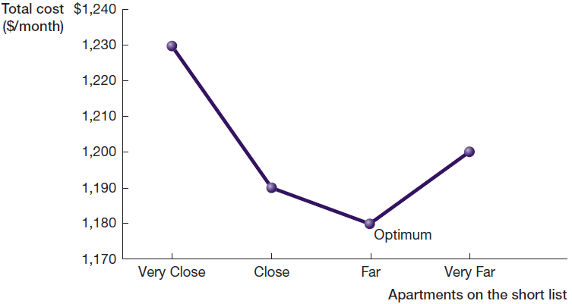
Eniyileme örneği
Toplam maliyet
Notes:
This is the same information as in the previous slide, just presented graphically instead of in a table. We are looking for the apartment with the lowest cost.

Slide 14
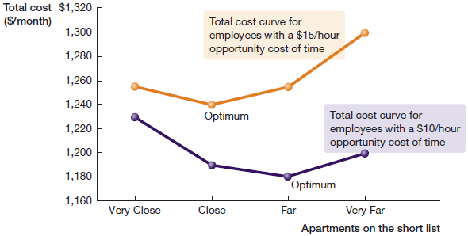
Eniyileme örneği
Zamanın fırsat maliyeti $10/saat ve $15/saat varsayımı altında

Slide 15
Marjinal Analiz
Marginal Analysis:
1. Tüm maliyetleri ve yararları aynı birime taşımak (ör: dolar/aylık)
2. Tercihler arasında değişiklik yapıldığında marjinal farkların hesaplanması
3. Seçildiğinde daha iyi durumu getiren ve bırakıldığında durumun kötüleştiği tercihin seçilmesi

Slide 16
Marjinal Analiz
Zamanın fırsat maliyeti $10/saat
A Comparison of the Apartments:
Daireler | Ulaşım maliyeti | Marjinal maliyet | Kira | Marjinal kira bedeli | Toplam maliyet | Marjinal toplam maliyet
Çok yakın | $50 |  | $1,180 |  | $1,230
 |  | $50 |  | −$90 |  | −$40
Yakın | $100 |  | $1,090 |  | $1,190
 |  | $50 |  | −$60 |  | −$10
Uzak | $150 |  | $1,030 |  | $1,180
 |  | $50 |  | −$30 |  | $20
Çok uzak | $200 |  | $1,000 |  | $1,200
Notes:
Tell students that the focus in marginal analysis is “how much more (or less) this option costs, compared to another one.”
From the table above, the marginal cost of the commute is going to be the same: how much more does it cost me to commute from a close apartment, compared to a very close apartment? $50. How much more does it cost to commute from a far apartment compared to a close apartment? $50.
Looking at the net benefits, then:
Should your choice change from a very close, to a close apartment? It would cost $50 more in commuting, but you would save $90 on rent, so yes—you would save $40.
Should your choice change from a close apartment to a far apartment? It would cost $50 more in commuting, but you would save $60 on rent, so yes again—you would save $10.
Should your choice change from a far apartment to a very far apartment? It would cost $50 more in commuting, but you would save $30 on rent, so no—you would be losing $20.
As in the total analysis, the best choice is the far apartment.

Slide 17
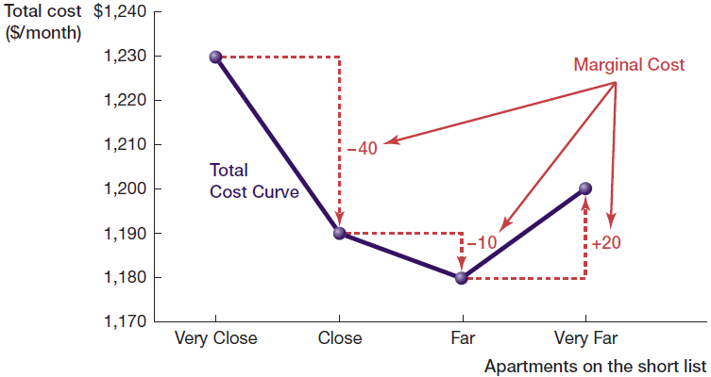
Marjinal Analiz
Notes:
Point out to students that regardless of which approach is used—optimization in levels or in differences—it leads to the same outcome.

