Slide 1
Ecology and Environmental Biology
Dr. Nüket BİLGEN

Slide 2
Population
Population: group of individuals of the same species that inhabit given area and time.
Same species→ in sexually reproducing organisms
Spatial boundary→ limitation of the place and time.

Slide 3
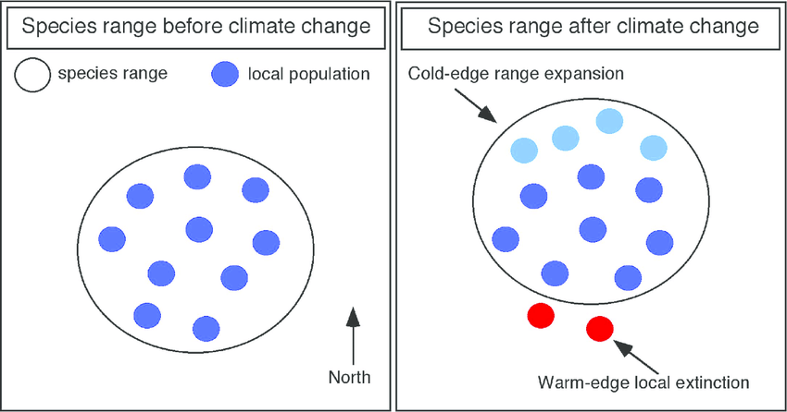
Define individual
What is an individual?
Examples?
Distribution
Distribution is based on the presence and absence of organism.
Geographic range

Slide 4
Population distribution
Influenced by;
Habitat: the natural environment of an organism; place that is natural for the life and growth of an organism.
Suitable environment, resource conditions.

Slide 5
https://www.slideshare.net/bassantnour/habitat-71409435

Slide 6
Organisms can be divided in two according to their distribution
Ubiquitous: A species with a geographically widespread distribution
Endemic: distribution is restricted to certain area.

Slide 7
Endemic species of Turkey
invertebrate species in Turkey is about 19,000, of which about 4,000 species/subspecies are endemic.
vertebrate species identified to date is nearly 1,500. over 100 species are endemic, including 70 species of fish.
Anatolia is home to the Fallow Deer and the Pheasant.
https://www.iucn.org/content/biodiversity-turkey

Slide 8
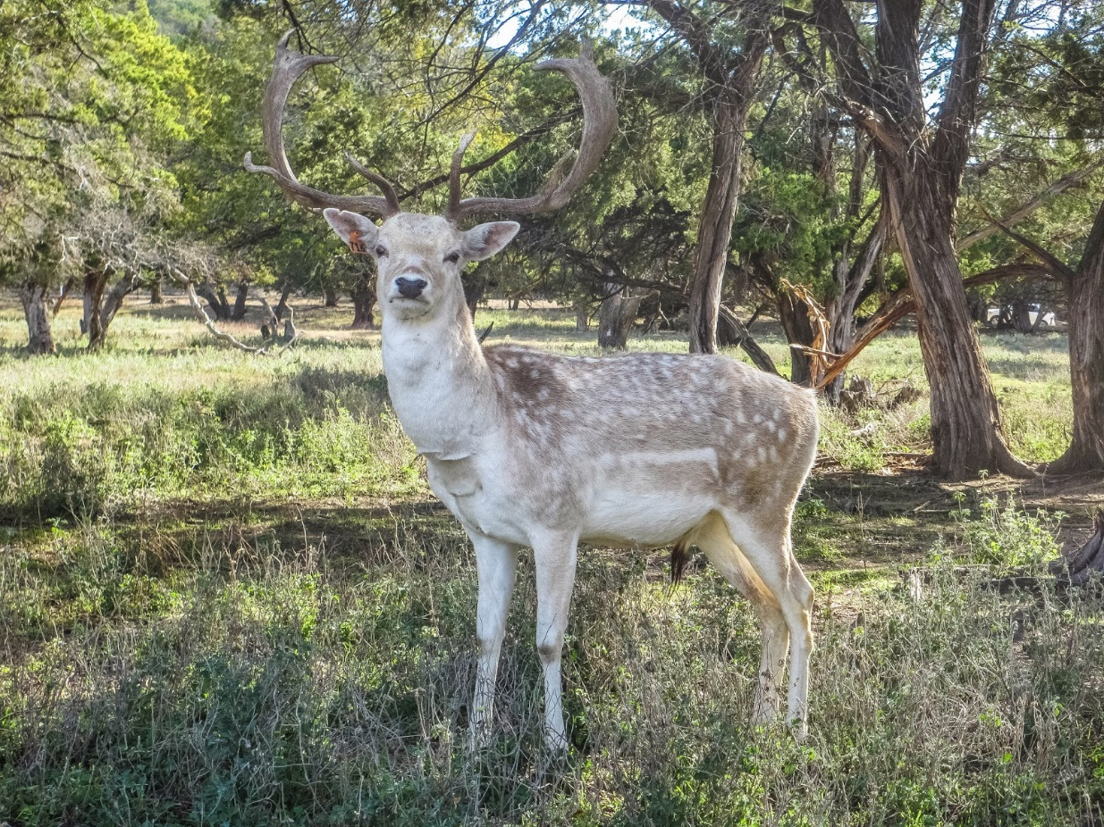
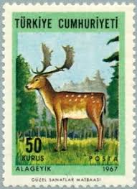
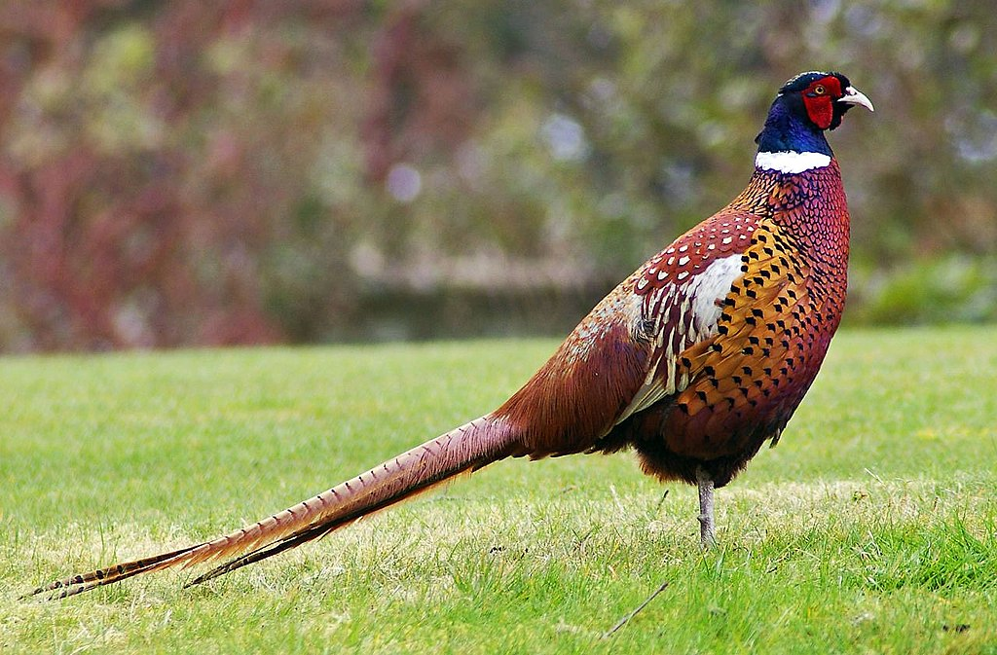
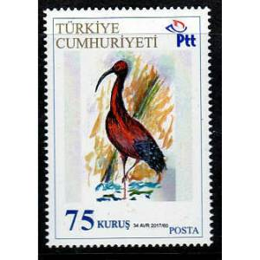

Slide 9
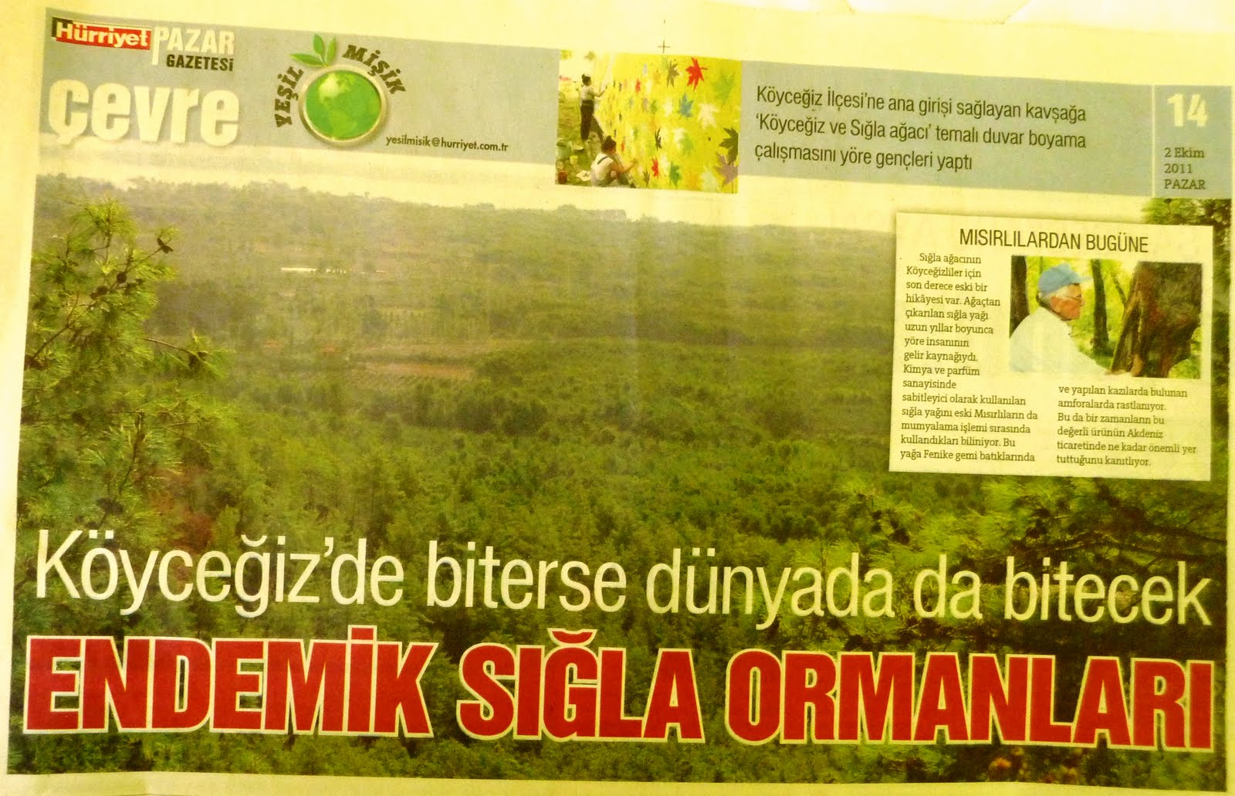
What are the factors limiting an organism’s distribution?
It is hard to define limits for organisms, but for some organisms, we can get an idea about the distribution of individuals by looking at areal photographs.

Slide 10
Species
a group of living organisms consisting of similar individuals capable of exchanging genes or interbreeding.
The species is the principal natural taxonomic unit, ranking below a genus and denoted by a Latin binomial
https://www.google.com.tr/search?q=species+definition&oq=species+definition&aqs=chrome..69i57j0l5.5077j0j7&sourceid=chrome&ie=UTF-8

