Slide 1
SEUE1003 WATER LITERACY
assıst. Prof. Şeyda Fikirdeşici Ergen

Slide 2
Eutrophication

Slide 3
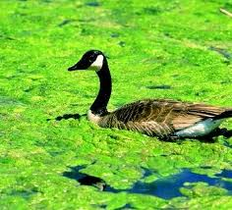
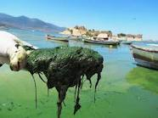
Eutrophication is an enrichment of water by nutrient salts that causes structural changes to the ecosystem such as: increased production of algae and aquatic plants, depletion of fish species, general deterioration of water quality and other effects that reduce and preclude use.
Originated from greek words: eu=‘well’ and trophes=‘fed’. Thus it means ‘well fed’ or ‘nutrient rich’

Slide 4
https://www.savegreenery.co.in/eutrophication-of-water-bodies-its-effects-and-prevention/

Slide 5
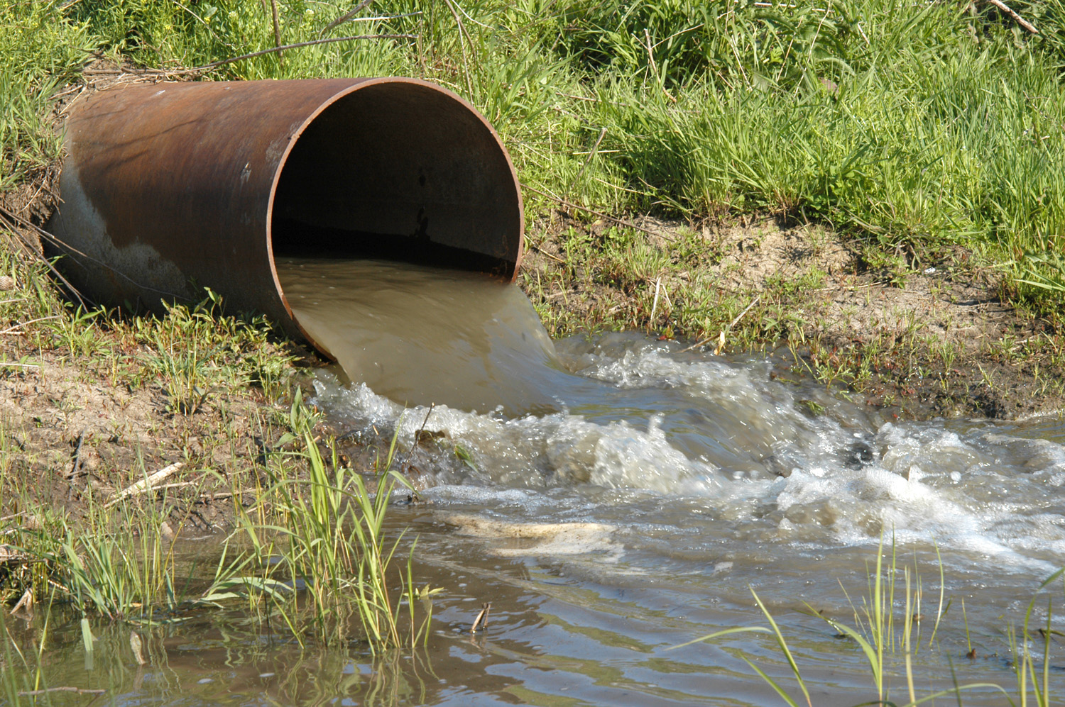
Sources of Eutrophication
Point sources (can locate the cause)
Sewage treatment plant discharges

Slide 6
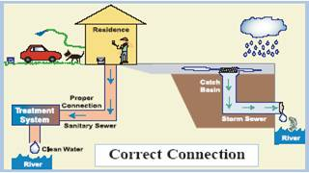
Storm sewer discharges
http://www.beachapedia.org/Illicit_Connections_and_Illicit_Discharges

Slide 7
Industrial discharges

Slide 8
Non-point sources (can’t locate the cause, it’s everywhere)
Atmospheric deposition
https://www.researchgate.net/figure/Atmospheric-deposition-processes_fig3_259167675

Slide 9
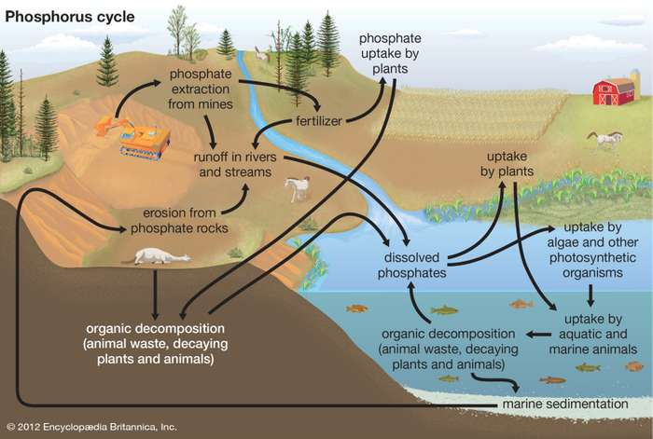
Agricultural runoff-fertilizer and soil erosion
https://earthhow.com/eutrophication-causes-process-examples/
https://www.britannica.com/science/eutrophication

Slide 10
References
Tanyolaç, J. 2000. Limnoloji. Hatiboğlu Yayınevi, Ankara.
Wetzel, G.R. 2017. editor Ergönül, M.B. Limnoloji, Göl ve Nehir Ekosistemleri. 3. baskıdan çeviri. Nobel Yayıncılık, Ankara.
"Nürnberg, G.K., 2017. Attempted management of cyanobacteria by Phoslock (lanthanum-modified clay) in Canadian lakes: water quality results and predictions. Lake Reserv. Manag. 33, 163–170. doi:10.1080/10402381.2016.1265618"
"Pérez-Sirvent, C., Hernández-Pérez, C., Martínez-Sánchez, M.J., García-Lorenzo, M.L. and Bech, J. 2017. Metal uptake by wetland plants: implicationsfor phytoremediation and restoration. J Soils Sediments, 17:1384–1393"
Kometa, S. S., Kimengsi, J. N. And Petiangma, D.M. 2018. Urban Development and its Implications on Wetland Ecosystem Services in Ndop, Cameroon, Environmental Management and Sustainable Development, Vol. 7, No. 1
Phytoremediation - Hinchman, Negri, and Gatliff, 2017. Argonne National Laboratory and Applied Natural Sciences, Inc., Phytoremediation: Using Green Plants to Clean Up Contaminated Soil, Groundwater, and Wastewater
Khan, M. Nasir and Mohammad, F. (2014 ) "Eutrophication of Lakes" in A. A. Ansari, S. S. Gill (eds.), Eutrophication: Challenges and Solutions; Volume II of Eutrophication: Causes, Consequences and Control, Springer Science+Business Media Dordrecht
" Chislock, M.F.; Doster, E.; Zitomer, R.A.; Wilson, A.E. (2013). ""Eutrophication: Causes, Consequences, and Controls in Aquatic Ecosystems"". Nature Education Knowledge. 4 (4): 10. Retrieved 10 March 2018."
"Xie, Zhenglei, Zhang, Hezi, Zhao, Xiaoxiang, Du, Zebing, Xiang, Lixiong, et al. 2016. Assessment of Heavy Metal Contamination and Wetland Management in a Newly Created Coastal NaturalReserve, China Journal of Coastal Research, 32(2) : 374-386."
G. Zhang et al.2016. Heavy metals in wetland soils along a wetland-forming chronosequence in the Yellow River Delta of China: Levels, sources and toxic risks. Ecological Indicators 69 (2016) 331–339
J. Tournebize et al. 2017. Implications for constructed wetlands to mitigate nitrateand pesticide pollution in agricultural drained watershed. Ecological Engineering 103 (2017) 415–425.
Mander, Ü., Tournebize, J., Kasak, K., Mitsch, W.J., 2014. Climate regulation byfree water surface constructed wetlands for wastewater treatment and createdriverine wetlands. Ecol. Eng. 72, 103–115
Fikirdeşici-Ergen, Ş et al. 2018. Bioremediation of heavy metal contaminated medium using Lemna minor, Daphnia magna and their consortium. Chemistry and Ecology. 34(1):43-55
Fikirdeşici-Ergen, Ş and Üçüncü-Tunca, E. 2018. Nanotoxicity Modelling and Removal Efficiencies of ZnONP, International Journal of Phytoremediation 20(1):16-26
Yakup Sedat VELIOGLU, Şeyda FİKİRDEŞİCİ-ERGEN, Pelin AKSU, Ahmet ALTINDAĞ. 2018. Effects of Ozone Treatment on the Degradation and Toxicity of Several Pesticides in Different Groups, Journal of Agricultural Sciences, 24(2):245-255

