Slide 1
MEAT HYGIENE, INSPECTION & TECHNOLOGY

Slide 2
What is meat?
The flesh(muscle) of animals used as food.
Include, as well as the musculature, organs such as liver and kidney, brains and other edible tissues.

Slide 3
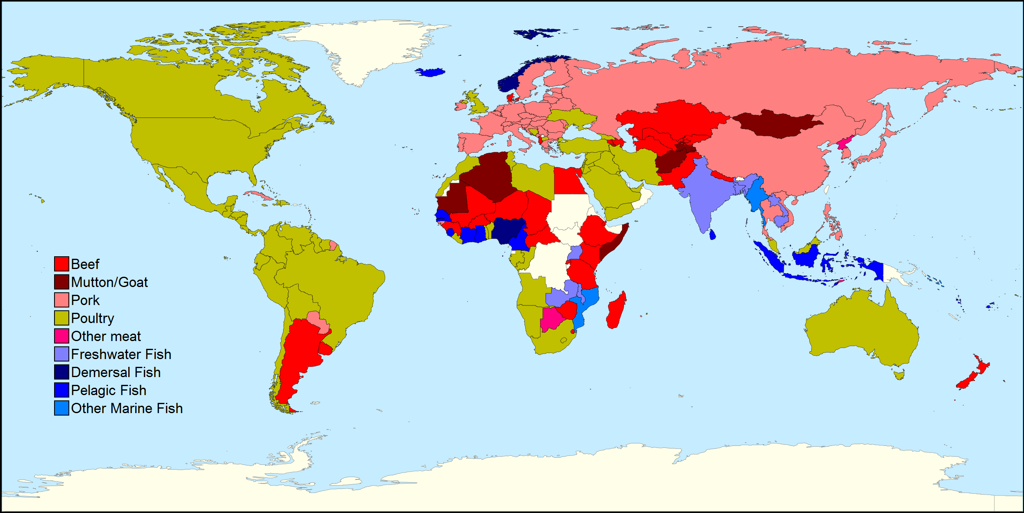

Slide 4
Horse
Non-domesticated sources of meat
Deer
Dogs
Cats
Seal
Polar bear
Camel
Crocodile
Hippopotamus
Elephant
Kangoroo

Slide 5
Types of meat
White meat
Game meat
Red meat

Slide 6
Meat in Human Diet
Good source of protein (concentrated and easily assimilable)
Stimulating the metabolism
Satisfaying- presence of fat
Palatable- gastric stimulant
Digestible

Slide 7
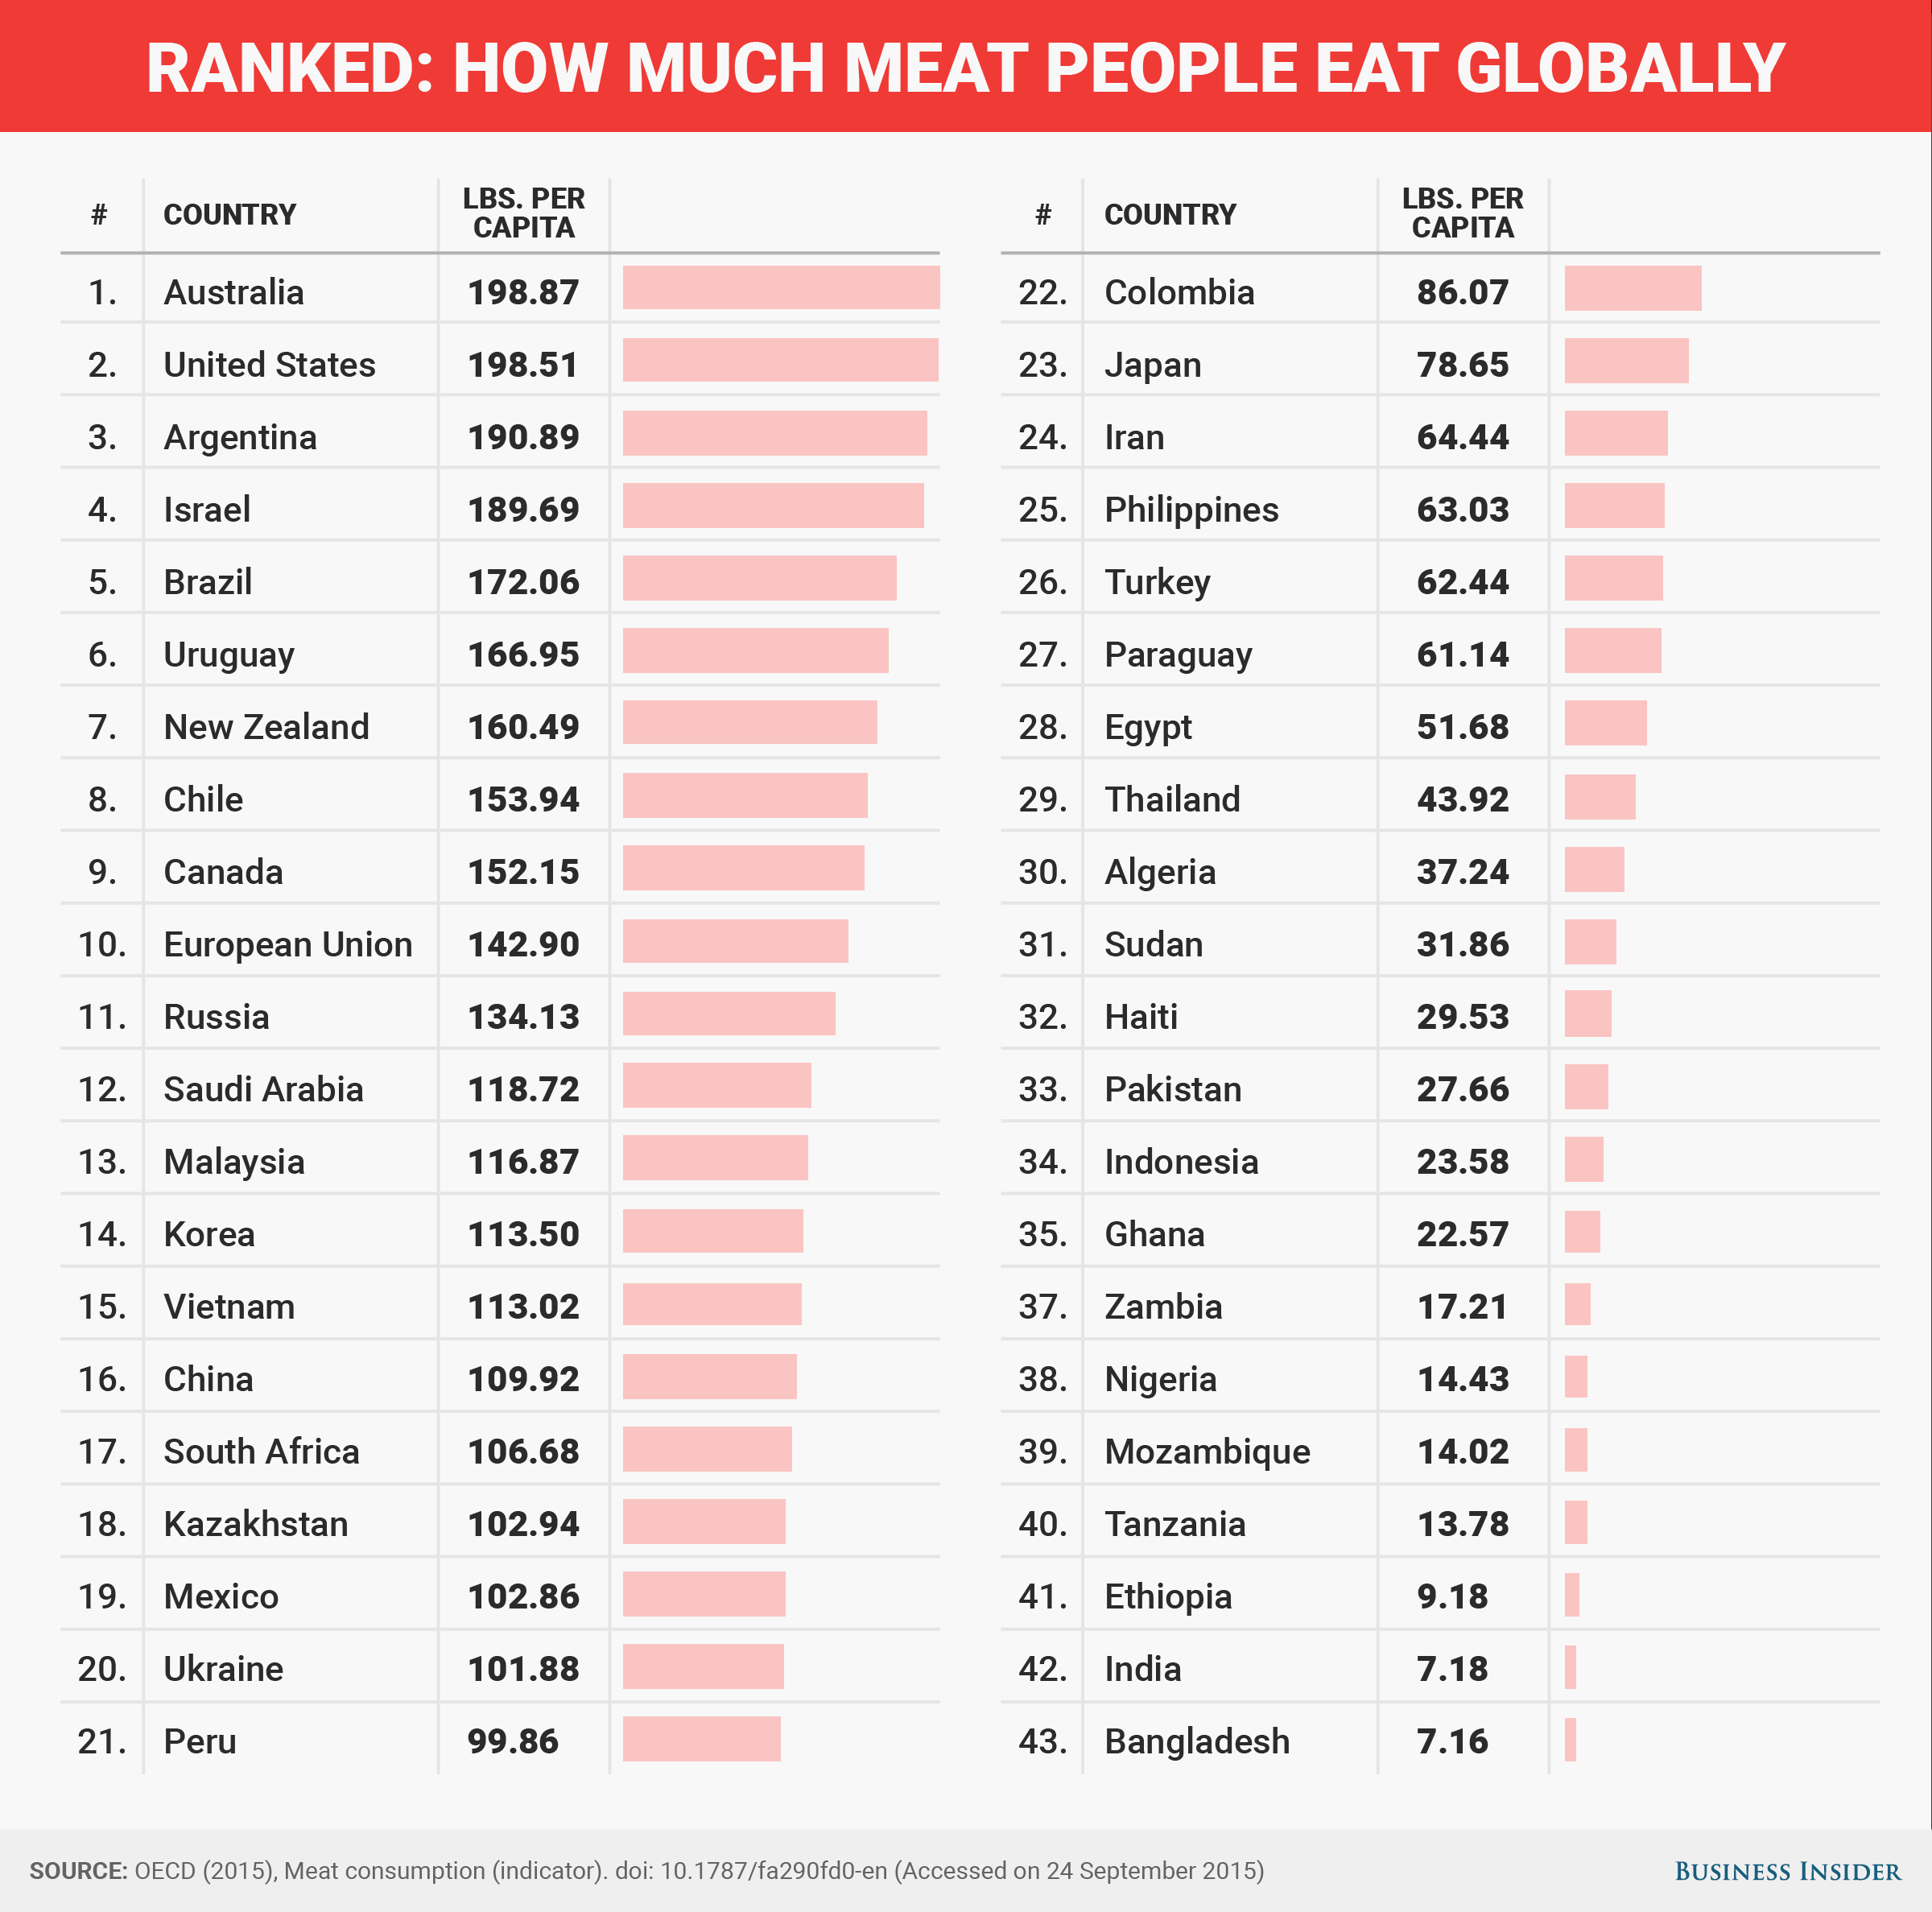
Meat Consumption
Notes:
It is difficult to make accurate comparisons of meat consumption between countries because different methods are used to estimate consumption.

Slide 8
Nutritional Values
Concentrated source of protein which is not only of high biological value but its amino acid composition complements that of cereal and other vegetable proteins.
Good source of iron and zinc and several B vitamins, liver-vitamin A.

Slide 9
Carcass
The term carcass is used in meat industry and represent the portion of body left after removal of the blood, head, feet, hides, internal organs (digestive tract, intestine, bladder, heart, trachea, lungs, kidneys, spleen etc.) and adhering fatty tissues.

Slide 10
Muscle
Connective tissue
Fat
Bone
Water
Species
Breed
Size
Age

Slide 11
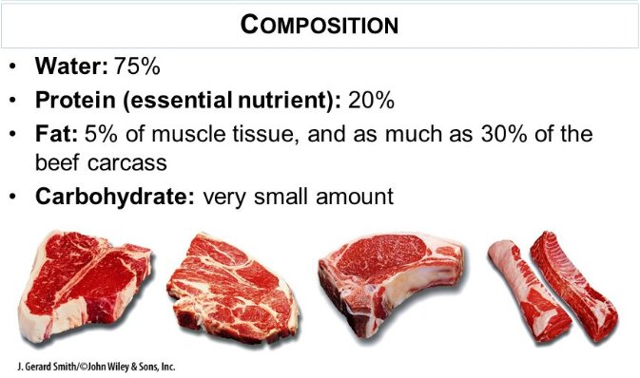
Fat | Calorie | Cholesterol | Iron

Slide 12
Proteins
Myofibrillar proteins
Sarcoplasmic proteins
Stromal protein
Muscle proteins can be broadly classified into three types depending on their solubility properties.

Slide 13
Sarcoplasmic proteins
These are readily extracted in aqueous solution of low ionic (0.15 or less) strength
Soluble in water or very dilute salt solutions.
It constitutes about 5.5 per cent of total muscle mass.
There are about 50 sarcoplasmic proteins.
myoglobin, hemoglobin, enzymes associated with glycolysis, the tricarboxylic acid cycle and the electron transport chain, flavour proteins.

Slide 14
Myofibrillar proteins
These are soluble in concentrated salt solutions and require higher (0.3 or greater) ionic strength solutions of sodium or potassium salts for their extraction.
Since they are extracted by salt solutions, they are called salt-soluble proteins.
They constitute about 11.5 per cent of muscle mass.
The myofibrillar proteins are further classified into three categories

Slide 15
Contractile proteins
Role in muscle cotntraction
Actin 20%, Myosin 45%
Regulatory proteins
regulation of actin-myosin interaction during muscle contraction and in maintenance of myofibril integrity
Tropomyosin, troponin, a-actinin and p-actinin
Cytoskeleton protein
Aligment and/or provide structural integrity of myofibrils
Titin, nebulin, C-protein, myomesin, M-protein, desmine, filamin, vinculin, synemin, 2-protein, creatinine kinase

