Slide 1
Shock
Dr murat çalışkan

Slide 2
Shock occurs as a result of inadequate tissue perfusion; the lack of an adequate energy supply leads to the buildup of waste products and failure of energy-dependent functions, release of cellular enzymes, and accumulation of calcium and reactive oxygen species (ROS) resulting in cellular injury and ultimately cellular death.
Activation of the inflammatory, coagulation, and complement cascades result in further cellular injury and microvascular thrombosis.
The amplification of these processes coupled with increased absorption of endotoxin and bacteria (due to liver and gastrointestinal dysfunction) lead to the systemic inflammatory response syndrome (SIRS), and multiorgan dysfunction and if uncontrolled, ultimately death.

Slide 3
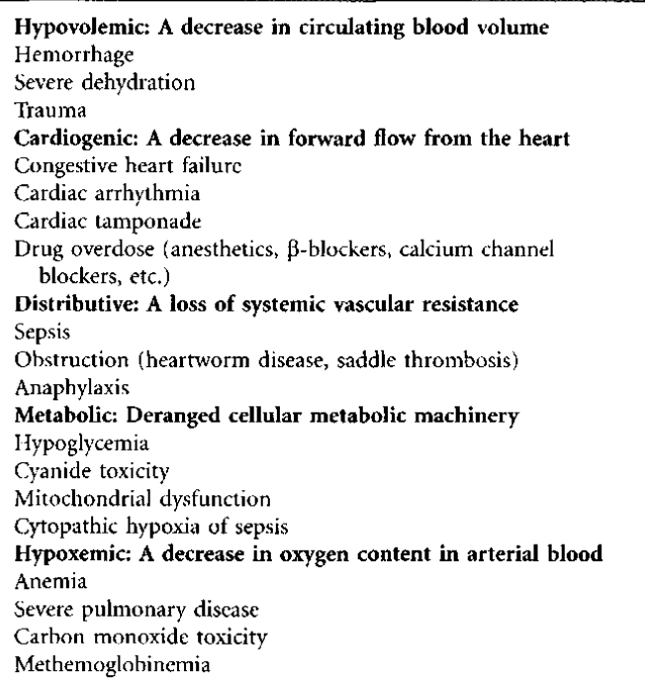
Functional Classifications and Examples of Shock

Slide 4
Tissue perfusion is dependent on blood flow. The three major factors affecting blood flow are the circulating volume, cardiac pump function, and the vasomotor tone or peripheral vascular resistance.
The interplay of these three factors can be seen in the formula for cardiac output (CO):
Cardiac output (CO) = Stroke volume × Heart rate
CO ultimately determines the blood flow to tissues and is regu- lated, in part, by the stroke volume.
Stroke volume is affected by the preload (amount of blood returning from the body and entering the heart), the cardiac contractility (muscle function), and the afterload or arterial blood pressure the heart must over- come to push blood through the aortic and pulmonic valves.

Slide 5
Causes of decreased preload include loss of volume, hypovolemia, decreases in vasomotor tone, and vasodilation, which results in pooling of blood in capacitance vessels and decreased return to the heart.
In this situation, although the total volume of blood remains unchanged, the effective circulating volume decreases.
Afterload the third component of CO, is directly affected by vasomotor tone or peripheral vascular resistance.
If vascular resistance or tone increases, afterload also rises (hypertension) with a resultant fall in CO and perfusion.

Slide 6
The opposite extreme is a severe fall in vascular resistance, which results in pooling of blood in capacitance vessels and a fall in blood pressure and preload, and it ultimately results in inadequate perfusion and shock. CO or flow can, therefore, also be described by the equation:
CO = Blood pressure / Total peripheral vascular resistance
Shock most commonly occurs because of one of three primary disturbances and can be classified accordingly.

Slide 7
Hypovolemic shock
Hypovolemic shock is the result of a volume deficit, either because of blood loss (e.g., resulting from profound hemorrhage), third space sequestration (e.g., occurring with a large colon volvulus), or severe dehydration.

Slide 8
Cardiogenic shock
Cardiogenic shock or pump failure occurs when the cardiac muscle cannot pump out adequate stroke volume to maintain perfusion.

Slide 9
Distributive shock
Distributive shock or microcircuTatory failure occurs when vasomotor tone is lost.
Loss of vascular tone can result in dramatic fall in both blood pressure and venous return.
Although the drop in blood pressure will ini- tially decrease afterload (which will improve CO), the pooling of blood and loss of venous return results in a severe decrease in preload and consequently, decreased CO and perfusion

Slide 10
Common causes of distributive shock include neurogenic shock, septic shock, and anaphylactic shock.
Because distributive shock is a loss in effective circulating volume, fluid therapy is indicated to help restore perfusion.
In contrast, cardiogenic shock is the result of pump failure, and fluid therapy may actu- ally worsen clinical signs

Slide 11
It is important to recognize that although the inciting cause may differ, as shock progresses, there is often failure of other areas as well.
For example, untreated hypovolemic shock can result in microcirculatory failure (loss of vasomotor tone) as oxygen debt causes muscle dysfunction and relaxation

Slide 12
Obstructive shock
obstructive shock is described where the mechanism underlying shock is the obstruction of ventilation, or CO.
This process is most commonly caused by tension pneumothorax (resulting in decreased venous return) or pericardiac tamponade, resulting in inadequate ventricular filling and stroke volume.
obstructive shock is ultimately a combination of the other three categories

Slide 13
PATHOPHYSIOLOGY OF SHOCK
Shock is usually defined by the stage or its severity.
Compensated shock represents an early or mild shock, during which the body’s response mechanisms are able to restore homeostasis.
As blood volume is depleted, pressure within the vessels falls. Baroreceptors and stretch receptors located in the carotid sinus, right atrium, and aortic arch sense this fall in pressure.
These receptor responses act to decrease inhibition of sympathetic tone while increasing inhibition of vagal activity and decreasing the release of atrial natriuretic peptide (ANP) by cardiac myocytes.

Slide 14
The increase in sympathetic tone and fall in ANP results in vasoconstriction, which increases total peripheral resistance and thereby increases blood pressure.
Increased sympathetic activity at the heart increases heart rate and contractility, hence increasing stroke volume (SV) and CO.
In addition, peripheral chemoreceptors stimulated by local hypoxia respond by enhancing this vasoconstrictive response.
In mild to moderate hypovolemia these responses are sufficient to restore perfusion
Because these compensatory responses result in tachycardia, increased SV (increased pulse pressure), and shortened capillary refill time (CRT), the term hyperdynamic is often used to describe this stage of shock.

Slide 15
The vasoconstrictive response will vary between organ systems, with the greatest response occurring in the viscera, integument, and kidney.
Cerebral and cardiac flow is preferentially maintained in mild to moderate hypovolemia.
Although this response improves blood pressure and flow, it also decreases perfusion to individual microvascular beds, worsening local hypoxia.
Consequently, as volume depletion worsens, certain tissues and organs will become ischemic more rapidly than others.

Slide 16
Other compensatory responses help to restore blood volume.
An increase in precapillary sphincter tone results in a drop in capillary hydrostatic pressure, which favors movement of fluid into the capillary bed from the interstitium.
This transcapillary fluid movement helps restore circulating volume by creating an interstitial fluid deficit.
Transcapillary fill is sufficient to restore circulating volume with blood loss of 15% or less.

Slide 17
In addition to transcapillary fill, a decrease in renal perfusion results in secretion of renin from juxtoglomerular cells located in the wall of the afferent arteriole.
Renin stimulates production of angiotensin I, which, after conversion to angiotensin II, increases sympathetic tone on peripheral vasculature and promotes aldosterone release from the adrenal cortex.
Aldosterone restores circulating volume by increasing renal tubular sodium and water reabsorption

Slide 18
Vasopressin, released from the posterior pituitary gland in response to decreased plasma volume and increased plasma osmolality, is a potent vasoconstrictor and stimulates increased water reabsorption in the renal collecting ducts.
Finally, an increase in thirst and a craving for salt is mediated by both the renin-angiotensin system and a fall in ANP.

Slide 19
With more severe blood loss (15% or more), compensatory mechanisms become insufficient to maintain arterial blood pressure and perfusion of vital organs.
This stage is termed uncompensated or hypodynamic shock.

Slide 20
Ischemia to more vital organs including the brain and myocardium begins to develop.
Blood pressure may be maintained, but clinical signs including resting tachycardia, tachypnea, poor peripheral pulses, and cool extremities are present.
Mild anxiety may be apparent as well as sweating from increased sympathetic activity.
Urine output and central venous filling pressure will drop.

Slide 21
As blood loss progresses, compensatory mechanisms are no longer capable of maintaining arterial blood pressure and perfusion to tissues.
Severe vasoconstriction further worsens the ischemia such that energy supplies are inadequate and cellular functions (including the vasoconstriction responses) begin to fail.
In addition, accumulations of waste products of metabolism (lactate and CO2) cause progressive acidosis and further cellular dysfunction.

Slide 22
At the cellular level the combination of decreased oxygen delivery and increased accumulation of waste products results in loss of critical energy-dependent functions, including enzymatic activities, membrane pumps, and mitochondrial activity, leading to cell swelling and release of intracellular calcium stores.
Cytotoxic lipids, enzymes, and ROS released from damaged cells further damage cells, triggering inflammation.
Inflammatory cell influx, activation of the arachidonic acid cascade, the complement cascade, and the release of enzymes and ROS cause further cellular injury.

Slide 23
Mitochondrial failure, calcium release, and reperfusion, if present, further increase production (and decrease scavenging) of ROS.
Endothelial cell damage and exposure of subendothelial tissue factor further activate the coagulation and complement cascades.
Formation of microthrombi coupled with coagulopathy impedes blood flow to the local tissues, worsening the already deteriorating situation.
The lack of energy supplies coupled with accumulation of toxic metabolites, microthrombi formation, and the inflammatory injury ultimately result in vascular smooth muscle failure and vasodilation.

Slide 24
The end results of decompensated shock are a pooling of blood and additional decreases in blood pressure, venous return, CO, and perfusion, ultimately resulting in organ failure.
Failure of the gastrointestinal tract manifests itself as loss of mucosal barrier integrity resulting in endotoxin absorption and bacterial translocation.
Renal ischemia leads to renal tubular necrosis and the inability to reabsorb solutes and water and excrete waste products.

Slide 25
At the cardiac level, the continued fall in blood pressure and venous return decreases coronary blood flow.
Cardiac muscle ischemia leads to decreased contractility and CO and ultimately to further deterioration of coronary artery blood flow.
Acidosis and ischemia accentuate the depression of cardiac muscle function.
These changes in combination with decreased venous return worsen hypotension and tissue perfusion

Slide 26
As the situation deteriorates, compensatory mechanisms designed to continue to perfuse more vital organs like the heart and brain will continue to limit flow to other organs.
This response results in the sparing of one organ with irreversible damage to another.
Consequently, an individual may recover with aggressive intervention only to succumb later because of failure of these “less vital” organs.
If blood flow is restored, these activated cellular and immunochemical cascades are washed into the venous circulation and lead to SIRS, multiple organ failures, and death
Intervention can no longer stop the cascade of events, and cellular, tissue, and organ damage is too severe for survival.

Slide 27
CLINICAL SIGNS OF SHOCK

Slide 28
Monitoring
Repetitive physical exams focusing on assessment of CO and perfusion may be the most sensitive method to assess a patient, especially during early compensated shock when subtle changes may indicate impending decompensation.
Heart rate, CRT, jugular venous fill, extremity temperature, pulse pressure, and mentation are all useful when repeatedly evaluated.
Steady improvement and stabilization of these parameters in response to treatment would suggest a positive response.
Continued tachycardia and poor pulse pressure, CRT, jugular fill, and deteriorating mentation despite treatment suggest that additional blood loss or decompensation is occurring.

Slide 29
Capillary Refill Time
Capillary refill time (CRT) is usually prolonged in hypovolemic shock.
However, CRT can also be affected by changes in vascular permeability such as seen with endotoxemia or sepsis.
In these situations, CRT may actually decrease because of vascular congestion and pooling of blood in the periphery.
Though CRT at any one time point can be misleading, if assessed over time, it is useful in evaluating the progression of shock.
Jugular fill is a relatively crude assessment of venous return or central venous pressure.

Slide 30
Urine Output
Urine output is a sensitive indicator of hypovolemia with normal urine production being approximately 1 mL/kg/hr or more, depending on how much water an individual is drinking.
Urine production of less than 0.5 mL/kg/hr suggests significant volume depletion, and fluid therapy is indicated to prevent renal ischemia
Though urine specific gravity can be used to assess renal concentrating efforts and consequently the water balance of the animal, it will be affected by intravenous fluid therapy and is not an accurate reflection of dehydration or volume status once bolus intravenous fluids have been begun.

Slide 31
TREATMENT
Treatment of shock is based on early recognition of the con­ dition and rapid restoration of the cardiovascular system
The mainstay of therapy for all forms of shock except that of shock of cardiogenic origin is based on rapid administra­ tion of large volumes of intravenous fluids to restore an effective circulating volume and tissue perfusion.

Slide 32
In cases in which intravenous access is difficult or delayed due to cardiovascu­ lar collapse, a cut-down approach or intraosseous catheteri­ zation may be necessary

Slide 33
Replacement isotonic crystalloids such as lactated Ringer's solu­ tion, 0.9% sodium chloride (NaCl), or Normosol R form the mainstay of therapy for shock, administered rapidly at doses equivalent to 1 blood volume (90 ml/kg for the dog, 40 to 60 ml/kg for the cat)
For animals with coexisting head trauma, the isotonic crystal­ loid of choice is 0.9% NaCl because it contains the highest con­ centration of sodium and is least likely to contribute to cerebral edema.
Excessive fluid administration is often evidenced by pulmonary or peripheral edema due to any combination of increased hydrostatic pressure, hypoalbuminemia, and increases in vascular endothelial permeability.

Slide 34
Synthetic colloids such as hetastarch or dextran 70 are hyperoncotic to the normal animal and therefore pull fluid into the vascular space following intravenous administra­tion.
They therefore cause an increase in blood volume that is greater than that of the infused volume and help to retain this fluid in the intravascular space in animals with normal capillary permeability.
They are appropriately used for shock therapy in acutely hypoproteinemic animals (total protein <3.5 g/dl) with a decreased colloid osmotic pres­ sure.
They can also be used with isotonic or hypertonic crystalloids to maintain adequate plasma volume expansion with lower interstitial fluid volume expansion and to expand the intravascular space with smaller volumes over a shorter time period

Slide 35
