Slide 1
Colonial Settlement: Spanish and English Colonization
AKE 117: American History
Dr. Gamze Katı Gümüş

Slide 2
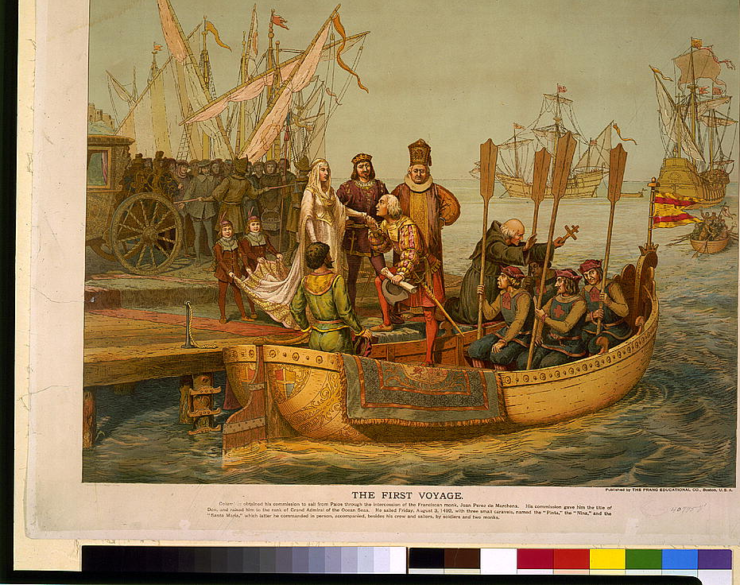
The Beginning
Christopher Columbus bidding farewell to the Queen of Spain on his departure for the New World, August 3, 1492.
Notes:
From loc.gov

Slide 3
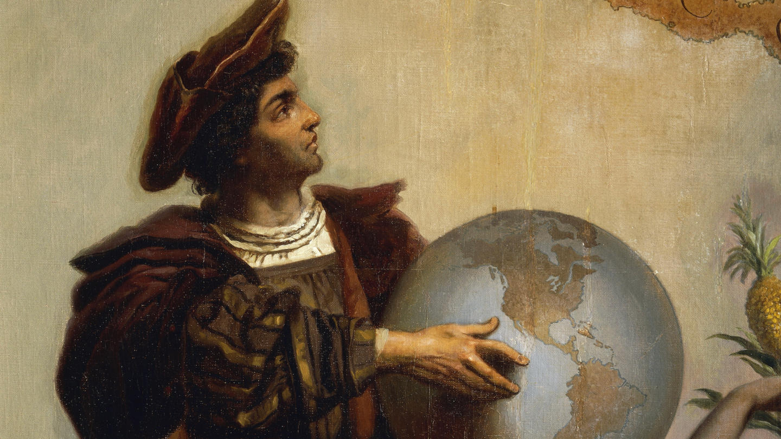
Christopher Columbus was a traveler and colonist who sailed to the New World with the financial support from Queen Isabella and King Ferdinand of Spain.
Initial aim was to find a western sea route to Asia (in search of gold and spice), since the only known routes were closed to the Europeans by the Ottoman Empire.
He landed in the West Indies in 1492 and reached the mainland in 1498.

Slide 4
The Letter of Columbus to Luis De Sant Angel Announcing His Discovery (1493)
“From that point I saw another isle to the eastward, at eighteen leagues' distance, to which I gave the name of Hispaniola. … This island, like all the others, is most extensive. It has many ports along the sea-coast excelling any in Christendom — and many fine, large, flowing rivers. The land there is elevated, with many mountains and peaks incomparably higher than in the centre isle. They are most beautiful, of a thousand varied forms, accessible, and full of trees of endless varieties, so high that they seem to touch the sky, and I have been told that they never lose their foliage. I saw them as green and lovely as trees are in Spain in the month of May. Some of them were covered with blossoms, some with fruit, and some in other conditions, according to their kind. The nightingale and other small birds of a thousand kinds were singing in the month of November when I was there. There were palm trees of six or eight varieties, the graceful peculiarities of each one of them being worthy of admiration as are the other trees, fruits and grasses. There are wonderful pine woods, and very extensive ranges of meadow land. There is honey, and there are many kinds of birds, and a great variety of fruits. Inland there are numerous mines of metals and innumerable people. Hispaniola is a marvel. Its hills and mountains, fine plains and open country, are rich and fertile for planting and for pasturage, and for building towns and villages. The seaports there are incredibly fine, as also the magnificent rivers, most of which bear gold. The trees, fruits and grasses differ widely from those in Juana. There are many spices and vast mines of gold and other metals in this island. ”

Slide 5
In 1507, Martin Waldseemüller, a German cartographer, created that map that first showed tithe area of Columbus’s discovery. Waldseemüller named this new land “America” in honor of Amerigo Vespucci, who recognized that a “New World” had been reached through Columbus’s voyage.*
Notes:
First document known to name America.* loc.gov

Slide 6
Spanish Conquests
1492
Christopher Columbus (starting in 1492)
Spaniards seized possession of most of the coastal lands of Central and South America.
1510s
Hernando Cortés (1510s to mid-century)
Rumors of treasures hidden inland
Wars with Aztecs
1530s
Francisco Pizarro

Slide 7
The Spanish America

Slide 8
Contrast b/w the British and Spanish Empires in Governing Their American Colonies
Spanish
British
Had a well-structured governmental organization
Imposed its rule on the Native “subjects”
The Catholic Church dominated the Spanish America
No effective structure of imperial government in the Anglo-American empire
Resistance of the colonists against the authority
British America became an asylum for religious dissenters

Slide 9
Why did not the Spanish America oppose the Spanish Rule?
Natives: Subjugated, enslaved, struggling to survive
Imperial Officeholders: Limited independency
Creoles: Small in number, politically dependent
Blacks: Slaves, never politically active
Mestizos: Socially inferior

Slide 10
The English Expansion
John Cabot discovered the Newfoundland, Labrador and Nova Scotia in 1497-98.
However, neither the crown nor private enterprise were interested in the New World (except for the fishermen).
This changed in 1550s due to England’s economy as well as its international relations.

Slide 11
1551
England’s economy depended on wool trade, but when the wool market collapsed in 1551, they started to look for new markets. During this time Spain was an ally whereas France was the enemy.
1558
When Elizabeth I took the throne (1558), she showed her inclination to Protestantism. By mid-1560s, Catholic Spain had become an enemy, and rebellious Protestant French became England’s new ally.

Slide 12
Reasons for Colonization
Religious:
Converting Natives to Christianity
01
Military:
Founding a base to attack the Spanish America
02
Social:
New opportunities for the unemployed English population
04
Economic:
Provide economic gain and create new markets
03

Slide 13
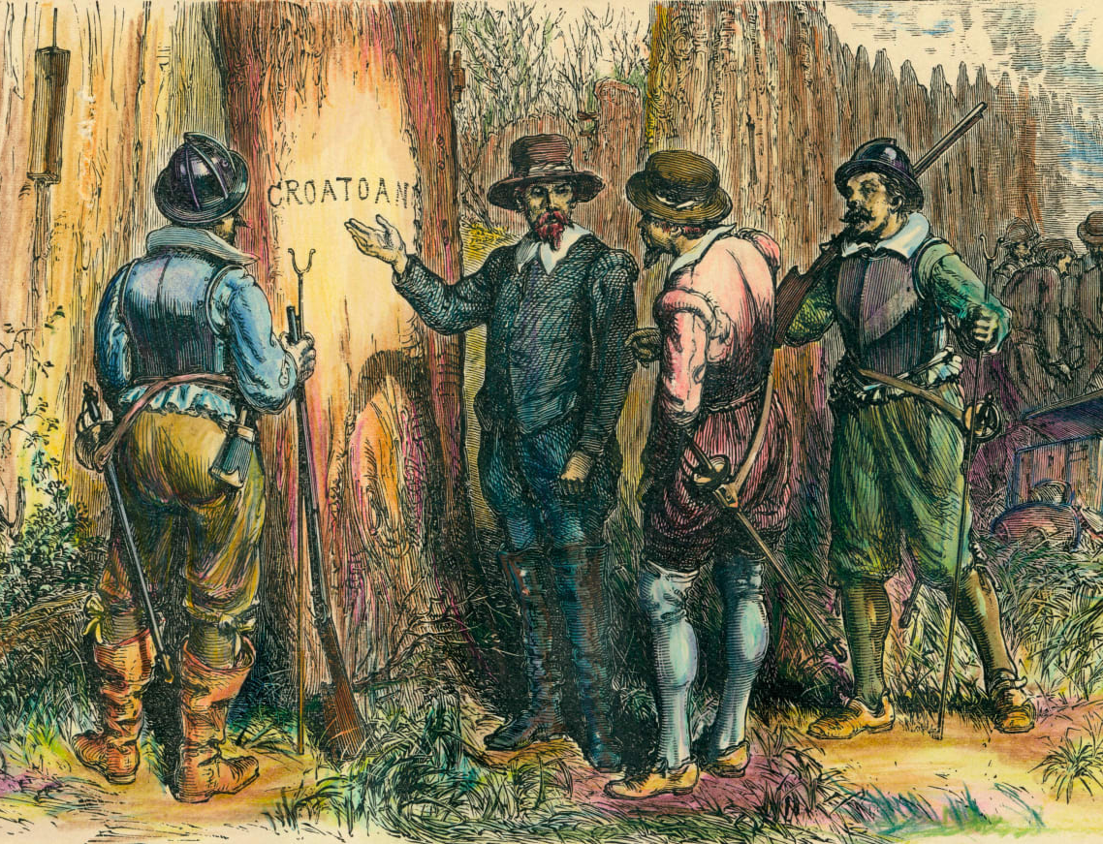
The “Lost Colony”
The first English colony in the New World was founded on Roanoke Island by Sir Walter Raleigh in 1585.
Three groups of settlers were transported to the island.
When governor John White returned to the colony in 1590, the colonists had vanished.

Slide 14
Who? How? Why?
Primogeniture : Younger sons who could not inherit family property, but, who wanted to maintain their genteel life
Unemployment: Employment was scarce with the rise of the population in the 16th century.
Merchants: They offered the capital available for overseas investment.
No direct British rule

Slide 15
The problem of governance
Minimal role in the governance of the colonies
Self-government with the imperial government as a superstructure
Finance: Organizers of the settlement or the settlers

Slide 16
Notes:
The Route from England to Virginia

Slide 17
North America

Slide 19
Financial Problems
Eleven commercial companies were financially responsible for settlements launched before 1640.
The capital was raised by selling stocks, making first settlers employees of the companies, and forcing them to send back proof of financial wealth in the colonies.
As settlers did not find any valuables, companies stopped providing supplies for them. This exposed settlers to starvation, diseases and attacks of the Natives.

Slide 20
The settlers were exploring their surroundings for
Gold
Routes to the Pacific Ocean
Indian cities
Furs and precious metals

Slide 21
Bankruptcy of the investors
Opened magazines (stores)
Developed private plantations
Sent brides over to the New World

Slide 22
Chronology
1492–1504
Columbus’ four voyages to New World
1497–1498
John Cabot explores Newfoundland, Labrador, Nova Scoatia and established English claim to North America
1523
Verrazano explores coast of North America, establishing French claim
1551
Antwerp market for English woolen goods fails
1558–1603
Elizabeth’s reign
1585–1587
Raleigh fails to establish Roanoke Colony
1603–1625
Reign of James I
1607
The foundation of Jamestowne

