Slide 1
4 DEVICES AND MATERIALS
What should be considered when working with glass devices?
How can interlocked glass connections be separated?
How can devices be installed properly and robustly?
What hazards exist in electrical devices?
What kinds of risks are encountered during heating and cooling of the devices?
Which heating and cooling environments should be used?
What should be considered when working under low pressures?

Slide 2
How to work with pressure cylinders (tubes)?
How to work with gas-passing systems?
How to prevent toxic or corrosive gas leaks?

Slide 3
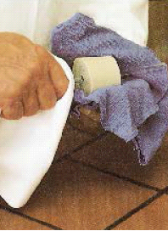
Working with Glass Materials
Glass material placement
Glass breaking during turning or bending
Sharp cornered glasses
Possible accidents during inserting of the glass tubes to the thermometer or rubber hose
Bonded rubber hoses and glass tubes

Slide 4
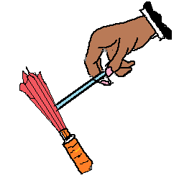
Cutting, breaking and flame polishing
Rotate cloth-covered tube on bench against tightly held file or glass-knife
Pull cloth-covered tube apart with hands, with slight bending
Flame polish sharp ends immediately

Slide 5
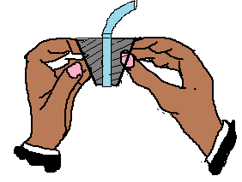
Removal of stuck bungs
Slice bung with sharp knife
Open bung to remove tubes

Slide 6
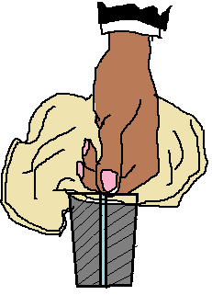
Fitting tubings into bungs
Insert rounded tube into correctly bored bungs.
Lubricate with glycerol, hold tube in cloth, and allow no space between fingers and bung

Slide 7
Removal of stuck joints
Do not use force
If tube is clean, rotate in yellow (sooty) flame until joint is free
Closed vessels with tight joints or stoppers which might contain flammables should not be heated

Slide 8
Heating of devices
1. Use the smallest amounts possible.
2. As much as possible, reduce or eliminate the combined presence of flammable material and an oxidizer, such as air. Cap bottles and vessels not in use. Use inert gas blankets when possible.
3. Store chemicals properly, physically separating flammable materials from other operations and sources of ignition.
4. Store flammable substances that require low-temperature storage only in refrigerators designed for that purpose. Never use ordinary refrigerators for storing chemicals.
5. Eliminate ignition sources from areas where flammable substances are handled. These sources include Bunsen burners; matches; smoking tobacco; gas burners; gas-fired space heating or water-heating equipment; electrical equipment such as stirring devices, motors, relays, and switches; and low-level ignition sources, such as hot plates, static discharge from clothing, steam lines, or other hot surfaces.

Slide 9
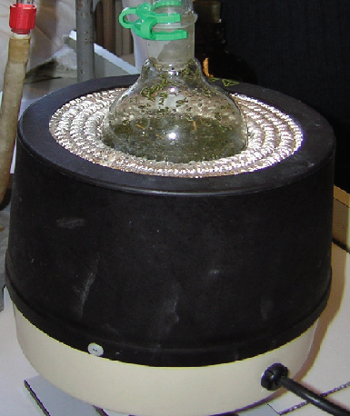
In a heating mantle, the heating element is insulated from the glass container, reducing the risk of igniting flammable substances
6. Never heat flammable substances with an open flame. Preferred heat sources include steam baths, water baths, oil and wax baths, salt and sand baths, heating mantles, and hot air or nitrogen baths.
7. Before igniting a flame, check for the presence of a flammable substance.
8. Properly ground static sources of ignition, and use the least hazardous alternative available.
9. Ground accumulated static charge when transferring flammable liquids in metal containers to avoid sparks.
10. Always attend to equipment such as hot plates, oil baths, heating mantles, stills, ovens, dryers, and other heating devices when in operation

Slide 10
Cooling
Ice, water/ice mixture (0 oC), ice/salts mixtures
(up to – 39 oC), solvent/dry ıce mixtures (-78 to
– 100 oC) and liquid nitrogen (-196 oC) can be used
as a cooling medium
Avoid skin and eye contact with cryogenic liquids.
Wear appropriate personal protective equipment,
such as a laboratory coat, temperature resistant
gloves, and chemical splash goggles. Also, do not inhale cryogenic vapors.
Store cryogenic liquids in double-walled, insulated
containers (e.g., Dewar flasks) which are designed for
this use.

Slide 11
Special working methods
Working Under Low Pressure
Glass materials with scratches or cracks on the outer surface should not be used.
Vacuumed glass should not be heated in one direction.
Only spherical glassware should be used.
When large volume glass containers are vacuumed, the glass container must be surrounded by a wire cage in case the glass is broken and scattered.

