Slide 1
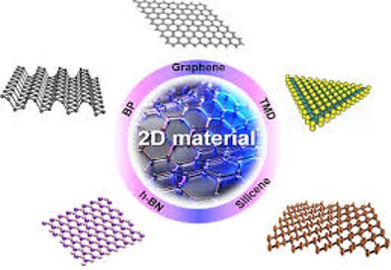
BIOCOMPATIBILITY AND BIODEGRADABILITY OF 2D MATERIALS : GRAPHENE AND BEYOND
http://choigroup.wixsite.com/nmrl/2d-material​

Slide 2
WHAT WILL BE TALK ABOUT ?​
​
The potential risks associated with 2D nanomaterials may cause serious concerns about their real applications and impact in biological systems.​
We summarise the new technology in the field of biocompatibility and biodegradability of graphene- related materials

Slide 3
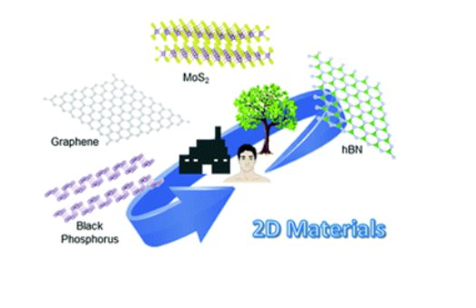
The development of 2D materials has stimulated enormous interest for their unique properties.​
2D materials => graphene, MoS2, BN, WS2
https://pubs.rsc.org/en/content/articlelanding/2019/cc/c9cc01205b#!divAbstract​

Slide 4
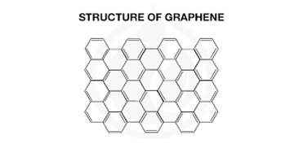
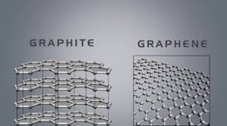
WHAT IS GRAPHENE?
https://blog.iglcoatings.com/the-science-of-graphene-based-protective-coating/
https://www.youtube.com/watch?v=ck66C0ngfhQ​
Graphene is a one-atom-thick layer of carbon atoms arranged in a hexagonal lattice. It is the building-block of Graphite.

Slide 5
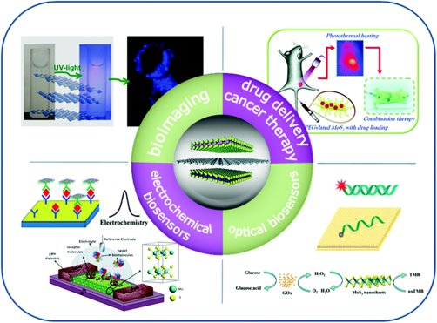
GRAPHENE IN NANOMEDICINE
Cancer​
Neurological disorder​
Wound infections
https://pubs.rsc.org/en/content/articlelanding/2015/nr/c5nr03398e#!divAbstract​

Slide 6
WHY WE USE ?
Scalable and cost effective preparation​
Physiochemical features ​
​
High specific surface area​
Ease in conjugation to peptides/antibodies/proteins and biocompatability​

Slide 7
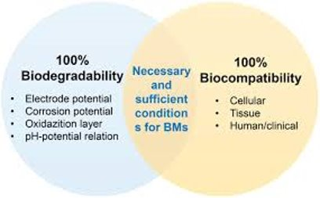
https://onlinelibrary.wiley.com/doi/abs/10.1002/adfm.201805402
Being aware of the environmental impact and possible risks on health of 2D materials.​
Focus on the biocompatibility and the biodegradation ability of 2D nanostructures

Slide 8
WHAT IS BIOCOMPATIBILITY?
The ability of materials to interact with cells, tissues or a living body without causing harmful effects is known as biocompatibility.
Comparing the biocompatibility by cytotoxicity studies of 2D nanomaterials, which differ in composition, size, number of layers, or functionalization degree, helps to better understand the mechanisms responsible of any toxic effect, really assessing the hazard potential of these materials.

Slide 9
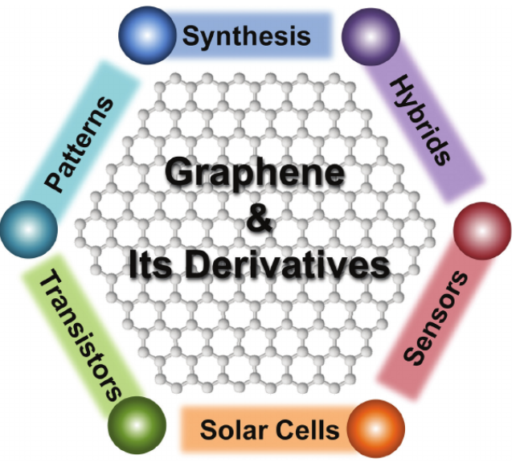
Graphene Based Materials (GBMs)
Graphene, a two-dimensional, single-layer sheet of sp2
hybridized carbon atoms, has attracted tremendous
attention and research interest, owing to its exceptional
physical properties, such as high electronic conductivity,
good thermal stability, and excellent mechanical strength.
Other forms of graphene-related materials, including
graphene oxide, reduced graphene oxide, and exfoliated
graphite, have been reliably produced in large scale.
The promising properties together with the ease of
processibility and functionalization make graphene-
based materials ideal candidates for incorporation into
a variety of functional materials. Importantly, graphene
and its derivatives have been explored in a wide
range of applications, such as electronic and photonic
devices, clean energy, and sensors.
https://www.researchgate.net/publication/51182206_Graphene-Based_Materials_Synthesis_Characterization_Properties_and_Applications

Slide 10
Regarding graphene-based materials (GBMs), Pinto et al. reviewed in 2013 their biocompatibility based on existing work. The authors concluded that some studies reported the decrease or the slight decrease of bacterial and mammalian cell viability, after GBMs exposure. However, systematic studies of the effect of the particle size on cell viability were still lacking.

Slide 11
Gurunathan et al. described the synthesis of graphene and GBMs, and highlighted their biocompatibility in the context of biological applications. The authors concluded that more studies on systematic toxicity versus biocompatibility were needed, especially using in vivo models.

Slide 12
The general conclusion of this comprehensive work is that GBMs can be categorised according to their physicochemical characteristics and cannot be considered as a single type of materials. Indeed, GBMs differ according to three key parameters:
the number of layers,
dimension, and
carbon-to-oxygen atomic ratio,
and these parameters modulate the toxicity of each specific GBM.

Slide 13
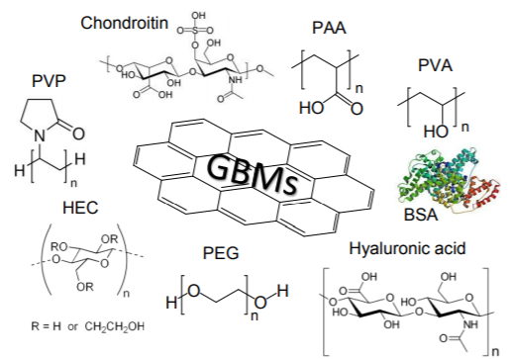
It has been demonstrated that reduced graphene oxide (rGO) functionalised with a biocompatible biopolymer, which makes it highly stable in water, showed good cytocompatibility towards endothelial cells even at very high concentrations (i.e. 100 µg mL-1).
In another work, graphene nanoplatelets were modified with poly(vinyl alcohol) (PVA), hydroxyethyl cellulose (HEC), poly(ethylene glycol) (PEG), poly(vinyl pyrrolidone), chondroitin, glucosamine, and hyaluronic acid. All materials resulted in low haemolysis up to 500 µg mL-1 , which further decreased after polymer adsorption, reaching the best results with PVA and HEC.
Functionalization strategies to enhance the biocompatibility of GBMs

Slide 14
The concentration of the 2D nanomaterial or the type of cell lines used in the experiments play also an important role. In fact, a few studies have shown a dose-dependent toxicity using different cell lines.
Concerning the in vivo impact of this type of materials, the most important studies today have focused on functionalized 2D materials. For example, iron oxide decorated MoS2 PEGylated nanosheets have been used for chelator-free radiolabelling and multimodal imaging guided photothermal therapy.

Slide 15
In conclusion, the mechanisms and material parameters responsible for tissue damage induced by 2D materials still need to be thoroughly examined. More investigations need to be performed to reveal the possible health risks of both 2D nanomaterials and related composites and hydrids.

Slide 16
WHAT IS BIODEGRADABILITY?
Biodegradability is the capacity for biological degradation of organic materials by living organisms down to the base substances such as water, carbon dioxide, methane, basic elements and biomass
Degradation of biomaterials is a serious issue for any medical device whether it is preventing degradation of implantable devices or predicting the quantity of degredation of tissue engineering scaffolds or drug releasing elements. Nanofiber scaffolds are used for orthopaedic tissue repair and regeneration
Biodegradable metals will be mostly magnesium based or iron-based alloys. They are chiefly useful for cardiovascular implants as stents and orthopaedics. Hydrogels are the polymeric materials encompassing water, that was the primary biomaterials used. They aid in tissue engineering, implantable devices, biosensors, materials controlling the activity of enzymes.

Slide 17
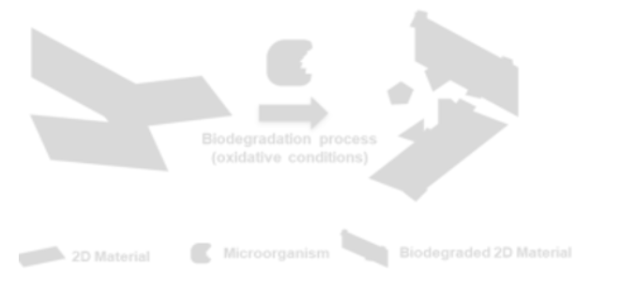
Schematic Representation of 2D Material Degradation

Slide 18
Some Techniques
Raman, mass spectrometry and transmission electron microscopy can be used to follow biodegradation particularly following the morphological and structural changes of the nanomaterials during biodegradation.
Raman spectroscopy is a spectroscopic technique based on inelastic scattering of monochromatic light, usually from a laser source. Inelastic scattering means that the frequency of photons in monochromatic light changes upon interaction with a sample. Photons of the laser light are absorbed by the sample and then reemitted. Frequency of the reemitted photons is shifted up or down in comparison with original monochromatic frequency, which is called the Raman effect. This shift provides information about vibrational, rotational and other low frequency transitions in molecules. Raman spectroscopy can be used to study solid, liquid and gaseous samples.

Slide 19
Biodegradation of Graphene-based materials
Biodegradation of nanomaterials by enzymes has been reported involving plant-derived horseradish peroxidase and animal-derived neutrophil myeloperoxidase
The scientists planned a new system to “attract” enzymes toward graphene oxide by funcitonalising the nanomaterial with coumarin and catechol, which are natural ligands of horseradish peroxidase
They studied the biodegradability materials with human myeloperoxidase and in the presence of degranulating human neutrophils, cells that are able to secrete high concentration of MPO when activated
Graphene oxide has versatile surface modification and the aqueos dispersibility
MoS2 nanosheets are thermodynamically and kinetically unstable to O2, being degraded under ambient conditions in various oxidising aqueous environments

Slide 20
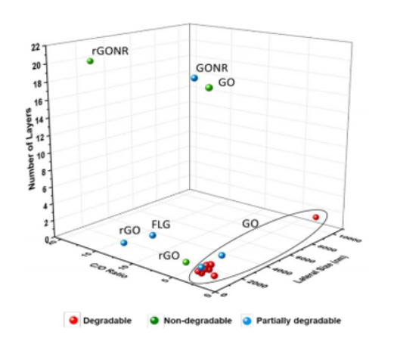
The Scientist investigated the material according to:
Number of layers
Lateral dimensions
The C/O ratio
Surface coatings on materials
The degradation of both single- and few-layer graphene was proved, concluding that these water-dispersed pristine carbon nanostructures are not biopersistent.

Slide 21
4-Conclusion and future prospects
Their safety evaluation should not only comprise the most recent GBMs.​
Also 2D materials like Si2BN, borophene, ZnO​
Validation tests should be extended to whole organisms (in vitro in vivo)​
​
Mechanisms of their biological effects are still poorly understood.

Slide 22
The design of new artificial enzymes mimicking natural systems could help fulfill this purpose.​
​
More research has to be performed to measure the safety of 2D materials.

Slide 23
THANK YOU FOR LISTENING US...
Büşra Nur Yeşilyurt - 15290192
Dilara Tokuç - 15290182
Elif Görücü - 15290159
Mihriban Özdemir - 15290171

