Slide 1
Evrim, Kurumlar ve İktisat Kuramı: Kuramlar Evrilir
Altug Yalcintas
Ankara University
altug.yalcintas@politics.ankara.edu.tr

Slide 2
Uniqueness of evolutionary social theory
4

Slide 3
Ideas evolve

Slide 4
Species evolve

Slide 5
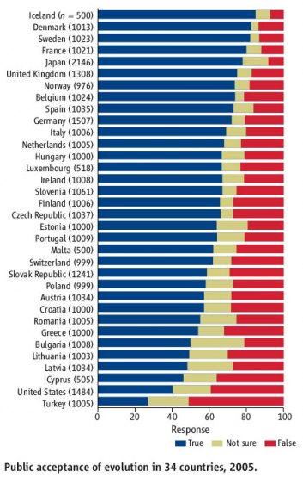

Slide 6
Results of the survey we conducted on 25 September 2014:
A question of perception: «Is evolutionary theory true?»
True: 19 / 68 (28%)
Not sure: 12 / 68 (17%)
Not true: 32 / 68 (47%)
Not responded: 5 / 68 (8%)
Results of the survey we conducted on 25 December 2014:
True: 30 / 57 (53%)
Not sure: 10 / 57 (17%)
Not true: 17 / 57 (30%)
Not responded:

Slide 7
Calamities of Nature, April 2015: http://www.calamitiesofnature.com/archive/?c=559

Slide 8
Metaphor – Tower of Babel
Christian theology
Islamic theology
Secular theology

Slide 9
Metaphor – Tower of Babel
GENESIS 11:1-9
And the whole earth was of one language, and of one speech. And it came to pass, as they journeyed from the east, that they found a plain in the land of Shinar; and they dwelt there. And they said one to another, Go to, let us make brick, and burn them throughly. And they had brick for stone, and slime had they for morter. And they said, Go to, let us build us a city and a tower, whose top may reach unto heaven; and let us make us a name, lest we be scattered abroad upon the face of the whole earth. And the LORD came down to see the city and the tower, which the children of men builded. And the LORD said, Behold, the people is one, and they have all one language; and this they begin to do: and now nothing will be restrained from them, which they have imagined to do. Go to, let us go down, and there confound their language, that they may not understand one another's speech. So the LORD scattered them abroad from thence upon the face of all the earth: and they left off to build the city. Therefore is the name of it called Babel; because the LORD did there confound the language of all the earth: and from thence did the LORD scatter them abroad upon the face of all the earth.

Slide 10
Metaphor – Tower of Babel
“Hz. İbrâhim ile Nemrud arasındaki mücadele ve Nemrud’un İbrâhim’i ateşe atması konusunda yahudi geleneğinde Bâbil Kulesi öyküsü ön plana çıkarılmıştır. Geleneksel olarak Bâbil Kulesi’nin Nemrud’un krallığı döneminde inşa edildiğine inanılır (Abodah Zarah, 53b; The Old Testament, I, 297). Milâttan sonra I. yüzyıla ait apokrif metin Pseudo-Philo’ya göre Nemrud devrinde göklere kadar uzanan kulenin inşası sırasında insanlar hazırladıkları kerpiçlere isimlerini kazırlar ve onları pişirerek inşaatta kullanırlar. Ancak İbrâhim ve yanındaki on bir kişi buna karşı çıkar, bunun üzerine tutuklanıp işkence görürler. Sonunda İbrâhim ateşe atılır, fakat yanmaktan mûcizevî şekilde kurtulur (a.g.e., II, 310-312; ayrıca bk. Pesahim, 118a; Teugels, s. 175; Evans, s. 152-153).”
Kaynak: Türkiye Diyanet Vakfı, İslam Ansiklopedisi
http://www.islamansiklopedisi.info/dia/ayrmetin.php?idno=320555&idno2=c320406 [Erişim Tarihi: Kasım 2017]

Slide 11
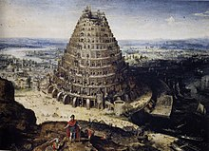
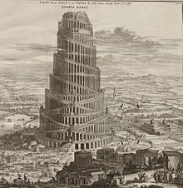
Metaphor – Tower of Babel
Gustave Dore, 1865
Lucas van Valckenborch, 1594
Athanasius Kircher, ?

Slide 12
Metaphor – Tower of Babel
Pieter Brueghel, 1563

Slide 13
Tower of Babel

Slide 14
Games (1) - Word of Mouth
Kulaktan kulağa
Rumour

Slide 15
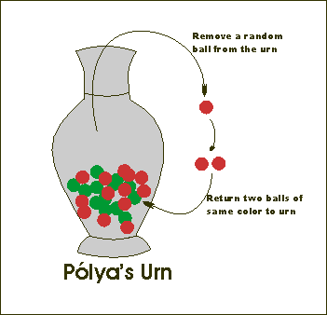
Games (2) - Polya Urn Processes

Slide 16
Games (2) - Polya Urn Processes
A simulation:
http://success-equation.com/urn.html

Slide 17
Games (2) - Polya Urn Processes
Polya Urn processes in social sciences
Value systems
Gender studies
Biographies and autobiographies
Rule of law (in Turkey)
Situation in the Middle East

Slide 18
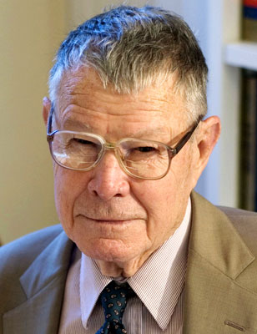
Games (3) - Segregation Models
«Segregation model» developed by Thomas Shelling
(2005 Nobel Laureate) in the 1970s.
Individual preferences and incentives matter
Such as: income, religion, language, age, education,
way of life etc.
A simple rule → a complicated pattern

Slide 19
Games (3) - Segregation Models
Unhappier
Happier

Slide 20
Games (3) - Segregation Models
Unhappier
Happier

