Slide 1
Introduction to Food Analysis
Assoc Prof. ÖZGE ŞAKIYAN DEMİRKOL
22.02.2021

Slide 3
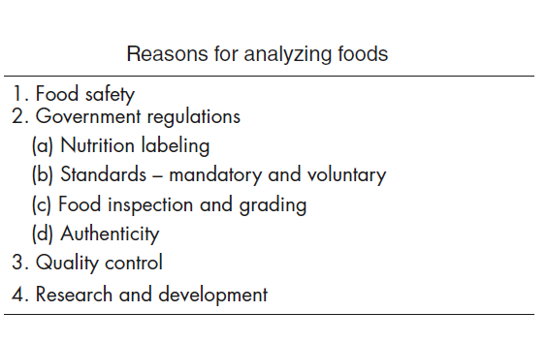
Why do we need food analysis?
Investigations in food science and technology, whether by the food industry, governmental agencies, or universities, often require determination of food composition and characteristics.
All food products require analysis of various characteristics (i.e., chemical composition, microbial content, physical properties, sensory properties) as part of a quality management program, from raw ingredients, through processing, to the final product.

Slide 4
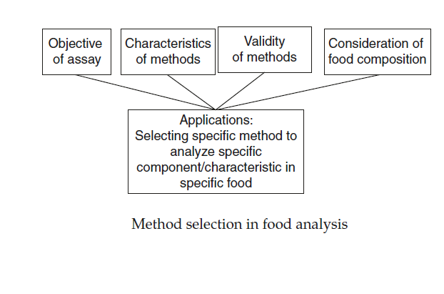
How do we decide the proper analysis method?
The nature of the sample
The specific reason for the analysis
Speed
Precision
Accuracy
Robustness
Specificity
Sensitivity

Slide 5
What are the steps of a typical analysis?
Selecting and preparing the sample
Performing the assay
Calculating and interpretting the results

Slide 6
Thanks!!!!
osakiyan@ankara.edu.tr

