Slide 1
Evaluation of the Immune System
Prof.Dr. Ümit Ölmez

Slide 2
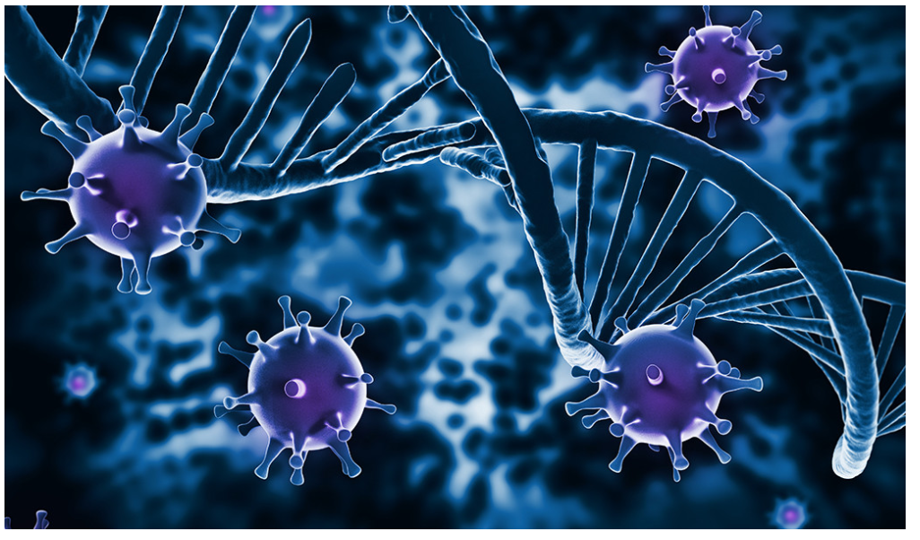

Slide 3
Immunity is defined as resistance to disease, specifically infectious disease.
The collection of cells, tissues, and molecules that mediate resistance to infections is called the immune system, and the coordinated reaction of these cells and molecules against infectious microbes comprises an immune response.
Immunology is the study of the immune system, including its responses to microbial pathogens and damaged tissues and its role in disease.
The most important physiologic function of the immune system is to prevent or eradicate infections.

Slide 4
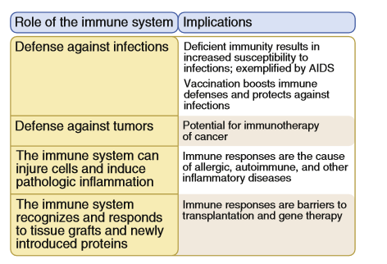
FIGURE 1-1 Importance of the immune system in health and disease.
Basic Immunology (Functions and Disorders of the Immune System) , AK Abbas, AH Lichtman, S Pillai , 5th edition.2016
FIGURE 1-1 Importance of the immune system in health and disease.

Slide 5
Host defenses are grouped under innate immunity, which provides immediate protection against microbial invasion, and adaptive immunity, which develops more slowly and provides more specialized defense against infections .
Innate immunity, also called natural immunity or native immunity, is always present in healthy individuals (hence the term innate), prepared to block the entry of microbes and to rapidly eliminate microbes that do succeed in entering host tissues.
Adaptive immunity, also called specific immunity or acquired immunity, requires expansion and differentiation of lymphocytes in response to microbes before it can provide effective defense; that is, it adapts to the presence of microbial invaders.

Slide 6
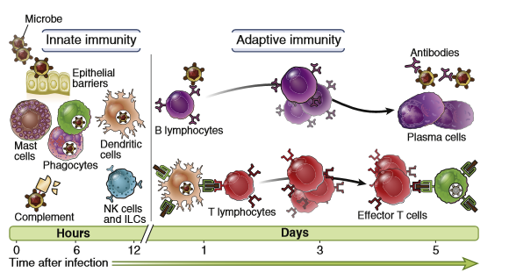
FIGURE 1-3 Principal mechanisms of innate and adaptive immunity. The mechanisms of innate immunity provide the initial defense against infections. Adaptive immune responses develop later and are mediated
by lymphocytes and their products. Antibodies block infections and eliminate microbes, and T lymphocytes eradicate intracellular microbes.
Basic Immunology (Functions and Disorders of the Immune System) , AK Abbas, AH Lichtman, S Pillai , 5th edition.2016

Slide 7
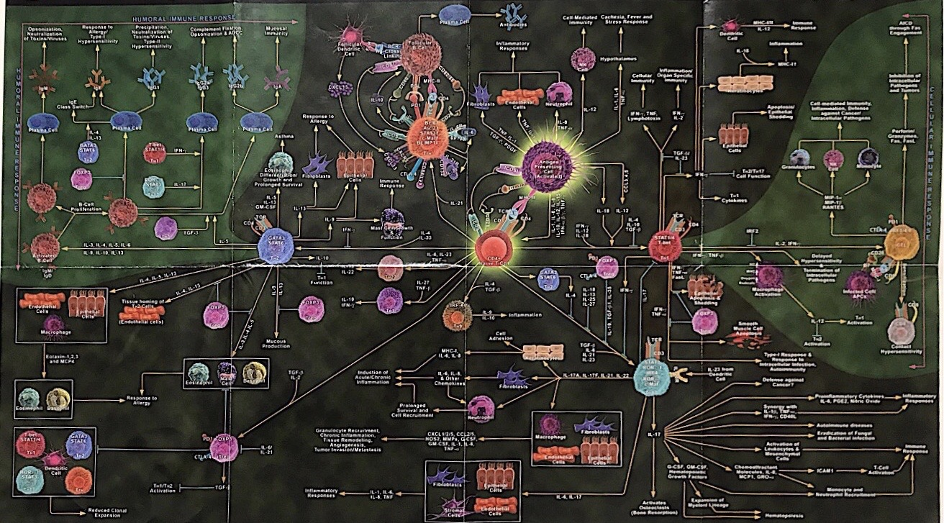

Slide 8
The adaptive immune system consists of lymphocytes and their products, such as antibodies.
Adaptive immune responses are especially important for defense against infectious microbes that are pathogenic for humans (i.e., capable of causing disease) and may have evolved to resist innate immunity.
The cells of adaptive immunity (lymphocytes) express receptors that specifically recognize a much wider variety of molecules produced by microbes as well as noninfectious substances.
Any substance that is specifically recognized by lymphocytes or antibodies is called an antigen.
There is cooperation between innate and adaptive immunity .
Adaptive immune responses often use the cells and molecules of the innate immune system to eliminate microbes.
Adaptive immunity functions to greatly enhance these antimicrobial mechanisms of innate immunity.

Slide 9
TYPES OF ADAPTIVE IMMUNITY
humoral immunity : Provide defense against extracellular microbes
cell-mediated immunity: Provide defense against intracellular microbes

Slide 10
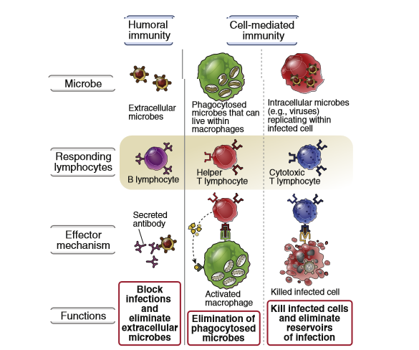
FIGURE 1-4 Types of adaptive immunity. In humoral immunity, B lymphocytes secrete antibodies that eliminate extracellular microbes. In cell-mediated immunity, different types of T lymphocytes recruit and activate phagocytes to destroy ingested microbes and kill infected cells.
Basic Immunology (Functions and Disorders of the Immune System) , AK Abbas, AH Lichtman, S Pillai , 5th edition. 2016

Slide 11
Humoral immunity, is mediated by proteins called antibodies, which are produced by cells called B lymphocytes.
Secreted antibodies enter the circulation and mucosal fluids, and they neutralize and eliminate microbes .
Microbial toxins that are present outside host cells, in the blood, extracellular fluid derived from plasma, and in the lumens of mucosal organs such as the gastrointestinal and respiratory tracts.

Slide 12
Defense against intracellular microbes is called cell-mediated immunity because it is mediated by cells, which are called T lymphocytes.
The T cells recognize microbial antigens that are displayed on host cell surfaces, which indicates there is a microbe inside the cell.

Slide 13
The specificities of B and T lymphocytes differ in important respects;
Most T cells recognize only protein antigens,
B cells and antibodies are able to recognize many different types of molecules;
Proteins
Carbohydrates
Nucleic acids
Lipids

Slide 14
Immunity may be induced in an individual by infection or vaccination (active immunity).
Conferred on an individual by transfer of antibodies or lymphocytes from an actively immunized individual (passive immunity).
In active immunity, an individual exposed to the antigens of a microbe mounts an active response to eradicate the infection and develops resistance to later infection by that microbe. Such an individual is said to be immune to that microbe.
In passive immunity, a naive individual receives antibodies or cells (e.g., lymphocytes, feasible only in animal experiments) from another individual already immune to an infection.
Passive immunity is therefore useful for rapidly conferring immunity even before the individual is able to mount an active response, but it does not induce long-lived resistance to the infection.

Slide 15
PROPERTIES OF ADAPTIVE IMMUNE RESPONSES
Specificity and Diversity
The adaptive immune system is capable of distinguishing among millions of different antigens or portions of antigens.
Specificity , is the ability to distinguish between many different antigens. It implies that the total collection of lymphocyte specificities, sometimes called the lymphocyte repertoire, is extremely diverse.
The diversity of the lymphocyte repertoire, which enables the immune system to respond to a vast number and variety of antigens.

Slide 16
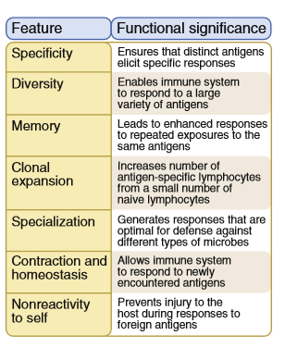
Figure 1-5 Properties of adaptive immune responses. This table summarizes the important properties of adaptive immune responses and how each feature contributes to host defense against microbes.
Basic Immunology (Functions and Disorders of the Immune System) , AK Abbas, AH Lichtman, S Pillai , 5th edition.2016

Slide 17
Memory
The adaptive immune system , mounts larger and more effective responses to repeated exposures to the same antigen. This feature of adaptive immune responses implies that the immune system remembers exposure to antigen, and this property of adaptive immunity is therefore called immunologic memory.
The response to the first exposure to antigen, called the primary immune response, is initiated by lymphocytes called naive lymphocytes that are seeing antigen for the first time . The term naive refers to these cells being immunologically inexperienced, not having previously responded to antigens.
Subsequent encounters with the same antigen lead to responses called secondary immune responses that usually are more rapid, larger, and better able to eliminate the antigen than primary responses. Secondary responses are the result of the activation of memory lymphocytes, which are long-lived cells that were induced during the primary immune response.

Slide 18
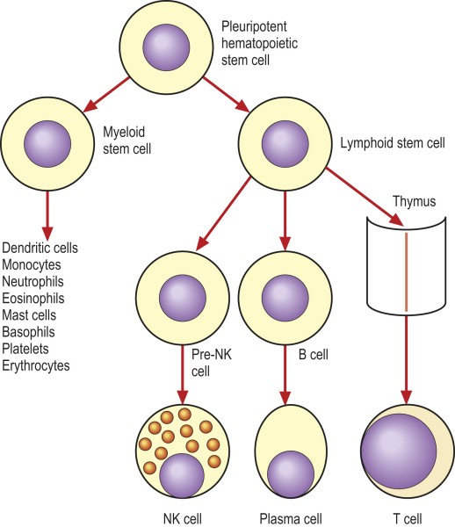

Slide 19
CELLS OF THE IMMUNE SYSTEM
The cells of the immune system are located in different tissues and serve different roles in host defense.
Lymphocytes circulate through lymphoid organs and nonlymphoid tissues.
They recognize foreign antigens and initiate adaptive immune responses.
Cells resident in tissues detect the presence of microbes and react against them. These cells include macrophages, whose function is to ingest and destroy foreign substances; dendritic cells, which capture microbes and display them to lymphocytes to initiate immune responses, and are therefore called antigen presenting cells.
Phagocytes that normally circulate in the blood, including neutrophils and monocytes, are rapidly recruited to sites of infection in the process called inflammation.
These leukocytes (white blood cells) ingest and destroy microbes and then start the process of repairing damaged tissues.

Slide 20
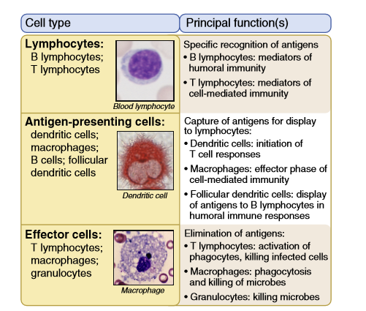
FIGURE 1-8 Principal cells of the immune system. The major cell types involved in immune response and the key functions of these cells.
Basic Immunology (Functions and Disorders of the Immune System) , AK Abbas, AH Lichtman, S Pillai , 5th edition.2016

Slide 21
Lymphocytes
Lymphocytes are the only cells that produce clonally distributed receptors specific for diverse antigens and are the key mediators of adaptive immunity.
Although all lymphocytes are morphologically similar and rather unremarkable in appearance, they are heterogeneous in lineage, function, and phenotype and are capable of complex biologic responses and activities.
B lymphocytes are the only cells capable of producing antibodies; therefore, they are the cells that mediate humoral immunity.
B cells express membrane forms of antibodies that serve as the receptors that recognize antigens and initiate the process of activation of the cells.
Soluble antigens and antigens on the surface of microbes and other cells may bind to these B lymphocyte antigen receptors, initiating the process of B cell activation.

Slide 22
T lymphocytes are responsible for cell-mediated immunity.
The antigen receptors of most T lymphocytes recognize only peptide fragments of protein antigens that are bound to specialized peptide display molecules, called major histocompatibility complex (MHC) molecules, on the surface of specialized cells, called antigen-presenting cells.
CD4+ T cells are called helper T cells because they help B lymphocytes to produce antibodies and help phagocytes to destroy ingested microbes. CD8+ T lymphocytes, are called cytotoxic T lymphocytes (CTLs) because they kill cells harboring intracellular microbes.
Some CD4+ T cells belong to a special subset that functions to prevent or limit immune responses; these are called regulatory T lymphocytes.
All lymphocytes arise from stem cells in the bone marrow.

Slide 23
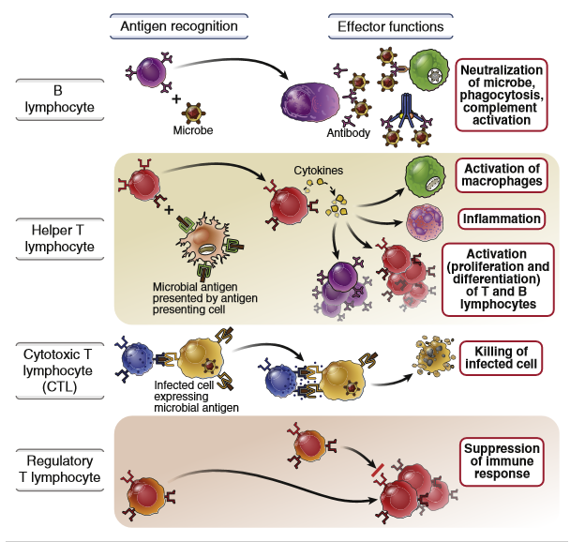
FIGURE 1-9 Classes of lymphocytes . B lymphocytes recognize soluble or cell surface antigens and differentiate into antibody-secreting cells. Helper T lymphocytes recognize antigens on the surfaces of antigen-presenting cells and secrete cytokines, which stimulate different mechanisms of immunity and inflammation. Cytotoxic T lymphocytes recognize antigens in infected cells and kill these cells. Regulatory T cells limit the activation of other lymphocytes, especially of T cells, and prevent autoimmunity. Basic Immunology (Functions and Disorders of the Immune System) , AK Abbas, AH Lichtman, S Pillai , 5th edition.2016

Slide 24
UpToDate. Waltham, MA: UpToDate Inc. https://www.uptodate.com

Slide 25
B lymphocytes mature in the bone marrow, and T lymphocytes mature in an organ called the thymus. These sites in which mature lymphocytes are produced (generated) are called the generative lymphoid organs.
Mature lymphocytes leave the generative lymphoid organs and enter the circulation and the peripheral lymphoid organs, where they may encounter antigen for which they express specific receptors.
When naive lymphocytes recognize microbial antigens and also receive additional signals induced by microbes, the antigen-specific lymphocytes proliferate and differentiate into effector cells and memory cells.

Slide 26
• Naive lymphocytes ,express receptors for antigens but do not perform the functions that are required to eliminate antigens.
The differentiation of naive lymphocytes into effector cells and memory cells is initiated by antigen recognition, thus ensuring that the immune response that develops is specific for the antigen.
• Effector lymphocytes are the differentiated progeny of naive cells that have the ability to produce molecules that function to eliminate antigens.
The effector cells in the B lymphocyte lineage are antibody-secreting cells, called plasma cells. Plasma cells develop in response to antigenic stimulation inthe peripheral lymphoid organs, where they may stay and produce antibodies.
Effector CD4+ T cells (helper T cells) produce proteins called cytokines that activate B cells, macrophages, and other cell types, thereby mediating the helper function of this lineage. Effector CD8+ T cells (CTLs) have the machinery to kill infected host cells.
Effector T lymphocytes are short-lived and die as the antigen is eliminated.
Memory cells, also generated from the progeny of antigen-stimulated lymphocytes, do survive for long periods in the absence of antigen. Memory cells are functionally inactive; they do not perform effector functions unless stimulated by antigen.
When memory cells encounter the same antigen that induced their development, the cells rapidly respond to initiate secondary immune responses.

Slide 27
Antigen-Presenting Cells
The common portals of entry for microbes—the skin, gastrointestinal tract, and respiratory tract—contain specialized antigen-presenting cells (APCs) located in the epithelium that capture antigens, transport them to peripheral lymphoid tissues, and display (present) them to lymphocytes.
This function of antigen capture and presentation is best understood for a cell type that is called dendritic cells because of their long surface membrane processes.
Dendritic cells capture protein antigens of microbes , entering through the epithelia and transport the antigens to regional lymph nodes, where the antigen-bearing dendritic cells display portions of the antigens for recognition by T lymphocytes.
If a microbe has invaded through the epithelium, it may be phagocytosed and presented by tissue macrophages.
Dendritic cells are the most effective APCs for initiating T cell responses.

Slide 28
Cells that are specialized to display antigens to T lymphocytes have another important feature that gives them the ability to stimulate T cell responses.
These specialized cells respond to microbes by producing surface and secreted proteins that are required, together with antigen, to activate naive T lymphocytes to proliferate and differentiate into effector cells.
Specialized cells that display antigens to T cells and provide additional activating signals sometimes are called professional APCs.
The prototypic professional APCs are dendritic cells, but macrophages, B cells, and a few other cell types may serve the same function .

Slide 29
Less is known about cells that may capture antigens for display to B lymphocytes.
B lymphocytes may directly recognize the antigens of microbes (either released or on the surface of the microbes), or macrophages lining lymphatic channels may capture antigens and display them to B cells.
A type of cell called the follicular dendritic cell (FDC) resides in the germinal centers of lymphoid follicles in the peripheral lymphoid organs and displays antigens that stimulate the differentiation of B cells in the follicles .
Follicular dendritic cells display antigens on their surface for recognition by B cells and are involved in the activation and selection of B cells expressing high-affinity membrane Ig during the process of affinity maturation.
FDCs do not present antigens to T cells and differ from the dendritic cells that function as APCs for T lymphocytes.

Slide 30
TISSUES OF THE IMMUNE SYSTEM
Generative lymphoid organs (also called primary, or central)
Peripheral (or secondary) lymphoid organs
Lymphocytes develop from precursors in the generative lymphoid organs (bone marrow and thymus).
Mature lymphocytes enter the peripheral lymphoid organs, where they respond to foreign antigens and recirculate in the blood and lymph.
Most of the lymphocytes in a healthy human are found in lymphoid organs and other tissues.

Slide 31
Peripheral Lymphoid Organs
The peripheral lymphoid organs;
Lymph nodes
Spleen
Mucosal and cutaneous lymphoid tissues , are organized in a way that promotes the development of adaptive immune responses.
T and B lymphocytes must locate microbes that enter at any site in the body, then respond to these microbes and eliminate them.
The anatomic organization of peripheral lymphoid organs enables APCs ,to concentrate antigens in these organs and lymphocytes to locate and respond to the antigens.

Slide 32
This organization is complemented by a remarkable ability of lymphocytes to circulate throughout the body in such a way that naive lymphocytes preferentially go to the specialized organs in which antigen is concentrated.
Effector cells go to sites of infection where microbes must be eliminated.
Furthermore, different types of lymphocytes often need to communicate to generate effective immune responses.
For example, helper T cells specific for an antigen interact with and help B lymphocytes specific for the same antigen, resulting in antibody production.

Slide 33
Lymph nodes are encapsulated nodular aggregates of lymphoid tissues located along lymphatic channels throughout the body .
Fluid constantly leaks out of blood vessels in all epithelia and connective tissues and most parenchymal organs.
This fluid, called lymph, is drained by lymphatic vessels from the tissues to the lymph nodes and eventually back into the blood circulation.
APCs in the nodes are able to sample the antigens of microbes that may enter through epithelia into tissues.
In addition, dendritic cells pick up antigens of microbes from epithelia and other tissues and transport these antigens to the lymph nodes.
The net result of these processes of antigen capture and transport is that the antigens of microbes entering through epithelia or colonizing tissues become concentrated in draining lymph nodes.

Slide 34
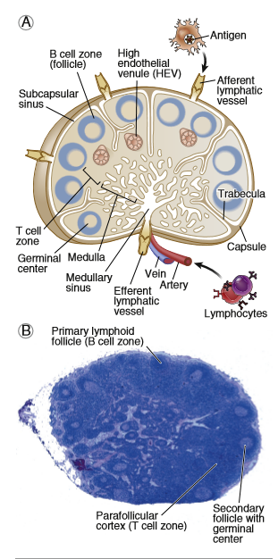
FIGURE 1-14 Morphology of lymph nodes. A, Schematic diagram shows the structural organization of a lymph node. B, Light micrograph shows a cross section of a lymph node with numerous follicles in the cortex, some of which contain lightly stained central areas (germinal centers). Basic Immunology (Functions and Disorders of the Immune System) , AK Abbas, AH Lichtman, S Pillai , 5th edition.2016

Slide 35
The spleen is a highly vascularized abdominal organ that serves the same role in immune responses to blood-borne antigens as that of lymph nodes in responses to lymph-borne antigens.
Blood entering the spleen flows through a network of channels (sinusoids).
Blood-borne antigens are captured and concentrated by dendritic cells and macrophages in the spleen.
The spleen contains abundant phagocytes, which ingest and destroy microbes in the blood.

Slide 36
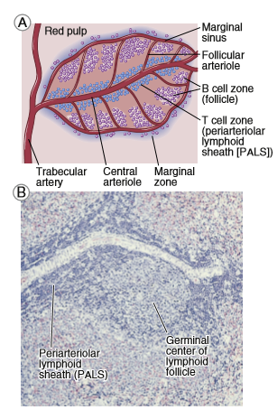
FIGURE 1-15 Morphology of the spleen. A, Schematic diagram shows a splenic arteriole surrounded by the periarteriolar lymphoid sheath (PALS) and attached follicle containing a prominent germinal center. The PALS and lymphoid follicles together constitute the white pulp. B, Light micrograph of a section of spleen shows an arteriole with the PALS and a follicle with a germinal center. These are surrounded by the red pulp, which is rich in vascular sinusoids.
Basic Immunology (Functions and Disorders of the Immune System) , AK Abbas, AH Lichtman, S Pillai , 5th edition.2016

Slide 37
Within the peripheral lymphoid organs, T lymphocytes and B lymphocytes are segregated into different anatomic compartments .
In lymph nodes, the B cells are concentrated in discrete structures, called Follicles, located around the periphery, or cortex, of each node.
If the B cells in a follicle have recently responded to an antigen, this follicle may contain a central lightly staining region called a germinal center.
Follicular dendritic cell (FDC) resides in the germinal centers of lymphoid follicles in the peripheral lymphoid organs and displays antigens that stimulate the differentiation of B cells in the follicles.
The T lymphocytes are concentrated outside but adjacent to the follicles, in the paracortex.
The follicles contain the FDCs that are involved in the activation of B cells, and the paracortex contains the dendritic cells that present antigens to T lymphocytes.
In the spleen, T lymphocytes are concentrated in periarteriolar lymphoid sheaths surrounding small arterioles, and B cells reside in the follicles.

Slide 38
The cutaneous immune system and mucosal immune system are specialized collections of lymphoid tissues and APCs located in and under the epithelia of the skin and the gastrointestinal and respiratory tracts, respectively.
Although most of the immune cells in these tissues are diffusely scattered beneath the epithelial barriers,
There are discrete collections of lymphocytes and APCs organized in a similar way as in lymph nodes.
For example, tonsils in the pharynx and Peyer’s patches in the intestine are two anatomically defined mucosal lymphoid tissues

Slide 39
Lymphocyte Recirculation and Migration into Tissues
Naive lymphocytes constantly recirculate between the blood and peripheral lymphoid organs, where they may be activated by antigens to become effector cells.
The effector lymphocytes migrate from lymphoid tissues to sites of infection, where microbes are eliminated .
Thus, lymphocytes at distinct stages of their lives migrate to the different sites where they are needed for their functions.
Migration of effector lymphocytes to sites of infection is most relevant for T cells, because effector T cells have to locate and eliminate microbes at these sites.
By contrast, plasma cells do not need to migrate to sites of infection; instead, they secrete antibodies, and the antibodies enter the blood, where they may bind blood-borne pathogens or toxins.

Slide 40
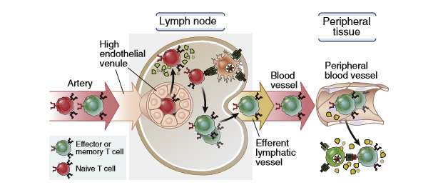
FIGURE 1-18 Migration of T lymphocytes. Naive T lymphocytes migrate from the blood through high endothelial venules into the T cell zones of lymph nodes, where the cells are activated by antigens. Activated T cells exit the nodes, enter the bloodstream, and migrate preferentially to peripheral tissues at sites of infection and inflammation.
Basic Immunology (Functions and Disorders of the Immune System) , AK Abbas, AH Lichtman, S Pillai , 5th edition.2016

Slide 41
The effector cells that are generated upon T cell activation preferentially migrate into the tissues infected by microbes, where the T lymphocytes perform their function of eradicating the infection.
B lymphocytes that recognize and respond to antigen in lymph node follicles differentiate into antibody-secreting cells, which either remain in the lymph nodes or migrate to the bone marrow.
Memory T cells consist of different populations; some cells recirculate through lymph nodes, where they can mount secondary responses to captured antigens, and other cells migrate to sites of infection, where they can respond rapidly to eliminate the infection.

Slide 42
OVERVIEW OF IMMUNE RESPONSES TO MICROBES
Early Innate Immune Response to Microbes
Inflammation
Antiviral mechanisms
Adaptive Immune Response
Initiation of Adaptive Immune Response
Capture and Display of Microbial Antigens
Cell-Mediated Immunity: Activation of T Lymphocytes and Elimination of Cell-Associated Microbes
Humoral Immunity: Activation of B Lymphocytes and Elimination of Extracellular Microbes
Homeostasis
Memory

Slide 43
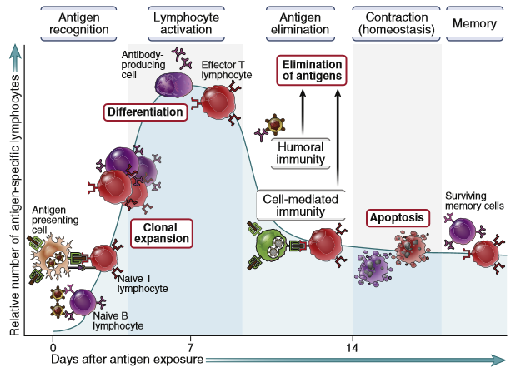
FIGURE 1-19 Phases of adaptive immune response. An adaptive immune response consists of distinct phases; the first three are recognition of antigen, activation of lymphocytes, and elimination of antigen (effector phase). The response declines as antigen-stimulated lymphocytes die by apoptosis, restoring the baseline steady state called homeostasis, and the antigen-specific cells that survive are responsible for memory. The duration of each phase may vary in different immune responses. These principles apply to both humoral immunity (mediated by B lymphocytes) and cell-mediated immunity (mediated by T lymphocytes).
Basic Immunology (Functions and Disorders of the Immune System) , AK Abbas, AH Lichtman, S Pillai , 5th edition.2016

Slide 44
As a result , an adaptive immune response consists of distinct phases;
the first three are,
Recognition of antigen
Activation of lymphocytes
Elimination of antigen (effector phase)
The response declines as antigen-stimulated lymphocytes die by apoptosis, restoring the baseline steady state called homeostasis, and the antigen-specific cells that survive are responsible for memory.
The duration of each phase may vary in different immune responses. These principles apply to both humoral immunity (mediated by B lymphocytes) and cell-mediated immunity (mediated by T lymphocytes).

Slide 45
