Slide 1
THermotHerapY
Dr.Pınar Can
pcan@ankara.edu.tr

Slide 2
Thermotherapy is the use of superficial heat and cold as a therapeutic modality for the treatment of disease or trauma.
For centuries superficial heat and cold has been used for;
managing soft tissue and joint injuries
relieving pain,
altering the physiologic processes underlying tissue healing,
affecting the elasticity of connective tissue, including muscle, tendon, ligament, and joint capsule.

Slide 3
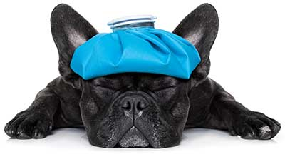
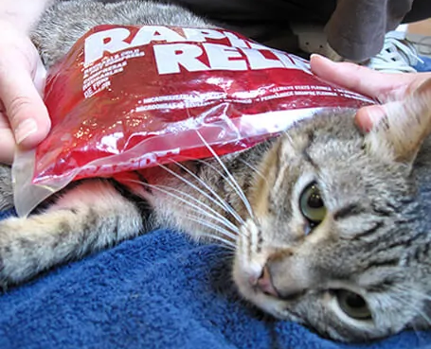
Superficial thermal agents are convenient modalities as they are readily available, involve minimal expense
They are frequently safe to include as part of a home treatment program
http://rehabvets.org/img/content/thermotherapy.jpg
https://4pawsrehabclinic.com/wp-content/uploads/2017/01/thermotherapy.jpg

Slide 4
The Physics of Thermotherapy
Thermotherapy applications fall in the infrared portion of the electromagnetic spectrum just beyond the wavelength and frequency ranges for visible light.

Slide 5
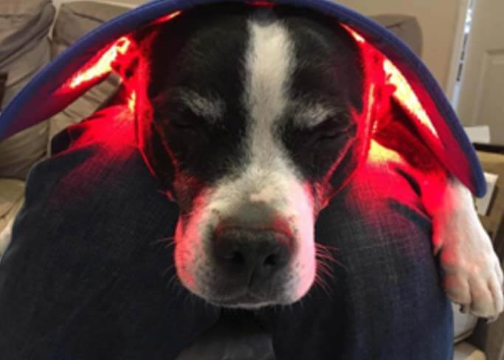
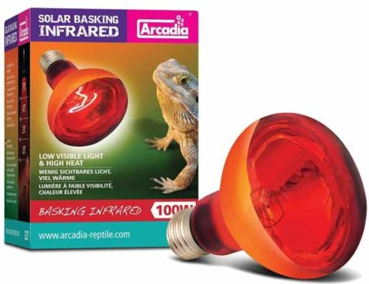
The shorter the wavelength, the greater the frequency and the more superficial the depth of penetration.
Tissue must absorb the energy produced by the thermal agent to stimulate the tissue’s normal function.
If the absorbed energy is insufficient to stimulate the tissue, there is no effect.
If too much energy is absorbed, tissue damage may occur.
https://photonichealth.com/wp-content/uploads/2020/05/red-light-therapy-dogs.jpg
https://redlightman.com/wp-content/uploads/reptile-bulb-510x392.jpg

Slide 6
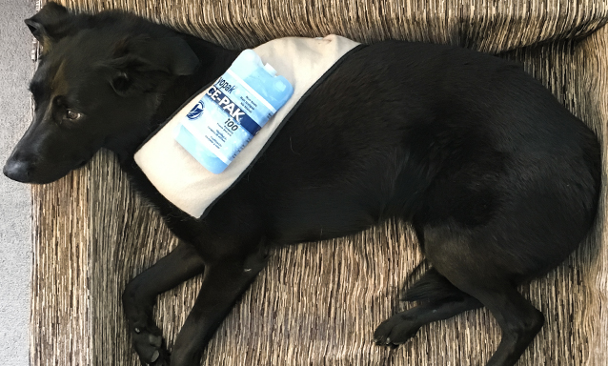
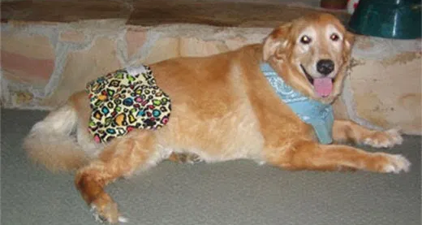
Most infrared thermal modalities (cold or hot packs, whirlpools, paraffin baths, or luminous infrared devices) can penetrate to a depth approximately 1 to 2 cm.
https://rehabfuryourpet.com/img/services/thermotherapy-cryotherapy.jpg
https://i1.wp.com/mydogsymptoms.com/wp-content/uploads/2014/05/6dc6f-hiphug.jpg?ssl=1

Slide 7
Transfer mechanisms of heat to the tissues
Conduction is the transfer of heat by the direct interaction of the molecules in one area with those in another area
Example: cold/hot packs
Convection is the heat transfer by movement of air or fluid from a warm area to a cooler area
Example: the circulatory system, air temperature

Slide 8
Radiation is the exchange of electromagnetic energy that occurs when there is a difference in temperature between two objects. Heat transfers from a warmer to cooler area.
Example: sun, infrared lamps
Evaporation is the vapocoolant sprays are used to cool the skin and underlying tissues by causing evaporation and extracting heat from the tissues.

Slide 9
Conversion is the conversion of a nonthermal form of energy (mechanical, chemical) that penetrates the tissues and is converted to heat.
Example: therapeutic ultrasound; sound waves being converted to thermal energy within the tissues
Most thermal techniques transfer energy by conduction.

Slide 10
CRYOTHERAPY
is used during the acute phase of tissue injury and healing to mitigate the effects and sequelae of tissue injury,
also after exercise during rehabilitation to minimize adverse secondary inflammatory responses.
is most effectively used immediately following trauma (accidental or following surgical procedures)

Slide 11
Cryokinetics combines cryotherapy with motion (passive, active-assisted, or active)
The aims of cryokinetics are to facilitate normal, pain-free movement, and to reduce edema through a muscle pumping action to facilitate the return of lymphatic fluid to the vascular system.

Slide 12
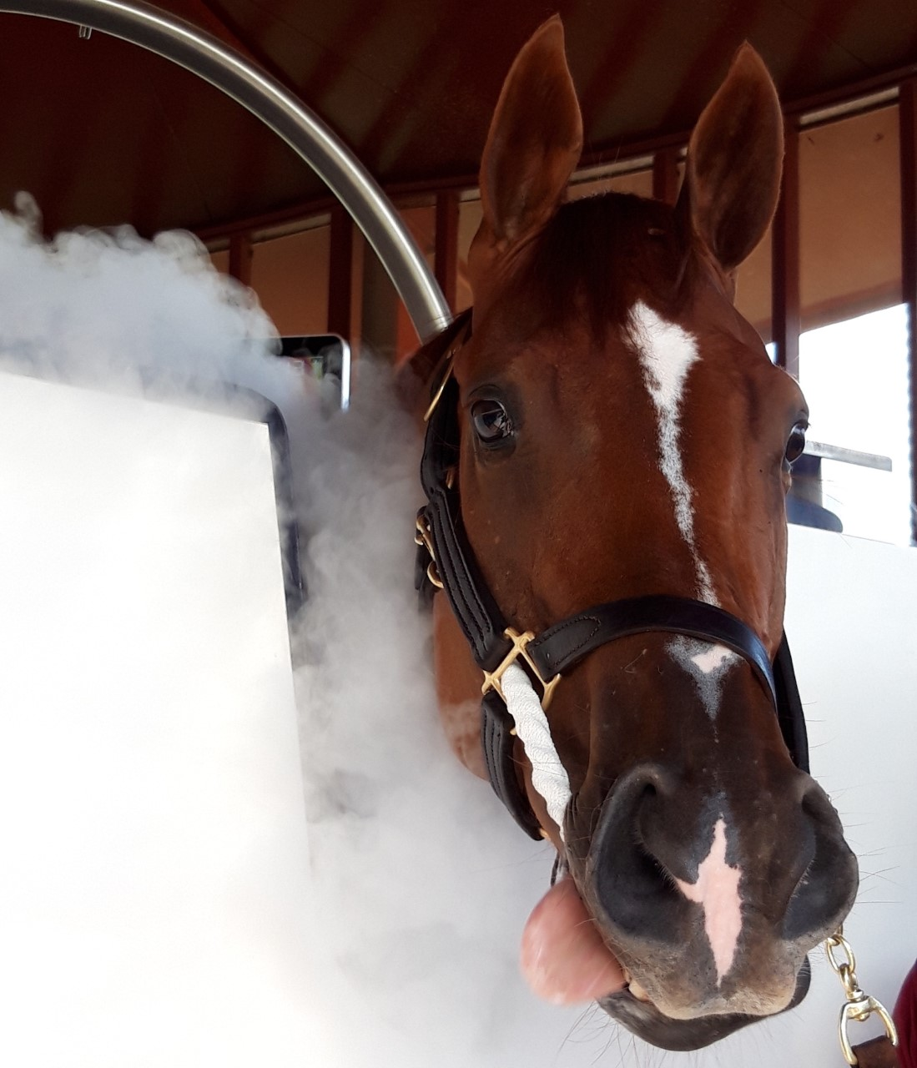
The effects of cryotherapy;
Vasoconstriction
Decreased blood flow
Decreased swelling
Reduced enzyme-mediated tissue damage
Analgesia
https://www.arabianbusiness.com/public/images/2019/07/25/revive-cryotherapy.jpg

Slide 13
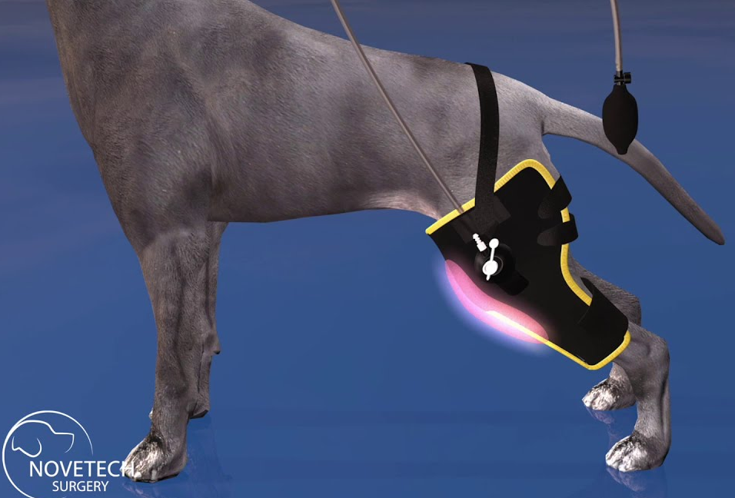
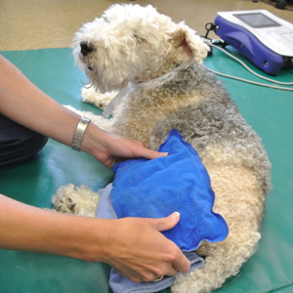
Cooling leads to vasoconstriction and local blood flow slows, bleeding reduces
edema formation after injury or after surgery is decreased
The cooling of the tissue;
reduces the metabolic rate of the treated tissue,
decreases the rate of reactions related to the acute inflammatory process,
causes the inhibition of enzymatic effects related to inflammation and minimizes the release of histamine, which reduces the tissue damage
https://i.ytimg.com/vi/MUH3tRVxDDI/maxresdefault.jpg
http://www.caninerehabcenterhouston.com/wp-content/uploads/2014/09/CRC_Heat.jpg

Slide 14
The vasoconstriction of blood vessels also may help to decrease pain by decreasing pressure on nociceptors
Pain relief may be provided by decreasing nerve conduction velocity.
The analgesia provides a concomitant reduction of reflex muscle spasm.
Cold is most effective when applied during the acute phase of trauma, typically in the first 72 hours after injury or surgery.

Slide 15
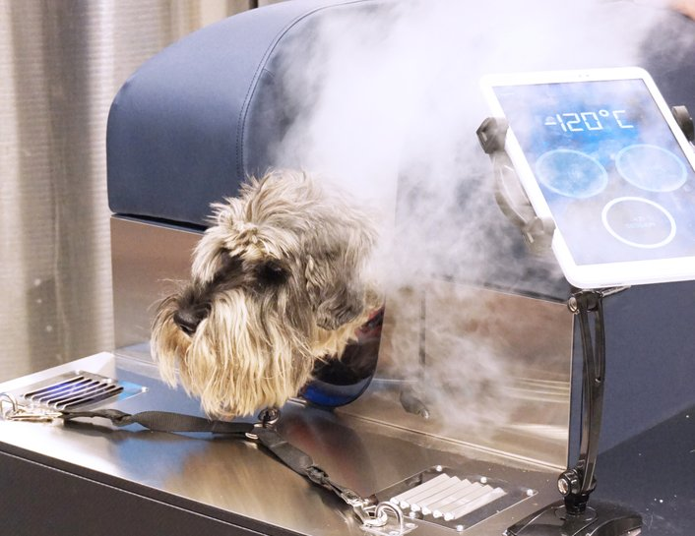
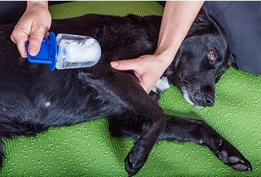
Cold application ways;
Cold water-circulating blankets,
reusable ice packs,
ice cubes wrapped in a towel,
ice cups,
cold immersion,
cold compression devices,
vapocoolant sprays,
contrast baths
https://vetcryo.se/vetcryo
https://www.vscsarasota.com/wp-content/uploads/2016/11/Rehab-Page_23-1.jpg

Slide 16
Contrast baths;
alternate immersion of an area in warm and cold water.
produces alternating vasodilatation and vasoconstriction
is sometimes used to decrease edema
are appropriate in the acute phase, also during the early subacute phase of tissue healing.
During the acute phase of tissue healing, the cycles of alternating immersion should have greater emphasis on cold water (exp; 3 mins cold 1 min warm)

Slide 17
Cryotherapy application duration
The application time is usually 15 to 20 minutes and may be repeated throughout the day.
A common method is to repeat the cold application every 2 to 4 hours during the first 24 to 48 hours after the injury,
or treat 10 to 15 minutes on and 10 to 15 minutes off twice.
An ice treatment should not be applied for more than 20 minutes per session to avoid tissue damage.

Slide 18
Heat therapy
Superficial heat applications are mostly used to increase temperature in the tissue before stretching exercises.
Superficial heating agents can penetrate tissue depths up to about 2 cm, while deep heating agents can raise tissue temperature to a depth of 5 cm.
Although the temperature of the skin can increase by 10 ° C or more, tissues at 1 cm depth typically rise below 3 ° C and tissues at 2 cm rise to less than 1 ° C.

Slide 19
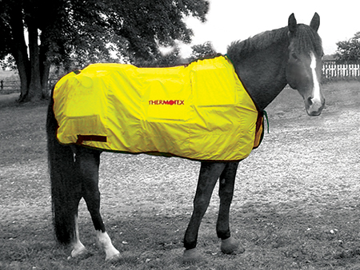
Effects of heat therapy;
Increasing circulation (vasodilation)
Pain relieving
Increasing the extension capacity of soft tissues
Reduction of muscle spasm
https://www.painreliefessentials.com/wp-content/uploads/Thermotex-Infrared-12-Pad-Blanket-2.jpg

Slide 20
When the tissue temperature increases, vasodilation occurs.
Heat causes vasodilation with various effects;
Direct reflex activation of smooth muscle of blood vessels by cutaneous thermoreceptors,
Indirect activation of local spinal cord reflexes by cutaneous thermoreceptors
Locally increasing the release of chemical inflammatory mediators (histamine, prostaglandin, bradykinin)

Slide 21
The oxygenation of the tissue and the transport of metabolites to the exercising tissue increases due to vasodilation.
In addition, the rate of enzymatic and biochemical reactions that will provide tissue healing increases.
The occurrence of vasodilation in the distal extremities may increase the absorption of edema.

Slide 22
The extension capacity of the soft tissues and the range of motion of the joint increase.
However, application of heat in the very early stages of tissue healing may exacerbate acute inflammation and increase enzymatic activity (eg collagenase and protease).
Therefore, tissue damage may occur when applied in the early period.

Slide 23
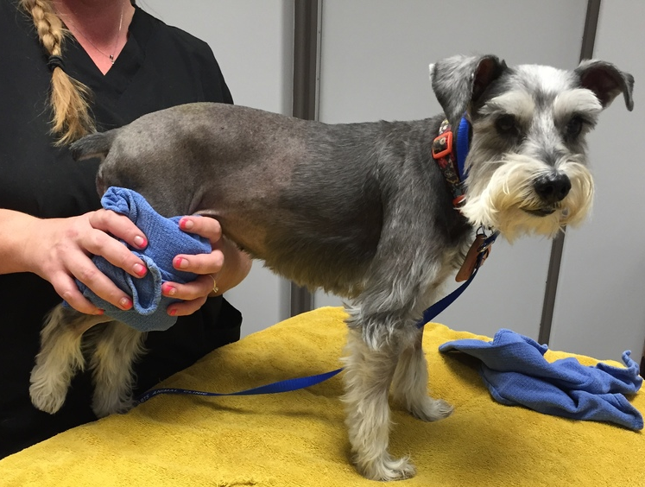
Local heat application increases the sensory and motor nerve conduction velocity.
An increase or decrease in conduction velocity reduces pain and muscle spasm.
For every 1 ° C temperature increase, the nerve conduction velocity increases by approximately 2 m / sec.
Local heat application may increase the individual pain threshold.
https://images.squarespace-cdn.com/content/v1/55ba9a1de4b08d0b7eb69388/1440623435210-XJCTICMSUOHK1VMQ445H/ke17ZwdGBToddI8pDm48kDHPSfPanjkWqhH6pl6g5ph7gQa3H78H3Y0txjaiv_0fDoOvxcdMmMKkDsyUqMSsMWxHk725yiiHCCLfrh8O1z4YTzHvnKhyp6Da-NYroOW3ZGjoBKy3azqku80C789l0mwONMR1ELp49Lyc52iWr5dNb1QJw9casjKdtTg1_-y4jz4ptJBmI9gQmbjSQnNGng/image-asset.jpeg?format=1000w

Slide 24
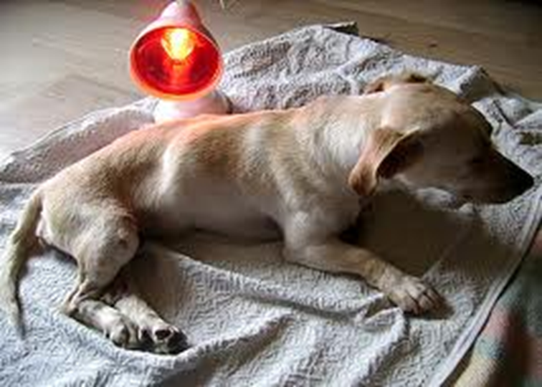
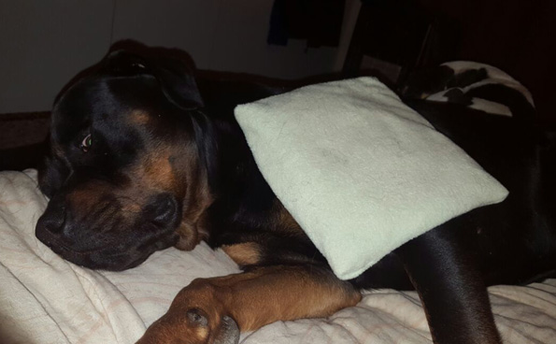
Heat application ways
Hot packs
Warm paraffin baths (45-50° C)
Infrared or UV lamps
Warm water bath (27-35 °C)
https://cdn.ampmarketing.co.za/wp-content/uploads/2017/06/Thermal-Therapies-Animal-Health-Hydro.jpg

Slide 25
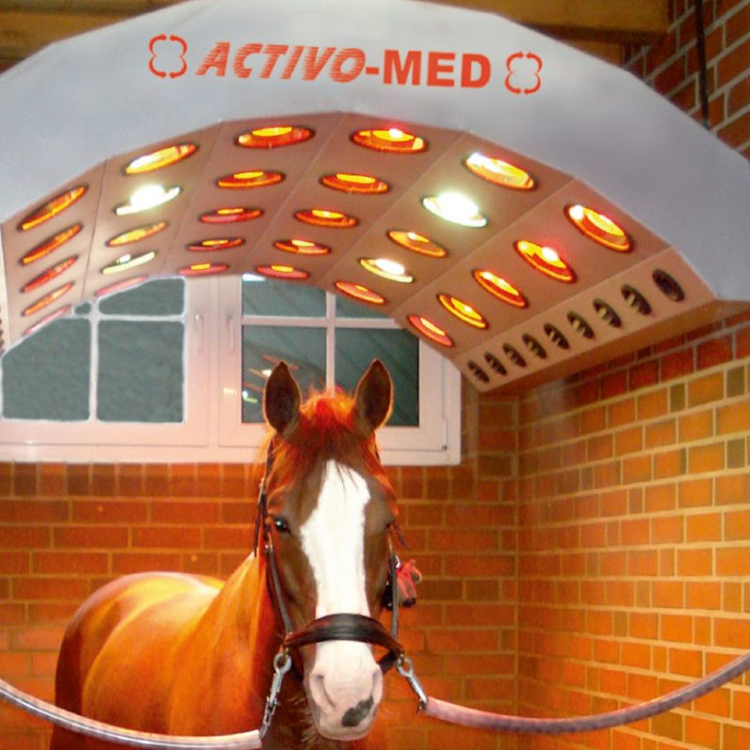
Heat therapy application duration
Usually 15-30 minutes, 3-4 times a day
Maximal benefit can be achieved when tissue temperature is increased by 2-4 ° C.
If the tissue temperature exceeds 45 ° C, it may cause pain and irreversible tissue damage.
It is more effective when combined with massage, exercise and electrotherapy.
https://fmbs.co.uk/wp-content/uploads/2018/10/solarium-800x800.jpg

Slide 26
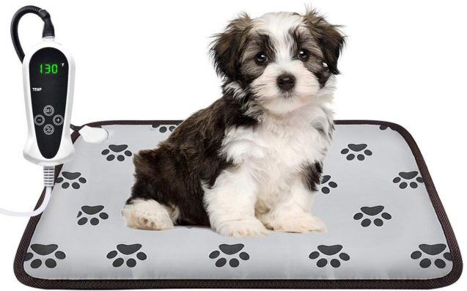
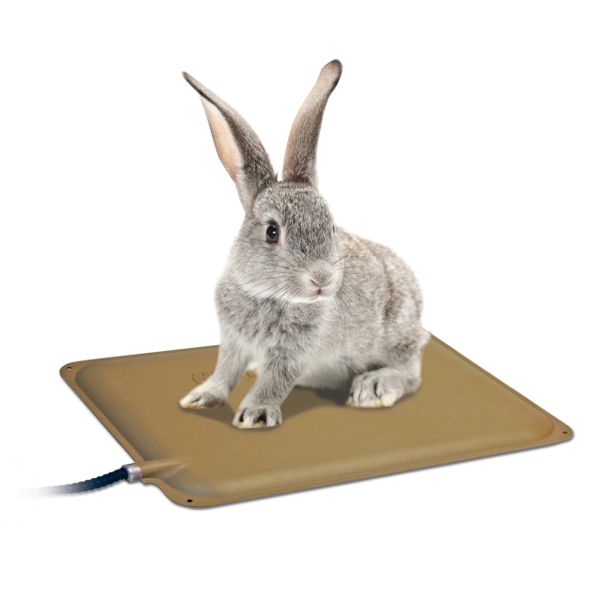
Precautions and Contraindications
Electrical heating pads and infrared lamps are types of thermotherapy with a higher risk of burning.
Electrical heating pads should never be placed under an anesthetized or heavily sedated animal with reduced superficial skin sensation.
https://www.petguide.com/wp-content/uploads/2019/12/AILEEPET-Pet-Heating-Pad-637x397.jpg
https://assets.petco.com/petco/image/upload/f_auto,q_auto/1040391-center-2

Slide 27
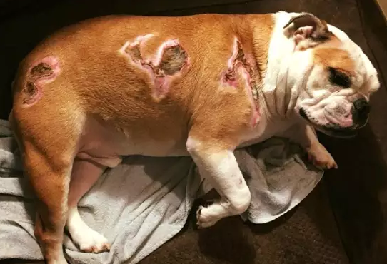
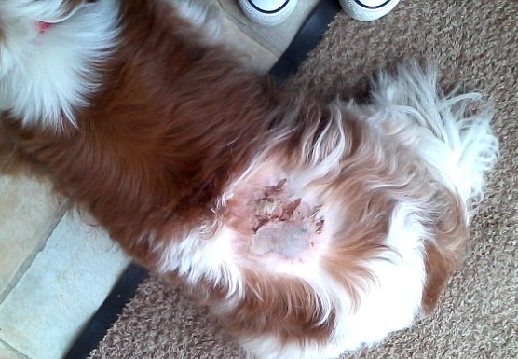
As a general rule, animals should never be left unattended during treatment and the skin should be checked frequently.
https://daily-voice-res.cloudinary.com/image/upload/c_fill,dpr_1,f_auto,q_auto:eco,w_640/27545125_10215717135821490_6176487397121700958_n_whzspv
https://i.dailymail.co.uk/i/pix/2015/04/17/14/27A8F98E00000578-3043678-image-a-20_1429278578092.jpg

Slide 28
It is contraindicated in acute inflammation because the increase in tissue temperature may exacerbate other signs of inflammation such as heat, redness and edema.
Caution should be exercised in patients who are pregnant, extremely obese, circulatory disorders, insufficient temperature regulation or heart failure.

Slide 29
Contraindications;
active bleeding,
acute inflammation,
thrombophlebitis,
heart failure,
fever,
neoplasms,
presence of swelling or edema
poor thermoregulation

