Slide 1
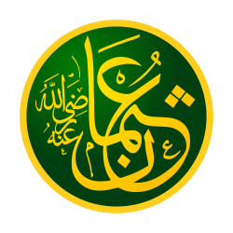
UTHMAN

Slide 2
Uthman ibn Affan (Arabic: عثمان بن عفان‎)was a son-in-law and notable companion of the Islamic prophet Muhammad, as well as the third of the Rashidun, or "Rightly Guided Caliphs". Born into a prominent Meccan clan, Banu Umayya of the Quraysh tribe, he played a major role in early Islamic history, and is known for having ordered the compilation of the standard version of the Quran.When Caliph Umar ibn al-Khattab died in office aged 59/60 years, Uthman, aged 64/65 years, succeeded him and was the second-oldest to rule as Caliph.

Slide 3
Uthman was married to Ruqayyah, and upon her death, married Umm Kulthum. Both his wives having been elder daughters of Muhammad and Khadija earned him the honorific title Dhū al-Nurayn ("The Possessor of Two Lights").Thus, he was also brother-in-law of the fourth Rashidun Caliph Ali whose own wife, Fatimah, was Muhammad's youngest daughter.

Slide 4
FAMILY AND EARLY LIFE
Uthman was born in Ta'if. The exact date is disputed: both 576 and 583 are indicated.
His father, Affan, died at a young age while travelling abroad, leaving Uthman with a large inheritance. He became a merchant like his father, and his business flourished, making him one of the richest men among the Quraysh.

Slide 5
MUHAMMAD’S TIME
On returning from a business trip to Syria, Muhammad told him Islam and then After a discussion with Abu Bakr, Uthman decided to convert to Islam, and Abu Bakr brought him to Muhammad to declare his faith. Uthman thus became one of the earliest converts to Islam, following Ali, Zayd, Abu Bakr and a few others. His conversion to Islam angered his clan, the Banu Ummayyah, who strongly opposed Muhammad's teachings.
Conversion To Islam

Slide 6
MUHAMMAD’S TIME
Uthman and his wife, Ruqayya, migrated to Abyssinia (modern Ethiopia) in April 615, along with ten Muslim men and three women. Scores of Muslims joined them later. As Uthman already had some business contacts in Abyssinia, he continued to practice his profession as a trader and he continued to flourish.
After four years, the news spread among the Muslims in Abyssinia that the Quraysh of Mecca had accepted Islam, and this acceptance persuaded Uthman, Ruqayya and 39 Muslims to return. However, when they reached Mecca, they found that the news about the Quraysh's acceptance of Islam was false. However, Uthman and Ruqayya re-settled in Mecca.
Migration to Abyssinia

Slide 7
MUHAMMAD’S TIME
In 622, Uthman and his wife, Ruqayya, were among the third group of Muslims to migrate to Medina. Upon arrival, Uthman stayed with Abu Talha ibn Thabit before moving into the house he purchased a short time later. Uthman was one of the richest merchants of Mecca, with no need of financial help from his Ansari brothers, as he had brought the considerable fortune he had amassed with him to Medina. Most Muslims of Medina were farmers with little interest in trade, and Jews had conducted most trading in the town. Uthman realized there was a considerable commercial opportunity to promote trade among Muslims and soon established himself as a trader in Medina. With hard work and honesty, his business flourished, making him one of the richest men in Medina.
Migration to Medina

Slide 8
Umaribn Al-Kattab (R.A.) on his death bed formed a committee of six people to choose the next Caliph from amongst themselves. This committee was: Ali bin Abi Talib (R.A.), Uthman ibn Affan (R.A.), Abdur Rahman bin Awf (R.A.), Saad ibn Abi Waqqas (R.A.), Al-Zubayrm (R.A) and Talhah (R.A.). Majority of the people favored the election of Uthman (R.A.). On the fourth day after the death of Umar (R.A.) in 23 AH, Uthman (R.A.) was elected as the third Caliph with the title ‘Amir Al-Muminin’ (The Prince of the Believers).

Slide 9
Highlights of His Reign as Caliph
Uthman’s (R.A.) achievements, during his reign as Caliph, are so many. Following are some highlights of his accomplishments during the tenure of his Caliphate (Khilafat):
Conquest: The most important works of Uthman (R.A.) are the conquest of Murrow, Turkey and the expansion of the Islamic State. In addition to the conquest of Alexandria and then Armenia, Caucasus, Khurasan, Kerman, Sajistan, Africa, and Cyprus.
Expansion of Prophet’s Mosque: Uthman (R.A.) expanded the Prophet's Mosque (Masjid Al-Nabawi) in 29-30 AH and has established the ﬁrst Islamic ﬂeet to protect the Muslim beaches from the attacks of Byzantines.

Slide 10
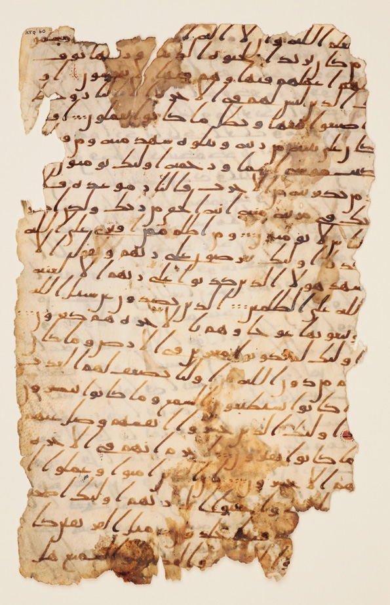
Compilation of the Quran
. One of the most important achievements of Uthman (R.A.) is the compilation of the Holy Quran, which was started in the caliphate of Abu Bakr Siddiq (R.A.).
Hudhaifah (R.A.) was very alarmed by the differences in the recitation of Quran of Syrian and Iraqi people. So Hudhaifah (R.A.) said to Uthman (R.A.):
“O Prince of Believers, save this nation before they differ concerning the Book (Quran) as the Jews and the Christians did.”
Uthman (R.A.) said:
"Send us the manuscript so that we may make copies of it, then we will return it to you".
So Hafsah (R.A.), with whom the original manuscript of Quran was safe, sent it to Uthman (R.A.) and he ordered four of the Companions (R.A.) to make copies of it. They did that until they had made many copies then Uthman (R.A.) returned the manuscript to Hafsah (R.A.) and he sent a copied Book (Mushaf i-e Quran) to every reign and ordered that all other Quranic material, other than the sent copies, whether it was manuscripts or entire copies, be burnt.

Slide 11
Sedition:
At the end of his reign and due to the expansion of Islamic conquests and the presence of recent Muslims who did not absorb the spirit of order and obedience, enemies of Islam, led by Jews, started to foment civil strife to undermine the unity of Muslims and their state. They raise suspicions about the policy of Uthman (R.A.) and incited the people in Egypt, Kufa, and Basra to revolt. They deceived their followers to implement their plan and met the caliph and asked him to give up. Uthman (R.A.) called them to the meeting in the mosque with senior Companions (R.A.) and other people of the city and he refuted their unreliable gossips, and he answered their questions and pardoned them. Thus, they returned to their country but they concealed malevolence and promised to come back to the city to carry out their plots, which were embellished by the Jew Abdullah bin Saba, who pretended Islam.

Slide 12
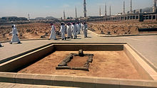
His Martyrdom:
In Shawwal, 35 AH, the turmoil occurred and the wrong-doers besieged Uthman (R.A.) in his home (forty days) and prevented him from praying in the mosque and even from water. But when he saw some of the Companions (R.A.) that had prepared to ﬁght them he prevented that ﬁght as he did not want to drop the blood of a Muslim for his own sake. Then the conspirators broke into his house from the back (from the house of Abu Hazm Al-Ansari) and attacked him as he was reading the Holy Quran. His wife Naila (R.A.) attempted to protect him, but they beat her with the sword, cutting off her ﬁngers. The rebels killed him (R.A.) and his blood spelled onto the Quran. He was martyred on the 18th of Dhul-Hijjah 35AH (17 June, 656 AD), and he was buried at Al-Baqee [sacred graveyard of Muslims near Prophet’s Mosque (Masjid Al-Nabawi)] in Madinah.

