Slide 1
BIO311 ACADEMIC PRESENTATION SKILLS
Assoc. Prof. Dr. Fadime Kıran
Assoc. Prof. Dr. İlker Büyük
Assist. Prof. Dr. Şeyda Fikirdeşici Ergen

Slide 2
Introduce Your Background and Methods

Slide 3
Don't get bogged down in details
Exceptional presenters balance details with the big picture

Slide 4
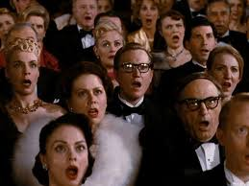
Read Your Audience

Slide 5
Design Visual Elements

Slide 6
References
Davis, M. 2005. Scientific Papers and Presentations, Revised Edition Elsevier
Wallwork, A. 2016. English for Presentations at International Conferences, Springer.
Carter, M. 2020. Designing Science Presentations, A Visual Guide to Figures, Papers, Slides, Posters, and More, Academic Press.

