Slide 1
ENGLISH FOR BUSINESS LIFE
Lecture 1
Job Finding

Slide 2
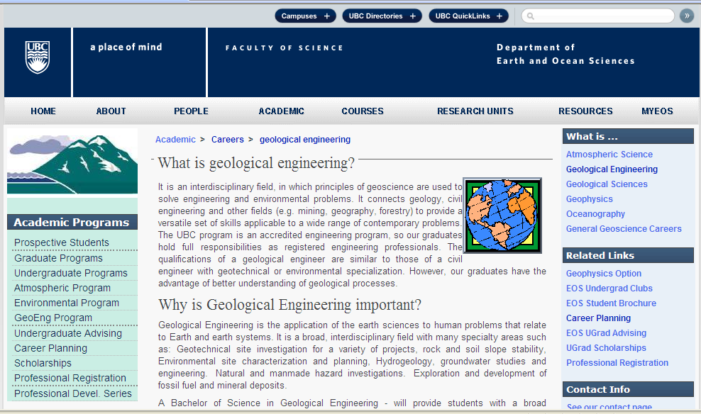

Slide 3
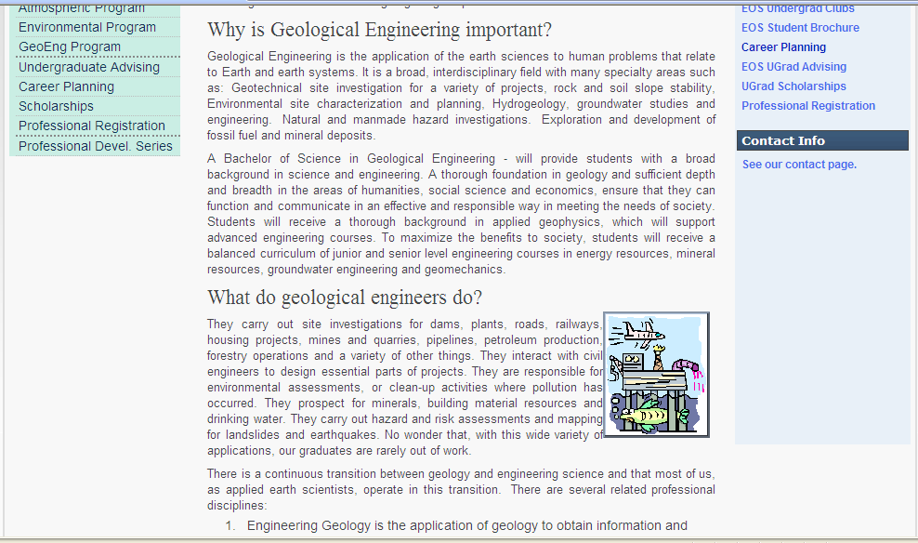

Slide 5
Finding a job:
Are You Really Ready to Begin a Job Search?
Critical First Steps It isn't productive to jump into a job search without a clear sense of what you want and what you offer. As you begin, take stock (liste, envanter yapmak) of how ready you really are.
To do this you must:
Know what you want.
Know what you offer.
Understand what employers want.
Research who needs what you have and has what you want.
Be focused, committed (taahhüt et) and active.
Identify and market your skills (hüner, maharet) effectively.
Make the link and convince with examples.
Be creative in identifying openings.

Slide 6
Do You Know What You Want?
What kind of work are you seeking? ("I'm flexible" or "whatever relates to my major" is not specific enough)
What are your interests, motivations and passions?
What skills (maharet, hüner) do you like to use and hope to develop further?
What do you value?
What kind of work environment would you be most comfortable in?
Do You Understand How to:
Effectively market yourself through resumes, letters, and interviews?
Identify and effectively network?
Perform the necessary research?
Articulate your strengths/your "value added" to the organization?

Slide 7
Do You Know What Employers Want?
Many employers say that the vast majority of people they interview cannot adequately (yeterince) define the skills they have to do the job or articulate how they have demonstrated these competencies. In general, employers look for evidence of:
Communication Skills
Motivation/Initiative/Drive to Succeed
Teamwork
Leadership
Academic Credentials/Active Learning
Interpersonal Skills
Analytical/Problem Solving Skills
Planning/Organizing
Adaptability
Employee: An individual who works part-time or full-time under a contract of employementt, whether oral or written, express or implied, and has recognized righte and duties. Also called worker.

Slide 8
Do You Know Why You Are a Good Candidate?
Can you identify all your skills and abilities?
Are you confident in them?
Can you give examples of how you've demonstrated these?
Develop a skill inventory and review for each position you apply for.
You'll need to know how your strengths meet a particular employer's needs.
Knowing what you offer increases your job search effectiveness, separates you from other candidates, and increases the effectiveness of your cover letter, resume, and interview.
If you are having difficulty answering these questions, visit CDC during Counselor-on-Call hours to discuss your career goals and formulate an action plan.

Slide 9
Most job openings are not advertised, so it is best to concentrate on the hiden job market.
How to start job search?
Ads in newspapers or newsletters,
Talk to people; networking: relatives, friends, faculty, supervisors, neigbors,
Alumni career network,
eRecruiting,
Special events and fairs,
Mailing to employers, employer’s web site,
Professional associations or societies,
The internet, telephone,
Off campus, job fairs, forums,
Employment agencies,

