Slide 1
Fırst aıd for respıratory emergencıes
Berna GUVEN,PhD

Slide 2
CPR
Cardiac EmERGENCIES
Heart Attack
Cardiac Arrest
■Opening the person’s airway (the passageway between the nose/mouth and the lungs).
■ Compressing the person’s chest to keep the blood circulating.
■ Giving rescue breaths that fill the lungs with air.
30 chest compressions followed by sets of 2 rescue breaths.
Breathing emergencies can also lead to cardiac arrest because if the body’s supply of oxygen is interrupted, the heart soon stops beating.

Slide 3
How Can I Tell Whether CPR Is Needed?
If the person is conscious but cannot talk and appears to be choking, CPR is not appropriate. Instead, follow the instructions for CHOKING

Slide 4
Do not attempt to carry out a rescue if it is likely to put your own life at risk !!!

Slide 5
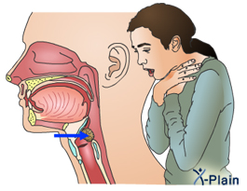
CONTENTS
1. The Respiratory System
2. Hypoxia
3. Airway Obstruction:
Choking Adult
Choking Child
Choking Infant
4. Hanging And Strangulation
5. Inhalation Of Fumes
6. Drowning
7. Hyperventilation

Slide 6
OBJECTIVES
assess condition,
identify the problem,
provide fresh air,
maintain an open airway,
check breathing,
obtain medical help if necessary.
112

Slide 7
THE RESPIRATORY SYSTEM
How it Works?
Respiratory center (Brain)
Intercostal muscles
Diaphragm!
Notes:
What does stimulate our respiratory center?

Slide 8
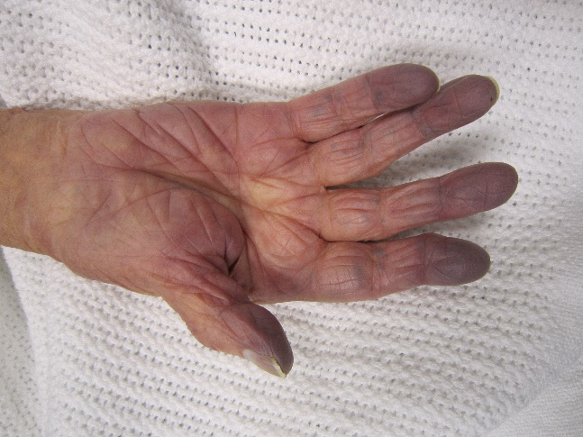
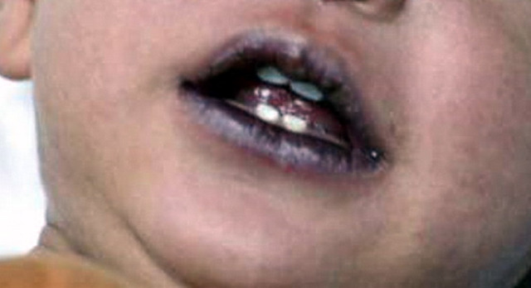
HYPOXIA
This condition arises when there is insufficient oxygen in the body tissues.
Causes??
Notes:
■ Rapid breathing
■ Breathing that is distressed or
gasping
■ Difficulty speaking
■ Gray-blue skin (cyanosis). At first,
this is more obvious in the
extremities, such as lips, nailbeds,
and earlobes, but as the hypoxia
worsens cyanosis affects the rest of
the body
■ Anxiety
■ Restlessness
■ Headache
■ Cessation of breathing if the hypoxia
is not quickly reversed

Slide 9
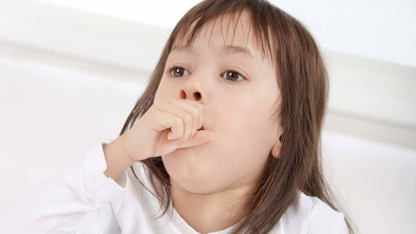
AIRWAY OBSTRUCTION
Main causes:
■ Inhalation of an object, such as food
■ Blockage by the tongue, blood, or vomit
■ Internal swelling of the throat burns, anaphylaxis
■ An asthma attack in which the small airways in the lungs constrict
■ External pressure on the neck, as in hanging or strangulation
Prompt!
Notes:
Airway obstruction requires prompt action!!

Slide 10
AIRWAY OBSTRUCTION
RECOGNITION
■ Difficulty speaking and breathing
■ Noisy breathing
■ Silence or high-pitched sounds if complete or near complete obstruction
■ Red, puffy face
■ Signs of distress from the casualty, who may point to the throat or grasp the neck
YOUR AIMS:
To remove the obstruction
To restore normal breathing
To arrange removal to the hospital

Slide 11
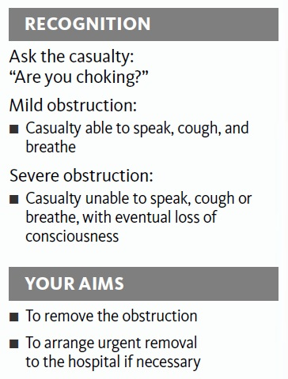
CHOKING ADULT
If the casualty is unconscious, look for normal breathing and, if not, begin CPR with
compressions !!!
Any casualty who has been
given abdominal thrusts must seek medical advice.

Slide 12
CHOKING ADULT What to do
2
1
heimlich maneuver
Stand behind the casualty with one leg back,
The other between the casualty’s legs,
Put both arms around the upper part of her abdomen,
Clench your fist with your thumb on top of your index finger and place it between the navel and the bottom of her breastbone,
Grasp your fist firmly with your other hand, Thrust sharply inward and upward until the
object is dislodged or the casualty becomes unconscious.
If the casualty is breathing,
encourage her to continue
coughing. If she is not coughing and not able to breathe, she is choking. Go to step 2.

Slide 13
CHOKING ADULT What to do
3
4
If the casualty loses consciousness,
carefully support her to the floor,
immediately call 112 for
emergency help,
Begin CPR with chest compressions.
Each time the airway
is opened during CPR, look for
an object in the casualty's mouth
and, if seen, remove it.
If the obstruction still has
not cleared, continue CPR
until help arrives.

Slide 14
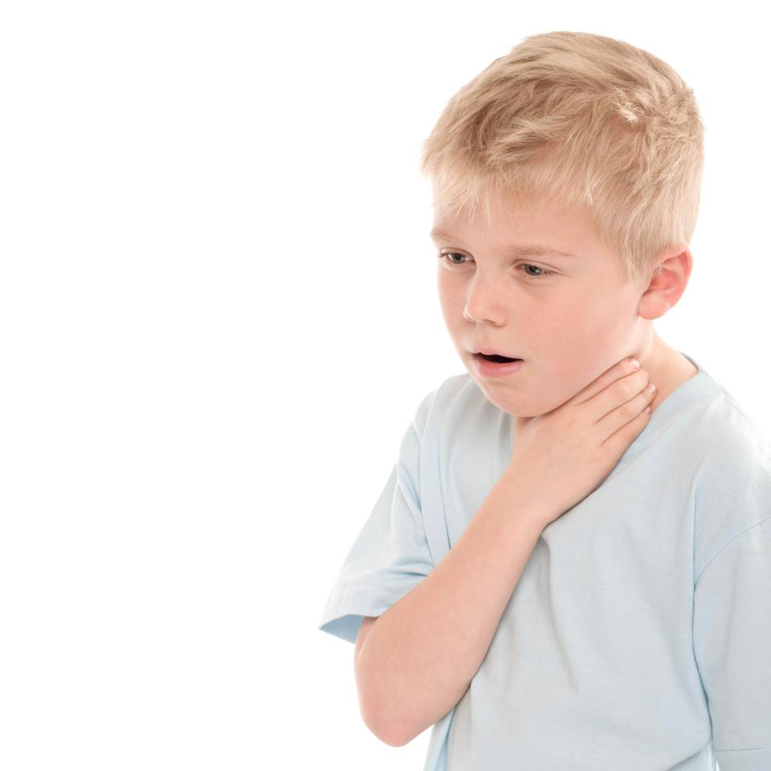
CHOKING CHILD (ONE YEAR TO PUBERTY)
Young children especially are prone to choking.
Act quickly!!!
If the child loses consciousness at any stage and is not breathing, begin CPR with chest compressions to try to relieve the obstruction

Slide 15
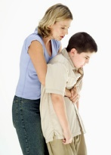
CHOKING CHILD (ONE YEAR TO PUBERTY) What to do
1
2
Put your arms around the
child’s upper abdomen,
Place your fist between the
navel and the bottom of her
breastbone,
Grasp it with your other hand,
Pull sharply inward and upward until the object is dislodged or the child becomes unconscious.
If the child is breathing, encourage her to continue coughing. If she is not coughing and not able to breathe, she is choking. Go to step 2.

Slide 16
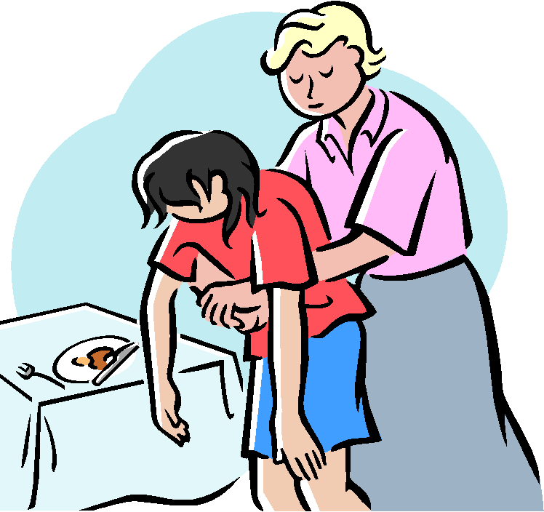
CHOKING CHILD (ONE YEAR TO PUBERTY) What to do
3
4
If the child becomes unresponsive, carefully support her to the ground,
Start CPR with chest compressions
After 30 compressions, open the airway and look in her mouth,
If a foreign body is seen, remove it but do not perform blind finger sweeps.
Then attempt to give two breaths and continue with cycles of chest compressions and ventilations until the object is expelled.
After two minutes, if no one has already done so, the obstruction still has not cleared or the child has not regained consciousness, call 112 for emergency help. Then continue CPR until help arrives.

Slide 17
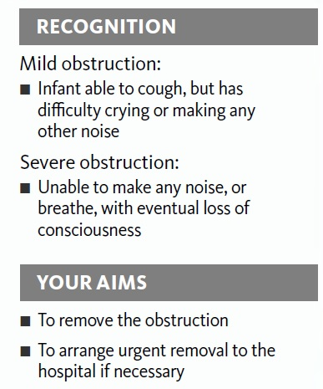
CHOKING INFANT (UNDER ONE YEAR)
CAUTION
■ If the infant loses consciousness at any stage, assess breathing. If the infant is not breathing, begin CPR with chest compressions, then
open the airway and remove any obvious foreign objects, give two rescue breaths if possible, and repeat compressions.
■ Seek medical advice for any
infant who has been given
chest compressions.
An infant is more likely to choke on food or small objects than an adult.
The infant will rapidly become distressed, and you need to act quickly to clear any obstruction.

Slide 18
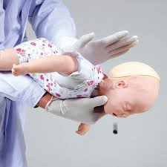
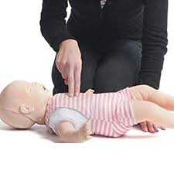
CHOKING INFANT What to do
1
2
If back blows fail to clear the
obstruction, turn the infant
onto his back and give chest
compressions. Using two fingers, push against the infant’s
breastbone, in the nipple line.
If the infant is distressed,
is unable to cry, cough, or breathe, lay him face down along your forearm, with his head low, and support his back and head.
Give up to five back blows, with
the heel of your hand.
3
Perform up to five chest
compressions. The aim is to
relieve the obstruction with each chest compression rather than necessarily doing all five.

Slide 19
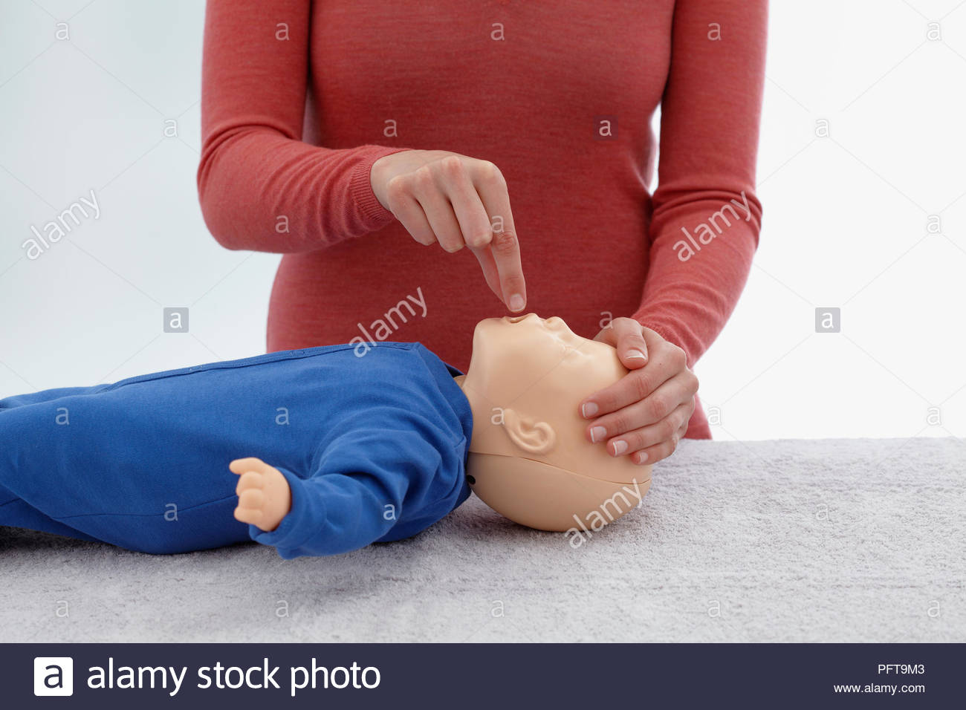
CHOKING INFANT What to do
4
Check the infant’s mouth;
remove any obvious
obstructions with your
fingertips. Do not sweep the
mouth with your finger because this may push the object farther down the throat. Repeat steps 1–4 until the object clears or the
infant loses consciousness.
5
If the obstruction has not
cleared and he becomes
unconscious, call 112 for
emergency help, then start CPR
with chest compressions. Continue until help arrives.

Slide 20
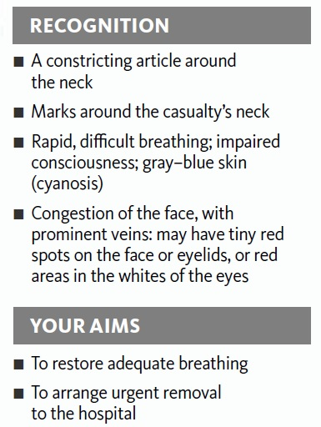
HANGING AND STRANGULATION
If pressure is exerted on the outside of the neck, the airway is squeezed and the flow of air to the lungs is cut off. The main causes of such pressure are:
■ Hanging: suspension of the body by a noose around the neck;
■ Strangulation: constriction or squeezing around the neck or throat.

Slide 21
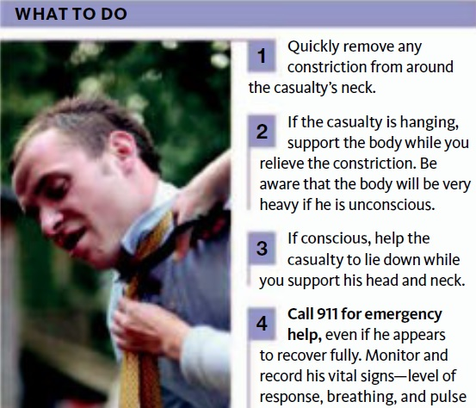
HANGING AND STRANGULATION WHAT TO DO
112

Slide 22
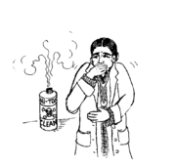
INHALATION OF FUMES
WHAT TO DO?
Call 112 for emergency help. Tell the dispatcher that you suspect fume inhalation.
If it is necessary to escape from the source of the fumes, help the casualty away from the fumes into fresh air. Do not enter the fume-filled area yourself.
Support the casualty and encourage him to breathe normally. If the casualty’s clothing is still burning, try to extinguish the flames. Treat any obvious burns or other injuries.
Stay with the casualty until help arrives.
Carbon monoxide
Smoke
bigger killer than fire itself!
Carbon dioxide
Solvents and fuels
hypoxic
Notes:
Casualties who have suffered from
fume inhalation should also be examined
for other injuries caused by the fire, such as
external burns.

Slide 23
INHALATION OF FUMES
CAUTION
■ If the casualty is found unconscious and is not breathing normally, begin CPR with chest
compressions
Notes:
Casualties who have suffered from
fume inhalation should also be examined
for other injuries caused by the fire, such as
external burns.

Slide 24
DROWNING
Hypothermia
Cardiac arrest
Spasm of the throat
Secondary drowning
YOUR AIMS:
■ To restore adequate breathing
■ To keep the casualty warm
■ To arrange urgent removal to the hospital
Notes:
Sec.drowning: Any water entering the lungs causes them to become
irritated, and the air passages may begin to swell several hours
later

Slide 25
DROWNING What to do
1
2
If you have rescued the casualty from the water, help him lie down on a rug or coat with his head lower than the rest of the body so that water can drain from his mouth. This reduces the risk of inhaling water
Treat the casualty for hypothermia; replace wet clothing with dry clothes if possible and cover him with dry blankets or coats. If the casualty is fully conscious, give him a warm drink.
3
Call 112 for emergency help even if he appears to recover fully because of the risk of secondary drowning.

Slide 26
DROWNING What to do?
4
Victims of drowning are likely to vomit during resuscitation. Be prepared to quickly turn the victim to the side to allow the vomit to drain.
If the casualty is unconscious and you are on your own, give CPR

Slide 27
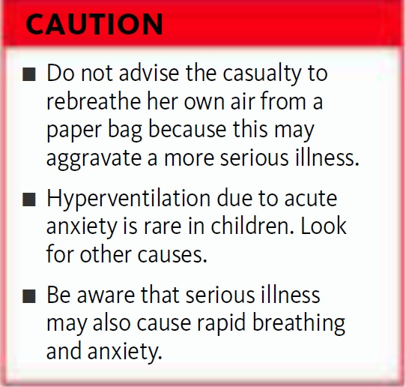
HYPERVENTILATION
This is commonly a manifestation of acute anxiety and may accompany a panic attack.
YOUR AIMS:
■ To remove the casualty from the cause of distress
■ To reassure the casualty and calm her down
X
False facts

Slide 28
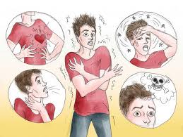
HYPERVENTILATION
WHAT TO DO
When speaking to the casualty, be firm, but kind and reassuring. If possible, lead the casualty away to a quiet place where she may be able to regain control of her breathing more easily and quickly. If this is not possible, ask any by standers to leave.
Encourage the casualty to seek medical advice on preventing and controlling panic attacks in the future.

Slide 29
REFERENCES
The American College Of Emergency Physıcıans (Acep)-First Aid Manuel 5th Edition The Everything First Aid Book

