Slide 1
Writing: Charts and Graphs

Slide 2
For Comparison
more + noun + than: More males than females read newspaper.
adjective+ -er+ than: The price of a car was lower in 1989 than 2001.
fewer +noun + than: Fewer females than males watch Tv.
more/less + adjectives+ than: Instagram was more popular among males than females.
the most/least + adjective: The most popular form of communication was the Internet.
the+ adjective+ -est: The fastest means of transportation is flying.
Source: Ramedani, A. (2012). «IELTS Writing Compact»

Slide 3
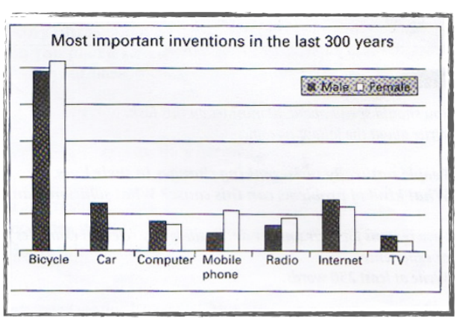
Analyzing the bar graph.
Source: Ramedani, A. (2012). «IELTS Writing Compact»

Slide 4
For Expressing Approximation
X is just under ....
X is just over ....
X is approximately
X is about ....

Slide 5
Expressions of Time
From January to July
In 1987
In the winter months
In the first quarter of the year
In the first/second half of the year
In the future

Slide 6
Numbers and Statistics
Year | 2005 | 2010
Value | 1200 $ | 1800 $
The price of X went up by 600, from $1200 to $1800. (numbers)
The price of X went up 50%, from $1200 to $1800. (percentages)

Slide 7
Some Prefabricated Forms
It is evident that ..
It is noticeable that ...
We can see from the data that ...
From the pie chart it can be seen that ...
on a weekly/monthly/... basis
During the same period, ...

Slide 8
Writing Analysis of Graphs
- Introduction:
What is the graph showing ?
- Short body paragraph:
The most important points about the graph.
- Main body paragraphs:
Some details and comparisons
- Conclusion

Slide 9
Introduction
The bar graph/pie chart/ line graph/table provides information about ...
«The pie charts show the amount of water used for domestic purposes.»
«The table shows different devices which were used to access the Internet by university students in a dormitory over the last year.»
Source: Ramedani, A. (2012). «IELTS Writing Compact»

Slide 10
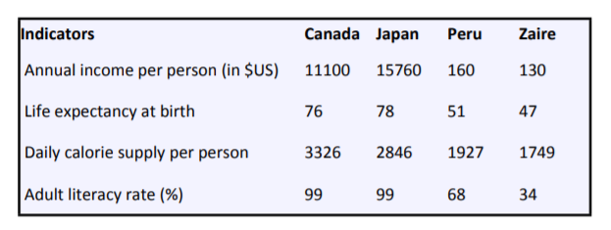
A glance at four indicators of economic and social conditions in four countries, Canada, Japan, Peru and Zaire (where), in 1994 (when) reflects the great differences that exist between wealthier and poorer nations (what).
Source: Ramedani, A. (2012). «IELTS Writing Compact»

Slide 11
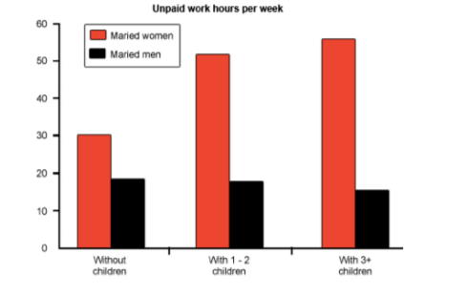
The double bar chart provides information about how many unpaid work hours (what) men and women in different categories (where) spend in a week (when). These categories are based on how many children they have.
Source: Ramedani, A. (2012). «IELTS Writing Compact»

Slide 12
Some synonyms
shows = illustrates
proportion = percentage
information = data
the proportion of = the figure for
people in the USA = Americans
from 1999 to 2009 = between 1999 and 2009
from 1999 to 2009 = over a period of 10 years
in three countries = in the UK, France and Spain
Source: Ramedani, A. (2012). «IELTS Writing Compact»

Slide 13
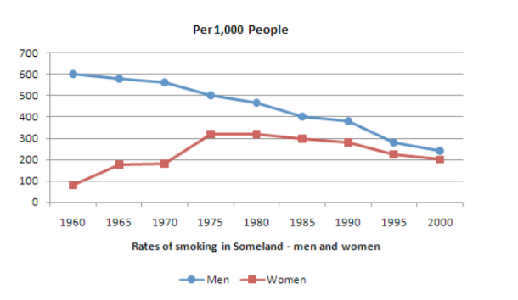

Slide 14
The graph compares the rate of smoking in men and women in Someland between the years 1960 and 2000. It can be clearly seen that the rate of smoking for both men and women was declining for the last 20 years and that fewer women had smoked throughout the period.
In 1960, 600 men in every 1,000 was smoking. This number decreased gradually to 500 by 1974 and continued to decrease but more steeply to 250 in 2000. In contrast, the rate of smoking in women in 1960 was very low at only 80 in every 1,000. By 1968 this increased to 170, and increased again but more steeply to 320 in 1977. The rate of female smokers then remained stable at 320 until 1984 at which point the figures began to decline and had dropped to 200 by 2000.
In conclusion we can see that the rate of smoking in men dropped throughout the whole period but was always at a higher level than the female figures. The rate of smoking in women increased until 1977 but then decreased for the rest of the period.
Source: Ramedani, A. (2012). «IELTS Writing Compact»

