Slide 1
Secure Software Development
What is OWASP?
Notes:
What is OWASP?
The Open Web Application Security Project (OWASP) is a worldwide non-profit charitable organization focused on improving the security of software.
OWASP mission is to make software security visible, so that individuals and organizations are able to make informed decisions.
The OWASP Top 10 is a powerful awareness document for web application security.
It represents a broad consensus about the most critical security risks to web applications.

Slide 2
OWASP TOP 10
A1:2017-Injection
A2:2017-Broken Authentication
A3:2017-Sensitive Data Exposure
A4:2017-XML External Entities (XXE)
A5:2017-Broken Access Control
A6:2017-Security Misconfiguration
A7:2017-Cross-Site Scripting (XSS)
A8:2017-Insecure Deserialization
A9:2017-Using Components with Known Vulnerabilities
A10:2017-Insufficient Logging&Monitoring
Notes:
OWASP top ten vulnerabilities of 2017.

Slide 3
Injection
Notes:
Injection flaws, such as SQL, OS, and LDAP injection occur when untrusted data is sent to an interpreter as part of a command or query.
The attacker’s hostile data can trick the interpreter into executing unintended commands or accessing data without proper authorization.

Slide 4
Injection
SELECT * FROM table WHERE field = '$EMAIL';
$EMAIL=aaa@bbb.net'
SELECT * FROM table WHERE field = 'aaa@bbb.net'';
EMAIL→anything' OR 'x'='x
SELECT * FROM table WHERE field = 'anything' OR 'x'='x';
Notes:
Think about a web application where users send their email adresses to login.
Let’s look at the SQL code behind.
Here, $EMAIL is the address submitted on the form by the user.
When we enter aaa@bbb.net' - note the closing, extra quote mark - this yields the constructed SQL as shown.
When this is executed, the SQL parser find the extra quote mark and aborts with a syntax error.
How this manifests itself to the user depends on the application's internal error-recovery procedures.
If the response is something like “email address is unknown” it is well-formed SQL.
But if it is “server error” or something like that then it means it is vulnerable.
This error response is a dead giveaway that user input is not being sanitized properly and that the application is ripe for exploitation.
By entering anything' OR 'x'='x
Because the application is not really thinking about the query – it just constructs a string - our use of quotes has turned a single-component WHERE clause into a two-component one, and the 'x'='x' clause is always true no matter what the first clause is.
And all data in the table is listed. Unauthorized access to sensitive data.

Slide 5
Injection
How to remediate?
Prepared statements with parameterized queries
txtUserId = getRequestString("UserId");
sql = "SELECT * FROM Users WHERE UserId = @0";
command = new SqlCommand(sql);
command.Parameters.AddWithValue("@0",txtUserID);
command.ExecuteReader();
Notes:
Use of prepared statements with parameterized queries is a strong control to mitigate an attack. Instead of writing dynamic queries—which fails to differentiate between application code and data—prepared statements force developers to use static SQL query and then pass in the external input as a parameter to query. This approach ensures the SQL interpreter always differentiates between code and data.

Slide 6
Injection
How to remediate?
Stored procedures
CREATE PROCEDURE SelectAllCustomers @City nvarchar(30)
AS
SELECT * FROM Customers WHERE City = @City
GO;
Execute the stored procedure
EXEC SelectAllCustomers @City = "London";
Notes:
Stored procedures are the SQL statements defined and stored in the database itself and then called from the application. Developers are usually only required to build SQL statements with parameters that are automatically parameterized. However, it’s possible for a developer to generate dynamic SQL queries inside stored procedures. Implement stored procedures safely by avoiding dynamic SQL generation inside.

Slide 7
Injection
How to remediate?
Validation Control / Sanitizing
An email address can contain only these characters, you can use whitelisting approach:
abcdefghijklmnopqrstuvwxyz
ABCDEFGHIJKLMNOPQRSTUVWXYZ
0123456789
@.-_+
Notes:
A common source of SQL injection is maliciously crafted external input. As such, it’s always a good practice to only accept approved input—an approach known as input validation. To protect against it, there are two variants of input validation: blacklist validation and whitelist validation.
Blacklist validation tests the external input against a set of known malicious inputs.
Whitelist validation tests an external input against a set of known, approved input.

Slide 8
Broken Authentication and Session Management
BROKEN AUTHENTICATION
Password length
Password complexity
Username/Password Enumeration
Protection against brute force login
Notes:
Application functions related to authentication and session management are often not implemented correctly, allowing attackers to compromise passwords, keys, or session tokens, or to exploit other implementation flaws to assume other users’ identities.
Password length: Minimum password length should be at least eight (8) characters long. Combining this length with complexity makes a password difficult to guess using a brute force attack.
Password complexity: Passwords should be a combination of alphanumeric characters. Alphanumeric characters consist of letters, numbers, punctuation marks, mathematical and other conventional symbols.
Username/Password Enumeration: Authentication failure responses should not indicate which part of the authentication data was incorrect. For example, instead of "Invalid username" or "Invalid password", just use "Invalid username and/or password" for both. Error responses must be truly identical in both display and source code.
Protection against brute force login: Enforce account disabling after an established number of invalid login attempts (e.g., five attempts is common). The account must be disabled for a period of time sufficient to discourage brute force guessing of credentials, but not so long as to allow for a denial-of-service attack to be performed.

Slide 9
Broken Authentication and Session Management
SESSION MANAGEMENT
Hashing/encrypting credentials
Don’t expose session IDs in URL
http://example.com/sale/saleitems;jsessionid=2P0OC2JSNDLPSKH CJUN2JV?dest=Hawaii
Session IDs timeout / recreate
Don’t send credentials cleartext
Notes:
Credentials should be protected: User authentication credentials should be protected when stored using hashing or encryption.
Do not expose session ID in the URL: Session IDs should not be exposed in the URL (e.g., URL rewriting).
Session IDs should timeout: User sessions or authentication tokens should be properly invalidated during logout.
Recreate session IDs: Session IDs should be recreated after successful login.
Do not send credentials over unencrypted connections: Passwords, session IDs, and other credentials should not be sent over unencrypted connections

Slide 10
Sensitive Data Exposure
Protect sensitive data, such as financial, healthcare, and PII.
How?
Notes:
Many web applications and APIs do not properly protect sensitive data, such as financial, healthcare, and PII (personally identifiable information).
Attackers may steal or modify such weakly protected data to conduct credit card fraud, identity theft, or other crimes.
Sensitive data may be compromised without extra protection, such as encryption at rest or in transit, and requires special precautions when exchanged with the browser.
•Classify data processed, stored, or transmitted by an application.
•Apply controls as per the classification.
•Don’t store sensitive data unnecessarily. Discard it as soon as possible.
•Make sure to encrypt all sensitive data at rest.
•Ensure up-to-date and strong standard algorithms, protocols, and keys are in place; use proper key management.
•Encrypt all data in transit with secure protocols such as TLS.
•Disable caching for responses that contain sensitive data.

Slide 11
XML External Entities (XXE)
<?xml version="1.0" encoding="UTF-8"?>
<stockCheck><productId>381</productId></stockCheck>
<?xml version="1.0" encoding="UTF-8"?>
<!DOCTYPE foo [ <!ENTITY xxe SYSTEM "file:///etc/passwd"> ]>
<stockCheck><productId>&xxe;</productId></stockCheck>
Output:
Invalid product ID: root:x:0:0:root:/root:/bin/bash
daemon:x:1:1:daemon:/usr/sbin:/usr/sbin/nologin
bin:x:2:2:bin:/bin:/usr/sbin/nologin
Notes:
XML external entity injection (also known as XXE) is a web security vulnerability that allows an attacker to interfere with an application's processing of XML data.
It often allows an attacker to view files on the application server filesystem, and to interact with any backend or external systems that the application itself can access.
For example, suppose a shopping application checks for the stock level of a product by submitting the following XML to the server.
The application performs no particular defenses against XXE attacks, so you can exploit the XXE vulnerability to retrieve the /etc/passwd file by submitting the following XXE payload.
This XXE payload defines an external entity &xxe; whose value is the contents of the /etc/passwd file and uses the entity within the productId value. This causes the application's response to include the contents of the file, In Linux all the login data of users are stored in passwd file.
Generally it is sufficient to disable resolution of external entities or input sanitizing.

Slide 12
Broken Access Control
SQL call:
pstmt.setString(1, request.getParameter("acct"));
ResultSet results = pstmt.executeQuery( );
Attacker modifies ‘acct’ parameter:
http://example.com/app/accountInfo?acct=notmyacct
http://example.com/app/getappInfo
http://example.com/app/admin_getappInfo
Notes:
Restrictions on what authenticated users are allowed to do are often not properly enforced.
Attackers can exploit these flaws to access unauthorized functionality and/or data, such as access other users' accounts, view sensitive files, modify other users’ data, change access rights, etc.
1st scenario:
The application uses unverified data in an SQL call that is accessing account information.
An attacker simply modifies the 'acct' parameter in the browser to send whatever account number they want.
If not properly verified, the attacker can access any user's account.
2nd scenario:
An attacker simply force browses to target URLs. Admin rights are required for access to the admin page.
If an unauthenticated user can access either page, it’s a flaw.
If a non-admin can access the adminpage, this is a flaw also.
You should implement access control mechanisms once and re-use them throughout the application.
You should disable web server directory listing.

Slide 13
Security Misconfiguration
The application server comes with sample applications .
One of these applications is the admin console, and default accounts weren’t changed.
A minimal platform without any unnecessary features.
Development, QA, and production environments should all be
configured identically.
Notes:
Security misconfiguration is the most commonly seen issue.
This is commonly a result of insecure default configurations, incomplete or ad hoc configurations, open cloud storage, misconfigured HTTP headers, and verbose error messages containing sensitive information.
Not only must all operating systems, frameworks, libraries, and applications be securely configured, but they must be patched and upgraded in a timely fashion.
For example; the application server comes with sample applications that are not removed from the production server. These sample applications have known security flaws attackers use to compromise the server. If one of these applications is the admin console, and default accounts weren’t changed the attacker logs in with default passwords and takes over.
Development, QA, and production environments should all be configured identically, with different credentials used in each environment.
A minimal platform without any unnecessary features, components, documentation, and samples. Remove or do not install unused features and frameworks.

Slide 14
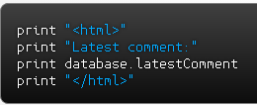
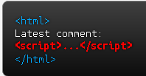
Cross-Site Scripting (XSS)
Notes:
Cross-site scripting (XSS) is a code injection attack that allows an attacker to execute malicious code in another user's browser.
XSS allows attackers to execute scripts in the victim’s browser which can hijack user sessions, deface web sites, or redirect the user to malicious sites.
Here is a simple server-side script is used to display the latest comment on a website.
The script assumes that a comment consists only of text.
However, since the user input is included directly, an attacker could submit this comment as a script and provide it to be saved into the database.
For example, if the attacker's ultimate goal is to steal the victim's cookies, this can be done by having the victim's browser parse this HTML code.
Since this script will be saved to the database as a comment, when the victim browses this web site and display the latest comment, he or she will be navigated to a different URL, triggering an HTTP request to the attacker's server. The URL includes the victim's cookies as a query parameter.
It’s done.

Slide 15
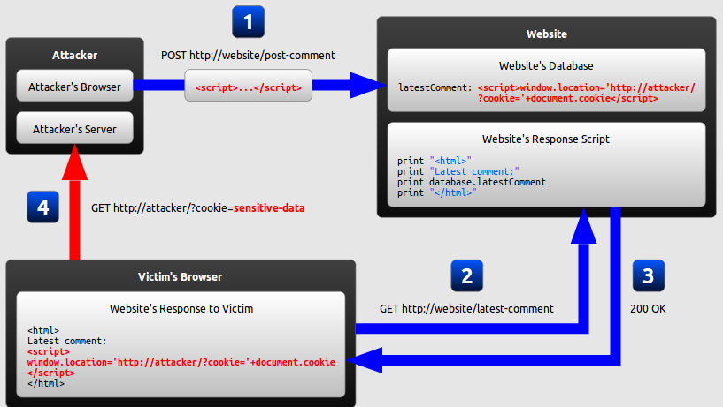
Cross-Site Scripting (XSS)
Notes:
1. The attacker uses one of the website's forms to insert a malicious string into the website's database.
2. The victim requests a page from the website.
3. The website includes the malicious string from the database in the response and sends it to the victim.
4. The victim's browser executes the malicious script inside the response, sending the victim's cookies to the attacker's server.

Slide 16
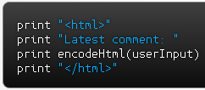
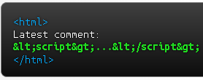
Cross-Site Scripting (XSS)
Notes:
How to mitigate?
Encoding, which escapes the user input so that the browser interprets it only as data, not as code.
The most recognizable type of encoding in web development is HTML escaping, which converts characters like < and > into &lt; and &gt;, respectively.
Validation, which filters the user input so that the browser interprets it as code without malicious commands.
Use frameworks that automatically escape XSS by design (such as the latest Ruby on Rails, React JS).
The disadvantage of protecting against XSS by using only secure input handling is that even a single lapse of security can compromise your website. A recent web standard called Content Security Policy (CSP) can mitigate this risk.
CSP is used to constrain the browser viewing your page so that it can only use resources downloaded from trusted sources.

Slide 17
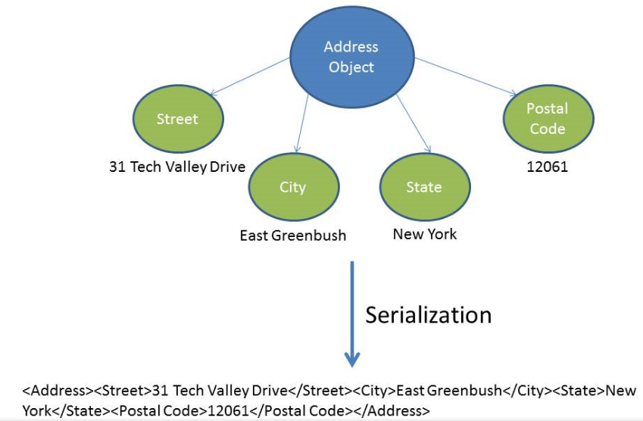
Insecure Deserialization
Notes:
When data structures need to be stored or transmitted to another location, such as across a network, they need to go through a process called serialization.
Serialization is the process of converting an object into a stream of bytes to store the object or transmit it to memory, a database, or a file.
Its main purpose is to save the state of an object in order to be able to recreate it when needed.
Once serialized, this data is converted into a linear data format (such as the XML text form in the diagram) representing the Address object.
The reverse process is called deserialization.

Slide 18
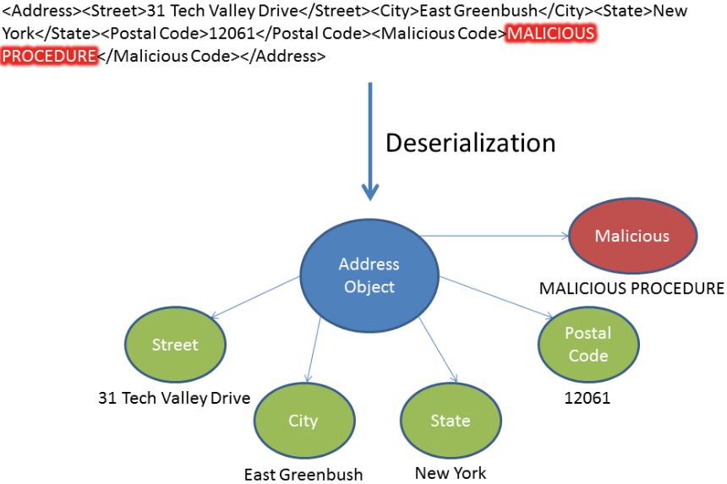
Insecure Deserialization
Notes:
The serialization vulnerability is of high impact as it could allow an attacker to perform remote code execution and remotely administer the victim machine.
The only safe architectural pattern is not to accept serialized objects from untrusted sources.
You should also sanitize user input.

Slide 19
Using Components with Known Vulnerabilities
Components typically run with the same privileges as the application itself.
Flaws in any component can result in serious impact.
Notes:
Remove unused dependencies, unnecessary features, components, files, and documentation.
Only obtain components from official sources over secure links.
Scan for vulnerabilities regularly and subscribe to security bulletins related to the components you use.

Slide 20
Insufficient Logging & Monitoring
The sandbox software had detected potentially unwanted software.
No one responded to this detection.
The sandbox had been producing warnings for some time before the breach was detected.
Notes:
The sandbox software had detected potentially unwanted software, but no one responded to this detection. The sandbox had been producing warnings for some time before the breach was detected.
Ensure all login, access control failures, and server-side input validation failures can be logged.
Ensure that logs are generated in a format that can be easily consumed by a centralized log management solutions.
Establish effective monitoring and alerting such that suspicious activities are detected and responded to in a timely fashion.
Establish or adopt an incident response and recovery plan.

