Slide 1
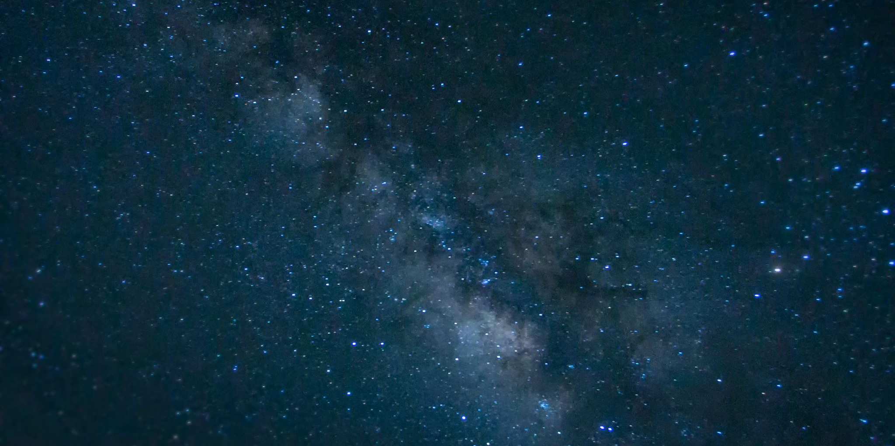
Science-Fiction

Slide 2
Sources
David Seed, Science Fiction: A Very Short Introduction. OUP, 2011.
Ken Gelder, Popular Fiction: The Logics and Practices of a Literary Field. Routledge, 2004.
Scott McCracken, Pulp: Reading Popular Fiction. MUP, 1998.
Edward James, Science Fiction in the 20th Century. Opus, 1994.
The Cambridge Companion to Science Fiction
Don D’Ammassa, Encyclopedia of Science Fiction. Facts on File, Inc., 2005

Slide 3
The Overlap
Always remember that all these genres and their sub-genres may overlap.
A definite categorization is not easy.
Many scholars studying these genres are against such categorization anyway.

Slide 4
David Seed suggests
thinking of S/F as a “field” where different genres and sub-genres intersect.
a thought experiment
always evolving

Slide 5
Joanna Russ suggests
S/F is “What if Literature”.
speculations and expectations in the writer’s present.

Slide 6
Samuel Delany suggests,
narratives positioned between possibility and impossibility.

Slide 7
Sub-genres
Hard S/F
Soft S/F
Utopia
Dystopia
Apocalyptic
Post-apocalyptic
Alien Invasion
Robots/AI/Androids
Alternate History
Alternate Universe
Time Travel
Steampunk
Cyberpunk
Solarpunk
Cli-fi
Space Opera
Space Western
Science Fantasy
Weird
Zombies
Superheroes

Slide 8
A Common Distinction
Hard S/F
Soft S/F
High brow
Scientific ideas
Low brow
Entertainment/Adventure

Slide 9
Helpful Link
https://www.scifiideas.com/posts/a-guide-to-science-fiction-subgenres/

Slide 10
Pre-Nineteenth Century
Travel &Fantasy Lit.
Tales of other lands
Nineteenth Century
Reactions to the Industrial Revolution
Late Nineteenth to Mid-Twentieth Century
Modernist Visions of the Scientific Enlightenment
Late Twentieth Century
Postmodern Visions of a Post-Industrial, Post-Holocaust Age
Notes:
1st Utopia, Bacon’s new Atlantis, Gulliver’s Travels. 2nd: anti-science views 3rd one: electricity, aeroplanes, radio, cinema, press. 1930-40s. Asimov, Heinlein. Became more apocalyptic and dystopian in the 1960s. Fear of science and technology: nuclear threats, radioactivity, moonlanding. Led to Cyberpunk. Nowadays also optimistic solarpunk.

Slide 11
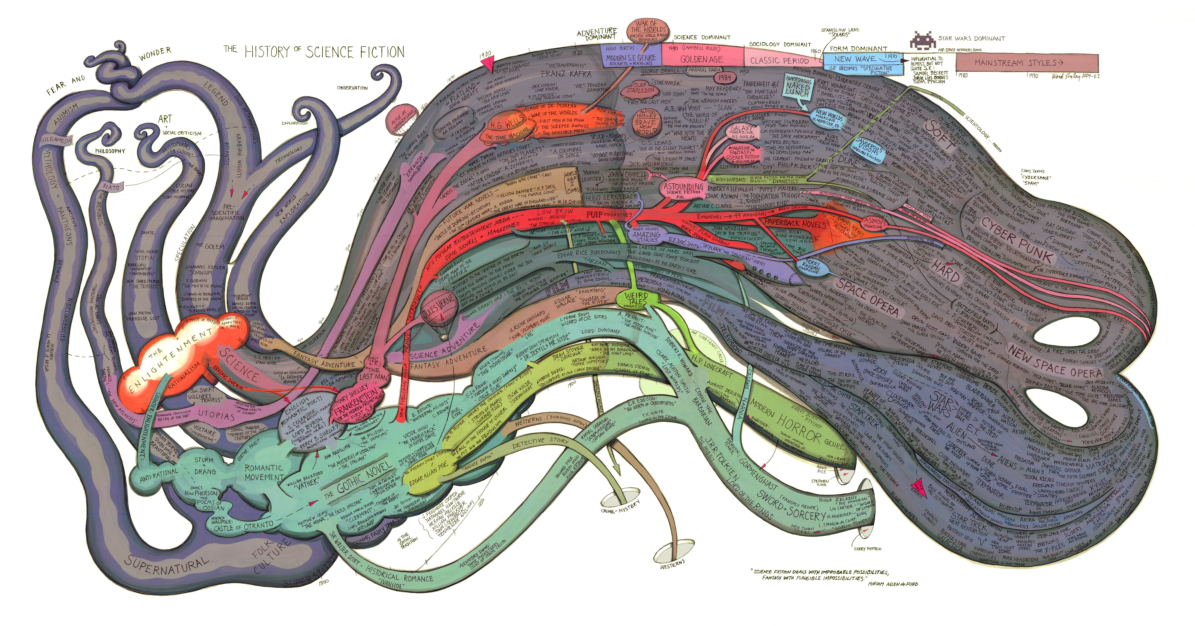

Slide 12
You might be familiar with:
Mary Shelley (Frankenstein)
H. G. Wells (The War of the Worlds, The Time Machine)
George Orwell (1984)
Aldous Huxley (Brave New World)
E. M. Forster (“The Machine Stops”)
Anthony Burgess
Doris Lessing
Margaret Atwood

Slide 13
Guidelines for the stories:
What makes it S/F?
Are there any social/political/etc issues that are questioned?
Is it relevant to today’s reader?
Narrative style
Is it inferior literature?

