Slide 1
ALKANES

Slide 2
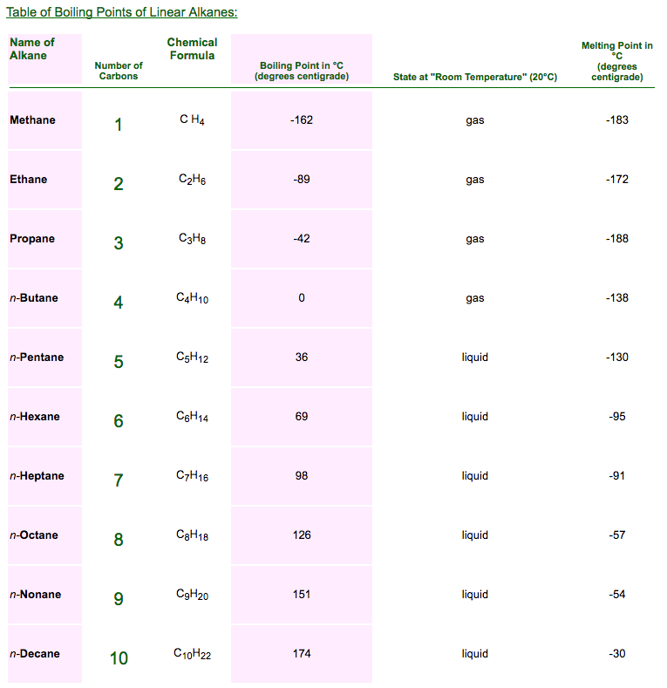
Physical Properties
Boiling point and the melting point of the alkanes increase with the number of atoms

Slide 3
Physical Properties
Branched chain isomer has a lower boiling point than a straight chain

Slide 4
Preparation of Alkanes
Hydrogenation of alkanes

Slide 5
Preparation of Alkanes
Reduction of alkyl halides Alkyl halides (except florides) on reduction with zinc and dilute HCl give alkanes

Slide 6
Preparation of Alkanes
Reduction of alkyl halides
Lithium aluminum hydride can be regarded as a source of hydride ions

Slide 7
Preparation of Alkanes
Reduction of carbonyl compunds
Clemmenson Reduction

Slide 8
Preparation of Alkanes
Wurtz Reaction

Slide 9
Coupling of alkyl halides with organometallic compunds

Slide 10
Reactions of Alkanes
Combustion

Slide 11
Halogenation

Slide 12
Nitration

Slide 13
Sulphonation

Slide 14
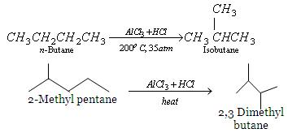
Isomerization

Slide 15
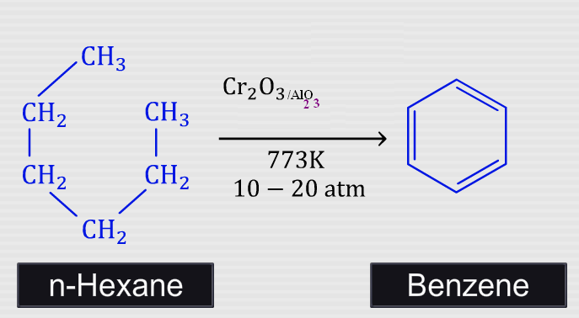
Aromatization

Slide 16
Pyrolysis
Presence of Cr₂O₃, V₂O₂, MoO₃ catalyses C-H bond fission
presence of SiO₂, AI₂O₃, ZnO catalyses C-C bond fission
Cracking has an important role in petroleum industry. Higher alkanes are converted into lower one (petrol C₆ to C₁₁) by cracking.

Slide 17
Reactions of cycloalkanes

Slide 18
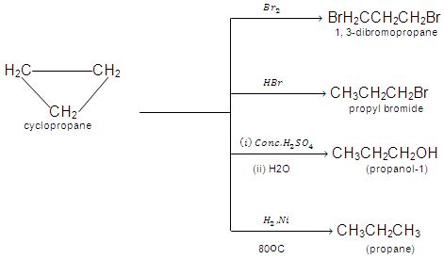
Ring opening reactions

