Slide 1
COMMUNICATING with the tex in RE

Slide 2
Key concepts
Challenges,
Communicative Model of Teaching,
The People of the Book,

Slide 3
How Does the Qur’an see «the people of the book» -the communıcatıve model of teachıng-
Within the pluralistic character of society and the modern school, students are seeking a different kind of understanding about the relationship between their religious traditions and life.
The communicative model of teaching is a kind of reflection on the text of the Qur’an within the subject in its historical and contemporary contexts.

Slide 4
‘Communication with the Qur’an’ means the Muslim’s relationship with it. This relationship is compulsory for every Muslim in the sense that the Qur’an is the word of Allah.
For understanding this relationship we should ascertain the relationship between the first addressees and the Qur’an during the revelation period. Because, the Qur’an was a message that met the needs and concerns of its addresses, related the concrete facts of the world in which they lived and gave examples from that world.

Slide 5
After the death of Prophet Muhammad, they continued to live their religion with the help of the revealed verses, with the fresh memories of the Prophet’s guidance and their understanding of the context of the verses.
First Muslims came into close contact with other cultures within a short time. This meant that people who did not know Arabic were becoming part of the Arab milieu. Knowledge and experience were being transferred in their own historical conditions under these circumstances. Therefore communication became an important part of Islamic world.

Slide 6
Need for a new search;
The appearance in Muslim history of different views by scribes, exegetes, theologians, sufis and philosophers indicates that, historically speaking, it is virtually impossible to see Islam as imposing only one perception and only one view. Therefore, we should make use of these contributions and build on them to reveal new scholarly and philosophical efforts.

Slide 7
Learnıng about the text and learnıng from the text;
The model proposed for Islamic teaching in religious education encompasses two elements; epistemology and pedagogy.
Epistemology is the study of what is known and how what is known can be known. Any concept of learning from religion depends on being clear about what teachers know about it.
Pedagogy is the communication of and critical reflection on what is known. Here theological foundations of the content must be secured to provide the learners a base on which to reflect.

Slide 8
The leading idea of the communicative model is, first to get the teachers to think about the historical context of the Qur’anic verses and, second, to provide them with a universal theological vision of the text that will allow them to approach the actual context in which the people stand in a broad perspective.

Slide 9
As an example; How Does the Qur’an see «the people of the book»
The religious groups in Qur’an; polytheists, people of the book (Jews and Christians), Magians and Sabians.
“We have sent thee inspiration, as We sent it to Noah and the Messengers after him: we sent inspiration to Abraham, Ismail, Isaac, Jacob and the Tribes, to Jesus, Job, Jonah, Aaron, and Solomon, and to David We gave the Psalms.”
Nisa/ 163-165

Slide 10
Kasas (The Narrative) 28/43: “We did reveal to Moses the Book after We had destroyed the earlier generations, (to give) Insight to men, and Guidance and Mercy, that they might receive admonition.”
Ahkaf (The Sandhills) 46/12: “And before this, was the Book of Moses as a guide and a mercy: and this Book confirms (it) in the Arabic tongue; to admonish the unjust, and as Glad Tidings to those who do right.”

Slide 11
a.Respect for dıversıty
Nahl (The Bee) 16/9: “Allah alone can show the right path, but there are ways that turn aside: if Allah Had willed, He could have guided all of you.”
Nahl (The Bee) 16/93: “If Allah so willed, He could make you all one people: But He leaves straying whom He pleases, and He guides whom He pleases: but ye shall certainly be called to account for all your actions.”

Slide 12
b.Respect for human freedom
Kaf (Qaf) 50/45: “We know best what they say; and thou art not one to compel them by force. So admonish with the Quran such as fear My Warning!”
Sad (Suad) 38/65: “Say: "Truly am I a Warner: no god is there but Allah, the One, Supreme and Irresistible,”
Sad (Suad) 38/70: “Only this has been revealed to me: that I am to give warning plainly and publicly.”

Slide 13
Jihad is often incorrectly translated as ‘holywar’, this meaning symbolize Islam as a religion of violence. This kind of translation also creates an obstacle in the critical task, namely that of building bridges of understanding between religions.
In the widest meaning that connotes paying effort and struggling in a way that pushes the whole limits of human beings, jihad covers all types of moral self-sacrifice and effort for human beings goodness in the sake of God. It is said in the Qur’an that none of the efforts on this issue will not be wasted and these roads will be opened to human beings.

Slide 14
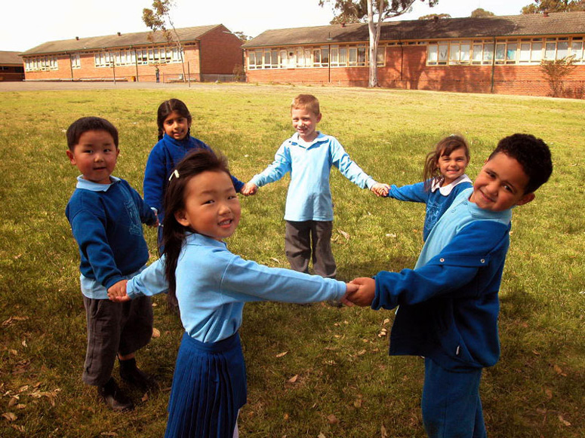
In terms of relıgıous educatıon;
With regard to religious pluralism and pluralism within Islam the programme must be ‘non-confessional’ and it must have multi-religious dimension.
The Programme must aim to raise up teachers;
1.Who adopt lifelong learning including the skill to search, ask and inquire.
2.Who promote a culture of living together.
3.Who know and appreciate the beliefs, traditions and customs of other
religions in respect and tolerance, as well as their own religion, traditions and customs.

Slide 15
The expansıon & dıfferent schools of thought;

Slide 16
…Activities Reflection in Action
Point to ponder
Teachings to remember
Questions to deepen the subject

Slide 17
Further Information;
Selçuk, Mualla. A Definition of ‘Jihad’ and Its Relationship to RE in a World of Religious Diversity. ISREV/Ottowa 2010.
Selçuk, Mualla. How Does the Qur’an See «The People of the Book»? An Example of the Communicative Model of Islamic Religious Education, Reaching for the Sky, ed. Stella El Bouayadi-van de Wetering and Siebren Miedema,11-33.
Düzgün, Şaban Ali. Winning Back Religion. - Countering the Misuse of Scripture Against Terrorism-

