Slide 1
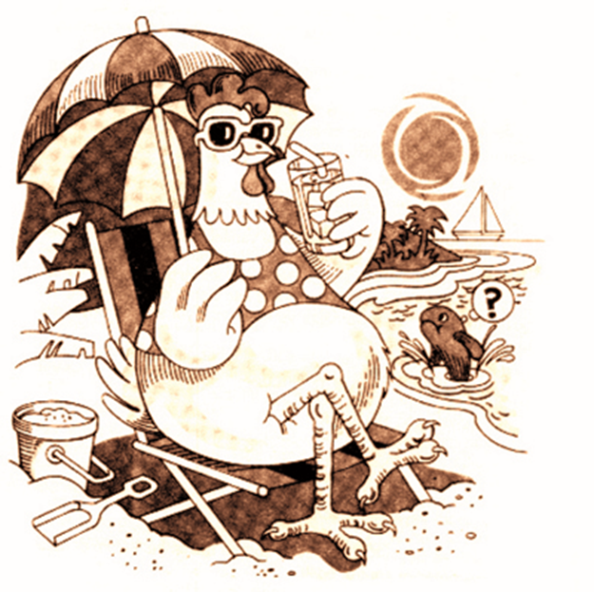
Why is animal welfare important?

Slide 2
Decrease of rural population,
Change in the point of view of animals,
Increase in social awareness,
Increase in the number of non-governmental organizations,
Increase in education level,
Increase in scientific publications and activities on the subject,
Increase in economic level,
Wondering which processes are applied from farm to table

Slide 3
There are 3 main directions in the emergence of welfare.
Emotional
Scientific
Legal

Slide 4
Increasing Welfare-Healthy Animal - Healthy Food- Healthy Human- Healthy Future

Slide 5
WHAT IS ANIMAL WELFARE?
In the 1960s and 1970s, animal welfare was considered to be the state of non-stress.
The Brambell Committee, established by the British Government in 1965, the mental and physical well-being of the animal called as ‘animal welfare’.

Slide 6
In the Brambell Committee;
The topics known as the five freedoms were emphasized.
According to this;
an animal must have the freedom to move adequately,
the freedom to wander over a wide area,
the freedom to scratch or rub his body,
the freedom to stretch his feet.

Slide 7
In the committee formed in 1993, five concepts of freedom were revised.
Animals should not be exposed to fasting, dehydration and lack of nutrients (Yield).
Animals should be provided with an appropriate environment (Yield).
Animals should be protected from pain, wounds and diseases. Protective measures must be taken for this purpose (Yield).
Animals should be provided with an environment in which they can behavior normally (Behavior).
Animals should not be subjected to any procedure that causes fear and stress (Behavior).

