Slide 1
INTRODUCTION TO
STEM CELLS
Assist. Prof. Dr. Açelya Yılmazer Aktuna

Slide 2
WHAT HAPPENS AFTER MEIOSIS?
WHAT DID MEIOSIS PRODUCE?

Slide 3
WHAT HAPPENS AFTER MEIOSIS?
WHAT DID MEIOSIS PRODUCE?
WHAT HAPPENS TO GAMETES?

Slide 4
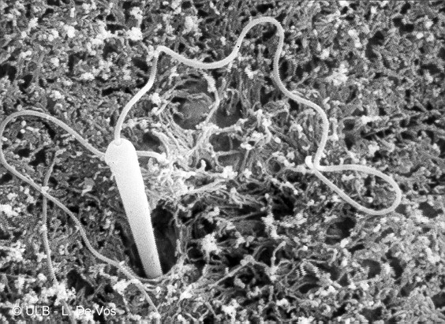
FERTILIZATION
Image courtesy of L. De Vos- U.L.B.- Biodic
http://www.ulb.ac.be/sciences/biodic/biodic/images/bio_animale/embryologie/fecondation/baefec_01_01.jpg

Slide 5
WHAT HAPPENS AFTER MEIOSIS?
WHAT DID MEIOSIS PRODUCE?
WHAT HAPPENS TO GAMETES?
WHAT’S THE PRODUCT OF FERTILIZATION?

Slide 6
ZYGOTE The fertilized egg
http://en.wikipedia.org/wiki/Image:Sperm-egg.jpg#file
Notes:
Figure 20-35. Immunofluorescence micrographs of human sperm and egg pronuclei coming together after in vitro fertilization. Spindle microtubules are stained in green with anti-tubulin antibodies, and DNA is labeled in blue with a DNA stain. (A) A meiotic spindle in a mature, unfertilized oocyte. (B) This fertilized egg is extruding its second polar body and is shown about 5 hours after fusion with a sperm. The sperm head (left) has nucleated an array of microtubules. (C) The two pronuclei have come together. (D) By 16 hours after fusion with a sperm, the centrosome that entered the egg with the sperm has duplicated, and the daughter centrosomes have organized a bipolar mitotic spindle. The chromosomes of both pronuclei are aligned at the metaphase plate of the spindle. As indicated by the arrows in (C) and (D), the sperm tail is associated with one of the centrosomes. (From C. Simerly et al., Nat. Med. 1:47–53, 1995. © Macmillan Magazines Ltd.)

Slide 7
WHAT HAPPENS AFTER MEIOSIS?
WHAT DID MEIOSIS PRODUCE?
WHAT HAPPENS TO GAMETES?
WHAT IS THE PRODUCT OF FERTILIZATION?
HOW DOES A ONE CELL ZYGOTE BECOME A HUMAN?

Slide 8
SO…..WHAT ARE STEM CELLS?
CELLS THAT CAN MAKE MORE OF THEMSELVES
CELLS THAT CAN BECOME ALMOST ANY CELL - MULTIPOTENT

Slide 9
Stem Cells
Self-renewing, undifferentiated, multipotent cells

Slide 10
WHERE DO STEM CELLS COME FROM?
EMBRYONIC
BLASTOCYST (day5)
ADULT
CORD CELLS
PLACENTA
ADULTS
INDUCED PLURIPOTENT STEM CELLS (iPS cells)
Skin cells to stem cell

Slide 11
Stem Cells
Embryonic Stem Cells
Adult Stem Cells
Derived from embryonic blastocysts
Pluripotent
Residue within adult tissues
Multipotent
iPS Cells
Generating stem cells from differentiated cells

Slide 12
PROS AND CONS
EMBRYONIC
CELL LINES LAST AND LAST AND LAST
MULTIPOTENT
EASY TO FIND
ETHICAL ISSUES - WHEN DOES LIFE BEGIN?
ADULT
CELL LINES DO NOT LAST
NOT MULTIPOTENT
HARD TO LOCATE
NO ETHICAL ISSUES
iPS CELLS
SIMILAR TO EMBRYONIC
NO ETHICAL ISSUE
STILL NEEDS OPTIMIZATION

Slide 13
Cell therapy challenges
Directing cells to the proper place
Integrating cells with the patient’s own tissue
Overcoming the phenomenon of tissue rejection

Slide 14
Multi-disciplinary clinical successes in regenerative medicine from voice box reconstruction to tendon repair
Stroke
Huntington Disease
Voice-box Reconstruction
Multiple Sclerosis
Rheumatoid Arthritis
Ophthalmology
Tendon repair
Cardiovascular
Cartilage repair
Diabetes
Immunotherapy
Digestive Tract
Oncology
Liver cirrhosis

