Slide 1
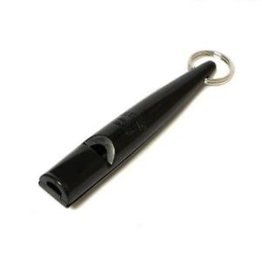
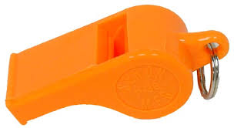
GENERALIZATION & DISCRIMINATION
Generalization: Tendency to respond to stimuli similar to the CS
Discrimination: Occurrence of responses only to a specific CS.

Slide 2
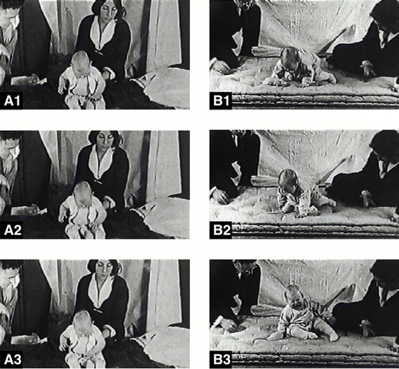
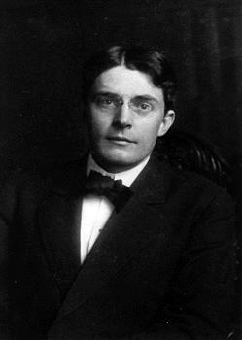
CONDITIONED EMOTIONAL RESPONSE
An emotional reaction of a specific stimulus is learned through CC.
Conditioning Little Albert to fear a white rat.
John B. Watson

Slide 3
COUNTER CONDITIONING
Extinction of an undesirable response to a stimulus through the introduction of a more desirable response

Slide 4
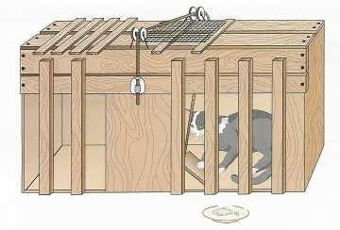
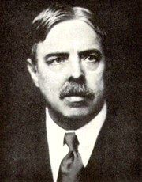
OPERANT CONDITIONING
Also known as instrumental conditioning
An organism operates on its environment to produce a change.
«Puzzle box»-Edward Thorndike
The law of effect: reinforcers promote learning, whereas punishers lead to the unlearning of responses.

Slide 5
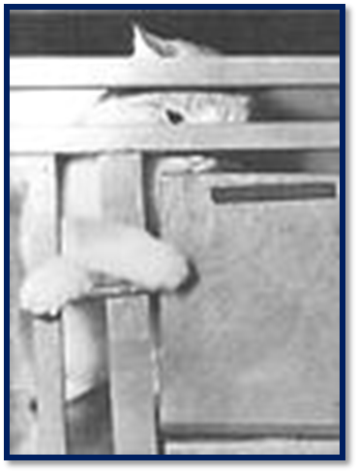
Cellular Level of Operant Conditioning
LTP
Repeated reinforcement insures better, more numerous and more efficient connections between neurons
Reward increases uptake of midbrain dopamine in the Nucleus Accumbens (NAcc)
Higher NAcc activation during encoding = greater likelihood of recall
* increased attention and increased contextual memory

Slide 6
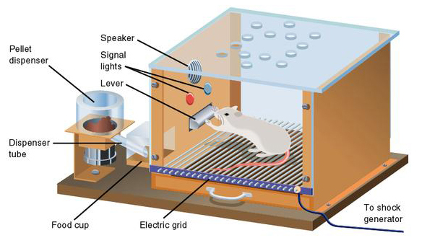
Skinner’s box(1938)
Reinforcer is an event or stimulus that increases the frequency of the response
Positive reinforcers are events or stimuli that are presented after the target response occurs.
Negative reinforcers are events or stimuli that are removed because a response has occurred.

Slide 7
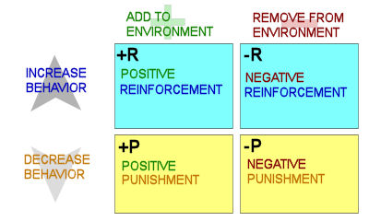

Slide 8
POSITIVE REINFORCEMENT
occurs when a response is followed by a positive reinforce
makes the behavior more likely to occur in the future.
Shaping: reinforcement of successive responses that more closely resemble the target response - “Successive Approximation”

Slide 9
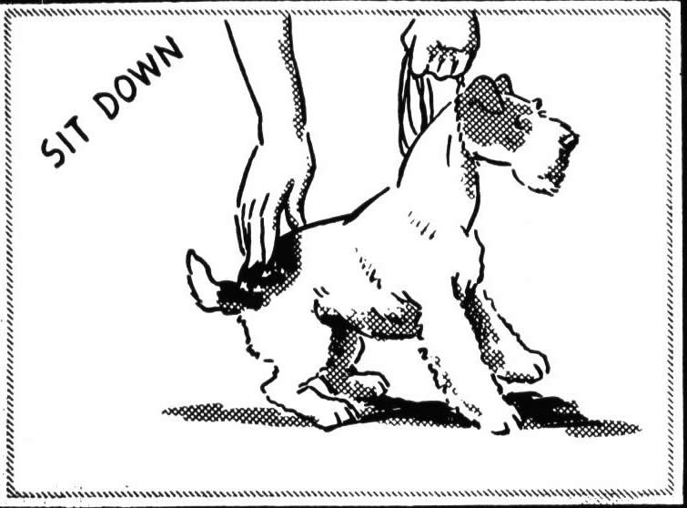
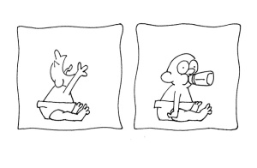
NEGATIVE REINFORCEMENT
occurs when a target behavior (response) is followed by removal or reduction of a negative reinforcer

Slide 10
EXTINCTION IN OPERANT CONDITIONING
Occurs when a behavior is no longer followed by a reinforcer.

Slide 11
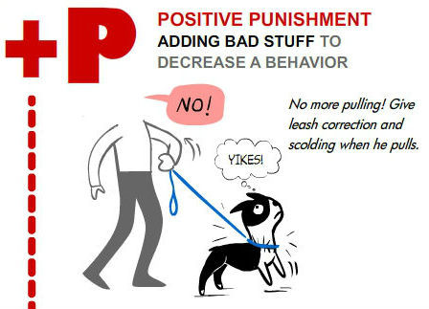
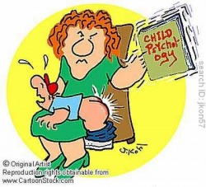
POSITIVE PUNISHMENT
use of a physically or psychologically painful event as a punisher.

Slide 12
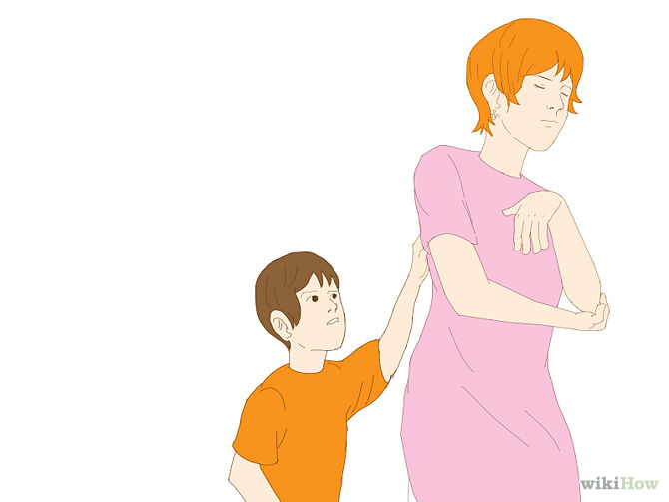
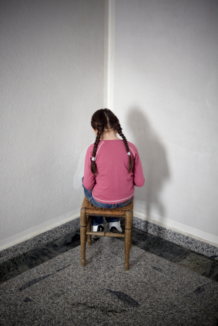
NEGATIVE PUNISHMENT
loss of reinforcement as a consequence of an inappropriate behavior.

Slide 13
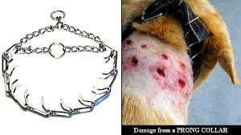
DRAWBACKS TO USE AVERSIVE METHODS
Pain-induced aggression – redirected aggression- fear induced aggression
High arousal level
Hyperactivity
Depression
Learned helplessness
The aversive quality of punishment may condition a fear response to the person administering it.
Generalization – using newspaper for house training

Slide 14
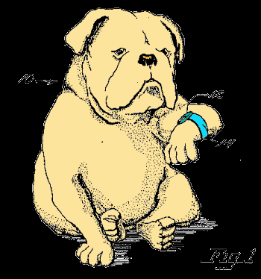
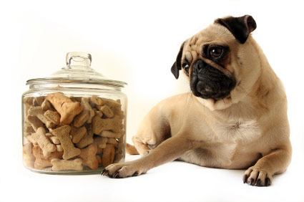
EFFICIENT TRAINING REQUIRES:
PERFECT TIMING
APPROPRIATE REINFORCER
STRONG STIMULUS

Slide 15
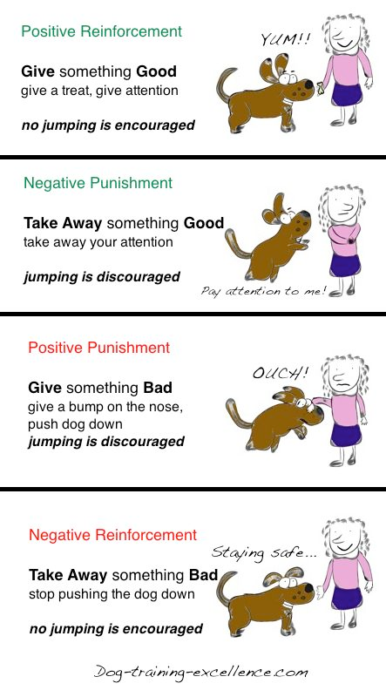
CONCLUSION
Learning is important to survive
Learning requires memory
Learning takes place in different regions
Two types of learning: Associative & Non-associative
Positive = Add to environment
Negative = Remove from environment

Slide 16
THANK YOU FOR YOUR ATTENTION

