Slide 1
Week-4 Antimicrobial Therapy Beta lactams

Slide 2
Terminology
Antimicrobial Greek words; anti (against), mikros (little) bios (life)
All agents that act against microbial organisms.
include all agents that act against all types of microorganisms – bacteria (antibacterial), viruses (antiviral), fungi (antifungal) and protozoa (antiprotozoal).
Antibacterials= largest and most widely known and studied class of antimicrobials
Antibiotics anti (against) biotikos (life).
Antibiotic = substances produced by microorganisms that act against another microorganism.
Thus, antibiotics do not include antimicrobial substances that are synthetic (sulfonamides and quinolones), or semisynthetic (methicillin and amoxicillin), or those which come from plants (quercetin and alkaloids) or animals (lysozyme).

Slide 3
ANTIBIOTIC
Low molecular substance produced by a microorganism that at a low concentration inhibits or kills other microorganisms.
ANTIMICROBIAL is any substance of natural, semisynthetic or synthetic origin that kills or inhibits the growth of microorganisms but causes little or no damage to the host.
All antibiotics are antimicrobials, but not all antimicrobials are antibiotics

Slide 4
History-1
19th century- microorganisms were found to be responsible for a variety of infectious diseases
Initiation of the chemotherapy aimed at the causative organisms was developed as the main therapeutic strategy.
Salvarsan- syphilis – Paul Ehrlich- 1910
selective toxicity
developed the Chemotherapeutic Index
Chemotherapeutic Index = Toxic Concentration/ Effective Concentration

Slide 5
History-2
1928-Alexander Fleming-penicillin.
Growth of Staphylococcus aureus was inhibited in a zone surrounding a contami nated blue mold (a fungus from the Penicillium genus) in culture dishes, leading to the finding that a microorganism would produce substances that could inhibit the growth of other microorganisms.
Florey & Chain purified it by freezedrying (1940) - Nobel prize 1945 • first used in a patient: 1942
Clinical use -1940s.

Slide 6
History-3
Era of antimicrobial chemotherapy- World War II- saving lives of 12-15%.
1935- Sulfonamides- Domagk and other researchers.

Slide 7
History-4
Selman Waksman - Streptomycin (1943)
Gram-negatives – first antibiotic active against Mycobacterium tuberculosis
Extracted from Streptomyces – 20 other antibiotics, incl. neomycin, actinomycin
Nobel prize 1952

Slide 8
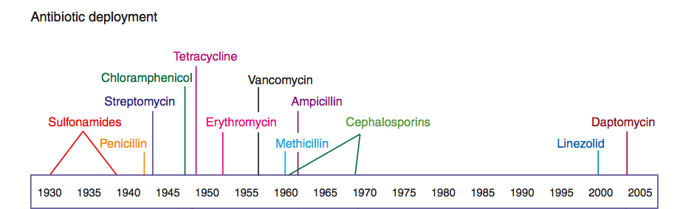
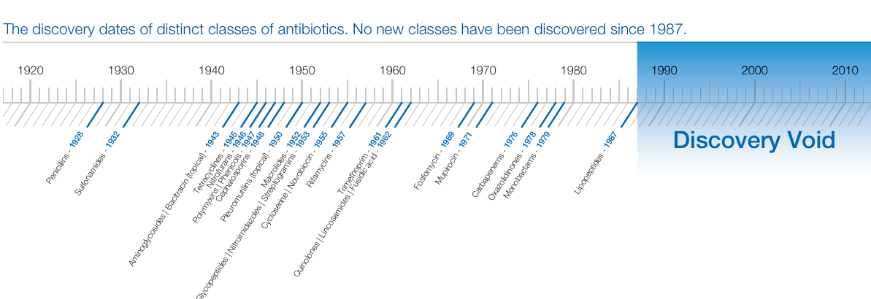
Clatworthy et al. 2007 Nat Chem Biol 3, 541-8

Slide 9
Types of antibiotic therapy
Targeted – based on sensitivity tests
Empiric – based on the symptoms and habits – knowledge of local epidemiological data
Profilactic – e.g. intestinal operation, dentical surgery

Slide 10
Selecting an Antimicrobial
Confirm the presence of infection
History and physical
Signs and symptoms
Predisposing factors
Identification of pathogen
Collection of infected material
Stains
Serologies
Culture and sensitivity
Selection of presumptive therapy
Drug factors
Host factors
Monitor therapeutic response
Clinical assessment
Lab tests
Assessment of therapeutic failure
Christine Kubin, 2004

Slide 11
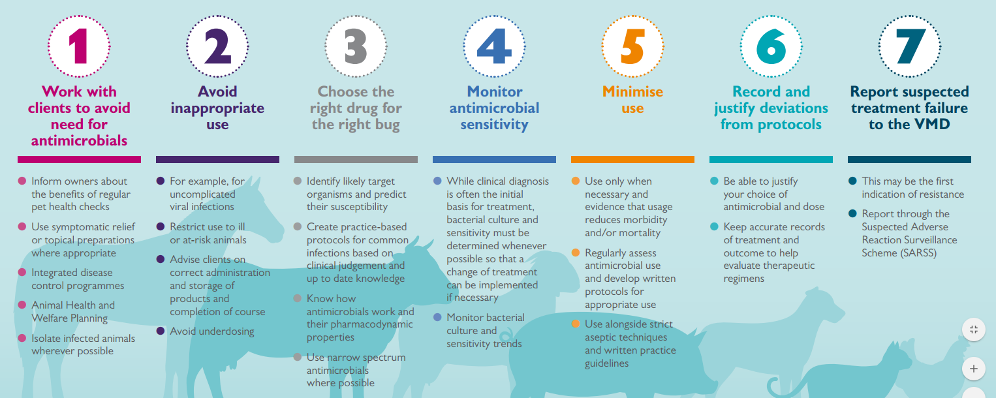

Slide 12
Classification of antimicrobials
spectrum of activity
effect on bacteria
mode of action

Slide 13
Spectrum of activity
range of bacterial species susceptible to the agents
broad-spectrum, intermediate-spectrum, or narrow- spectrum.
Broad spectrum antibacterials are active against both Gram-positive and Gram-negative organisms.
Tetracyclines, phenicols, fluoroquinolones, “third-generation” and “fourth-generation” cephalosporins.
Narrow spectrum antibacterials have limited activity and are primarily only useful against particular species of microorganisms.
Glycopeptides and bacitracin are only effective against Gram-positive bacteria, whereas polymixins are usually only effective against Gram negative bacteria.
Aminoglycosides and sulfonamides are only effective against aerobic organisms, while nitroimidazoles are generally only effective for anaerobes.

Slide 14
Effect on Bacteria
aminoglycosides, cephalosporins, penicillins, and quinolones
Bactericidal drugs -kill target organisms.
Bacteriostatic drugs- inhibit or delay bacterial growth and replication.
Some antibiotics can be both bacteriostatic and bactericidal, depending on the dose, duration of exposure and the state of the invading bacteria.
Aminoglycosides, fluoroquinolones, and metronidazole exert concentration-dependent killing characteristics; their rate of killing increases as the drug concentration increases.
tetracyclines, sulfonamides, and macrolides.

Slide 15
Effect on Bacteria
Onset of action for bacteriostatic agents is generally slower than that of bactericidal agents.
In addition, bacteriostatic drugs require a working immune system for effective elimination of the microorganism by the infected host.
Bacteriostaic antibiotics are therefore not advisable for use in animals with immunosuppressed or immunocompromised conditions and those suffering from life-threatening acute infections.

Slide 17
Mode of Action
Inhibit cell wall synthesis
Penicillins
Cephalosporins
Carbapenems
Monobactams (aztreonam)
Vancomycin
Inhibit protein synthesis
Chloramphenicol
Tetracyclines
Macrolides
Clindamycin
Streptogramins (quinupristin/dalfopristin)
Oxazolidinones (linezolid)
Aminoglycosides
Alter nucleic acid metabolism
Rifamycins
Quinolones
Inhibit folate metabolism
Trimethoprim
Sulfamethoxazole
Miscellaneous
Metronidazole
Daptomycin

Slide 18
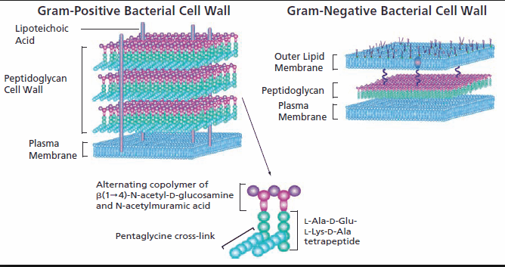
Inhibition of cell Wall synthesis
Bacterial cell Wall- unique in construction- contains peptidogylcan
Antimicrobials interfere with the synthesis of cell Wall do not interfere with eukaryotic cell (lack of cell Wall and membrane differences)
High therapeutic index- Low toxicity with high effectiveness

Slide 19
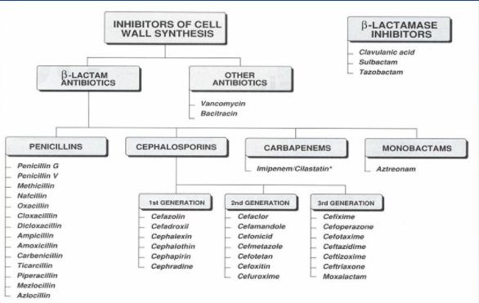

Slide 20
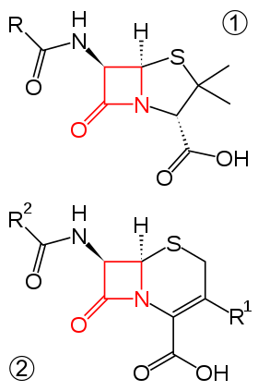
Beta Lactam Antibiotics
Inhibitors of cell wall synthesis
Four-membered, nitrogen-containing beta-lactam ring at the core
Beta-lactam ring portion- bind penicillin-binding proteins (PBP)
Target PBPs - enzymes found anchored in the cell membrane- involved in the crosslinking of the bacterial cell wall- unable to perform their role in cell wall synthesis.
Death of the bacterial cell due to osmotic instability or autolysis.

Slide 21
β-Lactam antibiotics mimic the terminal d-Ala-d-Ala moiety of the pentapeptide
The reactive β-lactam ring is able to acylate the active serine residue of the transpeptidase, leading to a stable acyl–enzyme intermediate that is still appended with a bulky substituent (the second ring of the β-lactam antibiotics)
thus preventing the access of an incoming amino group, required to achieve cross-linking

Slide 22
β-lactamases
Enzymes capable of destroying and inactivating β-lactam antibiotics.
Production of β-lactamases is one of the prime mechanisms for bacterial resistance to β-lactam antibiotics.
β-lactamases have different properties and preferred substrates (antibiotics).
Some are specific for penicillins (i.e., penicillinases) and some preferably destroy cephalosporins (i.e., cephalosporinases).
To date, more than 200 different β-lactamases have been described.

Slide 23
Beta Lactam Antibiotics
Generally regarded as safe agents - they target the bacteria’s cell wall, which does not exist in mammalian cells.
Hypersensitivity – commonly dermatological reaction.
Anaphylactic reaction is rare but can, under certain conditions, be serious and even fatal.

Slide 24
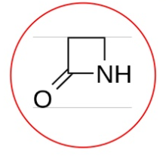
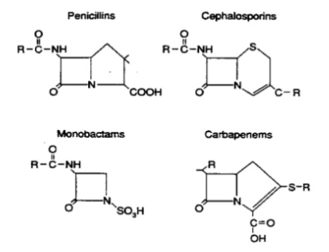
Beta Lactam Antibiotics
Classified into
Penicillin
Cephalosporin
Others
Carbapenem
Monolactam
Cephamycin
Oxacephalosporin

Slide 25
β-lactam ring
unstable, being sensitive to heat, light, extremes in pH, heavy metals, and oxidizing and reducing agents

Slide 26
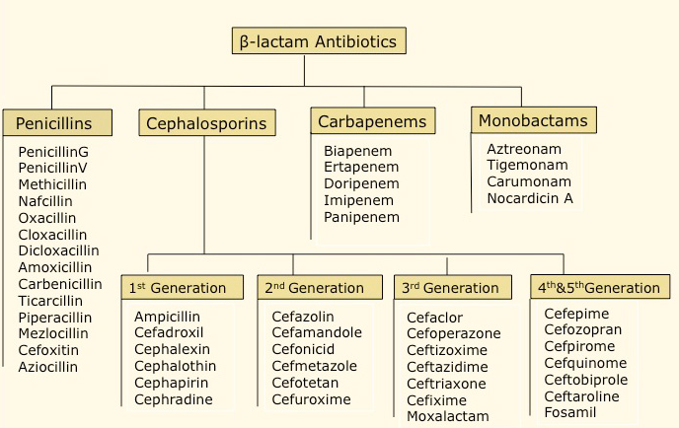

Slide 27
Uses of beta lactams in veterinary medicine
Ruminants: Anthrax, listeriosis, leptospirosis, clostridial and corynebacterial infections; streptococcal mastitis, keratoconjunctivitis Swine: erysipelas, streptococcal and clostridial infections
Horses: Tetanus, strangles, other strep and clostridial infections, foal pneumonia,
Dogs and cats: streptococcal and clostridial infections, urinray tract inf.
Poultry: Necrotic enteritis, ulcerative enteritis, and intestinal spirochetosis

Slide 28
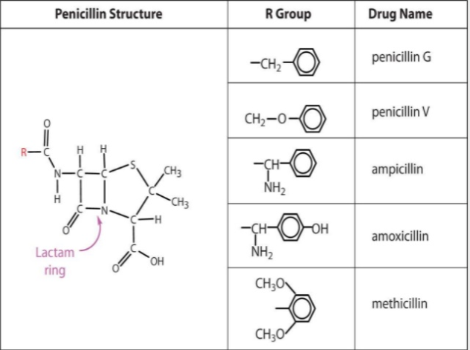
Penicillin
Derived directly or indirectly from strains of fungi of the genus Penicillium and other soil-inhabiting fungi.
Penicillum chrysogenum (syn: P. notatum), Aspergillus nidulans

Slide 29
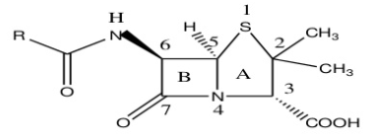
Position 1 – When the sulfur atom of the Thiazolidine ring is oxidized to a sulfone or sulfoxide, it improves acid stability, but decreases the activity of the agent. Position 2 – No substitutions allow at this position, any change will lower activity. The methyl groups are necessary
Position 3 – The carboxylic acid of the Thiazolidine is required for activity. If it is changed to an alcohol or ester, activity is decreased.
Position 4 – The nitrogen is a must.
Position 5 – No substitutions allowed.
Position 6 – Substitutions are allowed on the side chain of the amide.
Position 7 – The carbonyl on the Beta-lactam ring is a must
An electron withdrawing group added at this position will give the compound better acid stability because this substitution will make the amide oxygen less nucleophillic.
A bulky group added close to the ring will make the compound more resistant to Beta-lactamases.
Steric hindrance provides protect to the Beta-lactam ring.

Slide 30
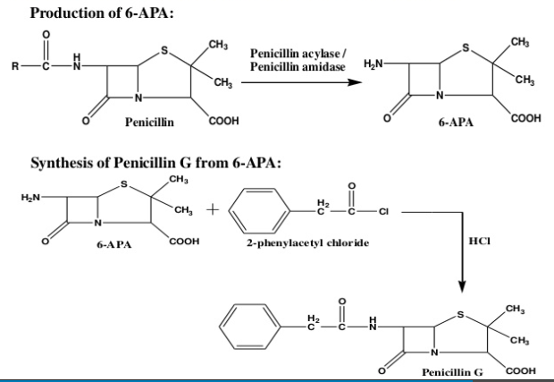

Slide 31
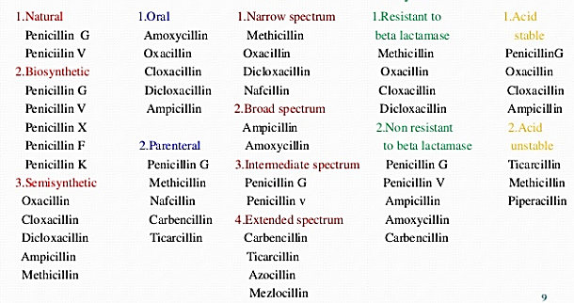
Classification
Resistance to beta lactamases
Acid stability
Source
Route
Spectrum

Slide 33
Narrow-spectrum β-Lactamase–sensitive Penicillins
streptococci, penicillin-sensitive staphylococci, Trueperella (Arcanobacterium) pyogenes, Clostridium spp, Erysipelothrix rhusiopathiae, Actinomyces bovis, Leptospira Canicola, Bacillus anthracis, Fusiformis nodosus, and Nocardia spp.
Natural - penicillin G (benzylpenicillin)
Penicillin G sodium
Penicillin G potassium
Prokain penicillin G
Benzatin penicillin G
Biosynthetic acid-stable penicillins - oral use (penicillin V [phenoxymethyl-penicillin] and phenethicillin).
Active against many gram-positive but only a limited number of gram-negative bacteria.
These drugs are also effective against anaerobic organisms.
Susceptible to β-lactamase (penicillinase) hydrolysis.
Exceptions (Haemophilus and Neisseria spp and strains of Bacteroidesother than B fragilis)

Slide 34
Broad-spectrum β-Lactamase–sensitive Penicillins
Semisynthetically - active against many gram-positive and gram-negative bacteria.
Destroyed by the β-lactamases (produced by many bacteria).
Acid stable- administered either PO or parenterally.
Aminopenicillins- ampicillin and amoxicillin
Ampicillin precursors -absorbed from the GI - hetacillin, pivampicillin, talampicillin.
A large number of gram-positive and gram-negative bacteria (but not β-lactamase–producing strains)
Staphylococcus, Streptococcus, Trueperella, Clostridium, Escherichia, Klebsiella, Shigella, Salmonella, Proteus, and Pasteurella.

Slide 35
Synergistic association with β-lactamase inhibitors- POTENCIATED PENICILLINS
β-lactamase inhibitors + broad-spectrum penicillins
enhances the spectrum and efficacy against both gram-positive and gram-negative pathogens.
Clavulanate-potentiated amoxicillin
Tazobactam-piperacillin
Sulbactam-ampicillin
Clavulanate-ticarcillin
β-Lactamase–protected Penicillins

Slide 36
Broad-spectrum β-Lactamase–sensitive Penicillins with Extended Spectra
Carboxypenicillins (carbenicillin, its acid-stable indanyl ester, and ticarcillin),
Ureido-penicillins (azlocillin and mezlocillin),
Piperazine penicillins (piperacillin).
Active against Pseudomonas aeruginosa, certain Proteus spp, Klebsiella, Shigella, and Enterobacter spp.
Imipenem and meropenem - resistant to β-lactamase destruction.
aerobic and anaerobic microorganisms, including most strains of Pseudomonas, streptococci, enterococci, staphylococci, and Listeria.
Anaerobes, including Bacteroides fragilis, are highly susceptible.

Slide 37
Narrow-spectrum β-Lactamase–resistant Penicillins
Not as active against many gram-positive bacteria as penicillin G and are inactive against almost all gram-negative bacteria.
Isoxazolyl penicillins (acid-stable/oral route)
oxacillin, cloxacillin, dicloxacillin, and flucloxacillin.
Methicillin and nafcillin (parenteral)
Temocillin (active against gram-negative bacteria except Pseudomonas spp.)
Active β-lactamase–producing strains of Staphylococci (especially S aureus and S epidermidis).

Slide 38
Carbapenems
Imipenem- Streptomyces cattleya
Meropenem
Aztreonam is a related (monobactam) compound but differs from other β-lactams in that it has a second ring that is not fused to the β-lactam ring.

Slide 40
Adverse Effects and Toxicity
Organ toxicity is rare.
Hypersensitivity- formation of penicillinoic acid-particularly in cattle
Skin reactions, angioedema, drug fever, serum sickness, vasculitis, eosinophilia, and anaphylaxis.
Intrathecal administration -convulsions.
Guinea pigs, chinchillas, birds, snakes, and turtles are sensitive to procaine penicillin.
The use of broad-spectrum penicillins -superinfection, and GI disturbances (DIARRHEA) - PO - ampicillin.
Potassium penicillin G should be administered IV with some caution, especially if hyperkalemia is present. (CATION TOXICITY)
The sodium salt of penicillin G may also contribute to the sodium load in congestive heart failure.

Slide 41
Caution
β-lactams in general interact chemically with the aminoglycosides and should not be mixed in vitro.
Ampicillin and penicillin G are incompatible with many other drugs and solutions and should not be mixed.

Slide 42
Therapeutic Use

Slide 43
Penicillin withdrawal

Slide 44
Cephalosporin
Same mechanism of action as penicillins.
Weak acid
contain a 7-alpha-methoxy group-resistance to extended-spectrum β-lactamases.
Wider antibacterial spectrum - increased stability to many types of β-lactamase
Improved pharmacokinetic properties
Generally well distributed -rarely penetrate the blood–brain barrier

Slide 45
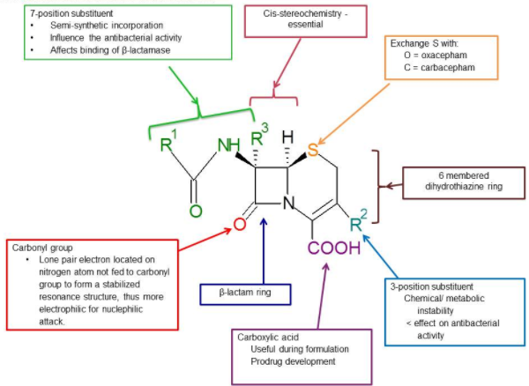
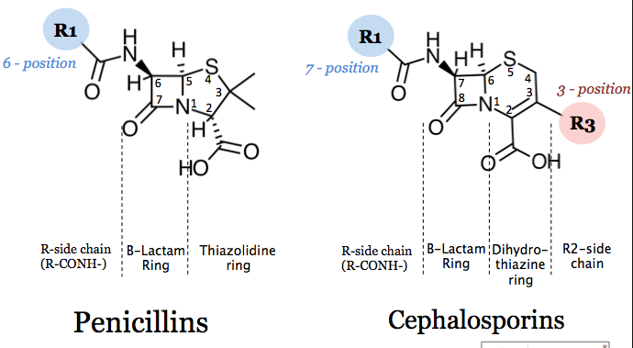

Slide 46
Cephalosporins
First generation
The optimum activity
Gram-positive bacteria such as staphylococci and streptococci.
They also have little gram-negative spectrum
Second generation
More spectra against gram-negative bacteria (Haemophilus influenzae, Enterobacter aerogenes) in comparison to the first generation.
Their gram positive spectrum is less than the first generation.

Slide 47
Cephalosporins
Third generation
Broad spectrum
Effective against both gram positive and gram negative bacteria.
Optimum activity -gram negative bacteria.
Fourth generation
Extended spectrum antibiotics.
Resistant to beta lactamases.
Fifth generation
Extended spectrum antibiotics.

Slide 48
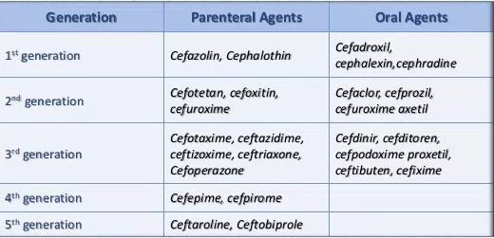

Slide 49
First-generation –infections involving Staphylococcus spp (eg, oral cephalexin for dermatitis)
surgical prophylaxis (eg, cefazolin).
emerging resistance- methicillin-resistant organisms.
Bovine respiratory disease- Pasteurella spp
Urinary tract infections-dogs.
Infections of soft tissue and bone- incase of resistance to other antibiotics
Cefazolin (IV) - prophylactically 1 hr before surgery.

Slide 50
Cephalosporins- penetrate tissues and fluids
osteomyelitis, prostatitis, and arthritis.
Oral cephalosporins - urinary tract infections (except Pseudomonas aeruginosa).
Cephapirin benzathine - dry-cow therapy
Cephapirin sodium- mastitis.
Extra-label use of cephalosporins is banned in major food animal species (except cephapirin).

Slide 51
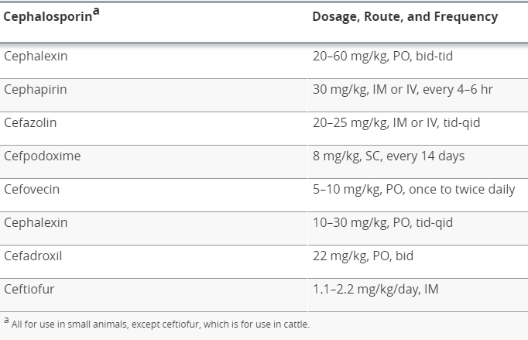

Slide 52
Carbapenem
Imipenem,
Meropenem,
Doripenem,
Ertapenem
Parenteral- bactericidal β-lactam antibiotics- extremely broad spectrum.
Active against
Haemophilus influenzae
Anaerobes
Most Enterobacteriaceae
Methicillin-sensitive staphylococci and streptococci, including S. pneumoniae (except possibly strains with reduced penicillin sensitivity)

Slide 53
Carbapenem
Imipenem is inactivated by dehydropeptidases in renal tubules, resulting in low urinary concentrations.
It is administered together with an inhibitor of renal dehydropeptidase, Cilastatin, for clinical use.
As cleared renally, and the dose must be reduced in patients with renal insufficiency.

Slide 54
Carbapenem
Penetrate body tissues and fluids well, including the cerebrospinal fluid
Imipenem and meropenem penetrate into CSF when meninges are inflamed.
Meropenem - gram-negative bacillary meningitis
While imipenem is not used in meningitis – seizures (CNS abnormalities /renal insufficiency - given inappropriately high doses)

Slide 55
Carbapenem
Indicated for infections caused by susceptible organisms, e.g. P. aeruginosa, which are resistant to other available drugs and for the treatment of mixed aerobic and anaerobic infections.
Active against many highly penicillin-resistant strains of pneumococci.

Slide 56
Carbapenem
Adverse effects
Nausea, vomiting, diarrhea, skin rashes, and reactions at the infusion sites.
Excessive levels- (imipenem) - renal failure-seizures.
Allergic penicillins- carbapenems.

Slide 57
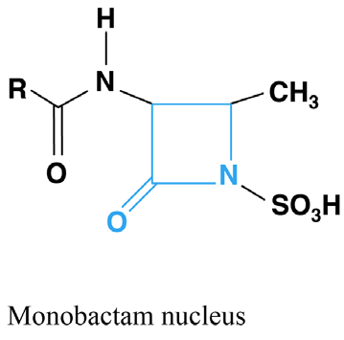
Monobactams- Monocyclic betalactams
Parenteral β-lactam bactericidal antibiotics.
Aztreonam
Active - Enterobacteriaceae (do not produce ampC β-lactamase or extended-spectrum β-lactamase (ESBL)
Pseudomonas aeruginosa
Aztreonam is not active - anaerobes.
Gram-positive bacteria are resistant to aztreonam

Slide 58
Acts synergistically with aminoglycosides.
Metabolic products differ (from those of other β-lactams)- cross-hypersensitivity is unlikely.
Mainly- severe aerobic gram-negative bacillary infections
(meningitis, β-lactam allergy patients- Penicillin-allergic patients tolerate aztreonam without reaction)
Dose is reduced in renal failure.

Slide 59
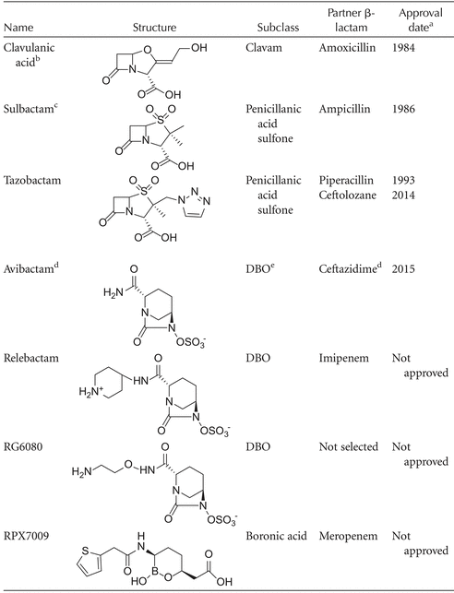
β-lactamase inhibitors have been developed to conserve the activity and extend the spectrum of any accompanying β-lactam drug against β-lactamase–producing microorganisms.
side effects of β-lactam/β-lactamase inhibitor combinations include diarrhea, elevated liver enzyme levels, and rashes

Slide 60
Side effects of β-lactam/β-lactamase inhibitor combinations include diarrhea, elevated liver enzyme levels, and rashes

