Slide 1
B-310 BİYOKİMYA II DERSİ
XII.HAFTA

Slide 2
ONİKİNCİ HAFTA DERS İÇERİĞİ
Oksidatif Fosforilasyon: Mitokondri iç zarında yer alan membran bağımlı taşıyıcılar, elektron akışı, bu akışı engelleyen inhibitörler,

Slide 3
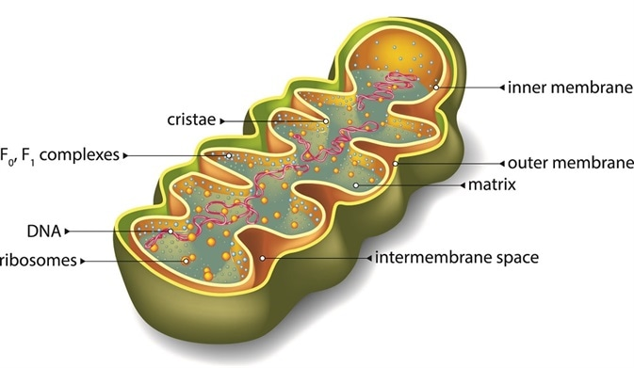

Slide 4
Multienzim kompleksleri,
Kemiozmotik hipotez ve
ATP sentezi bu hafta işlenecek başlıklardır.

Slide 5
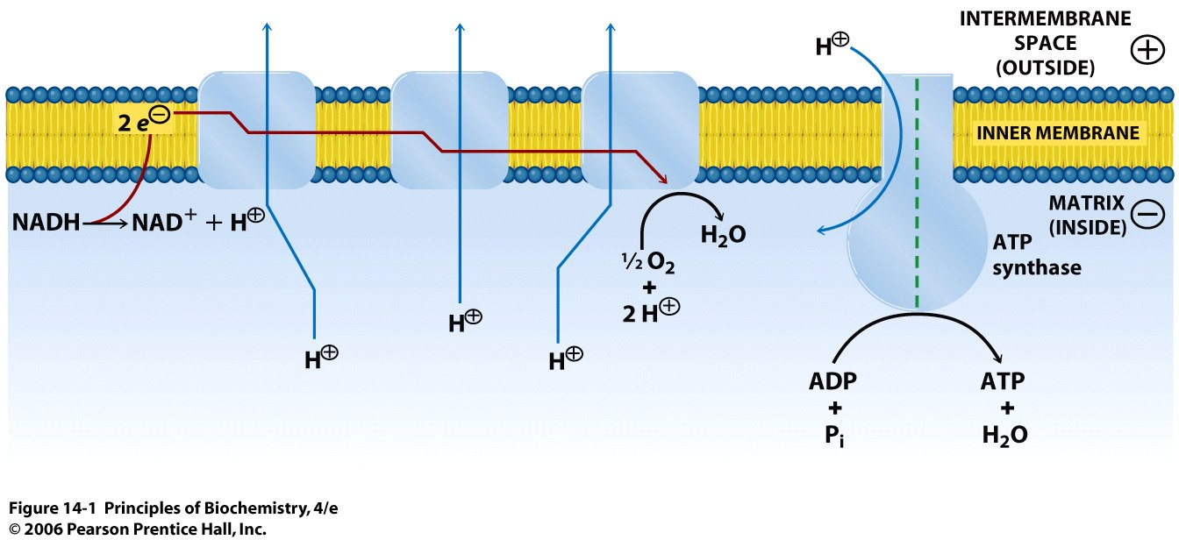
…and e⁻ are transferred to a final acceptor.
As electrons flow through the membrane-associated complexes…
High [H⁺]
Positive potential
III
IV
I
e⁻ enter the electron transport chain
Low [H⁺]
Negative potential
…protons are translocated across the membrane…
The H⁺ concentration gradient is utilized to convert ADP to ATP via ATP synthase
Notes:
Figure 14.1
Overview of membrane-associated electron transport and ATP synthesis in mitochondria. A proton concentration gradient is produced from reactions catalyzed by the electron transport chain. As electrons from reduced substrates flow through the complexes, protons are translocated across the inner mitochondrial membrane from the matrix to the intermembrane space. The free energy stored in the proton concentration gradient is utilized when protons flow back across the membrane via ATP synthase; their reentry is coupled to the conversion of ADP and P_{i} to ATP.

Slide 6
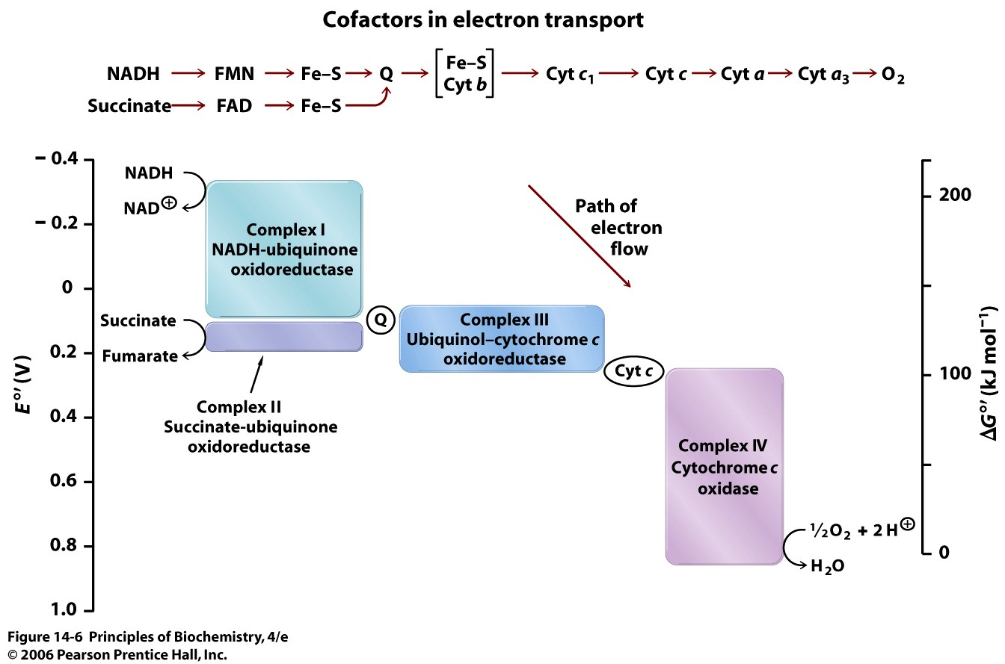
Fe-S clusters in cytochromes serve to transfer e⁻
e⁻ enter the ETC from NADH or succinate
Final e⁻ acceptor
Electrons flow through the components of the electron transport chain (ETC) in the direction of increasing reduction potential. The mobile coenzymes ubiquinone (Q) and cytochrome c serve to transport electrons from one complex to another.
Notes:
Figure 14.6
Electron transport.Each of the four complexes of the electron-transport chain, composed of several protein subunits and cofactors, undergoes cyclic reduction and oxidation. The complexes are linked by the mobile carriers ubiquinone (Q) and cytochrome c. The height of each complex indicates the Δ E°' between its reducing agent (substrate) and its oxidizing agent (which becomes the reduced product).

Slide 7
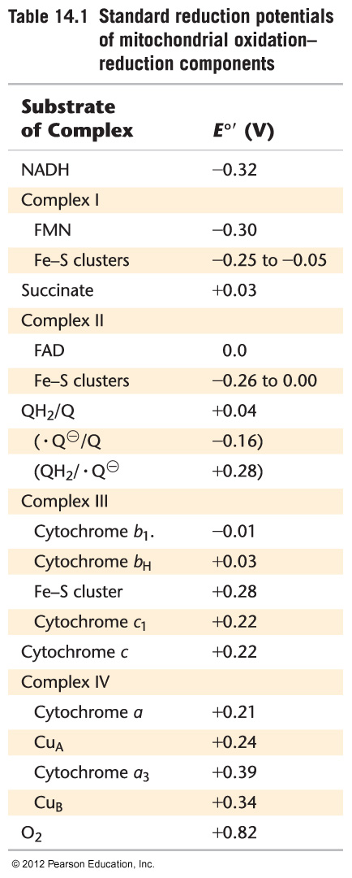
Electrons flow to higher reduction potentials!
Enters ETC
Complex II accepts e⁻ from succinate and adds them to the ETC
Ubiquinone serves a an e⁻ transporter that is associated with the membrane, transfers e⁻ from Complex I and Complex II to Complex III
Cytochrome c transfers e⁻ from Complex III to Complex IV
Final e⁻ acceptor

Slide 8
Protons pass across the mitochondrial membrane. The redox reaction is driven mainly by the charge gradient (and to a small degree by the concentration gradient).
The difference in potential is the protonmotive force.
Introducing a proton gradient across membrane-associated ATP synthase resulted in formation of ATP from ADP and P_{i}!

Slide 9
Kemiosmotik teori, oksidatif fosforillenme ve fotofosforilasyonun zarlarda aktif taşınma ve birçok enerji dönüşümlerinin anlaşılmasını sağlamaktadır. Buna göre, biyolojik oksidasyon tepkimelerinden kazanılan enerji,

Slide 10
zar boyunca proton derişimi farkı şeklinde saklanır.
Mitokondrideki elektron taşıma tepkimelerinde elektronlar genel elektron alıcılarına aktarılır ve zara bağlı bir dizi taşıyıcı üzerinden geçer.

Slide 11
Kompleks I : NADH dehidrogenaz NADH dan ubikinona,
Kompleks II: Süksinat dehidrogenaz
Kompleks III: Übikinon:sitokrom c oksidoredüktaz, sitokrom c
Kompleks IV: Sitokrom oksidaz

Slide 12
Elektronlar NADH dan koenzim Q ya, sitokrom b den sitokrom c1 e, sitokrom c1 den sitokrom c’ye, sitokrom a + a₃ den oksijene aktarılır,
Elektron akışını rotenon, antimisin A ve siyanür veya CO engellemektedir.

Slide 13
Elektronların kompleksler üzerinden akışı sonucu, protonlar iç zardan pompalanarak zarlar arası bölgeye kıyasla daha bazik yapar.
Bu proton farkı, iç zardaki ATP sentazın ADP ve Pi dan ATP sentezlenmesi için enerji sağlar.

Slide 14
Suya indirgenen her oksijen (1/2) başına sentezlenen ATP (P/O) oranı , elektronlar solunum zincirine Kompleks I üzerinden girerlerse 2,5, ubikinon üzerinden girerlerse 1,5 olur.

Slide 15
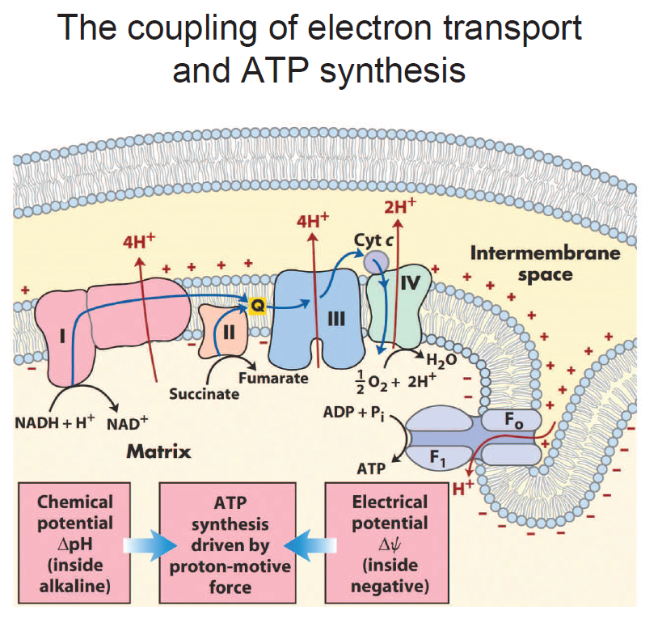

Slide 16
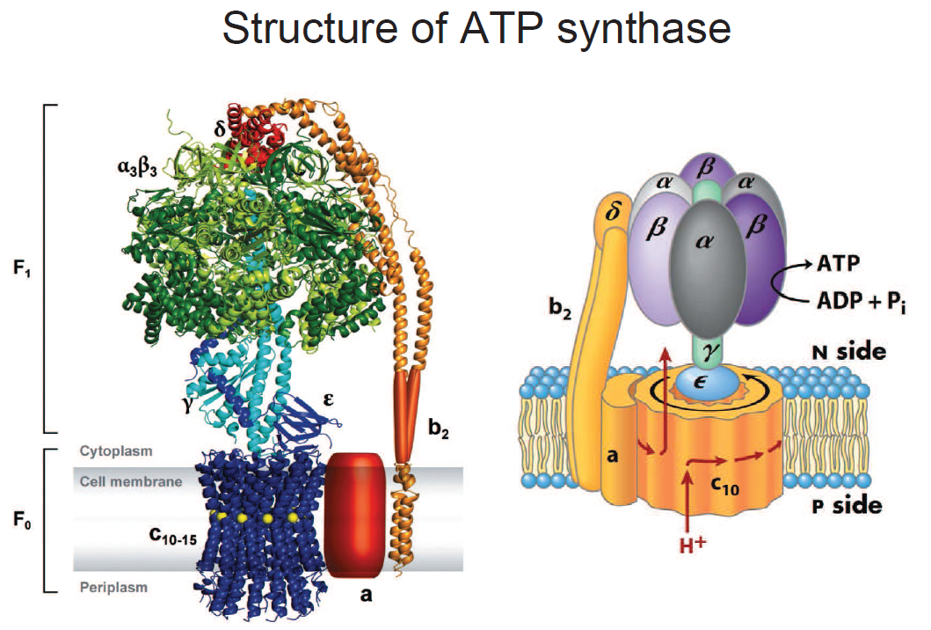
Knob-and-stalk structure of ATP synthase
As H⁺ ions pass through the channel of the a-c interface, the rotor (c-ε-γ) spins inside the membrane, relative to the stator (a-b-δ-α₃β₃). This causes a conformational change in the β subunits of the α₃β₃ hexamer.

Slide 17
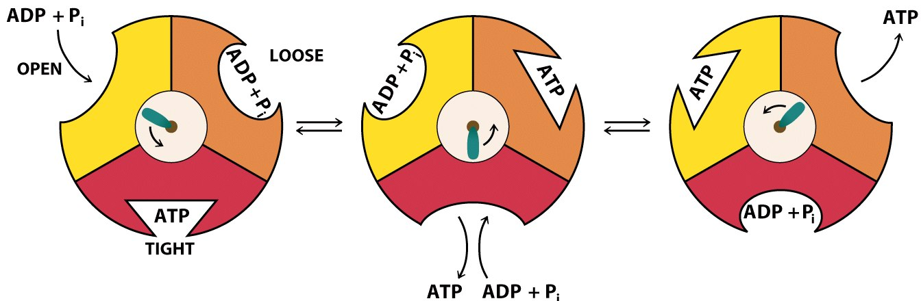
ADP + P_{i} bind to an open site
The site is converted to a loose conformation, where ADP + P_{i} are more firmly bound
The site is converted to a tight conformation, and ATP is sythesized
The shaft rotates counter-clockwise (viewed from F₁ end)
The site is converted back to an open conformation, releasing ATP and allowing for ADP + P_{i} binding.
This cycle continues for each subunit coupled to a conformation change.
~10 revolutions/second
= 30 ATP /second
Notes:
Figure 14.15
Binding change mechanism of ATP synthase. The different conformations of the three catalytic sites are indicated by different shapes. ADP and P_{i} bind to the yellow site in the open conformation. As the shaft rotates in the counter-clockwise direction (viewed from the cytoplasmic/matrix end of the F₁ component), the yellow site is converted to a loose conformation where ADP and P_{i} are more firmly bound. Following the next step of the rotation, the yellow site is converted to a tight conformation and ATP is synthesized. Meanwhile, the site that had bound ATP tightly has become an open site, and a loose site containing other molecules of ADP and P_{i} has become a tight site. ATP is released from the open site, and ATP is synthesized in the tight site.

Slide 18
Phosphorylation/Oxidation ratio (P/O ratio)
The ratio of the amount of ATP synthesized (P) to the amount of oxygen reduced (O)
For each e⁻ pair entered into the ETC, 10 H⁺ are pumped out
For each ATP generated, 4 H⁺ are pumped in
3 per ATP, plus 1 to import P_{i}
NADH: 10 H⁺_{out} / 4 H⁺_{in} = 2.5 ATP per NADH
QH₂: = 6 H⁺_{out} / 4 H⁺_{in} = 1.5 ATP per QH₂
QH₂ bypasses Complex I of the ETC

Slide 20
BU KONU İLE İLGİLİ ŞEKİL VE FORMÜLLER GÖSTERİLEREK KONUNUN DETAYLI ANLATIMI YAPILACAKTIR.

Slide 21
KAYNAKÇA
Başlıca Kaynak: Lehninger Biyokimyanın İlkeleri, David L.Nelson, Michael M. Cox, Beşinci Baskıdan Çeviri, Çeviri Editörü; Y. Murat Elçin, Palme Yayıncılık, 2013.

Slide 22
Principles of Biochemistry, H. R. Horton, L. A. Moran, K. G. Scrimgeour, M. D. Perry, J. D. Rawn, Pearson Prentis Hall, 2006.
Color Atlas of Biochemistry, J. Koolman, K. H. Roehm, Georg Thieme Verlag, 2005.

