Slide 1
The Postwar Boom in the United States
AKE 118 Dr. Gamze Kati Gumus

Slide 2
1950s
The United States was the world’s strongest military power.
Its economy was booming, and the fruits of this prosperity–new cars, suburban houses and other consumer goods–were available to more people than ever before.

Slide 3
1950s
However, the 1950s were also an era of great conflict.
the civil rights movement
the crusade against communism at home and abroad exposed the underlying divisions in American society.

Slide 4
WWII
As the WWII came to an end and millions of men and women in uniform were scheduled to return home, the nation’s military-focused economy was not necessarily prepared to welcome them back.
Notes:
https://www.history.com/news/post-world-war-ii-boom-economy

Slide 5
However..
Most returning veterans had no trouble finding jobs
U.S. factories that had proven so essential to the war effort quickly mobilized for peacetime
And consumers who had been encouraged to save up their money were now ready to spend it.
Americans were saving an average of 21 percent of their personal disposable income, compared to just 3 percent in the 1920s.

Slide 6
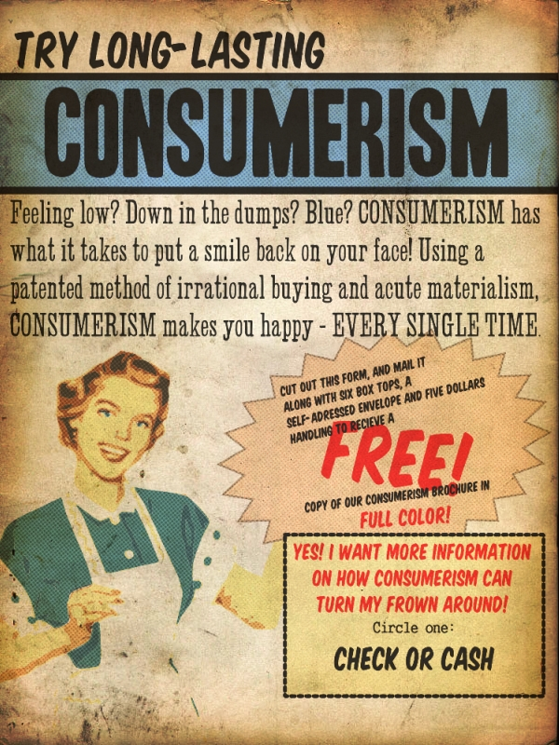
The Age of Consumerism
This Photo by Unknown Author is licensed under CC BY-SA

Slide 7
Gross national product (GNP)
1940
$200 billion in 1940.
1950
$300 billion by 1950,
1960
$500 billion by 1960, firmly establishing the United States as the richest and most powerful nation in the world.

Slide 8
GDP
Much of this increase came from government spending:
the construction of interstate highways and schools,
the distribution of veterans’ benefits
the increase in military spending
on goods like airplanes
and on new technologies like computers–all contributed to the decade’s economic growth.

Slide 9
GDP
Rates of unemployment and inflation were low, and wages were high.
Middle-class people had more money to spend than ever–and, because the variety and availability of consumer goods expanded along with the economy, they also had more things to buy.

Slide 10
Consumerism
With the war finally over, American consumers were eager to spend their money, on everything from big-ticket items like homes, cars and furniture to appliances, clothing, shoes and everything else in between.

Slide 11
Consumerism
1945 and 1955
New car sales quadrupled between 1945 and 1955, and by the end of the 1950s some 75 percent of American households owned at least one car.
1965
In 1965, the nation’s automobile industry reached its peak, producing 11.1 million new cars, trucks and buses and accounting for one out of every six American jobs.

Slide 12
1951 Mercedes-Benz Type 300 Limo

Slide 13
1954 Buick Skylark

Slide 14
Cadillac Eldorado Convertible-1954

Slide 15
1959 CADILLAC COUPE DEVILLE

Slide 16
1956 CHEVROLET CORVETTE

Slide 17
Baby Boomers
1946
This boom began in 1946, when a record number of babies–3.4 million–were born in the United States.
1950s
About 4 million babies were born each year during the 1950s.
1964
In all, by the time the boom finally tapered off in 1964, there were almost 77 million “baby boomers.”

Slide 18
The Suburban Boom-Lewittowns

Slide 19
Consumerism
Companies like Levitt & Son, based in New York, found success applying the mass-production techniques of the auto industry to home building.
Between 1946 and the early 1960s, Levitt & Son built three residential communities (including more than 17,000 homes).

Slide 20
Consumerism in the 50s
At home, television exerted a profound influence on the development of a modern, consumer-based popular culture.
TV lamps glowed atop television sets while families ate pre-packaged TV dinners on Melamine trays.
Networks divided viewers into target audiences and advertisers spent large sums to promote their products.
Official toys and games were marketed alongside children’s programs and television serials.
Notes:
https://www.sfomuseum.org/exhibitions/modern-consumer-1950s-products-and-style

Slide 22
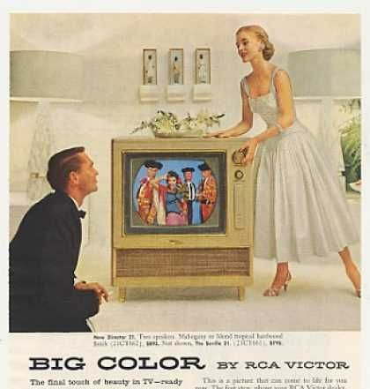

Slide 24
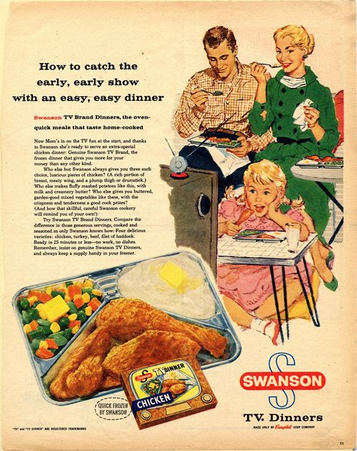

Slide 25
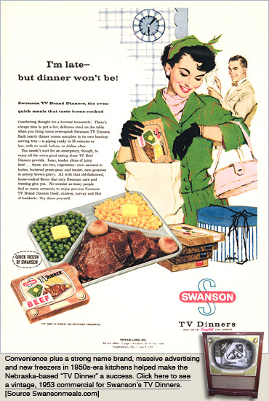

Slide 26
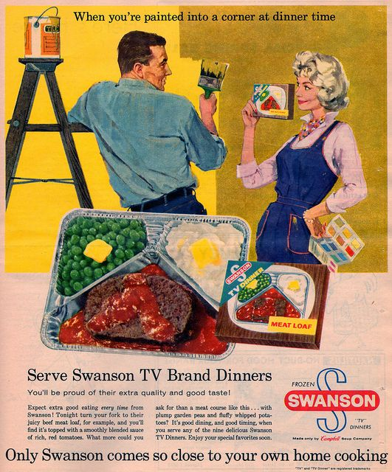

Slide 27
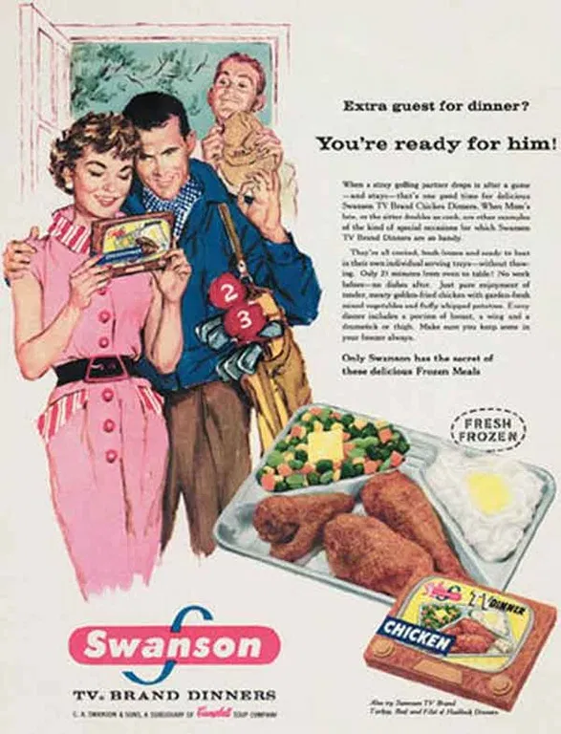

Slide 28
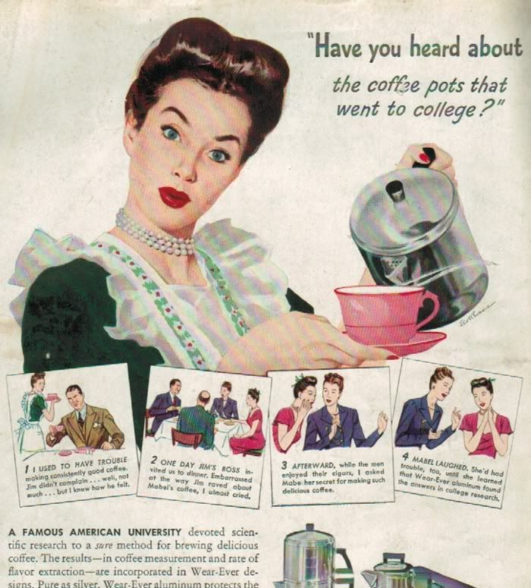

Slide 29
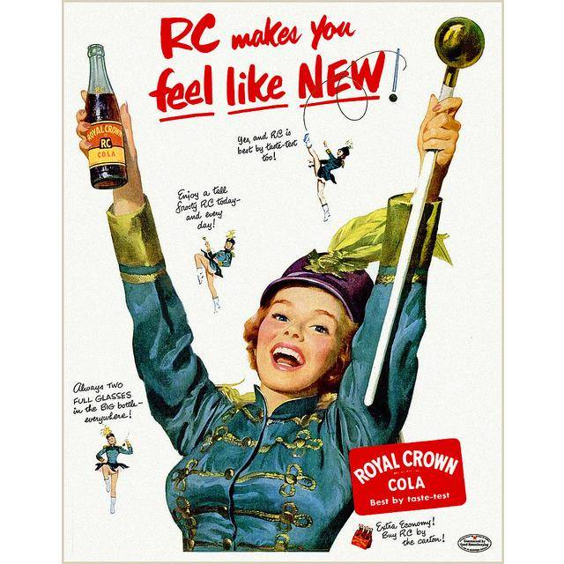

Slide 30
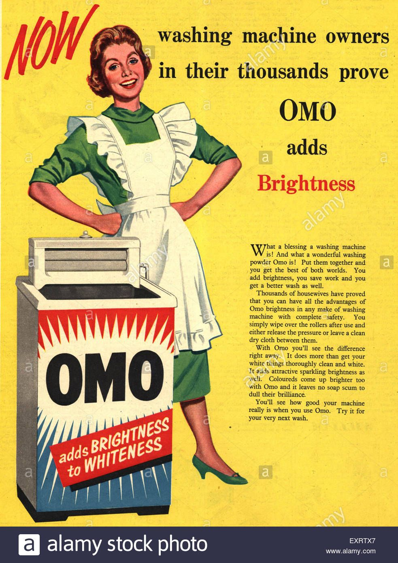

Slide 31
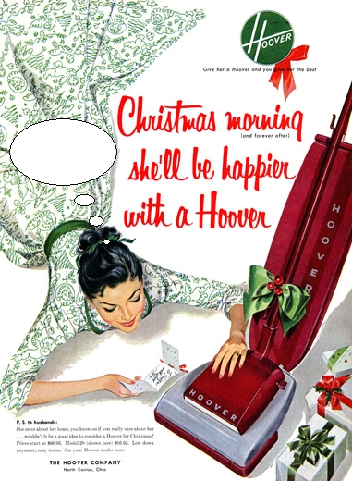

Slide 32
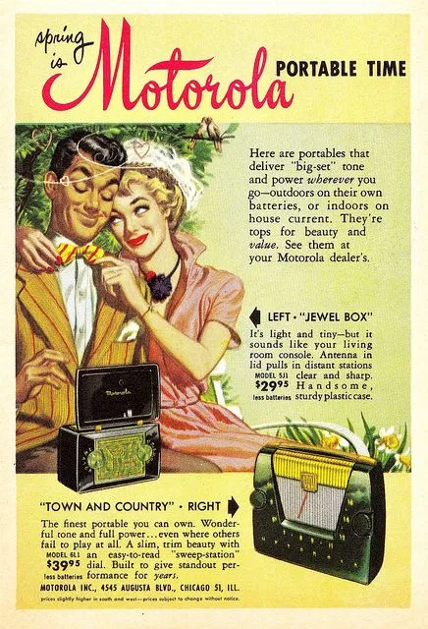

Slide 33
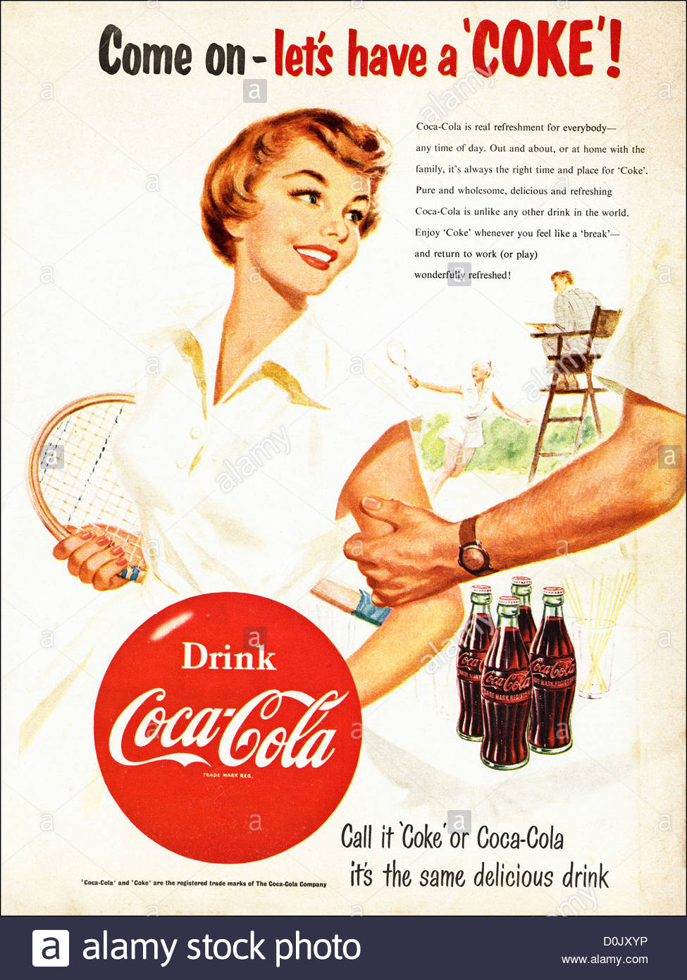

Slide 34
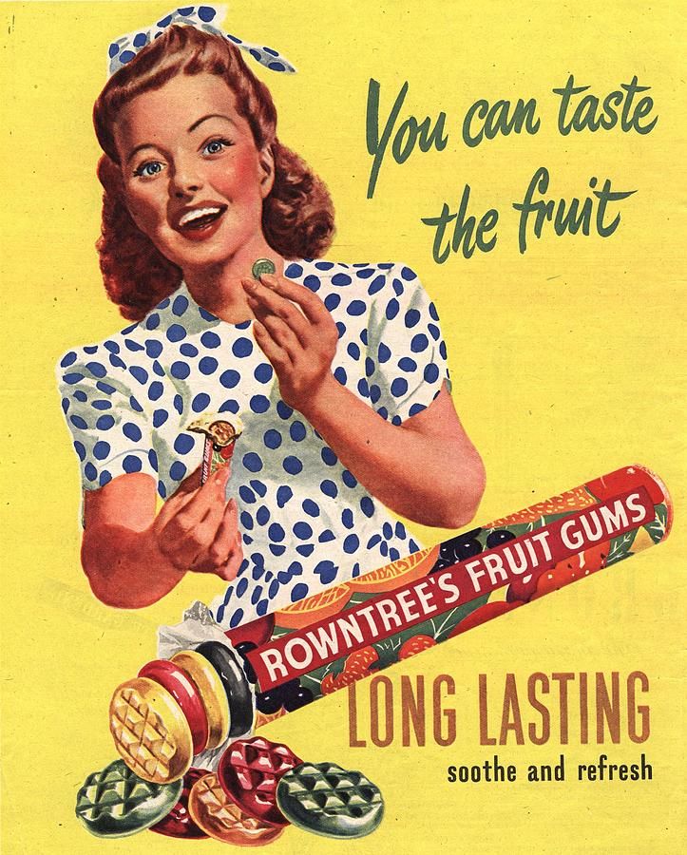

Slide 35
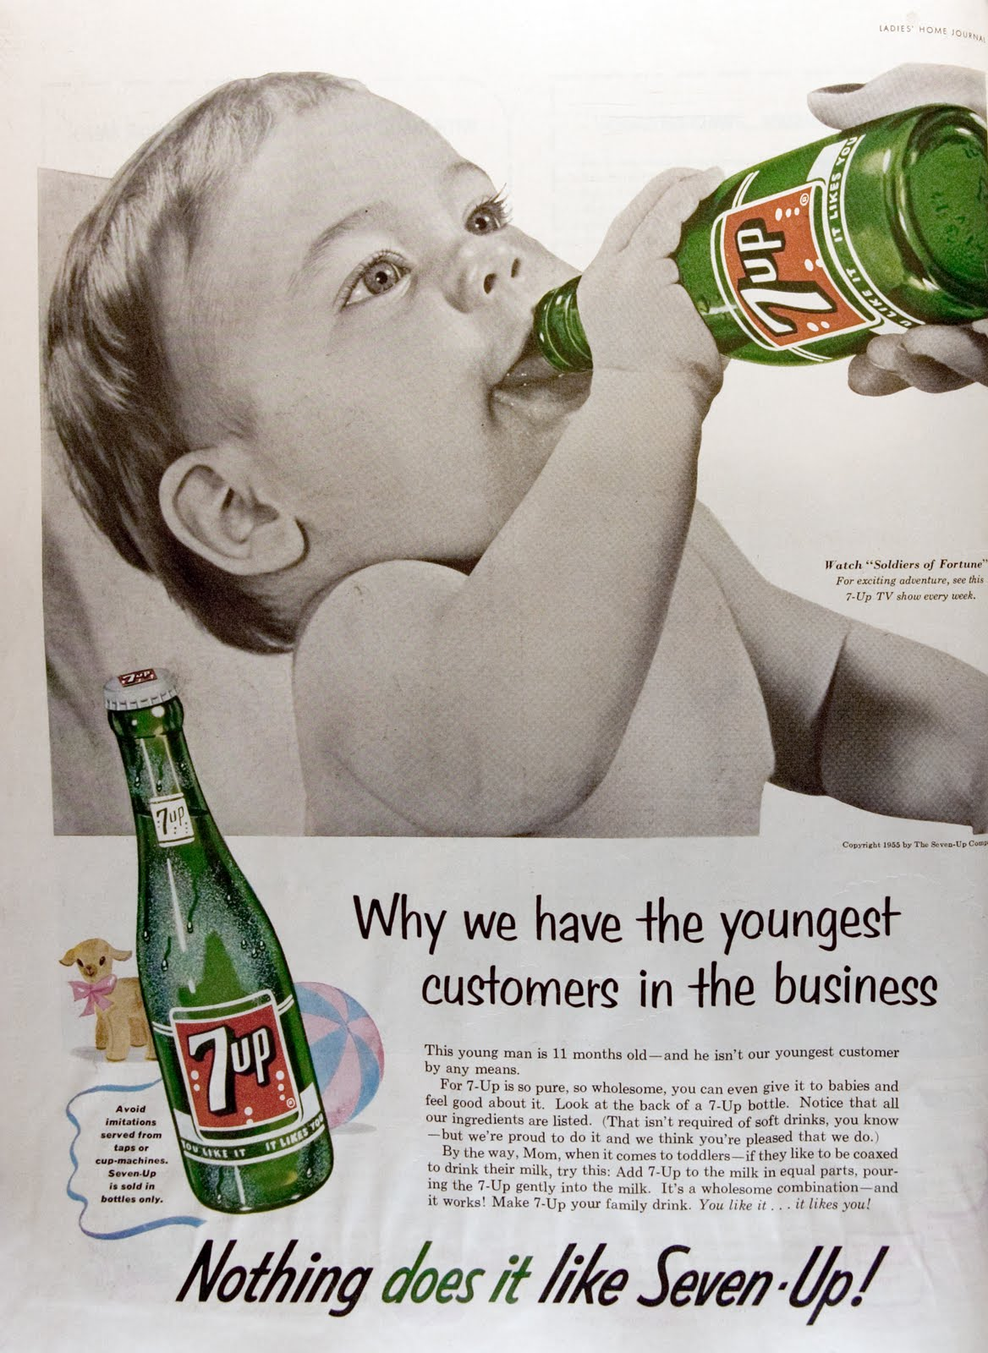

Slide 36
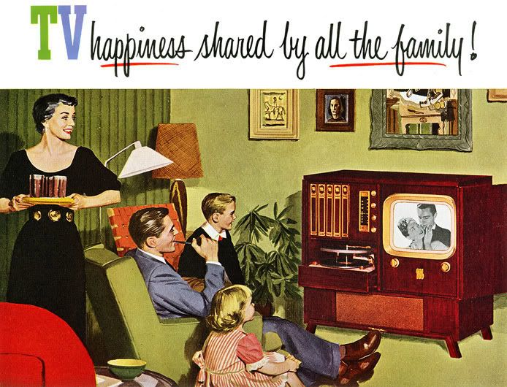

Slide 37
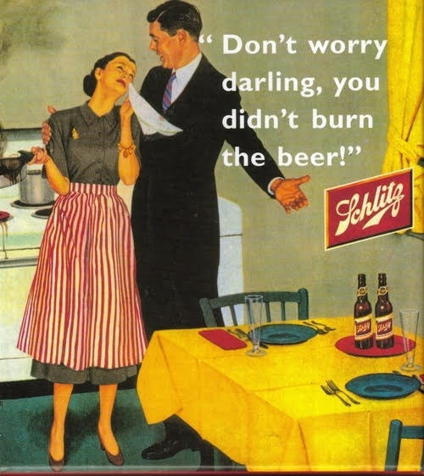

Slide 38
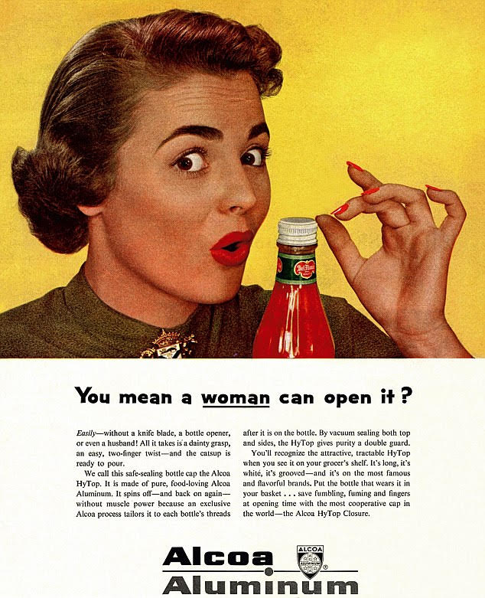

Slide 39
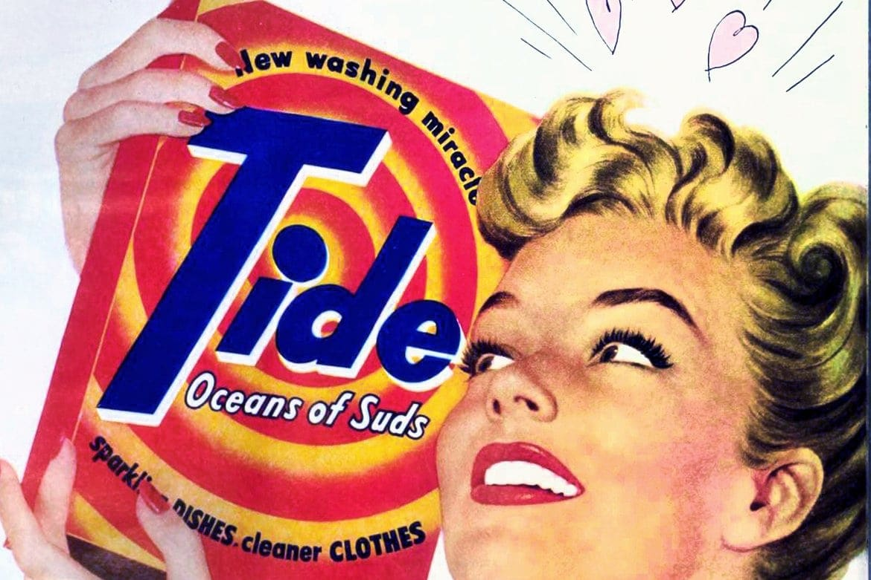

Slide 40
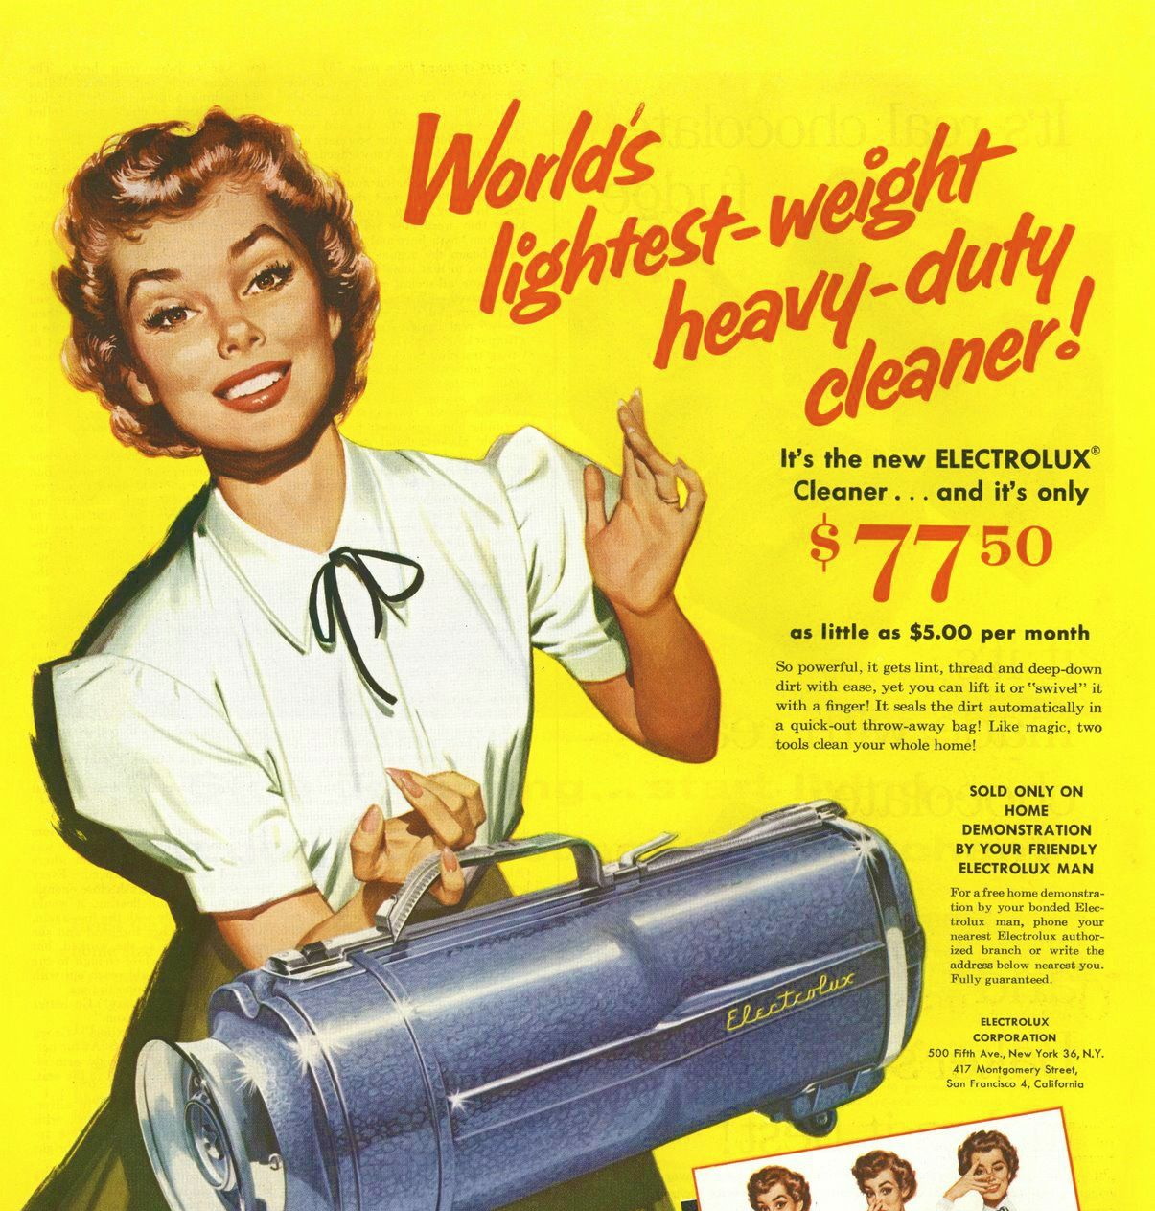

Slide 45
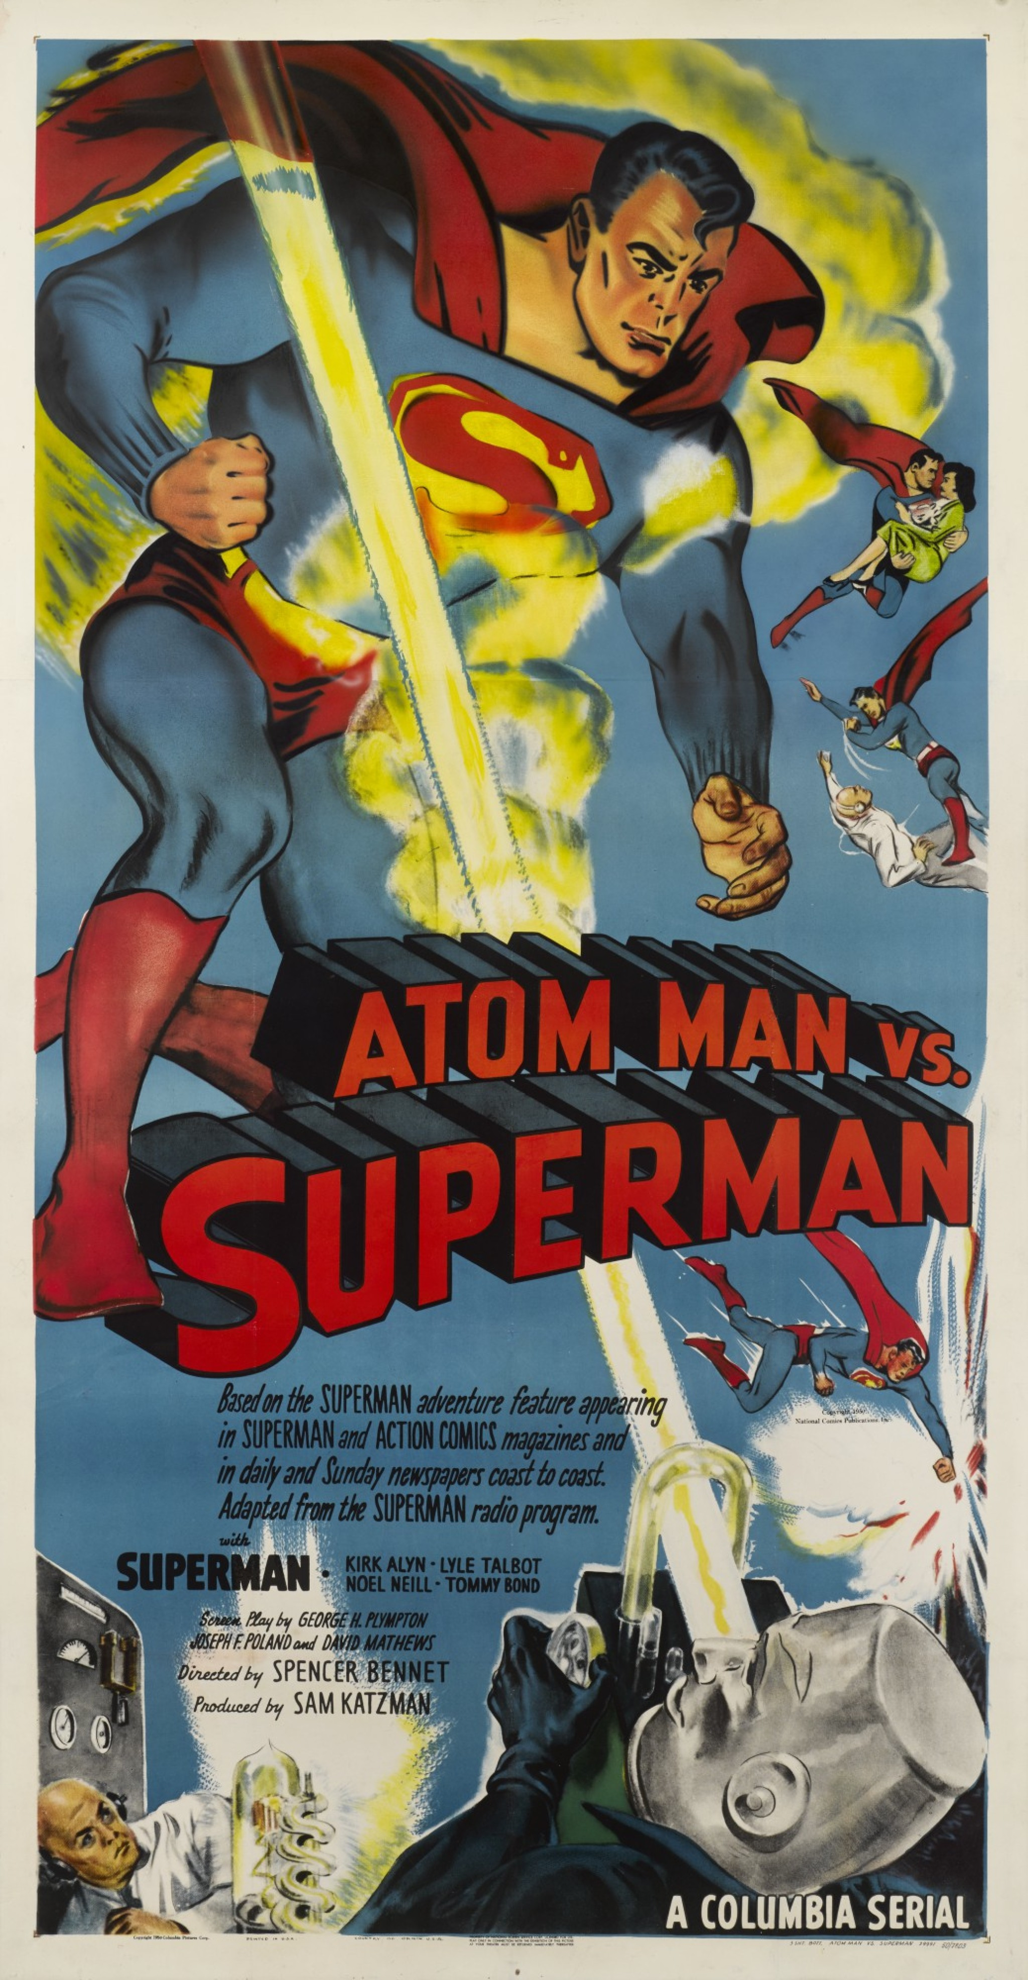
1950s Pop Culture
In the 1950s, televisions became something the average family could afford, and by 1950 4.4 million U.S. families had one in their home.
The Golden Age of Television was marked by family-friendly shows like I Love Lucy, The Honeymooners, The Twilight Zone and Leave It To Beaver.

Slide 46
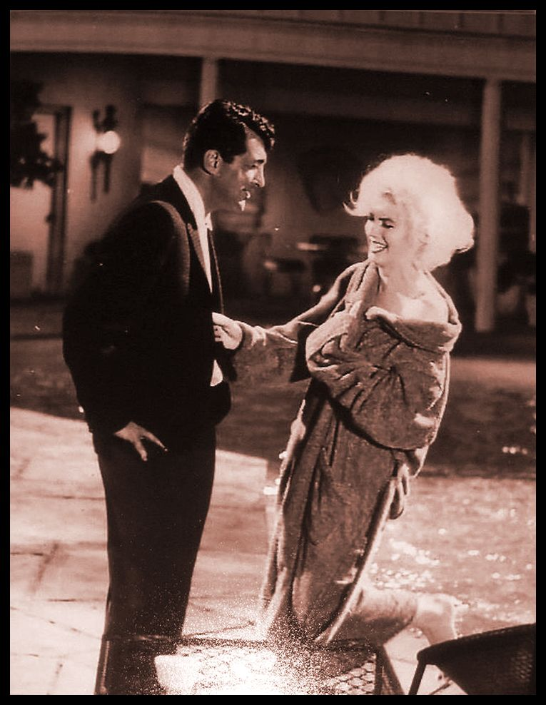
1950s Pop Culture
In movie theaters, actors like John Wayne, James Stuart, Charlton Heston, Marlon Brando, Grace Kelly, Jerry Lewis, Dean Martin, Elizabeth Taylor and Marilyn Monroe dominated the box office.

Slide 47
1950s Pop Culture
Critics of television objected to the stereotypical portrayals of women and minority
Males outnumbered females 3 to 1
African Americans and Latinos rarely appeared
Portrayed an idealized white America

Slide 48
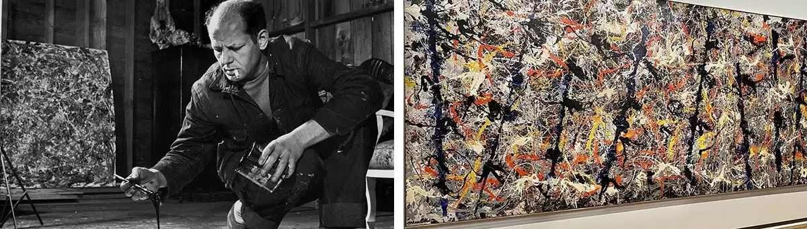
1950s Pop Culture
The Abstract Expressionism of Jackson Pollock and Willem de Kooning signaled a new age in art, paving the way for the Pop Art of artists like Andy Warhol in the 1960s.

Slide 49
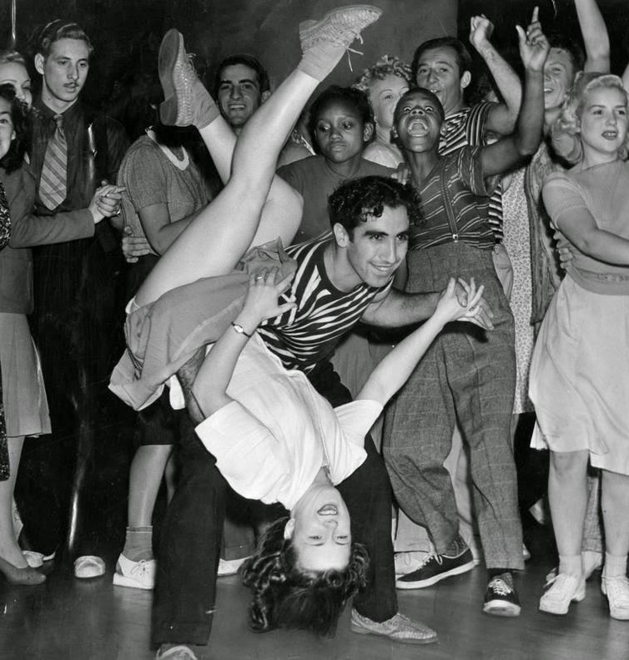
The Emergence of Rock’n Roll
Chuck Berry, Elvis Presley, Little Richard, Jerry Lee Lewis, Buddy Holly and the Crickets, Fats Domino, and others.

Slide 50
Literature in 1950s
The Beat Generation (the Beatniks)
Allen Ginsberg
Amiri Baraka (LeRoi Jones)
William S. Burroughs
Leonard Cohen
Jack Kerouac
Lawrence Ferlinghetti

Slide 51
Literature in 1950s
1951
J. D. Salinger, The Catcher in the Rye
1952
Ralph Ellison, Invisible Man
1953
Ray Bradbury, Fahrenheit 451
1955
James Baldwin, Notes of a Native Son
1957
Ayn Rand, Atlas Shrugged
1957
Jack Kerouac, On the Road

Slide 52
THE G.I. BILL
Residential construction companies mobilized to capitalize on a surge in housing demand, as Federal Housing Administration (FHA) loans and the GI Bill gave many returning veterans the ability to buy a home.
And yet, 1.2 million African American soldiers were excluded from the benefits of the GI bill as a result of racial discrimination.

Slide 53
THE G.I. BILL
Officially the Servicemen’s Readjustment Act of 1944, the G.I. Bill was created to help veterans of World War II.
It established hospitals, made low-interest mortgages available and granted stipends covering tuition and expenses for veterans attending college or trade schools.
From 1944 to 1949, nearly 9 million veterans received close to $4 billion from the bill’s unemployment compensation program.
Notes:
https://www.history.com/topics/world-war-ii/gi-bill

Slide 54
Consumerism
Though the GI Bill guaranteed low-interest mortgages and other loans, they were not administered by the VA itself.
Thus, the Veterans Affairs (VA) could cosign, but not actually guarantee the loans. This gave white-run financial institutions free reign to refuse mortgages and loans to Black people.

Slide 55
Consumerism
Redlining—a decades-old practice of marking maps by race to characterize the risks of lending money and providing insurance—made purchasing a home even more difficult for Black veterans.
Lenders froze out poorer neighborhoods, ensuring that loan assistance and insurance would be denied.
And new white suburbs often came with overtly racist covenants that denied entry to Black people.

Slide 56
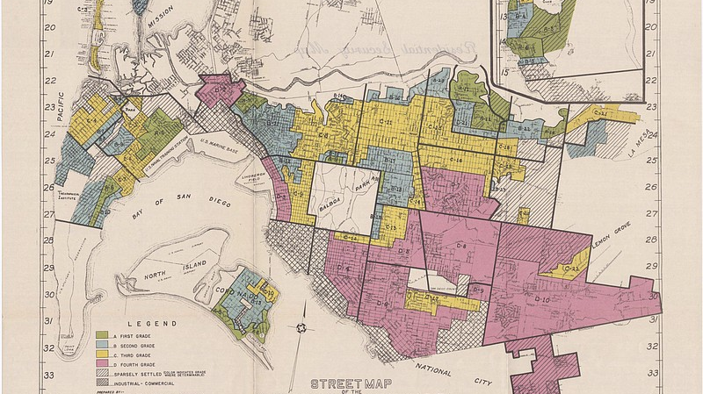

Slide 58
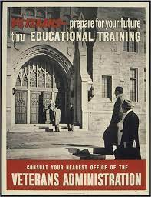

Slide 59
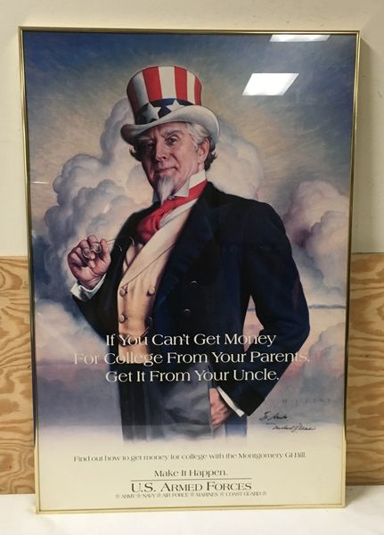

Slide 60
Racism
Northern universities dragged their feet when it came to admitting Black students, and Southern colleges barred Black students entirely.
And the VA itself encouraged Black veterans to apply for vocational training instead of university admission and arbitrarily denied educational benefits to some students.

Slide 61
Dr. Stock and Women’s Role as Mothers
Dr. Stock, who was a pediatrician, wrote how children should be raised in Common Sense Book of Baby and Child Care
sold 10 million copies in 50’s
believed the role of the mother staying at home was extremely important

Slide 62
The Feminist Movement
Advice books and magazine articles (“Don’t Be Afraid to Marry Young,” “Cooking To Me Is Poetry,” “Femininity Begins At Home”) urged women to leave the workforce and embrace their roles as wives and mothers.
The idea that a woman’s most important job was to bear and rear children was hardly a new one, but it began to generate a great deal of dissatisfaction among women who yearned for a more fulfilling life.
(In her 1963 book The Feminine Mystique, women’s rights advocate Betty Friedan argued that the suburbs were “burying women alive.”)
This dissatisfaction, in turn, contributed to the rebirth of the feminist movement in the 1960s.

